Slide 1
Regional Tourism Crisis Management (RTCM)
HEI Course, 2023
Developed by Laura Magan (Momentum)
Module 9
Regional Recovery, Rebuilding & Resilience
Towards a ‘New Norm’ Post Crisis

Slide 2
Module 1
Module 2
Module 3
Phase 1 Preparation & Mitigation
Introduction to Regional Crisis Tourism Management & Its Complexities
Set Up a Regional Public Private Partnership & Crisis Management Team
Conduct a Regional Crisis Vulnerability SWOT Analysis and Destination Audit
Phase 2 Planning,
& Response
Module 4
Module 5
Module 6
Develop a Regional Crisis Management Strategy (Long Term Mitigation Planning)
Develop a Regional Crisis Management Response Plan (Short Term Response Plan)
Response Activation and Communication with Industry for Regional Collaboration
Phase 3
Recovery, Rebuild, Resilience
Module 7
Module 8
Module 9
Communication Strategy and Dealing with PR & Media
Strategic Regional Crisis Response and Recovery Marketing
Regional Recovery, Rebuilding & Resilience Towards a ‘New Norm’ Post Crisis

Slide 3
Regional Tourism Roadmap to Managing a Crisis
(Prepare, Prevent, Mitigate, Plan, Respond, Recover, and Rebuild)
1
Regional Tourism Crisis Management Team (TCMT) Create for a collaborated, coordinated response to a crisis
2
Regional Risk Analysis
Assess the most likely crisis a region will face and the priority actions to mitigate the risk.
3
SWOT Analysis
Analyse strengths, opportunities, and threats to review and strengthen a tourism region.
4
Regional Crisis Audit
Audit regional gaps and needs to implement Risk and SWOT Priorities and Actions
5
Crisis Management Strategy
Develop a CMS so a tourism region can follow a long-term plan to mitigate and prevent the impact of a crisis
6
Crisis Management Plan
Develop a CMP so a tourism region can follow a short term plan to respond and recover from a crisis
7
Activating a Response to a Regional Crisis
Crisis response activation measures, protocols, systems of communication, and information sharing with internal industry stakeholders to ensure an aligned response.
8
External Communication with PR, Media, and Tourist Marketing Regional response and communication approaches with different external stakeholders. How each is dealt with differently in terms of messaging, approach and timing.
9
Rebuild, Recovery, and Resilience Rebuilding tourism regions to a ‘new normal’ using business continuity and resilience approaches, discovering a need to prioritize change, and adapting to the ‘new norm’.

Slide 4
Table of Contents
Sections 6 - 8
Regional Recovery, Rebuilding & Resilience
Towards a ‘New Norm’ Post Crisis
Resilience is needed even more so in the tourism sector, while being one of the fastest growing sectors of the economy in recent decades, it is also likely to be one of the hardest hit sectors during a crisis. Regions need to develop resilience prior to a crisis to prevent long-term damage. This Module demonstrates different approaches around business continuity, recovery, and destination rebuilding and how they can assist a region to come back quicker with alleviated impact post-crisis. It shows the different ways regions and businesses have been tested, responded to, reopened, rebuilt, and recovered from different crises using COVID-19 as a primary example. For some, it led them to effective recovery and rebound post-crisis.
1
Tourism Regions and Building Resilience Post Crisis
2
Building a Regional Tourism Business Continuity Plan
Identify Industry and Regional Changes
3
Recovery and Rebuilding Tourism Regions is Not Plain Sailing. It requires Adaptation and Updating
Rebuilding a Tourism Region Post Crisis
Rethinking the Future and Rebuilding a ‘New Normal’
4

Slide 5
Learning Outcomes
Learn how tourism regions are resilient but now more than ever need to implement recovery, resilience and rebuilding strategies
Understand the difference between business continuity and resilience of tourism regions
Learn how through existing case studies how regional tourism has changed to a ‘New Norm’ with a focus on future sustainability, digital technologies, safety, and greener tourism priorities
Learn how regions can move from response to recovery for business continuity
Understand the different adaptations and aftermath that can shape and change destination growth

Slide 6
1. Tourism Regions and Building Resilience Post Crisis

Slide 7
Tourism is Often the Hardest Hit
Before the pandemic, it was estimated that tourism would generate 11,5% of the global GDP by 2029, and the number of travellers worldwide would grow to EUR 1.8 billion.
During the pandemic, (UNWTO) stated the coronavirus pandemic caused a 72% decline in international tourist arrivals in 2020 and 71% in 2021, compared to 2019. This represents a loss of 2.1 billion international arrivals in both years combined which amounts to a loss of EUR 2.1 trillion in this two-year period.
Now UNWTO announced International tourism continued to show strong signs of recovery, with arrivals reaching 57% of pre-pandemic levels in the first seven months of 2022. International tourist arrivals almost tripled from January to July 2022 (+172%) compared to the same period in 2021.

Slide 8
Tourism is Resilient Post Crisis
Right now, nobody wants to imagine another crisis happening but unfortunately, crises of varying degrees are inevitable. This section demonstrates how tourism is a tough and resilient sector.
It provides examples of how tourism has been resilient through different crises including COVID, and how regions and businesses have been tested, responded to, reopened, rebuilt, and recovered from different crises. For some, it even led them into recovering and rebounding more efficiently in the future. Resilience is needed even more so in the tourism sector, while being one of the fastest growing sectors of the economy in recent decades, it is also likely to be one of the hardest hit sectors during a crisis.

Slide 9
What is Business Resilience?
Business resilience is the ability of an organization or region to quickly adapt to disruptions while maintaining continuous business operations and safeguarding people, assets, and overall brand equity. Disruptions can be natural disasters, destination violence, or failure in an infrastructure.
Business resilience goes beyond disaster recovery (DR) and business continuity by offering post-disaster strategies to avoid costly downtime, shore up vulnerabilities, and maintain business operations in the face of additional, unexpected breaches. (Source)

Slide 10
Business Resilience Versus Business Continuity
The easiest way to understand the difference is business continuity is the set of procedures that allow a region or company to continue operating during a crisis.
In contrast, resilience is the capability to withstand the shock of an unexpected disruption and rebound to an acceptable state of an ongoing operation.
Extra Reading
What is BCDR? Business continuity and disaster recovery guide
Business resilience vs. business continuity: Key differences
A free business continuity plan template and guide
Preparing an annual schedule of business continuity activities

Slide 11
Article: Tourism Business Preparedness, Resilience And Disaster Planning In A Region Of High Seismic Risk: The Case Of The Southern Alps in New Zealand
Southern Alps, is considered overdue for a M7.8–8.0 earthquake. A survey of tourism business operators revealed generally poor levels of perceived preparedness and actual planning for a future earthquake disaster, particularly amongst micro-sized businesses.
The presence or absence of business resilience ‘tools’ was investigated, all of which are more common in businesses with higher incomes.
The article draws on tourism disaster planning and business resilience literature to outline an alternative approach to disaster planning for small tourism-reliant communities.
It describes community-based efforts to prepare in two remote Southern Alps townships, lending support to the concept of collective, community-led disaster planning.
Read Research Article

Slide 12
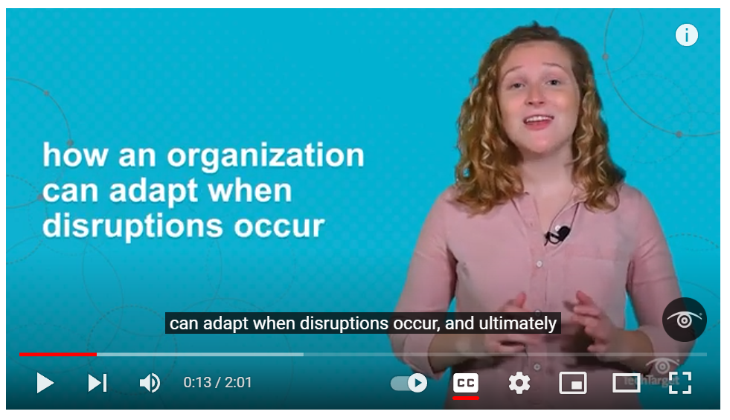
Regions and Businesses Should be Resilient Before a Crisis
The Business Resilience Plan
Business resilience is about business processes and workflows must be preserved to survive unexpected events. Among the important challenges of business resilience planning is the human element. People must be prepared and educated on how to respond to a chaotic situation.
A business resilience plan is sometimes referred to as a business continuity plan (BCP). Resilience is an outcome of various approaches to readiness, including business continuity, technology DR, crisis management, risk management, and incident management.
Regional resilience includes various elements of overall resilience, such as regional tourism resilience, operational resilience, cyber resilience, and supply chain resilience.
https://www.youtube.com/watch?v=cHAu-OLLR9M
What is a Business Resilience Plan? The Importance of Business Resiliency

Slide 13
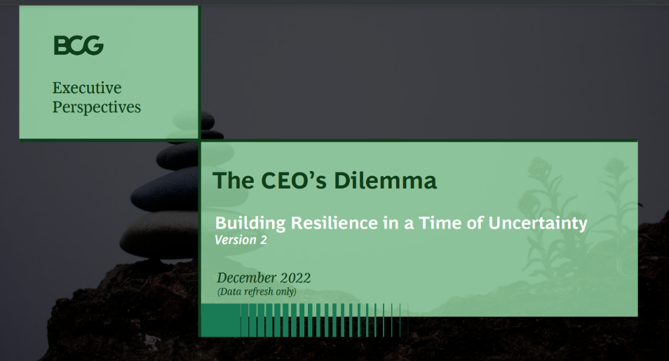
Building Resilience
Winners Are Proactive!
Winners in economic uncertainty do not just sit back and wait for recovery—instead, they are proactive and turn ambiguity into opportunity.
Today's global tourism disruptions (e.g., geopolitical tensions, market demand and trend changes, soaring inflation, rising interest rates, and currency fluctuations) have created a complex ‘poly-crisis', with significant variations across geographic areas and sectors
Navigating this unprecedented complexity requires business leaders to develop a dynamic perspective on how their operating and economic environments will evolve, but also on the distinct opportunities and risks these scenarios present for their companies.
https://media-publications.bcg.com/BCG-Executive-Perspectives-CEOs-Dilemma.pdf
Building Resilience in Times of Uncertainty

Slide 14
Business Resilience Framework
It’s never been more important for leaders navigating uncertainty to sharpen their approach to managing volatility and cost reduction. While an economic downturn is never guaranteed, regions need a strong resilience strategy in order to evaluate trade-offs and successfully lead. No two resilience journeys are the same, with each path forward individually based on region and industry,
Our business resilience framework—sense, adapt, and thrive—equips leaders managing uncertainty with a head-on approach or a more long-term business resilience strategy. (Source)

Slide 15
No One Size Fits All!
There is no “one size fits all” solution to today's complex strategic challenges. Regional leaders embed a “dynamic strategy” mindset into their planning, comprising three elements:
Sensing Observing trends, defining and monitoring critical uncertainties, and outlining a set of scenarios against which to assess business decisions
Adapting Building operational and financial stability by shaping and reshaping strategies based on market trends and data-driven forecasts
Thriving Moving rapidly from assessment to action to seize growth opportunities and strengthen competitive advantage (Source)

Slide 16
Business Resilience Plan
A business resilience plan includes various elements. Among them are the following:
Business Impact Analysis
Risk Assessment
Risk Management
Testing And Running Exercises
Emergency Communications Plan
Business Continuity Plan
DR Plan
Incident Response Plan
Emergency Management Plan
(Source; Techtarget)
What encompasses a business resilience plan?
Business impact analysis
Business continuity
Risk analysis and management
Disaster recovery plan
Business resilience plan
Testing and exercising
Incident response plan
Emergency communications
Emergency management plan

Slide 17
Research: The UK Foot and Mouth Disaster Plan (Resilience Plan) Was Not Updated Since 1967. An Updated Version Could Have Limited the Severity of the Crisis.
…there was only a rumour that there was one (a disaster plan) lying around.”
Although they did have one regarding foot and mouth it was last examined briefly after
the 1967 outbreak. Furthermore, of the industry representatives interviewed none had a
crisis plan in place for their own business before the outbreak. Perhaps more surprisingly
the tourism industry seemed to have learned little from their experience at the local level.
According to one representative, “I don’t know whether people would have (a plan) in the future because I think that people felt that it has happened once and couldn’t happen again.”
Only two people expressed an interest in developing a crisis management plan in the future because crises are seen as infrequent and that little can be done to alter their
impacts. The only contingency considered was setting aside money and resources to deal
with unforeseen events. However, crisis management theory suggests that established
plans can limit the severity of crises and disasters through proactive contingency planning (Kash and Darling, 1998; Heath, 1998).
Read Research Article

Slide 18
Business Resilience Plan
Each of the components can stand alone. However, combined they create a framework from which an overall resilience plan is developed.
The most important aspect of a business resilience plan is to define the end state of the region following the completion of all recovery plans and resumption processes. It's easy to say a business has recovered from an incident once it has resumed operations. But does that mean it's resilient? Ultimately, a region must determine what its end state should be following an incident. To achieve that, it must determine what constitutes a state of resilience.

Slide 19
2. Building a Business Continuity Plan

Slide 20
Regions and Businesses Should Have a Business Continuity Plan
If a region or business does not have a continuity plan when an interruption occurs, it risks financial, reputational, and personal loss.
How a region can maintain essential operations and recover with as little downtime as possible. How to keep operations going during a crisis and react quickly during a crisis event.
First, a region decides which functions are essential e.g., transportation, accommodation, food, and travel.
Development elements include data, revision management, guidelines, emergency response management, step-by-step procedures, checklists and flowcharts
https://youtu.be/ZetTrqWFE_w
Business Continuity Planning with Templates

Slide 21
Article: Resilience and Recovery Requires Cultivating the PPP
Firstly, governments play a crucial role in cultivating PPPs as they are “the principal actors in political processes, and they often remain responsible for providing incentives and imposing requirements on actors in promoting objectives around common goals” (Wan & Bramwell, 2015, p. 318). Salem et al. (2021) note that resilience and recovery strategies require partnership and coordination among stakeholders and timely government intervention in managing the collaborations. In addition, prior studies reveal that some governments offer subsidies and interest-free loans to businesses and employees to ensure continuity of employment (Khanal, 2020; Loi et al., 2021) (PPP Public Private Partnerships)
Read Research Article

Slide 22
Article: Resilience and Speed of Recovery Depends on The Leadership
Secondly, the speed of crisis recovery depends very much on leadership (Foster et al., 2020). A good crisis leader possesses certain attributes. Wardman (2020) summarizes 13 key attributes of crisis leaders during the COVID-19 pandemic: planning and preparing, narrating a clear-sighted strategy, making meaning (i.e., understanding the extent of risks involved), giving direction, differentiating people's needs, credibility and trustworthiness, transparency, openness, partnership and co-ordination, empathy, and solidarity, as well as being responsive and adaptive to media engagement across traditional and digital platforms. Finally, a good crisis leader should also constantly review crisis management progress by listening to feedback, monitoring outcomes, and then adjusting strategies in a timely and responsive manner (Kuščer et al., 2021). If PPPs appear to be effective even under difficult conditions brought by the unprecedented pandemic situation, this is possibly attributable to active government interventions as well as demonstrable leadership actions during the crisis.
Read Research Article

Slide 23
Regional Tourism Continuity
Assess how the region can get to business as normal as soon as possible. This may mean not everyone operating e.g., those that can’t because they are located in the affected crisis areas. There are a number of business continuity measures that an be put in place
Conduct a Vulnerability and Impact Assessment to determine who can and can’t open post-crisis. Survey tourism businesses to assess the impact and to see if they can open for business if they can’t why and how can they be supported to re-open? Problems may be a lack of resources, employees, or evident hazards as a result of the crisis e.g., after a storm a tree may have damaged their property.

Slide 24
Regional Tourism Continuity Measures
Seek recovery funding – industry, government, and stakeholders
Determine and implement recovery marketing strategy with TCMT and implement cooperative recovery marketing activities ‘We are Open’ or ‘Back in Business’ or ‘X Welcomes You Back’. Implement a consistent marketing campaign that is in line with national marketing (if necessary)
Consider longer-term media – tell good news stories and milestones, anniversaries, and blogs. Post regularly until normality is regained. Then normal marketing activities and messages can resume.
Meet with local disaster recovery group so that crisis communication can be updated from crisis response to recovery to tourists and stakeholders
Get to work regarding conversations and lobbying to fix or replace visitor infrastructure, services, and attractions
Update all visitor channels to reflect post-crisis status e.g., pricing, opening hours, what is available or not available, safety protocols and guidelines

Slide 25
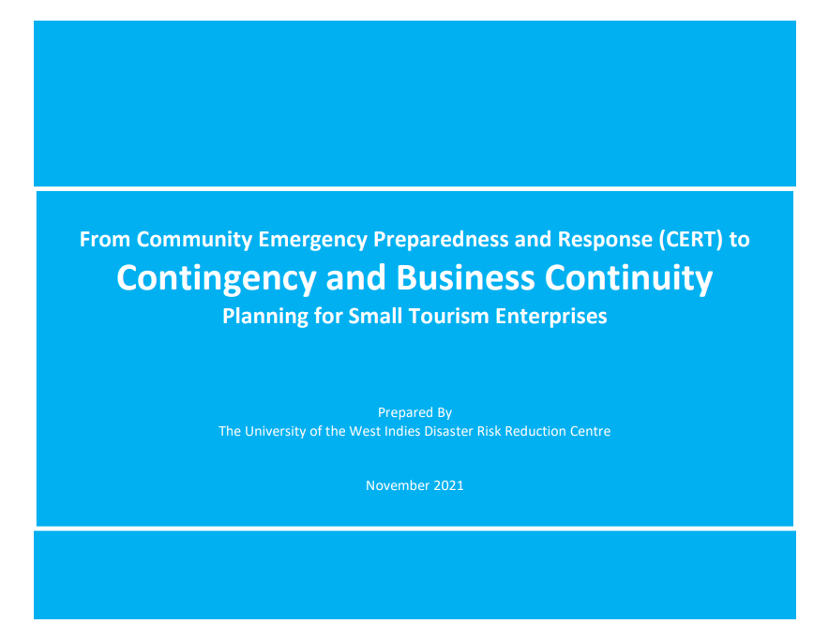
https://caribbeanhotelandtourism.com/wp-content/uploads/2022/10/UWI-OAS-BCP-WORKSHOP-FINAL-REPORT-for-submission.pdf
Sample Regional Tourism Workshop on Contingency and Business Continuity Planning
The main objectives of the Workshop series sought to enhance understanding of continuity planning by:
Introducing participants to continuity of operations and contingency planning and its critical components
Importance of continuity planning for businesses and the local hazard environment
Overview of the Business Continuity Management life cycle, the benefits, and requirements
Utilizing continuity planning tools to develop tailored Business Continuity Plans
Providing detailed, step-by-step training needed to develop comprehensive, practical, and reliable business continuity and contingency plans
Business Contingency and Continuity for Small Tourism Enterprises

Slide 26
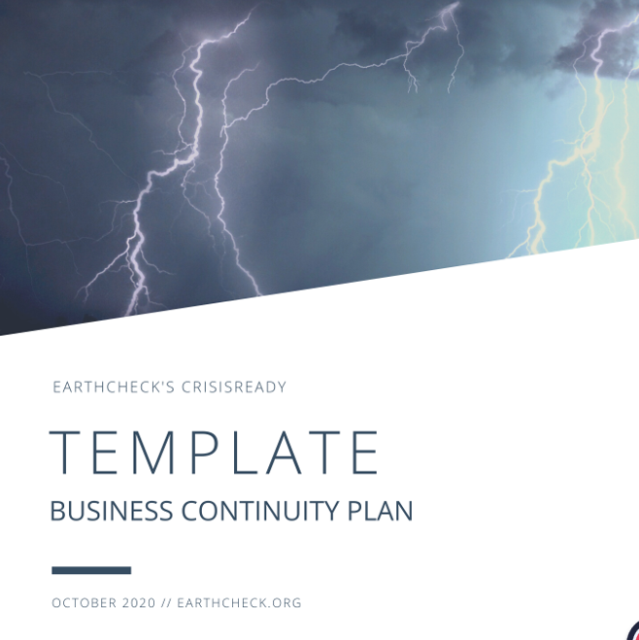
Resilience is About Adaptation
Resilience is about adapting how a region operates during and after a crisis.
As the COVID-19 crisis demonstrated, businesses had to quickly adjust to changing work environments that included support of remote work and hybrid setups.
In many cases, it may not be enough to return to the previous norms; the old ways might not accommodate the way the business or region now operates. Resilience goes beyond strict business continuity and DR, providing the agility, adaptability, and sustainability businesses and regions need to adjust to long-term changes in how they operate.
https://www.qtic.com.au/industry-development/business-resources/
Build a Business Continuity Plan (Template)

Slide 27
Too much information post disaster is better than too little. To help counter misinformation, rumour and media exposure it is better to overshare and provide too much information during recovery. (Source)

Slide 28
3. Identify Industry and Regional Changes
Recovery and Rebuilding Tourism Regions is Not Plain Sailing. It requires Adaptation and Updating

Slide 29
Moving from Response to Recovery
and Business Continuity
It is difficult to know when the Response phase becomes the Recovery phase. However, it is clear that, while a region is on the road to Recovery, it should continue to follow the Crisis Management Response Plan. It will come to a time when the region needs to see if there are any changes as a result of the crisis and if its markets have changed.
The markets may have changed and there may be other changes in how tourism processes and procedures function. For example: during the COVID-19 crisis, many countries imposed additional health checks on incoming visitors. A region might have to adapt its operations and processes to a ‘new normal’.
The regional tourism team might have changed: it may have decreased or increased in size, or it may need more team building to make things work.

Slide 30
Moving from Response to Recovery
Changes in market preferences could mean investments in technology and training, implementing new ways to communicate, or even refocusing on new markets, such as by offering lower-cost packages to the domestic market while a region waits for your international clients to return.
Being flexible and adaptable will help the region at this stage, as the markets will not be stabilized. Being able to respond quickly and implement necessary changes will ensure that the region is able to benefit from the situation as much as possible. (Source)

Slide 31
Regional Recovery & Adaptations
Open Partially? Sometimes a whole region may suffer a loss of trade even though parts of the region are directly affected by a crisis and the remainder is not. In this case, it may be appropriate to promote parts of the region that are physically unaffected by a crisis, being clear in marketing communications which areas, roads, attractions, etc. are operating (source)
Encourage back to normal mentality. Visitors returning to an affected area can help with the psychological, as well as economic, recovery of local communities. (source)

Slide 32
Regional Recovery & Adaptations
Managing pent-up demand with a slow recovery and fewer resources
Understand the ‘new tourist’ and their motives and preferences e.g., care for the environmental or climate change
Expansion of cross-country borders i.e., travel visas
Target high-yield markets or domestic tourists
Co-operative marketing and advertising
Events as a catalyst for tourism
Develop the tourism industry in terms of careers and opportunities
Build and solidify tourism business networks that include public, private, and community representatives

Slide 33
The Aftermath Impact of COVID-19
Growth. According to UNWTO, COVID-19 meant a loss of five to seven years` worth of tourism growth.
Staff. Given that the sector used to employ 1 out of 10 jobs in the world, it wreaked havoc. For example, tourism jobs slumped by over 25% in Ireland. Small businesses which shoulder 80% of global tourism are particularly vulnerable.
Conservation. The sudden fall in tourism cut off funding for biodiversity conservation. Some 7% of world tourism relates to wildlife, a segment growing by 3% annually. (UNWTO Economic Impacts)
Culture and heritage preservation are under pressure as well as on the cultural and social fabric of communities, particularly for indigenous people and ethnic groups as festivals, events, craft-making products, etc were postponed and many didn’t survive. Further, 90% of museums closed and 13% may never reopen..
(Read the full Impact of the Covid-19 Outbreak)

Slide 34
Report: Tourism COVID Changes and Implications (OECD)
Sustainability became more prominent in tourism choices, due to greater awareness of climate change and the adverse impacts of tourism. Natural areas, regional, and local destinations drove the recovery, and shorter travel distances resulted in a lower environmental impact of tourism.
Domestic tourism benefited, as people preferred to stay local and visit destinations within their own country.
Traveller confidence was hit hard by the crisis and the ongoing uncertainty. This led to a decline in demand and tourism consumption that continued well long after the initial shock.
Traveller behaviour will be influenced by the evolution of the crisis, as well as longer-term consumer trends that are reshaping the way people travel. This may include the emergence of new niches and market segments, and a greater focus on safety protocols and contactless tourism experiences.
Safety and hygiene have become key factors to select destinations and tourism activities. People are likely to prefer ‘private solutions’ when travelling, avoiding big gatherings, and prioritising private means of transport, having a positive impact on the environment.
Read Research Article

Slide 35
4. Rebuilding a Tourism Region Post Crisis
Rethinking the Future and Rebuilding a ‘New Normal’

Slide 36
Stage 1 Denial
Stage 2 Panic
Stage 3 Repatriation
Stage 4 Anger
Stage 5 Safe Flight and Regulations
Stage 6 Recovery
Stage 7 New Normal
7 Stages to the New Normal in Travel
Timeline Model
STAGE 1
Denial
STAGE 2
Panic
STAGE 3
Repatriation
STAGE 4
Anger
STAGE 5
Safe Flight & Regulations
STAGE 6
Recovery
STAGE 7
New Normal
we are here
Dec ‘19/Jan /20
It’s someone else not us
Not to worry.
March
We will get everyone home and then shut down its all about survival.
June-Sept
Re-shape everything. Rationing of routes and traffic. Developing Safe Flight Protocol.
July ‘21+
The New Normal is smaller, more cooperation. Traffic only returns 75%.
Feb/March
Oh heck, we have lost control we need to splash. Start appealing for government help.
April-May
How do we reset? What do we do next? Lots of talking, little action.
Oct-June ‘21
Early recovery, bilaterals, small regional traffic, M&A. More ball outs.
SOURCE
Source

Slide 37
‘
UNWTO Secretary-General Zurab Pololikashvili said: “Tourism continues to recover steadily, yet several challenges remain, from geopolitical to economic. The sector is bringing back hope and opportunity for people everywhere. Now is also the time to rethink tourism, where it is going and how it impacts people and planet.”
‘

Slide 38
The Factors that Affect Speed of Recovery
The level of preparedness of the tourism industry
The nature of the crisis and its impact on perceptions of safety
Whether the crisis involved any loss of life
The extent of damage or loss caused to vital infrastructure
The efficiency with which facilities are brought online line and services resumed
The success of media management strategies
The effectiveness of marketing to promote the region’s status
People and businesses will require variable lengths of time to recover after a crisis. In both cases, it is usually a long process. (source)

Slide 39
Rebuilding Sustainable Tourism Regions Post Crisis
‘Post Covid many countries developed measures to build a more resilient tourism economy. These include preparing plans to support the sustainable recovery of tourism, promoting the digital transition and moving to a greener tourism system, and rethinking tourism for the future’. (OECD Report)
‘Key objectives include ‘how to live alongside the virus and consider the longer-term implications of the crisis while capitalizing on digitalization, supporting the low-carbon transition, and promoting the structural transformation needed to build a stronger, more sustainable, and resilient tourism economy’.

Slide 40
Research: Tourism Undergoing Drastic Changes. Remote Europe is the Future Post Covid
"Tourism will no longer be the same as before. It is clear that there will be less mass and more individual and zero-emission tourism. We will need more digital and more green skills to enable such a transformation, which means new skills and new occupations, "said Slawomir Tokarski, Director of DG REGIO, Directorate General for Regional and Urban Policy of the European Commission in a debate entitled" Supporting macro-regional recovery strategy from COVID-19 ”.
The Ministry of Tourism and Sports of the Republic of Croatia presented all seven strategic project proposals selected so far, which arose from the priorities of the thematic group Sustainable Tourism EUSAIR Adriatic-Ionian Strategy. Among these strategic project ideas, refers to the development of education - Master's program and lifelong learning for sustainable integrated management of destinations in the region. The aim is to educate professionals with the new skills needed for the "new normal“.
Read Research Article

Slide 41
Regional Survival Depends on a Number of Priorities
Key priorities for business and regional tourism survival is
Restoring traveller confidence
Supporting tourism businesses to adapt and survive
Promoting domestic tourism and supporting the safe return of international tourism
Providing clear information to travellers and businesses, and limiting uncertainty (to the extent possible)
Evolving response measures to maintain capacity in the sector and address gaps in supports
Strengthening cooperation within and between regions
Building more resilient, sustainable tourism

Slide 42
Report: Rebuilding Tourism for the Future (OECD)
The outlook for tourism is extraordinarily uncertain, and recovery will depend on the interlinked consequences of the economic and health crisis on demand and supply side factors. These include the evolution of the pandemic, availability of a vaccine (or alternative control measures), and the lifting of travel restrictions, as well as the survival and readiness of businesses throughout the tourism ecosystem to meeting demand, impacts on consumer confidence and travel behaviour, and developments in the wider economy. The global scale and extended duration of the crisis, continued uncertainty, and the interlinked economic and health nature of this crisis makes it unlike any previous shock to the tourism system.
Read Report Article

Slide 43
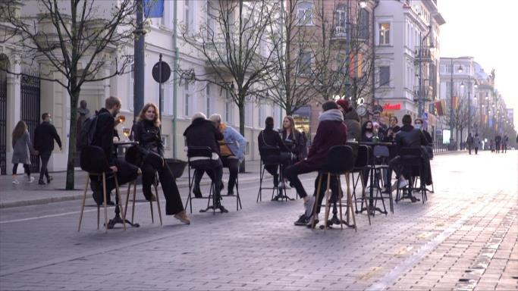
Case Study
Lithuania Turned into A Vast Open Air Cafe
Reimagining Public Spaces
The pandemic highlighted how inadequate access to open space is for many city dwellers, and how much this is disadvantaging already underprivileged groups. Being more creative in reimaging public space will be key to short-term recovery and will also drive longer-term place attractiveness by ensuring the health and resilience of our communities and by improving the quality of life for all residents.
Public - Private regional tourism partnerships working with local planners provide a big opportunity for getting creative and resourceful and considering approaches to placemaking. There’s never been a better time to work together on a place brand and development strategy that engages the community, and re-imagines a better future. (Source)
Vilnius, the capital of Lithuania, re-allocating much of its public space to struggling bar and restaurant owners – effectively turning the city into an open-air café. It gave eighteen of the city’s public spaces so businesses were able to resume business while still observing physical distancing rules. Over 160 businesses applied to be a part of the initiative. Outdoor theatre and cinema can be moved into the mainstream. Art exhibitions can be bought on the streets. Disused public spaces can be reclaimed as pocket parks to help bring green spaces into densely urban areas.

Slide 44
Research: Tourism Workers' Perceptions Of Supporting Tourists’ Evacuation In Emergency Situations
The impact of the crisis is being felt throughout the entire tourism ecosystem, and reopening and rebuilding destinations will require a joined-up approach.
Restoring traveller confidence and stimulating demand with new safe and clean labels for the sector, information apps for visitors and, domestic tourism promotion campaigns.
Preparing comprehensive tourism recovery plans, to rebuild destinations, encourage innovation and investment, and rethink the tourism sector.
These actions are essential, but to reopen the tourism economy successfully and get businesses up and running, more needs to be done in a coordinated way as tourism services are very interdependent. The travel and tourism industry and governments should continue to reinforce their coordination mechanisms to accompany the businesses, notably the smallest ones, and the workers. Particular attention should be given also to the most sensitive/vulnerable destinations in the recovery phase.
Read Research Article

Slide 45
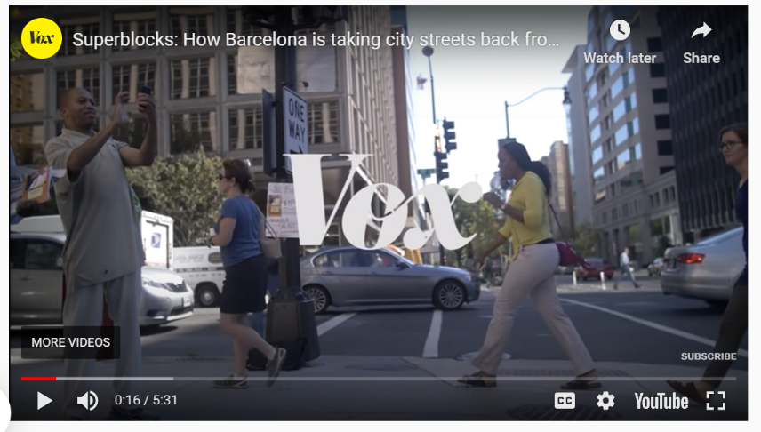
Case Study
Superillas of Barcelona
Barcelona’s superblocks could be a model for the future. Take the Poblenou superblock. By restricting traffic to a set of one-way systems and a 10km/hr speed limit, the superblock encourages traffic to move elsewhere. And by decreasing the number of cars on the roads to residential traffic, they were able to convert the unused lanes into community spaces – outside seating, play parks, and cafes. Cars have become an afterthought to community life. (Source)
https://youtu.be/ZORzsubQA_M

Slide 46
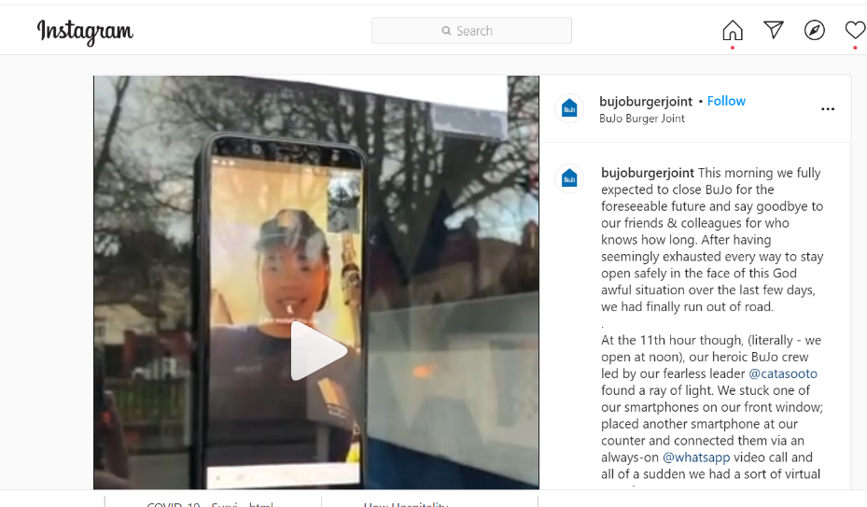
Case Study
Bujo (Burger Bar) Sandmount Dublin, Ireland
Digitalization will Accelerate
Digitalization in tourism services is expected to continue to accelerate, including a higher use of automation, contact-less payments, and services, virtual experiences, real-time information provision
A burger bar that reinvented how to do business ‘closed’. The owner Michael Sheary created a digital drive-thru using WhatsApp to take orders. While it's very much so a take-it-day-by-day approach, it's a testament to the inventiveness of some business owners, and a clever way to work around the social distancing guidelines.
‘We stuck one of our smartphones on our front window; placed another smartphone at our counter and connected them via an always-on @whatsapp video call and all of a sudden we had a sort of virtual portal. It provided social distance, (no guests allowed on the premises); a contactless pick-up service’.

Slide 47
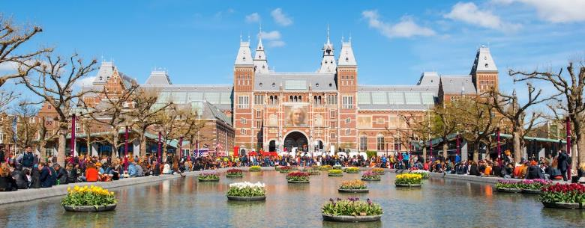
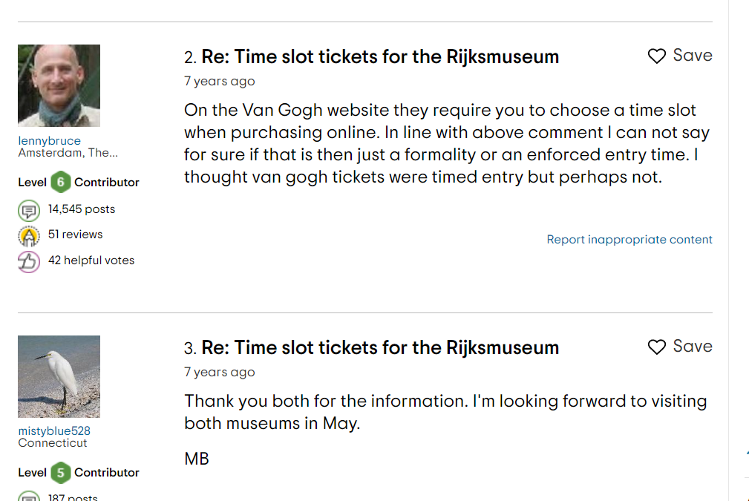
Case Study
Phantom of the Opera Uses State of the Art Technology
Rijksmuseum Amsterdam uses times ticket slots
Moving Indoors Outdoors
More businesses creating innovating and creating safe experiences for a post-COVID-19 world. The touring production of ‘The Phantom of the Opera’ in Seoul plays to a nearly full house each night thanks to a comprehensive tracking system and temperature sensors at the doors of the theatre. Other organisations are enforcing timed ticket slots and reduced numbers, such as the Rijksmuseum in Amsterdam.

Slide 48
“This pandemic sent a warning that we need to change the way we live, travel, and see the world. We have an opportunity to build back greener and opt for low-carbon measures that protect nature and biodiversity while maintaining the economic benefits that the multi-million dollar tourism industry brings to local communities around the world.”
Mark Radka Chief, Energy and Climate Branch of the UN Environment Programme (UNEP)

Slide 49
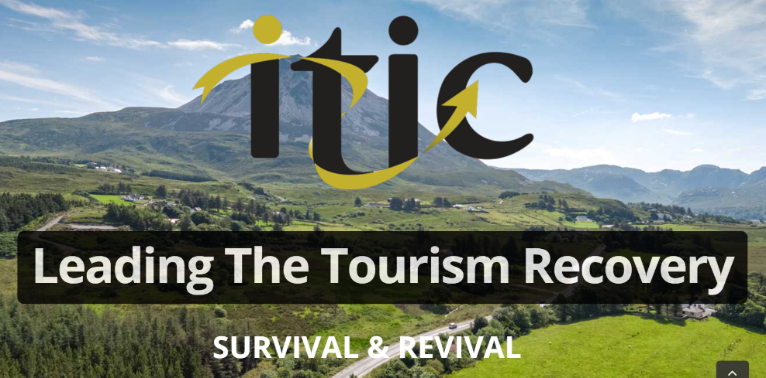
Case Study
Ireland Prioritises Sustainability and Interconnectedness
Survival Report
How Irish Tourism Can Recover From An Existential Crisis
Interconnectedness and Sustainability are a Priority
The Covid-19 pandemic has heightened the focus on the resiliency, sustainability, and interconnectedness of the tourism sector. Covid impacts decreased CO2 emissions and stalled the ‘over-tourism’ issue.
Ireland is now supporting a more sustainable recovery. It is predicted to improve its competitive positioning by transitioning to more environmentally friendly tourist transport, increased emphasis on outdoor activities, more hands-on heritage, and cultural experiences, local food production, and slow tourism hubs. Government action including financial incentives is already supporting tourism businesses. (source)
https://www.itic.ie/RECOVERY/tourism-survival-revival-report/

Slide 50
Research: Tourism Workers' Perceptions Of Supporting Tourists’ Evacuation In Emergency Situations
Looking ahead, the measures put in place today will shape the tourism of tomorrow. Governments need to already consider the longer-term implications of the crisis while staying ahead of the digital curve, supporting the low-carbon transition and promoting the structural transformation needed to build a stronger, more sustainable, and resilient tourism economy. The crisis is an opportunity to rethink tourism for the future.
Read Research Article

Slide 51
Report: OECD Crisis Recovery Solutions
Key policy considerations, identified by the OECD Tourism Papers No. 2021/01, recommend a greater emphasis on environmental and socio-cultural pillars of sustainability; the adoption of an integrated policy-industry-community approach; and the mainstreaming of sustainable policies and practices to develop and manage more sustainable tourism business models.
The immediate aftermath of the crisis provides an opportunity to better align recovery plans and investments with a transition that meets the objectives of health and safety, sustainability, climate action, and biodiversity protection.
Read Research Article

Slide 52
Module 1
Module 2
Module 3
Phase 1 Preparation & Mitigation
Introduction to Regional Crisis Tourism Management & Its Complexities
Set Up a Regional Public Private Partnership & Crisis Management Team
Conduct a Regional Crisis Vulnerability SWOT Analysis and Destination Audit
Phase 2 Planning,
& Response
Module 4
Module 5
Module 6
Develop a Regional Crisis Management Strategy (Long Term Mitigation Planning)
Develop a Regional Crisis Management Response Plan (Short Term Response Plan)
Response Activation and Communication with Industry for Regional Collaboration
Phase 3
Recovery, Rebuild, Resilience
Module 7
Module 8
Module 9
Communication Strategy and Dealing with PR & Media
Strategic Regional Crisis Response and Recovery Marketing
Regional Recovery, Rebuilding & Resilience Towards a ‘New Norm’ Post Crisis

Slide 53
Well Done!
You have completed the Course!
https://www.tourismrecovery.eu/
Facebook
Momentum, Ireland Developer of Modules
The European Commission supports the production of this publication and does not constitute an endorsement of the contents which reflects the views only of the authors, and the Commission cannot be held responsible for any use which may be of the information contained therein 2020-1-UK01-KA203-079083

