Slide 1
Module 7
Communication Strategy and Dealing with PR & Media

Slide 2










Module 1
Module 2
Module 3
Phase 1 Preparation & Mitigation
Introduction to Regional Crisis Tourism Management & Its Complexities
Set Up a Regional Public Private Partnership & Crisis Management Team
Conduct a Regional Crisis Vulnerability SWOT Analysis and Destination Audit
Phase 2 Planning,
& Response
Module 4
Module 5
Module 6
Develop a Regional Crisis Management Strategy (Long Term Mitigation Planning)
Develop a Regional Crisis Management Response Plan (Short Term Response Plan)
Response Activation and Communication with Industry for Regional Collaboration
Phase 3
Recovery, Rebuild, Resilience
Module 7
Module 8
Module 9
Communication Strategy and Dealing with PR & Media
Strategic Regional Crisis Response and Recovery Marketing
Regional Recovery, Rebuilding & Resilience Towards a ‘New Norm’ Post Crisis

Slide 3
Regional Tourism Roadmap to Managing a Crisis
(Prepare, Prevent, Mitigate, Plan, Respond, Recover, and Rebuild)
1
Regional Tourism Crisis Management Team (TCMT) Create for a collaborated, coordinated response to a crisis
2
Regional Risk Analysis
Assess the most likely crisis a region will face and the priority actions to mitigate the risk.
3
SWOT Analysis
Analyse strengths, opportunities, and threats to review and strengthen a tourism region.
4
Regional Crisis Audit
Audit regional gaps and needs to implement Risk and SWOT Priorities and Actions
5
Crisis Management Strategy
Develop a CMS so a tourism region can follow a long-term plan to mitigate and prevent the impact of a crisis
6
Crisis Management Plan
Develop a CMP so a tourism region can follow a short term plan to respond and recover from a crisis
7
Activating a Response to a Regional Crisis
Crisis response activation measures, protocols, systems of communication, and information sharing with internal industry stakeholders to ensure an aligned response.
8
External Communication with PR, Media, and Tourist Marketing Regional response and communication approaches with different external stakeholders. How each is dealt with differently in terms of messaging, approach and timing.
9
Rebuild, Recovery, and Resilience Rebuilding tourism regions to a ‘new normal’ using business continuity and resilience approaches, discovering a need to prioritize change, and adapting to the ‘new norm’.

Slide 4
Table of Contents
Sections 1 - 2
Communication Strategy and Dealing with PR & Media
1
Communicating With PR and Dealing with Media
This Module covers the different ways that PR and Media can assist a region during a crisis response or cause detrimental long-term harm. It explains why and how a region should lead first with communication and work with media to manage regional reputation and image perception during a crisis. Case Studies and examples are throughout demonstrating best practices and what not to do and the impact of both approaches. It becomes evident that all regional crisis communication is underpinned by a regional-specific Crisis Communication Strategy. These strategies should be kept separate from internal industry communication. The final section shows the learner what is involved in building a Communication Strategy and the necessary supporting communication templates.
2
2
Develop a Regional Crisis Communication Strategy and Plan
3

Slide 5
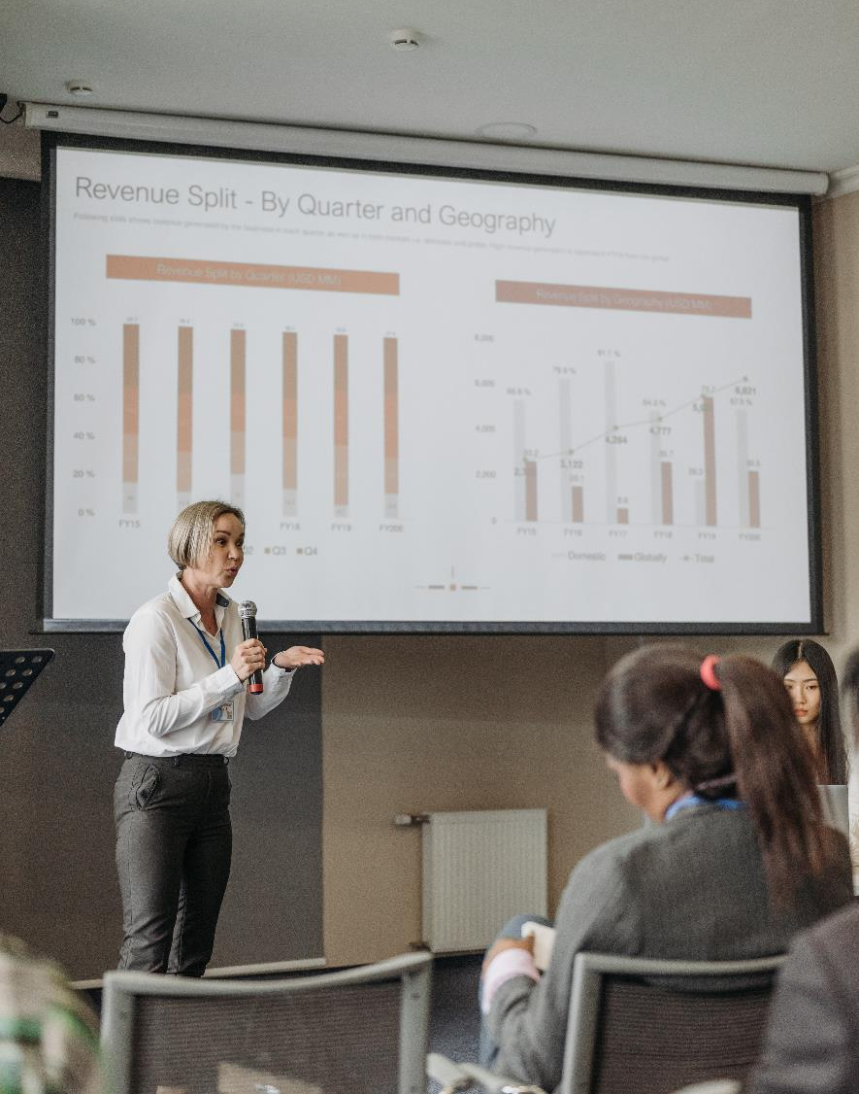
Learning Outcomes
Understand how PR and Media can be a benefit or a problem for a region in crisis
Learn how to deal with PR and Media and build strong relationships where they come to the region for reliable news rather than make their own copy
Learn how to create and lead a regional PR and Media Campaign
Understand the Elements of a Crisis Communication Strategy and the different supporting communication templates needed during a crisis

Slide 6
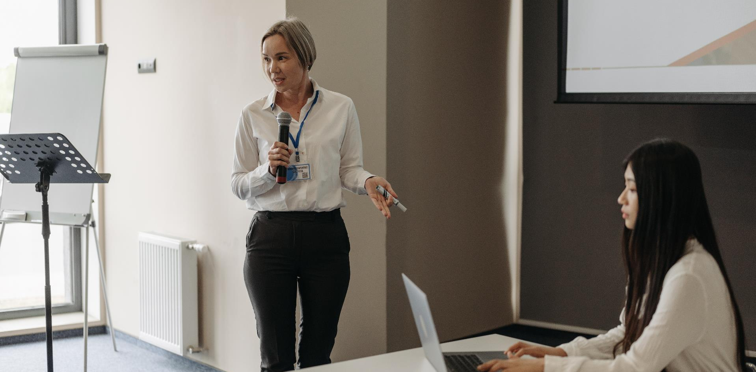
1. Communicating with PR and Dealing with Media

Slide 7


Dealing with PR & Media
Every disaster or crisis will attract unwelcome attention of varying degrees, with the potential to impact negatively on visitors’ perceptions regarding personal safety, suitability of access, availability of accommodation and the likelihood of disruption to travel plans.
Furthermore, the nature of media coverage means that often the seriousness and extent of incidents may be magnified, or even distorted, through the lens of a television camera or the words of a newspaper reporter.
These factors underline the benefit of a planned, considered communications response that seeks to put an issue into perspective, reassures observers about the measures taken to control and address the situation and fully explain the true extent of the crisis.
Regional Crisis Management Planning

Slide 8

Research: The Supervision of Media Coverage During a Crisis is a Core Issue for Tourism Authorities and Operators
Media relations remain one of the most critical elements in crisis management. The supervision of media coverage of both the crisis and the crisis management process is a core issue for tourism authorities and tour operators. The establishment and maintenance of effective media relations is a critical function of destination tourist authorities. Media relations extend beyond developing a network of contacts with local media and usually require the development of global contacts.
The November 1997 Luxor massacre, Israeli–Palestinian political violence, and the 2001 foot-and-mouth disease crisis in the United Kingdom were all subject to worldwide attention and scrutiny. When foreign tourists are victims or are indirectly affected by a particular crisis, they are often subject to media attention in their home country. Conversely, the international pervasiveness of American, British, and German global news networks such as CNN, BBC, and Deutsche Welle meant that many local issues in those countries become globally disseminated.
Read Research Article

Slide 9

Media Love ‘Bad News’
Crisis events often make globalized news depending on how it is publicized it can both cause problems or can assist in recovery and restoring
The international media appear to have a penchant for focusing on a number of key elements which determine the newsworthiness of an issue. Favored items tend to be defined under the following categories: crime; crisis; conflict; conquest; corruption; catharsis; cataclysm; rescue; scandal; triumph over adversity. (Research Article)
The role of effective public relations management is critical for tourist authorities in democratic countries to ensure that recovery and restoration efforts are reported at all, let alone in proportion to the coverage of the actual crisis.
Regional Crisis Management Planning

Slide 10
Research: Media Love to Magnify on ‘Bad News’
The article says ‘Any content analysis study of media news reporting will ascertain that these elements dominate lead stories in print and electronic media. They tend to focus on what is broadly described as ‘bad news’. The ingredient of magnification—the degree to which any of the above elements is exaggerated—determines whether the publication, television, radio program or website is deemed to be ‘responsible’ or sensationalistic. Issues such as editorial and political bias, in addition to accessibility of sources, will have a large bearing on the frequency, extent and nature of coverage. Democratic countries committed to the broad concept of freedom of the press are open to uncontrolled reportage of variable accuracy. A crisis has a higher probability of being subject to media coverage than the recovery and restoration stage’
Read Research Article

Slide 11

Public Relations are Not Always Necessary
Public relations are often an integral aspect of the crisis management process. An organization may choose to enlist outside public relations help to handle communications aspects, such as dealing with the media. With a public crisis response, an organization can counter any misleading and false information and seek to ease concerns. If an organization resolves a crisis situation quickly enough, bringing the event to the attention of the public may not be necessary and could even bring unwanted attention. (TechTarget, Disaster Recovery)

Slide 12


TCMT Should Manage all Communication with PR & Media
At the time of a crisis, all initial media queries and requests should be referred by the TCMT it is important to have the following in place when dealing with the media:
Have a TCMT media spokesperson, they is the authoritative source for all things tourism related to ensuring message consistency. they should be trained and experienced and have a backup.
Develop a set of agreed media protocols and communicate to staff and tourism to guide them on how to respond appropriately to media during a crisis. It is important they are encouraged to defer media inquiries to the TCMT media spokesperson to ensure that a consistent message is conveyed via the media to the general public
Toolbox for Crisis Communications in Tourism: Checklist and Best Practices
Crisis communication is a crucial element of a good crisis management system. It helps limit the negative impact of a crisis by addressing the information needs of all industry stakeholders in an efficient, timely, and responsible manner. UNWTO has developed a comprehensive, up-to-date Toolbox on Crisis Communications in Tourism.

Slide 13
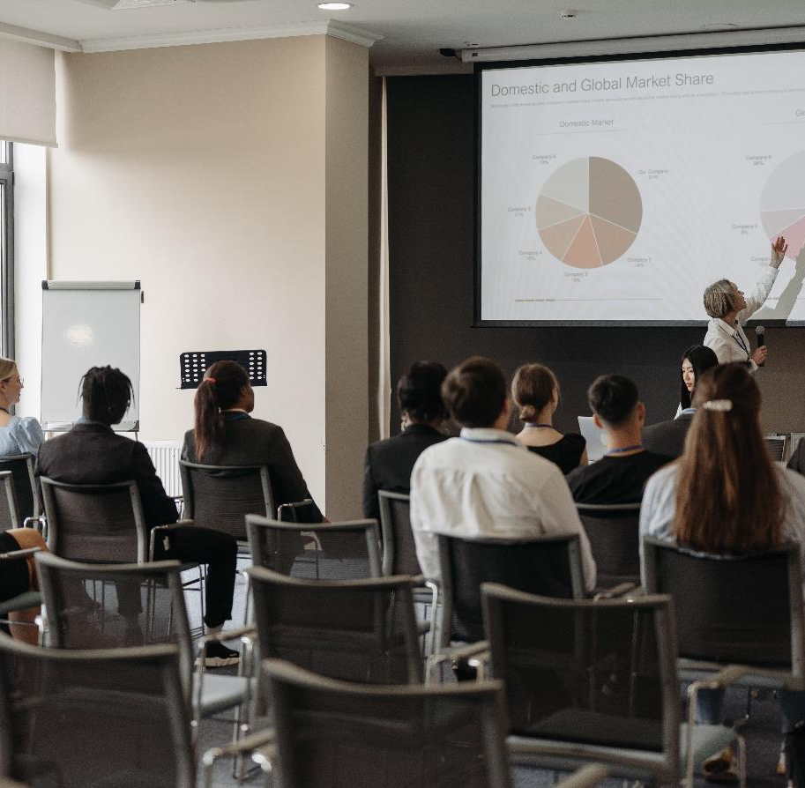
How to Deal and Communicate with Media
Where exceptions to this protocol might apply. For example, it may become necessary for directly impacted tourism businesses to comment on a crisis in many instances and this should be done in coordination with the TCMT
Liaise with Media Officers of emergency response agencies.
Arrange for all media inquiries regarding tourism to be directed and handled or forwarded immediately by the TCMT.
Determine strategic approach to answering media inquiries and the proactive release of information.
Respond to media inquiries in a calm, measured and reassuring manner, as quickly as practicable. If necessary, explain why more details are not immediately available.

Slide 14
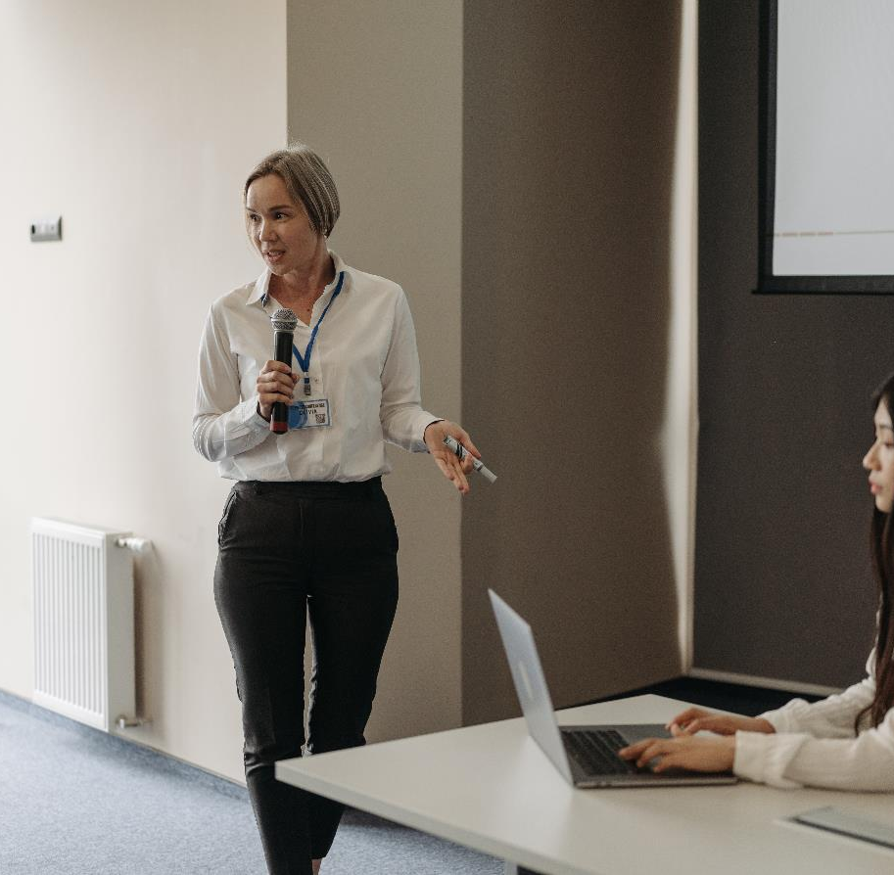
Monitor all media coverage, and immediately alert TCMT of significant issues
Maintain a log of journalists making inquiries
Monitor the extent and tone of media coverage
Determine the appropriateness of issuing a holding statement and draft if necessary
Authorise extra public affairs support e.g.: other agencies, and consultants if required
Brief Crisis Committee Chair in advance of media commitments
Draft media statements and website updates for authorization by TCMT
Review all media statements prior to release to assess implications
Provide background information to media as required
Carefully manage all media events
Remember Media can be an invaluable way of getting out important information quickly

Slide 15

Correct any factual errors or misperceptions reported by the media
If appropriate, and only in consultation with the TCMT, respond to any potentially damaging claims by third parties
Participate in debriefing once the crisis is resolved
The media should be regarded as a vehicle for the region to communicate effectively with visitors, potential visitors and the wider community. It offers an opportunity not a threat. All media interaction must be calm and measured in order to convey a sense of control and preparation.
REMEMBER Monitor media coverage of the event. This will help inform key messages released to the media aimed to minimize negative public perceptions of the region.

Slide 16
Article: Tourism Organisations Should Also Act on Behalf of the Industry as a Whole
Crises can impact negatively upon destination image, especially if it is dramatized or distorted through rumours. Henderson states that “National Tourist Organisations with their responsibility for general destination marketing, research and development have an important role to play in the process of travel and tourism crisis management, representing and acting on behalf of the industry as a whole.” This quote emphasizes the importance of a national tourist organization in responding to crises, implementing crisis communication strategies, and designing recovery marketing campaigns. However, Henderson (1999) found that in the case of the Asian Economic Crisis, the Singapore Tourist Board implemented reactive strategies which took time to implement reducing their effectiveness.
Read Research Article

Slide 17

Guidelines When Speaking with Media
Including other agencies, groups or individuals your own stuff working on the crisis.
Be upfront, even regarding bad news, if it is to be relied upon for an official position.
Often bad news can be tempered by emphasising the actions taken to address it and by putting the matter into its full context.
A short tone at a press conference, during a phone call, or elsewhere can affect your future relationship with an individual or other media who may hear the conversation.
Be
honest & transparent
Avoid speculation by not releasing information or commenting on any matter which is not in your control.
Give credit to others
If you say things that may result in other agencies being contracted, warn them of impending calls.
Avoid antagonising the media
Avoid speculation and generalisations
Put the crisis into context
Do not impose a news blackout
Always return media calls. Failure to provide information to the media will force the media to seek alternative news sources which may not always communicate the truth.
Use maps to demonstrate that the crisis is limited to a specific area.
Challenge untrue statements
Remember the victims in your media response
Monitor media reports and correct inaccuracies before they can be repeated.
Every crisis has its victims and many people will be receptive to your comments. Be sensitive and don’t play the blame game.
Unknown Source

Slide 18
Crisis Management Strategy
For some of the less known or even neglected natural hazards in Switzerland, sound hazard assessments have been carried out recently (Source)
Give credit to others
Be Honest & Transparent
Avoid Speculation and Generalisations
Do not Impose A News Blackout
Including other agencies, groups, or individuals your own staff working on the crisis.
Be upfront, even regarding bad news, if it is to be relied upon for an official position. Often bad news can be tempered by emphasising the actions taken to address it and by putting the matter into its full context.
Avoid speculation by not releasing information or commenting on any matter which is not in your control. If someone say things that may result in other agencies being contacted, warn them of impending calls.
Always return media calls. Failure to provide information to the media will force the media to seek alternative news sources which may not always communicate the truth.
Remember The Victims
Challenge Untrue Statements
Put The Crisis Into Context
Avoid Antagonising The Media
Every crisis has its victims and many people will be receptive to your comments. Be sensitive and don’t play the blame game.
A short tone at a press conference, during a phone call, or elsewhere can affect your future relationship with an individual or other media who may hear the conversation.
Monitor media reports and correct inaccuracies before they can be repeated.
Use maps to demonstrate that the crisis is limited to a specific area.

Slide 19
Research: The Instantaneous Nature of News Reporting Requires a Tourism Region to Initiate Communication with Media and Build a Good Relationship
The instantaneous nature of news reporting, especially via electronic media, requires that tourist authorities immediately implement their contingency plan, deploy their crisis management team and initiate communication with the media. Failure to prepare for a crisis scenario places the tourist authority consistently on the defensive when responding to reporters’ questions at media press conferences. Tourist authorities must exercise maximum control during interviews and initiate the agenda of the media’s coverage of the crisis. Once a strong cooperative relationship is developed with the relevant media, it is also likely that the media will seek to cover the tourist authorities’ management of the actual crisis and post-crisis developments. The Tasmanian government’s sensitive and effective media management of the Port Arthur massacre, coupled with an effective post-crisis tourism marketing program, resulted in Tasmania experiencing a relatively rapid tourism recovery following the Port Arthur massacre in 1996. The Egyptian Ministry of Tourism, the Fiji Visitors Bureau, the Turkish Ministry of Tourism, and the British Tourist Authority all include examples of effective media management of specific recent crises which impacted on their respective tourist industries followed by relatively swift recoveries.
Unknown Source

Slide 20
Example Foot and Mouth, UK
How to Communicate With PR & Media Good Practice
The Foot and Mouth Communication Strategy is known as one of the worst management of crisis communication. For example at the local level access to information was difficult to find as the District Council was unsure of what to do and what the risks were to local farms and tourism. As one respondent noted the
“attractions were seeking advice as they did not know how they were going to be affected” and were passed to different national organizations in search of information which was described by an industry respondent as “frustrating.”
At the local level, consistent messages were created by press and media contacts as well as briefing Tourist Information Centre staff regarding what attractions and footpaths were open. However, research indicated that staff had detailed information concerning attractions, but little knowledge of footpaths which attract a number of hikers to the local region and are a major tourist asset.
Poor communication and decision-making were determined to be major contributing causes to the disaster.
1. Communicate Clearly
Present information openly and in a way that others can understand. Recognize that personal perspective influences how everyone interprets information. Don’t hide from bad news.

Slide 21
Article: How Not to Manage A Crisis- Being Reactive
The paper then applies the foot and mouth disease (FMD) which occurred in the United Kingdom to crisis communication theory at a national level by examining the response action was taken in the emergency phase of the crisis and was reactive involving inconsistency in developing key messages to stakeholders, partly due to confusion and a lack of information at the national level. Recovery marketing was also limited due to the length of time of the disease outbreak. At the local level, the majority of respondents did not believe the implications of the outbreak until the emergency phase. According to one respondent, “we knew what was going on, but we were trying not to think about it.” Furthermore, another respondent described decision-making as “mainly stabbing in the dark.” This slow response could be because the initial outbreaks were in other districts and there seemed to be confusion about the potential impacts and what should be done about them. Little communication was occurring between decision-makers at the national level and the local level. This decision-making was further complicated by mixed
messages at the national level by the government over whether the countryside was closed or actually open for business, illustrating that consistency in responding to the crisis and communicating positive messages to key audience groups was lacking.
Read Research Article

Slide 22
Example COVID 19 Spokesperson
How to Communicate With PR & Media Good Practice
During the coronavirus pandemic, Dr. Anthony Fauci, Director of the National Institute of Allergy and Infection Diseases for more than 30 years, brought expertise to his role as explainer in chief to the American public.
He conveyed the importance of citizens staying home with clear and consistent messaging, and he deftly handled complex questions about science from the media. He gave interviews on social media, podcasts, sports shows, digital news sites, as well as traditional media, to reach all demographics, including teenagers.
2. Pick the Right Spokesperson
The individual should have the knowledge and training to address the crisis and is in a position of authority. A person can be coached to work with the media, but putting a representative who lacks expertise in front of the cameras will backfire: a region will come across as uninformed or incompetent.

Slide 23
Article: The Spokesperson Matters
Risk researchers have long-argued that the choice of spokesperson should be carefully considered, as perceptions of trustworthiness can affect compliance with risk prevention guidelines (Abraham 2009; Freimuth et al. 2014; Siegrist and Zingg 2014).
Public health guidelines are more likely to be accepted and adopted if people trust risk managers and have confidence in their abilities (Kasperson, Golding, and Tuler 1992; Slovic, Flynn, and Layman 1991) and the sources of information are reputable.
Lyu et al. (2013) found that spokespersons that demonstrate professional competence and have positive interactions with reporters are more trusted than those who are confrontational in press conferences, blame the media for reporting on their mistakes, and who lack the authority to make decisions. Clear and consistent messages are also crucial for successful crisis communication.
Read Research Article

Slide 24
Example Cyclone Larry, Australia
How to Communicate With PR & Media Good Practice
Cyclone Larry with winds speeds of up to 240 km/h struck the coast of North Queensland, Australia damaging or destroying up to 70% of the buildings in its path (Falco-Mammone et al., 2006).
The civil defence authorities had planned for and practised such an event and were able to evacuate all residents at risk with the result that there were no deaths although the damage bill exceeded AUD$1 billion.
The success of the emergency services in dealing with Cyclone Larry illustrates the importance of retaining organizational learning in the post-resolution stage of Faulkner's model. Lessons learnt from Cyclone Winifred which struck the same region 20 years before (Falco-Mammone et al., 2006) had been used to develop a detailed response plan and to inform local government disaster planning.
3. Respond Quickly
A region should issue a statement within the first hour of a crisis and publish frequent updates. Keep customers and other stakeholders informed about progress. If a spokesperson is unsure about frequency, err on the side of too much communication, rather than too little.

Slide 25
Article: The Impacts of a Reactive and a Slow Response
Because of a combination of a delay in identifying foot and mouth, disbelief of the severity of such a crisis, and a lack of proactive planning, there was a delay in reacting to the crisis by the tourism industry at both a national and local level. Both the BTA and industry at the national and local levels only accepted the implications of the outbreak at the emergency phase and reacted only due to negative publicity. This involved inconsistency in developing key messages to stakeholders, partly due to confusion and a lack of information at the national level.
The BTA in their media releases noted this in a statement issued by the head of EU Affairs in Brussels which stated “in dealing with the Belgian media, the current tactics are more reactive than proactive” (BTA 2001a). Although in the personal interview the BTA insisted that they reacted within the first three days of the outbreak it was not until 28 March (one month later) that a BTA board meeting took place to coordinate communications and prepare a recovery plan for England. Industry representatives at the national level agreed that the response of the tourism sector generally had been slow and the power and effect of the media had been under-evaluated. (British Tourism Association BTA)
Read Research Article

Slide 26
Example Handle Media Misinformation
How to Communicate With PR & Media Good Practice
Regions should release only authoritative, reliable information. Regular updates will serve to counter speculation and misunderstandings. Furthermore, all reasonable media requests should be accommodated as quickly as possible in order to disseminate factual details and to position the region’s tourism industry as being open and responsible, and working in the best interests of its customers.
The nature and timing of the TCMT media response must be guided by the extent of the crisis or incident. In some cases, particularly those that require sensitivity such as the loss of life, it will be advisable to wait until an appropriate time before issuing anything other than essential factual advice for travellers.
4. Feed PR & Media with Tailored News
Journalists will create a story with or without the help of the region. Don’t let media and PR mislead the crisis story. Create their story and send it to them. Have a holding copy statement template on standby. Spokespeople need to be quick, upfront, and transparent. Simple words to avoid further mistrust and resentment.

Slide 27
Article: Media Needs to Be Managed. Otherwise it can Break a Business
Responding quickly to the demands of the media and public is important as the media have deadlines to work to and are looking for quick sources of information. If the crisis team does not fill the void, someone else will (Coombs, 1999). Zerman (1995:25) agrees to state that “the mass media has the power to make break a business.”
Sensationalist media coverage of the 1980 Mt St Helens disaster and the 1985 East Kootenay forest fires were noted as contributing to confusion during the emergency phase as the media were blamed for misleading public opinion concerning the severity of the disasters. This also impacted the long-term recovery phase for the destination (see Murphey and Bayley, 1989). However, difficulties have been noted in managing the media as it is unlikely that there will be a time delay between the start of any crisis and media coverage (Ashcroft, 1997)
Read Research Article

Slide 28



Article: Tourism Crisis and Recovery Strategies
An incident occurs, which the media describes and often, but not always exaggerates
Tourists leave the area, bookings are cancelled
Destination suffers economically, poor press coverage may continue, magnifying the effects of the incident
Read Research Article
Destination commences its own media coverage
Based on WTO 1998, page 156
Read Research Article

Slide 29
Example How to Stay Consistent
How to Communicate With PR & Media Good Practice
Anticipate potential questions and prepare thoroughly.
Speak calmly and concisely and in short sentences. Stick to pre-planned central key messages and responses.
Never assume the cameras or recorders are off.
Remember who the audience is – viewers, tourists, stakeholders, listeners, and readers.
Be aware of the latest information and know the facts. Have background information to hand.
Be aware of how the crisis or incident is being reported and of any specific concerns raised.
Don’t do media interviews off the cuff – think first and have a clear objective.
If appropriate, ask whether the journalist has spoken to anyone else.
Use simple everyday language.
Ignore surrounding distractions, and dress appropriately.
Don’t be defensive or lie, don’t repeat, and avoid debates. Ensure an appropriate backdrop for television interviews.
5. Consistency of Response
The crisis can be unplanned but the communication can be planned in advance where discussions can lead to consistent strong messages. Having a Holding Statement is a good place to start for consistency of response. The Holding Statement will outline the who, what, where, when, how, and answer all other relevant priority questions.

Slide 30
Article: Media Needs to Be Managed to Reduce Misinformation
Crisis communication is mainly concerned with providing correct and consistent information to the public and enhancing the image of the organization or industry sector faced with a crisis. An emphasis on communication and public relations is required to limit harm to an organization in an emergency that could ultimately create irreparable damage. Cooperation with the media is considered vital because the media provides information to the public (Berry, 1999), illustrating the need to keep the media briefed frequently so misinformation is reduced. Regular two-way communication is the best way of developing a favorable relationship with public (Coombs, 1999:134).
Consistency of response is also noted as a key element in crisis communication. The ability to provide a consistent message to all stakeholders will build credibility and preserve the image of an organization instead of tarnishing reputations through providing inconsistent messages (Coombs, 1999). Barton (1994) believes that many issues are overlooked by crisis managers regarding crisis communication, namely to focus on identifying the audience, developing goals for communicating effectively, and creating strong positive messages.
Read Research Article

Slide 31
Example Benefits of Leading Own PR
How to Communicate With PR & Media Good Practice
PR brings valuable media connections. The media regularly release, for example, lists of the top hotels and places to visit – regions should take advantage of and make sure they are on the radar. Such positive publicity builds credibility and helps create a positive image.
PR can be a useful promotional tool. Blog reviews and press releases are a great way to tell a region’s story in an engaging, opinionated tone. They can help a region build credibility and exposure for the brand.
PR streamlines the process of creating a region’s brand awareness. By supporting charities or organizing special events, a region can easily promote its brand and build awareness e.g., by launching a new product.
PR provides a greater connection with the audience. All actions will not stay irrelevant to a target audience. It will pay off in the future.
PR can help a region communicate with the stakeholders. Public relations activities can help maintain a good relationship with all the stakeholders, e.g., engage employees.
.
6. Lead Your Own PR
It is essential for a region to lead its own PR and Media so it can maintain and enhance its brand and reputation. It is essential it portrays its brand well to ensure bookings, customer engagement, and a positive reputation is built post-crisis. This will impact a region’s whole brand performance. Source

Slide 32

How to Drive Regional PR and Media Campaigns
Have a strong social media strategy
Bet on local, personalized messages
Partner with important travellers and influencers
Focus on mobile devices
Create video content
Participate in and organize events (can also be done online)
Look to the future of VR technology
Interact with prospects and customers (can also be done online)
Monitor social media mentions of your brand
Measure the results of your efforts
https://youtu.be/oovURIu4040
Read More Detail Here

Slide 33
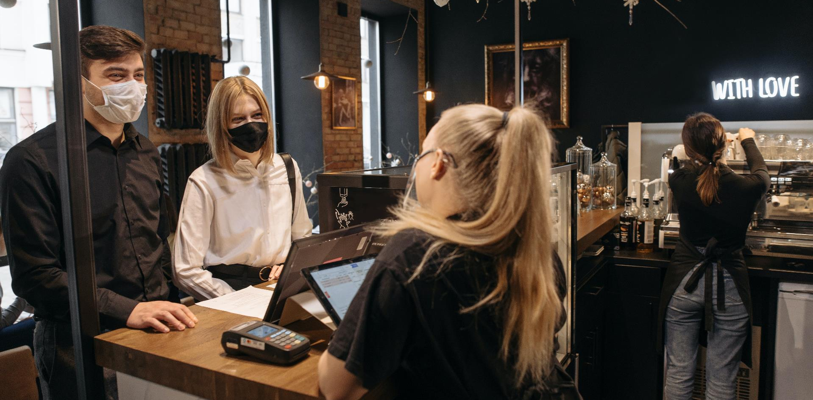
2. Develop a Regional Crisis Communication Strategy and Plan

Slide 34
Example Develop the Communications Plan and Strategy
How to Communicate With PR & Media Good Practice
A Crisis Communication Plan and Strategy are two very useful tools that bring all the elements that need to be brought together in one place for the speedy recovery of tourism. Essential tools include a holding statement, media releases, a central communications database, websites and social media for industry and tourist information, emails, switchboard scripts, briefings, advertising and campaigns…and more.
Thinking about this for the first time when a crisis occurs is a challenging task. It’s much easier is to have a program of communication activities that a region can use as a guide and update to reflect the specifics of the crisis event.
The next section covers different approaches to using such tools. Each tool is different for different reasons and purposes.
7. Develop a Communication Program (Plan & Strategy)
Knowing to whom, what and how a region needs to communicate after a crisis is a critical step in responding to a crisis. This is the most important element in managing public perceptions after a crisis, as well as ensuring there is united industry support for the recovery process, and strong government backing.

Slide 35
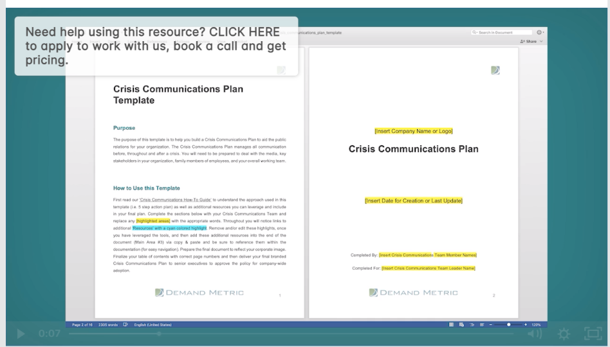
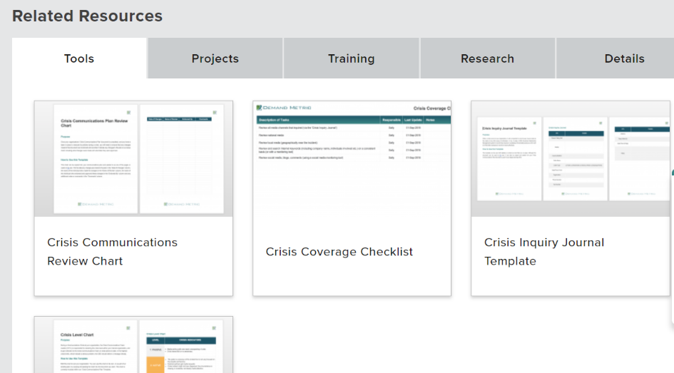
Regional Crisis Communication Plan and Strategy
The majority of crisis management lies in the response and communication to the crisis. Communication is an ongoing process during the entire process of crisis management. All the preparation helps the region in the response stage including developing a Crisis Communication Strategy and Plan that underpins how a region should respond and recover. A major part of the communication is mitigation the response depends on it.
Communication is sent to different audiences and channels for different and very specific purposes.
A region should define and fine-tune its communications processes on an ongoing basis.
It should never over-communicate, and remain factual and to the point.

Slide 36
Regional Crisis Communication Plan and Strategy
Develop communication templates to cover communications to suppliers, teams, tourists, stakeholders agents and international partners, and customers, each aligned to what a region would want to tell them at this specific point in time. Use the experience gained during each communication stage to further develop existing communication strategies and plans.
Set expectations and do not create expectations without a solid foundation for doing so. For examples of communication plans, take a look at the website of Demand Metric.

Slide 37
Sample Crisis TCMT Communication Plan – Communications Team
Speciality Area | Tasks/Updates/Notes | Contact Details
TCMT media spokesperson (& backup) |  | Name: Contact Details (Email, Phone etc)
Tourism businesses (& backup)
Update web site (visitors) (& backup)
Government (& backup)
Other stakeholders (& backup)
Media (News Respondent)
Media (Tourism Respondent)
Media (Editor and Chief Editor)
Media (Local Area x Respondent)
Contact Hierarchy Here Draw your contact hierarchy here – that is, who is responsible for contacting who

Slide 38

Sample Communications Plan Grid Template
MARKETING COMMUNICATION PLAN GRID TEMPLATE
 | TARGET AUDIENCE | OBJECTIVE | DELIVERABLE | TASK DESCRIPTION | STARTING DATE | ENDING DATE | COMMUNICATION CHANNEL | OWNER
CURRENT CUSTOMERS
SALES PROSPECTS
MEDIA PARTNERS
INTERNAL STAKEHOLDERS
EVENTS
Smartsheet Templates
Smartsheet Templates

Slide 39
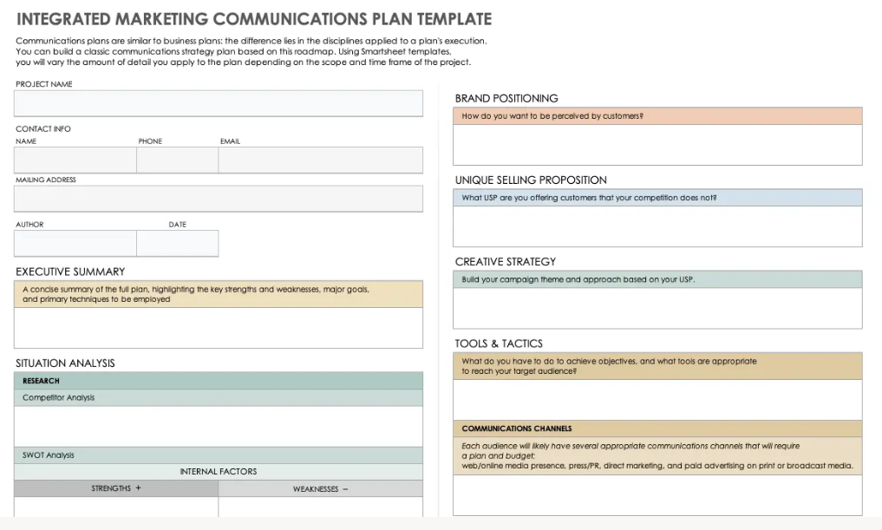
Sample Integrated Marketing Communications Plan Template
Smartsheet Templates

Slide 40
Sample Integrated Marketing Communications Plan Template
INTEGRATED MARKETING COMMUNICATIONS PLAN TEMPLATE
PROJECT NAME
CONTACT INFO
NAME | PHONE | EMAIL
MAILING ADDRESS
AUTHOR | DATE
EXECUTIVE SUMMARY
A concise summary of the full plan, highlighting the key strengths and weaknesses, the major goals, and the primary techniques to employ
SITUATION ANALYSIS
RESEARCH
Competitor Analysis
SWOT Analysis
INTERNAL FACTORS
STRENGTHS + | WEAKNESSES –
EXTERNAL FACTORS
OPPORTUNITIES + | THREATS –
SWOT Analysis Summary
IDENTIFY SMART (Specific, Measurable, Achievable, Realistic, and Timely) OBJECTIVES & METRICS
Communication plans are similar to business plans: the difference lies in the disciplines applied to a plan’s execution. You can build a classic communications strategy plan based on this roadmap. Using Smartsheet templates, you will vary the amount of detail you apply to the plan depending on the scope and time frame at the project.
Smartsheet Templates
Smartsheet Templates

Slide 41
Sample Integrated Marketing Communications Plan Template
INTEGRATED MARKETING COMMUNICATIONS PLAN TEMPLATE
TARGET AUDIENCE
Describe the target audience that you want to influence with your campaign.
BRAND POSITIONING
How do you want to be perceived by customers?
UNIQUE SELLING PROPOSITION
What USP are you offering to customers that your competition is not?
CREATIVE STRATEGY
Build your campaign theme and approach based on your USP.
TOOLS & TACTICS
What do you have to do to achieve objectives, and what tools are appropriate to reach your target audience?
COMMUNICATIONS CHANNELS
Each audience will likely have several appropriate communications channels that require a plan and budget: web/online media presence, press/PR, direct marketing, and paid advertising on print and/or broadcast media.
BUDGETS
You should create a separate budget for each tactical project that supports the plan.
PROJECT PLAN & SCHEDULES
Create a milestone chart that displays all your tactics, and include a list of who needs to complete which tasks by when, so you can measure your progress toward your ultimate goals.
TASK OWNER | DATE DUE | TASK DESCRIPTION
EVALUATE
Based on your incremental metrics, evaluate how successful you were in meeting objectives.
Smartsheet Templates
Smartsheet Templates

Slide 42
Sample Annual Marketing Communications Plan Template
Smartsheet Templates
ANNUAL MARKETING COMMUNICATIONS PLAN TEMPLATE
 | Q1 |  |  |  |  |  |  |  |  |  |  |  |  |  |  | Q2
 | JANUARY |  |  |  |  | FEBRUARY |  |  |  |  | MARCH |  |  |  |  | APRIL |  |  |  |  | MAY |  |  |  |  | JUNE
Enter date of first Monday each month | 4 | 11 | 18 | 25 | - | 1 | 8 | 15 | 22 | 29 | 7 | 14 | 21 | 28 | - | 4 | 11 | 18 | 25 | - | 2 | 9 | 16 | 23 | 30 | 6 | 13 | 20 | 27 | -
Sales Goal
Sales Actual
National Marketing
Banner Ads
Local Marketing
Newspaper
In-Store Marketing
POP
Public Relations
Events
Sponsorships
Press Releases
Social Media
Twitter
Facebook
Pinterest
Online
Blog
Website
Mobile App
Mobile Alerts
Advertising
Online
Print
Outdoor
Radio
Television
Market Research
Surveys
Impact Studies

Slide 43

Well Done!
You Have Finished Module 7 Communication Strategy and Dealing with PR and Media
Now Get Ready for
Module 8 Strategic Regional Crisis Response and Recovery Marketing
https://www.tourismrecovery.eu/
Facebook
Momentum, Ireland Developer of Modules
The European Commission supports the production of this publication and does not constitute an endorsement of the contents which reflects the views only of the authors, and the Commission cannot be held responsible for any use which may be of the information contained therein 2020-1-UK01-KA203-079083

