Slide 1
Regional Tourism Crisis Management (RTCM)
HEI Course, 2023
Developed by Laura Magan (Momentum)
Module 8
Strategic Regional Crisis Response and Recovery Marketing

Slide 2










Module 1
Module 2
Module 3
Phase 1 Preparation & Mitigation
Introduction to Regional Crisis Tourism Management & Its Complexities
Set Up a Regional Public Private Partnership & Crisis Management Team
Conduct a Regional Crisis Vulnerability SWOT Analysis and Destination Audit
Phase 2 Planning,
& Response
Module 4
Module 5
Module 6
Develop a Regional Crisis Management Strategy (Long Term Mitigation Planning)
Develop a Regional Crisis Management Response Plan (Short Term Response Plan)
Response Activation and Communication with Industry for Regional Collaboration
Phase 3
Recovery, Rebuild, Resilience
Module 7
Module 8
Module 9
Communication Strategy and Dealing with PR & Media
Strategic Regional Crisis Response and Recovery Marketing
Regional Recovery, Rebuilding & Resilience Towards a ‘New Norm’ Post Crisis

Slide 3
Regional Tourism Roadmap to Managing a Crisis
(Prepare, Prevent, Mitigate, Plan, Respond, Recover, and Rebuild)
1
Regional Tourism Crisis Management Team (TCMT) Create for a collaborated, coordinated response to a crisis
2
Regional Risk Analysis
Assess the most likely crisis a region will face and the priority actions to mitigate the risk.
3
SWOT Analysis
Analyse strengths, opportunities, and threats to review and strengthen a tourism region.
4
Regional Crisis Audit
Audit regional gaps and needs to implement Risk and SWOT Priorities and Actions
5
Crisis Management Strategy
Develop a CMS so a tourism region can follow a long-term plan to mitigate and prevent the impact of a crisis
6
Crisis Management Plan
Develop a CMP so a tourism region can follow a short term plan to respond and recover from a crisis
7
Activating a Response to a Regional Crisis
Crisis response activation measures, protocols, systems of communication, and information sharing with internal industry stakeholders to ensure an aligned response.
8
External Communication with PR, Media, and Tourist Marketing Regional response and communication approaches with different external stakeholders. How each is dealt with differently in terms of messaging, approach and timing.
9
Rebuild, Recovery, and Resilience Rebuilding tourism regions to a ‘new normal’ using business continuity and resilience approaches, discovering a need to prioritize change, and adapting to the ‘new norm’.

Slide 4
Table of Contents
Sections 1 - 3
Strategic Regional Crisis Response and Recovery Marketing
1
Effective Crisis Response Marketing For Tourism Regions
This Module covers key marketing strategies to assist regions during crisis response and recovery phases. Regions often think to stop all marketing altogether but it is better to continue promoting and communicating to existing and potential visitors to keep the destination top of mind. Marketing during and post-crisis ensures an effective restoration post-crisis response and recovery phases.
This Module demonstrates the different approaches leading marketers have taken to ensure tourists’ hearts and minds stay connected to their regions during these phases so that it is in a strong position in the ‘business as normal’ restoration phase. An important step highlighted is that regions need to discover and adapt to the ‘new tourist’ so a ‘new norm’ can be understood and potential recovery maximised.
Regions Must Adapt Crisis Response Marketing and Continue to Promote for Effective Restoration Post Crisis
2
3
14 Effective Crisis Response Marketing Case Study Examples
3
Regional Recovery and Restoration Marketing
Discovering and Adapting to the Needs of ‘New’ and ‘Existing’ Tourism Markets

Slide 5
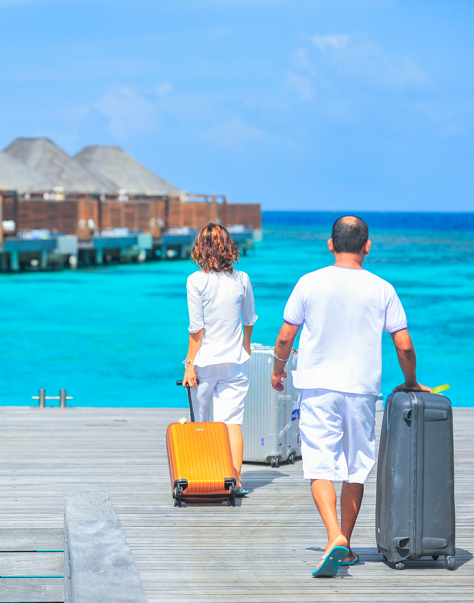
Learning Outcomes
Understand different crisis marketing approaches and strategies during a crisis and in the restoration phases
Learn how regions and partners can work together as a collective for the benefit of the destination
Be inspired by compelling tried and tested and often low-budget marketing campaigns that have won prestigious awards
Learn how to assess the ‘new tourist’ and ‘new norm’ post-crisis and how a region can adapt its marketing practices to a post-crisis region

Slide 6
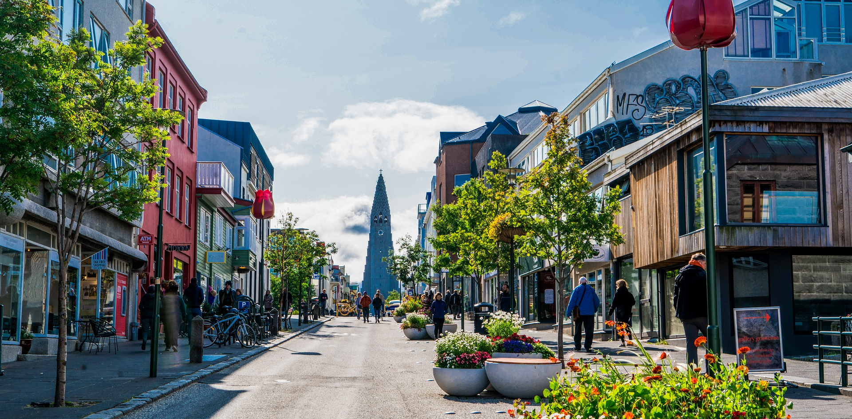
1. Effective Crisis Response Marketing For Tourism Regions
Regions Must Adapt Crisis Response Marketing and Continue to Promote for Effective Restoration Post Crisis

Slide 7

Regions Must Switch to Crisis Marketing During a Crisis
Crisis events can change the whole way tourism regions market. During COVID people were hesitant and avoided connecting, interacting or getting close to strangers when this is usually why tourists come to destinations – to connect with people.
During COVID everything had to change, the images, the messages, the information, what was being promoted, who was targeted. All planned marketing had to be completely taken off the table and swapped with messages that had to be clear, safety-focused and made the destinations accessible (somehow!)
Tourism Marketing took a complete 360-degree turn and had to move quick to manage destination image and visitor perception. This next section shows how different tourism regions did exactly that in simple, impactful effective ways. Marketers need to factor in crisis as a new dimension to their strategies.

Slide 8
Promote During a Crisis Can Put a Region Ahead of Competitors When Markets Return
The travel industry was hit extremely hard by COVID. International tourist travel dropped 65% in the first half of 2020 alone. And for many companies, the response was to slash marketing budgets to counteract plummeting revenues.
Now, advertising during a time when customers physically cannot travel might feel counterintuitive. But in past recessions, companies that continued to spend on advertising through a downturn actually ended up outselling their competitors as the market rebounded back to normal.

Slide 9
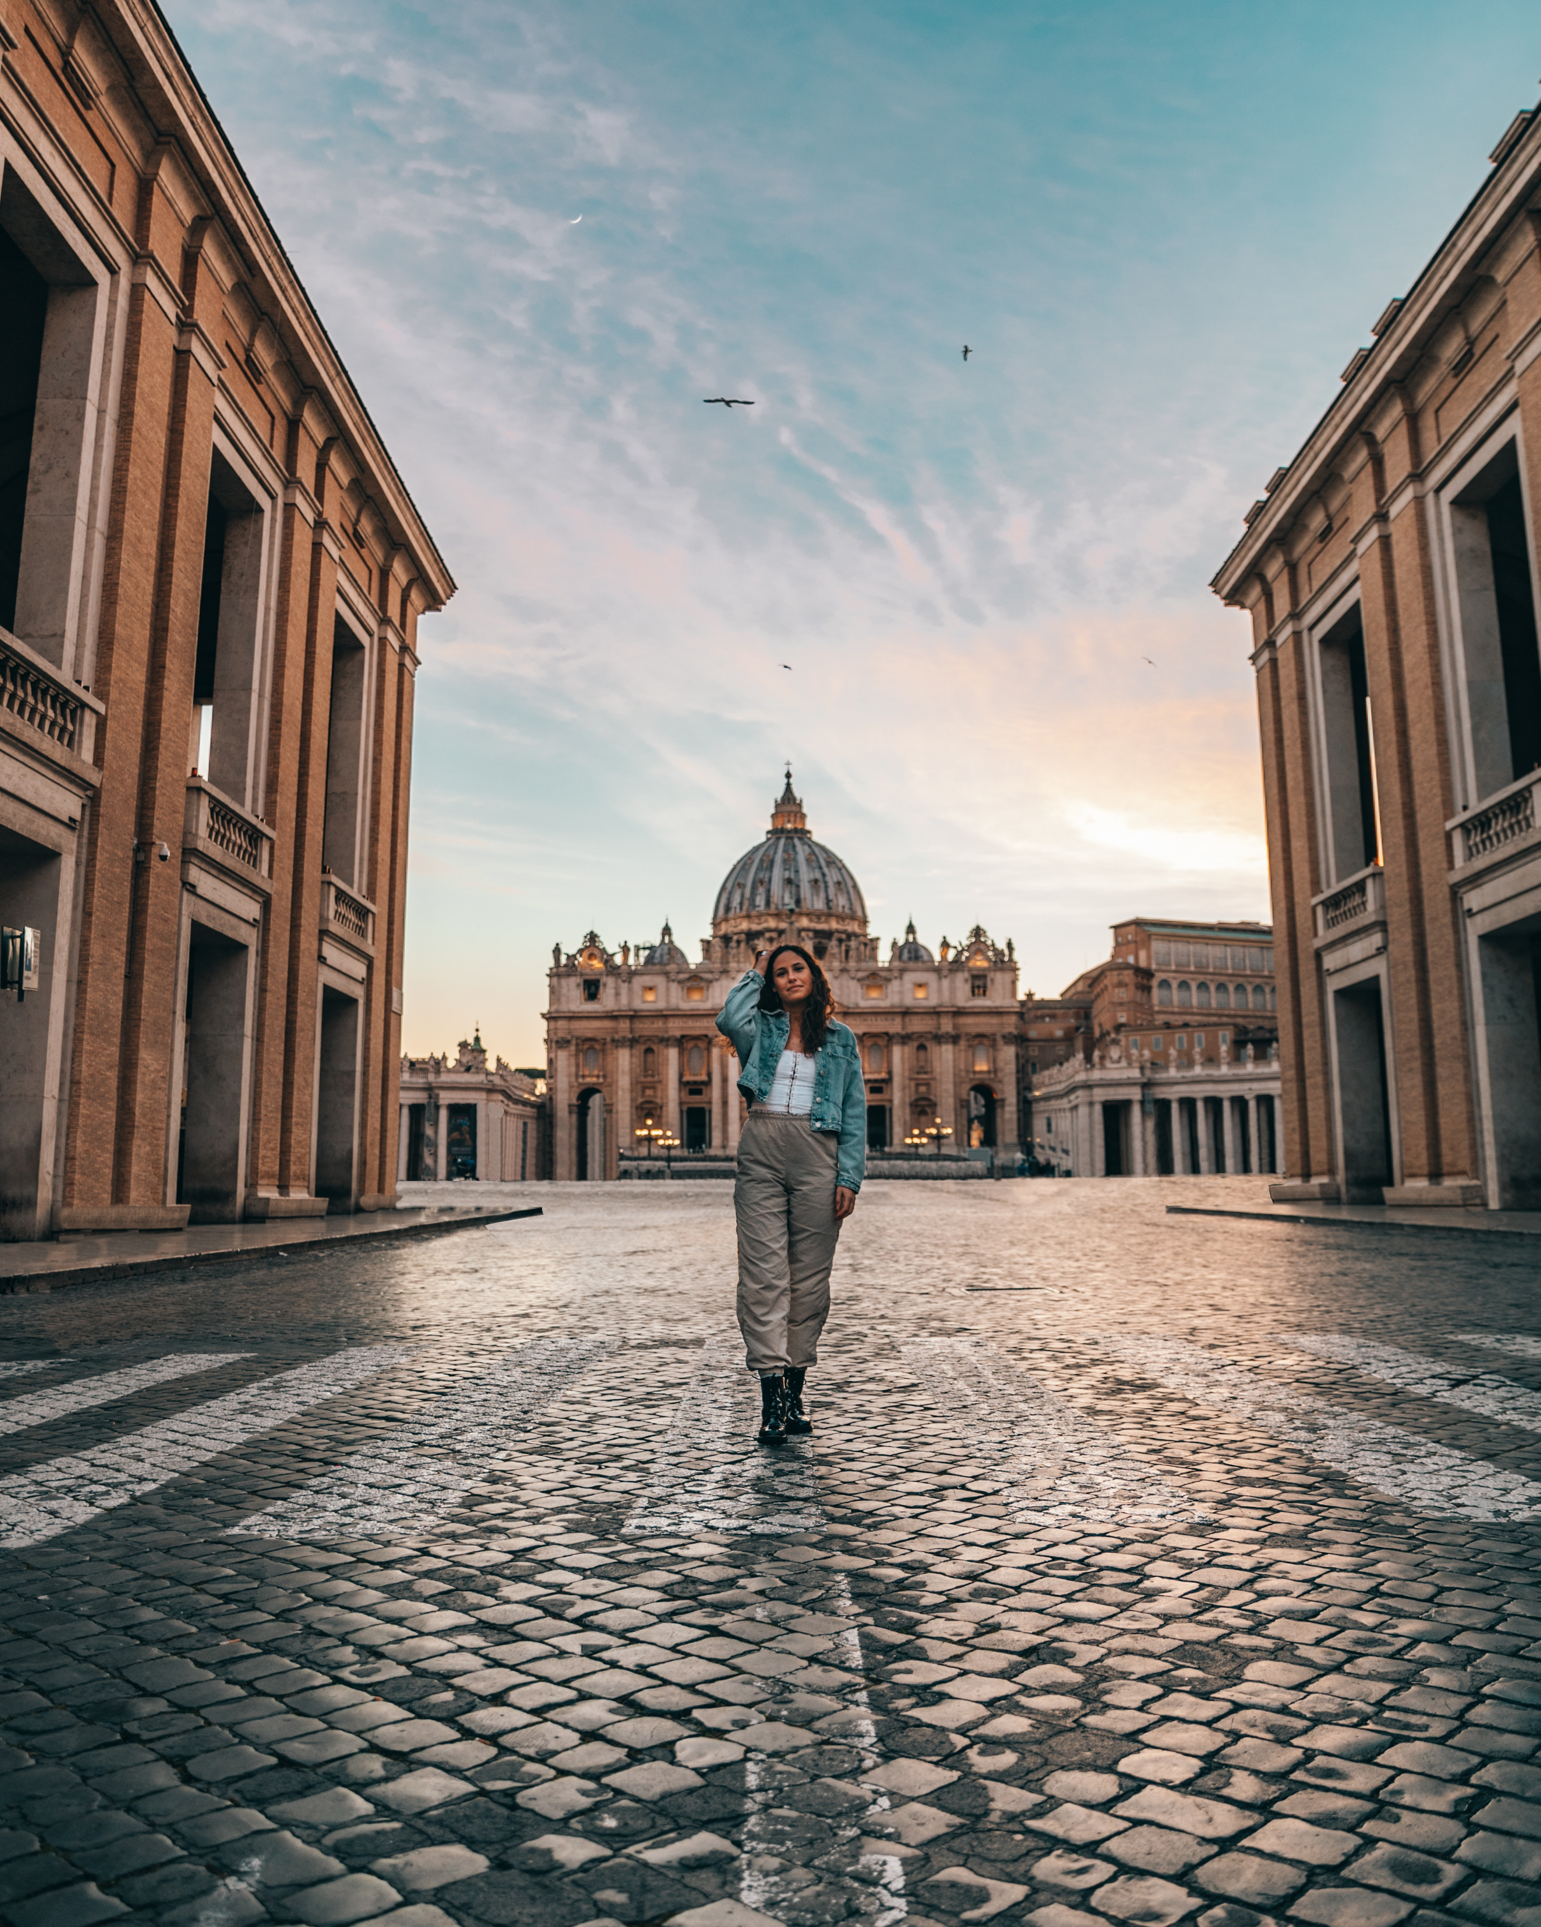
Regional Crisis Response Marketing
The region should be clear in advance about how it will communicate with visitors will make the job of navigating and responding to a crisis much easier.
Involve Operators in Distributing Crisis Marketing & Communication. In addition to the media providing information to visitors about a crisis event, tourism operators and accommodation providers are perfectly positioned to provide their customers and potential visitors with practical and authoritative information regarding travel plans, the safety of routes, alternative activities, and so on.
Provide Operators with The Information They Need. Tourism businesses will need clear and concise information, as well as regular updates, so that visitors, their families, and potential visitors can be properly informed about the crisis situation. (Source)

Slide 10
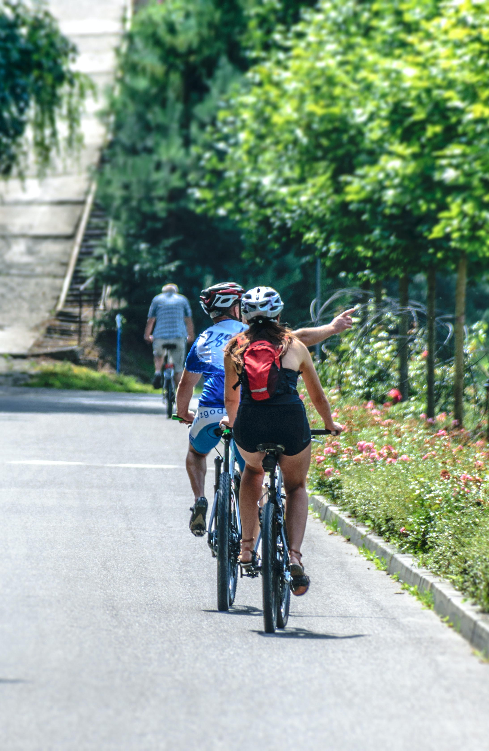
Nurture Communication with Potential Future Visitors to Keep The Region Top of Mind
Identify contacts/outlets and ways to provide up-to-date advice directly to existing and potential visitors. This should include information on the status of the region as a tourism destination and travel advice to prospective visitors should be included on regional tourism websites, radio and newspaper, and other key media.
As already noted above, tourism operators and visitor information centers are also useful avenues to communicate with visitors.
The advent of social media means response times have shortened. Fast, effective communication can provide important safety information to prospective visitors, and give reassurance to visitors who are unsure about planned visits.
Consider how access to databases of key consumer contacts (e.g. TripAdvisor) containing a variety of forms of communication allows a region to communicate with the public as quickly and effectively as possible. (Source)

Slide 11
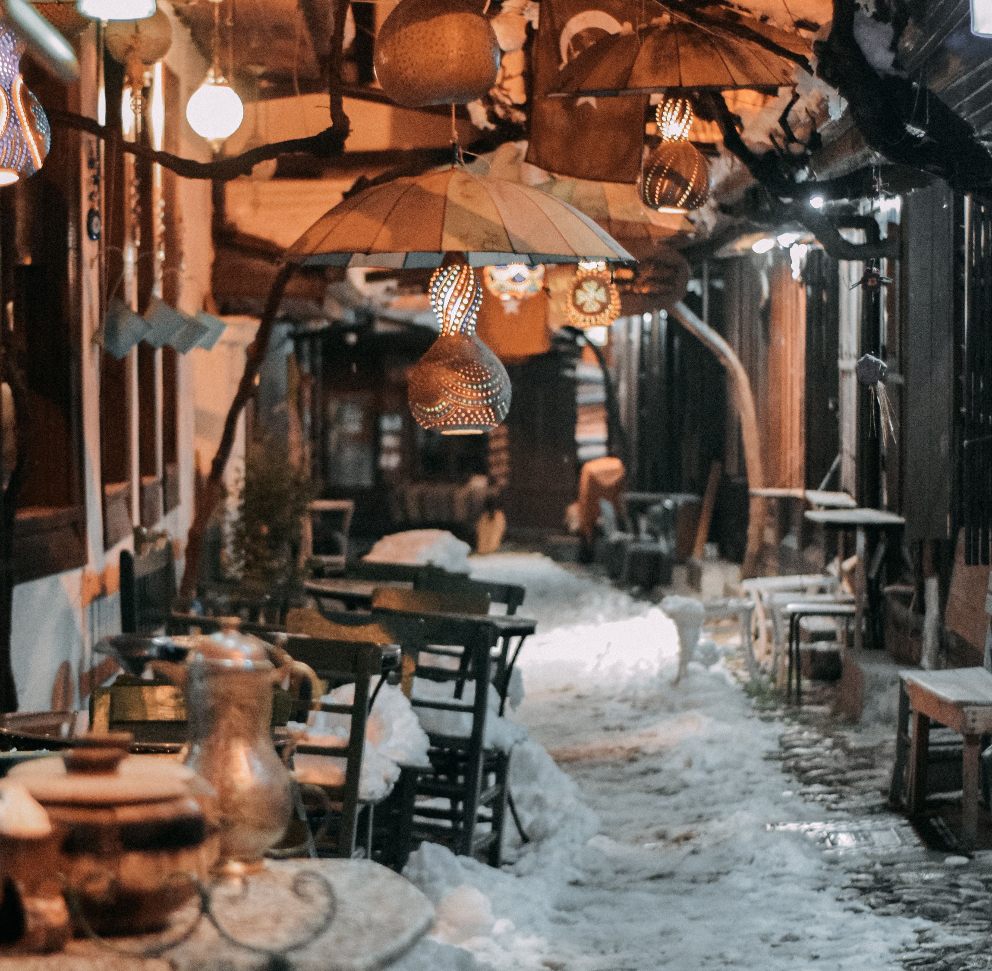

Promoting During a Crisis Continues to Build Brand Loyalty
Launching promotions for when people decide to travel again is also a good initiative that can help regions continue building brand loyalty. From lower rates and discounts to additions like free Wi-Fi access in the cabin, personalized travel guides, a 3rd night free or spa credits, offering promotions will incentive some travellers to choose a regional brand for their future trips.
Thai Airways, for instance, handed out free miles of up to three million to its members in a new campaign under one condition: they have to stay at home. We are also seeing creative and emotional marketing campaigns from top Tourism Boards and travel companies, like for instance TourSpain, or Discover Puerto Rico.
Source

Slide 12
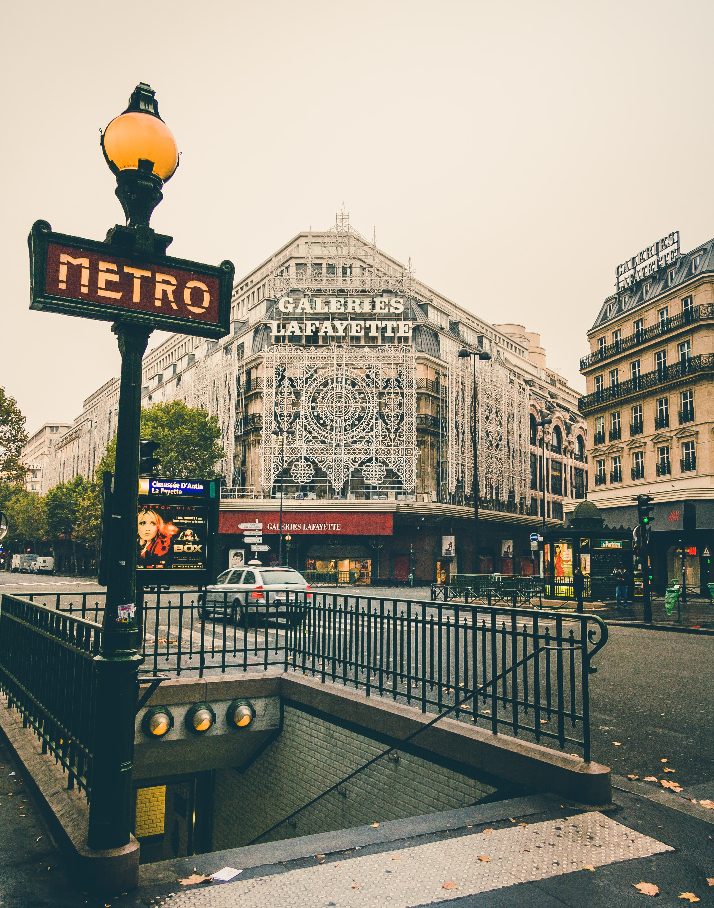
Ways to Inform Visitors About The Crisis Status in the Region
Tools a TCMT can provide to operators to assist them are email updates, reception/phone/email scripts, Q&A sheets, etc. The advent of social media means communication times have shortened. Facebook, Twitter, and others can provide fast, effective safety information to prospective visitors, and give reassurance to visitors who are unsure about planned visits.
Other ways to inform visitors about the crisis include:
Visitor websites (local, regional, state, and national)
Visitor information centers (in the region and adjacent regions)
Local visitor radio
Stop regular marketing. The TCMG also needs to either revise or suspend any current marketing programs for the region immediately after a crisis until an appropriate recovery strategy has been determined. (Source)

Slide 13
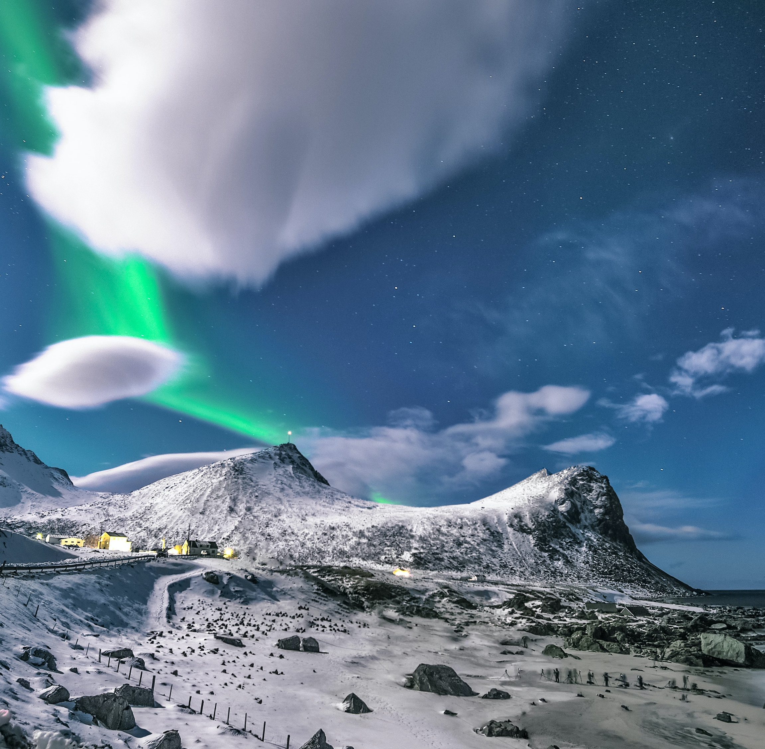

How Iceland Communicates to Prospective Tourists During Covid
Research
Destination Brand Communication during COVID-19 Pandemic - The Case of Iceland.
The Iceland DMO (Destination Marketing Organization) provides prospective tourists with general travel-related information, and links to government notifications and also has an official website for Iceland and COVID-19. It has also established its social media presence on Facebook, Instagram, Twitter, YouTube, and Pinterest.
We propose to evaluate the brand communication strategy of Iceland tourism using the PESO (Paid, Earned, Owned, and Shared) framework. This evaluation will yield insights into platforms and types of media employed by the DMO with the intention of addressing the concerns of tourists. The strategies implemented by Iceland may be adopted by other destination DMOs to restart their tourism industry.
Article

Slide 14
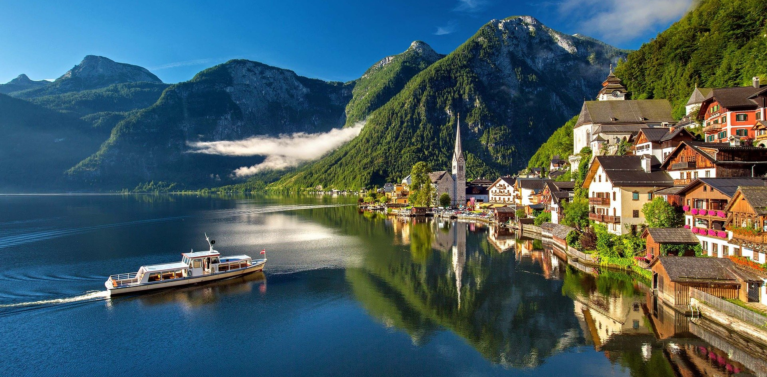
2. 14 Effective Crisis Response Marketing Case Study Examples

Slide 15
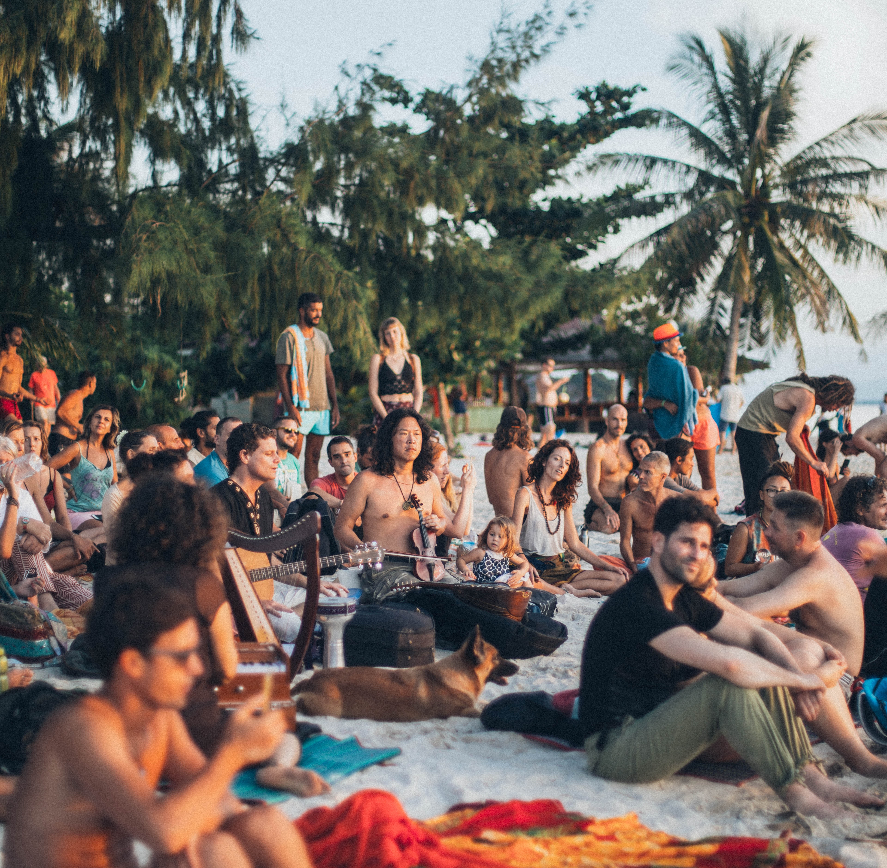
The First Place People Go to Is Online to Engage with Travel Content So Be Prepared and Updated
Reports indicate that when a crisis or restriction from travel is lifted, people are eager to get out and explore. Most likely, to nearby destinations first see local visitors. While the current crisis is unfolding, many have moved past the initial shock and are taking stock of how to survive and thrive in the future.
One thing we know is that businesses who continue to market, even during downturns, are in a stronger position when this turns around.
Clayton Reid, CEO of MMGY Global says, be ready for shorter lead times. People are already tired of the virtual world and are craving physical connections like restaurant visits and other ways to socialize.
However, in the short term, people are online and they’re engaging with travel content. By reallocating marketing spend to digital channels, regions have a tremendous opportunity to come out strong when a crisis turns around.

Slide 16
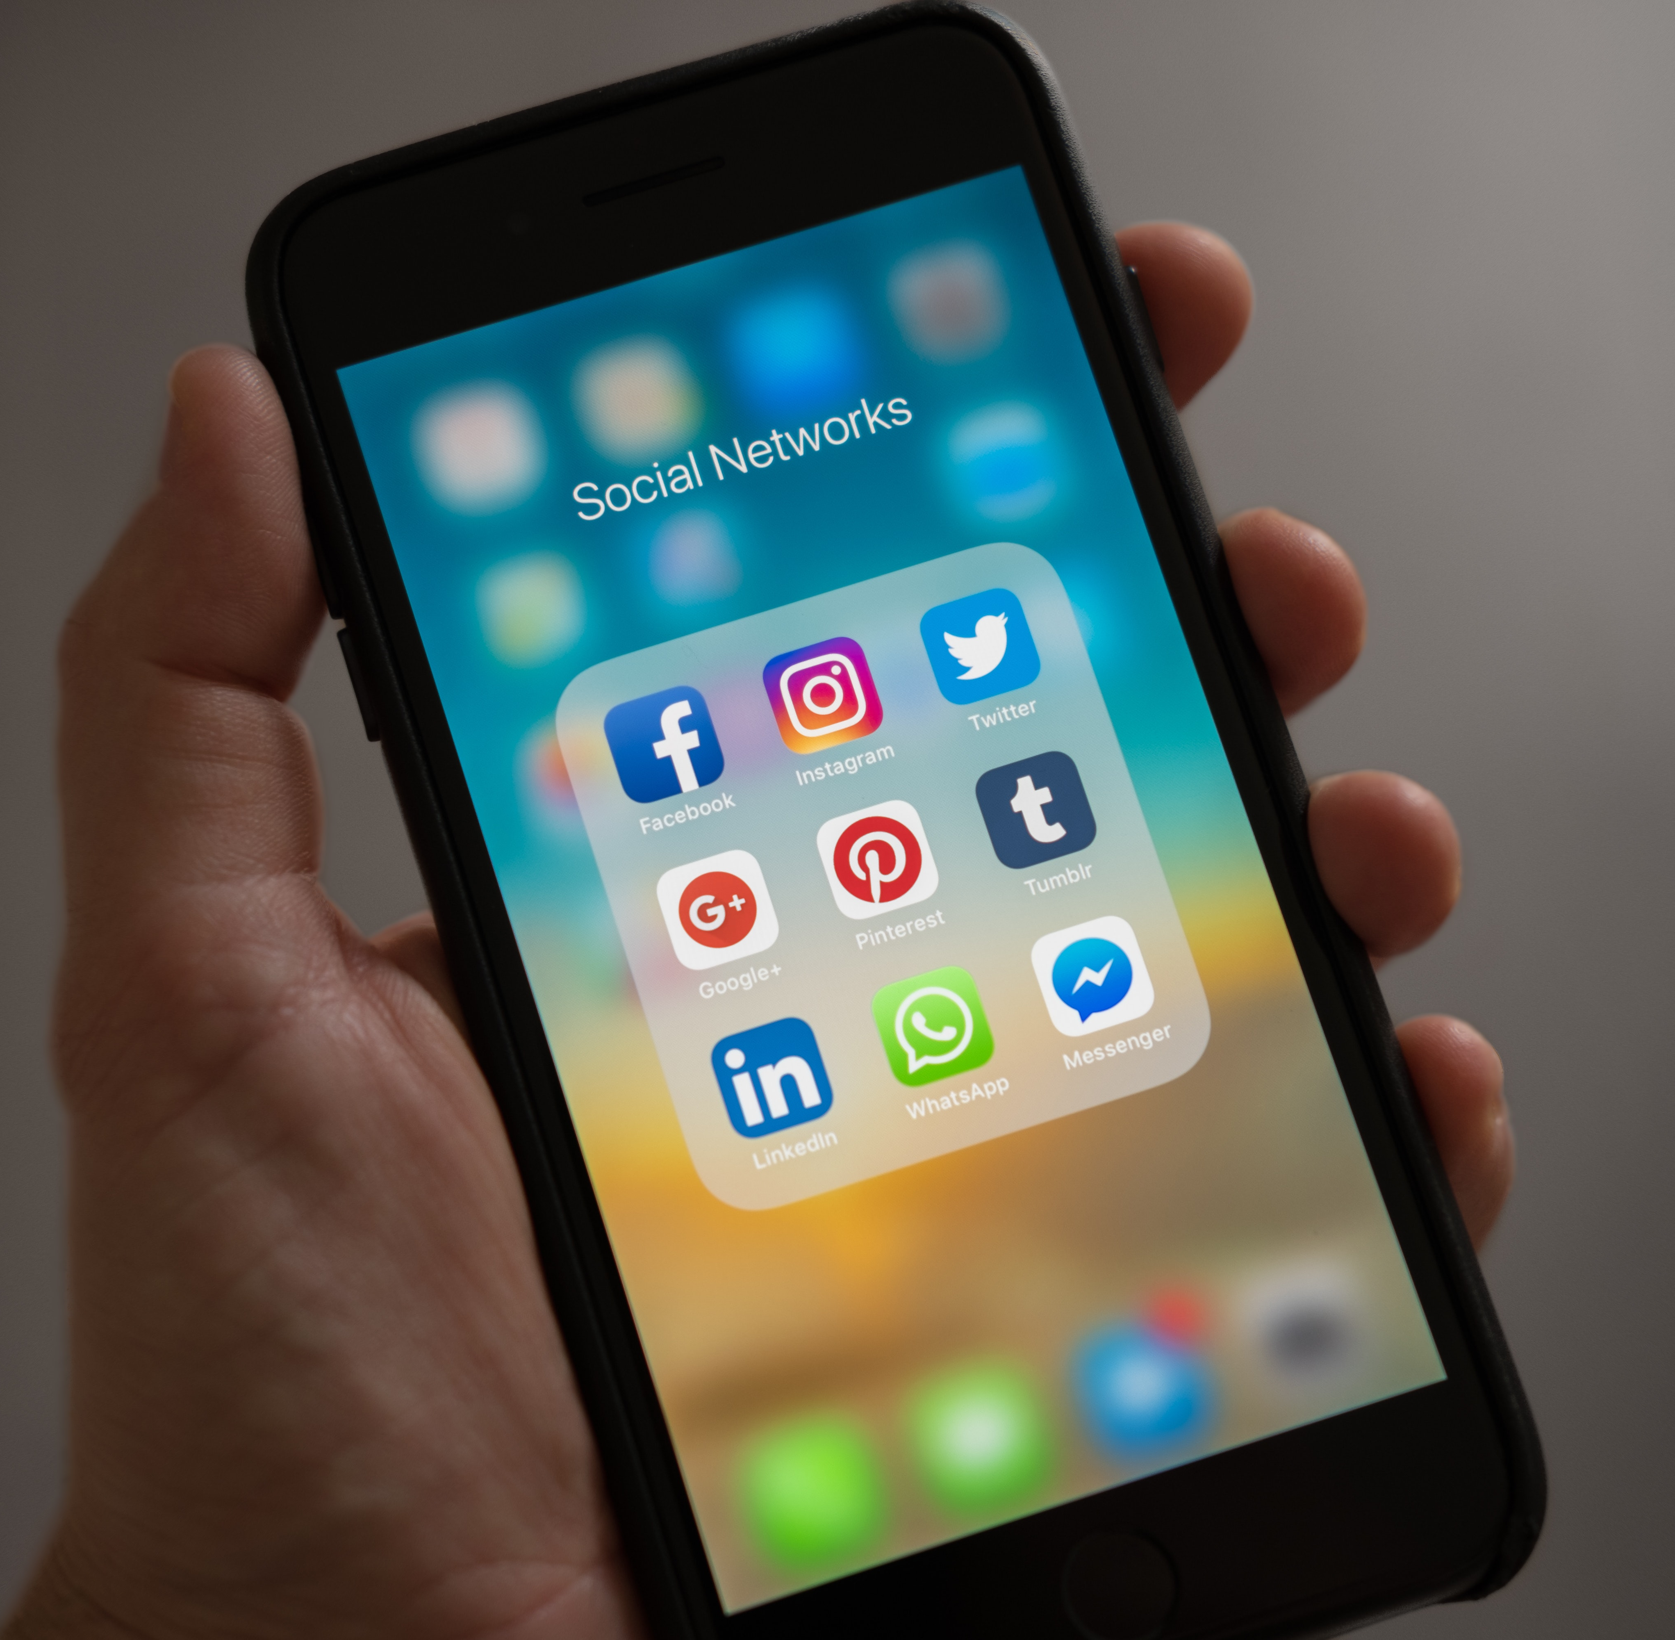
How to Keep Top of Mind During and After a Crisis
Crisis-relevant marketing collateral should be developed pre-crisis. Depending on the level and scale of a regional crisis marketing activities and promotional strategies need to change significantly. It is a good idea pre-crisis to have the necessary and relevant crisis management promotional marketing material, messages, and campaigns in place.
Revisit Website Content and Marketing Assets. If a region has slowed down completely a redesign or revamp is another good opportunity. Regions can take the opportunity to get the most out of their content, make it more relevant and effectively perform. During a crisis or downtime regions can clean up, update and edit their marketing libraries of photos, videos, blog posts, and other content so it’s easy to access. Review what worked and didn’t’ work. Remember that blog, video and infographic content are the highest-performing formats, according to Life Marketing.

Slide 17
The main reason why advertising during a downturn is so critical has to do with “mind-share.” Simply put, staying top of mind with consumers helps a region capitalize on the increase in demand as it rebounds, and advertising helps regions do that.
However, regions have to strike the right tone — otherwise, advertising will work against them. To help a region stay top of mind with consumers for when the demand for travel increases again, this section demonstrates using different types of crisis case studies how other regions and tourism destinations realigned their marketing campaign to a crisis campaign.

Slide 18
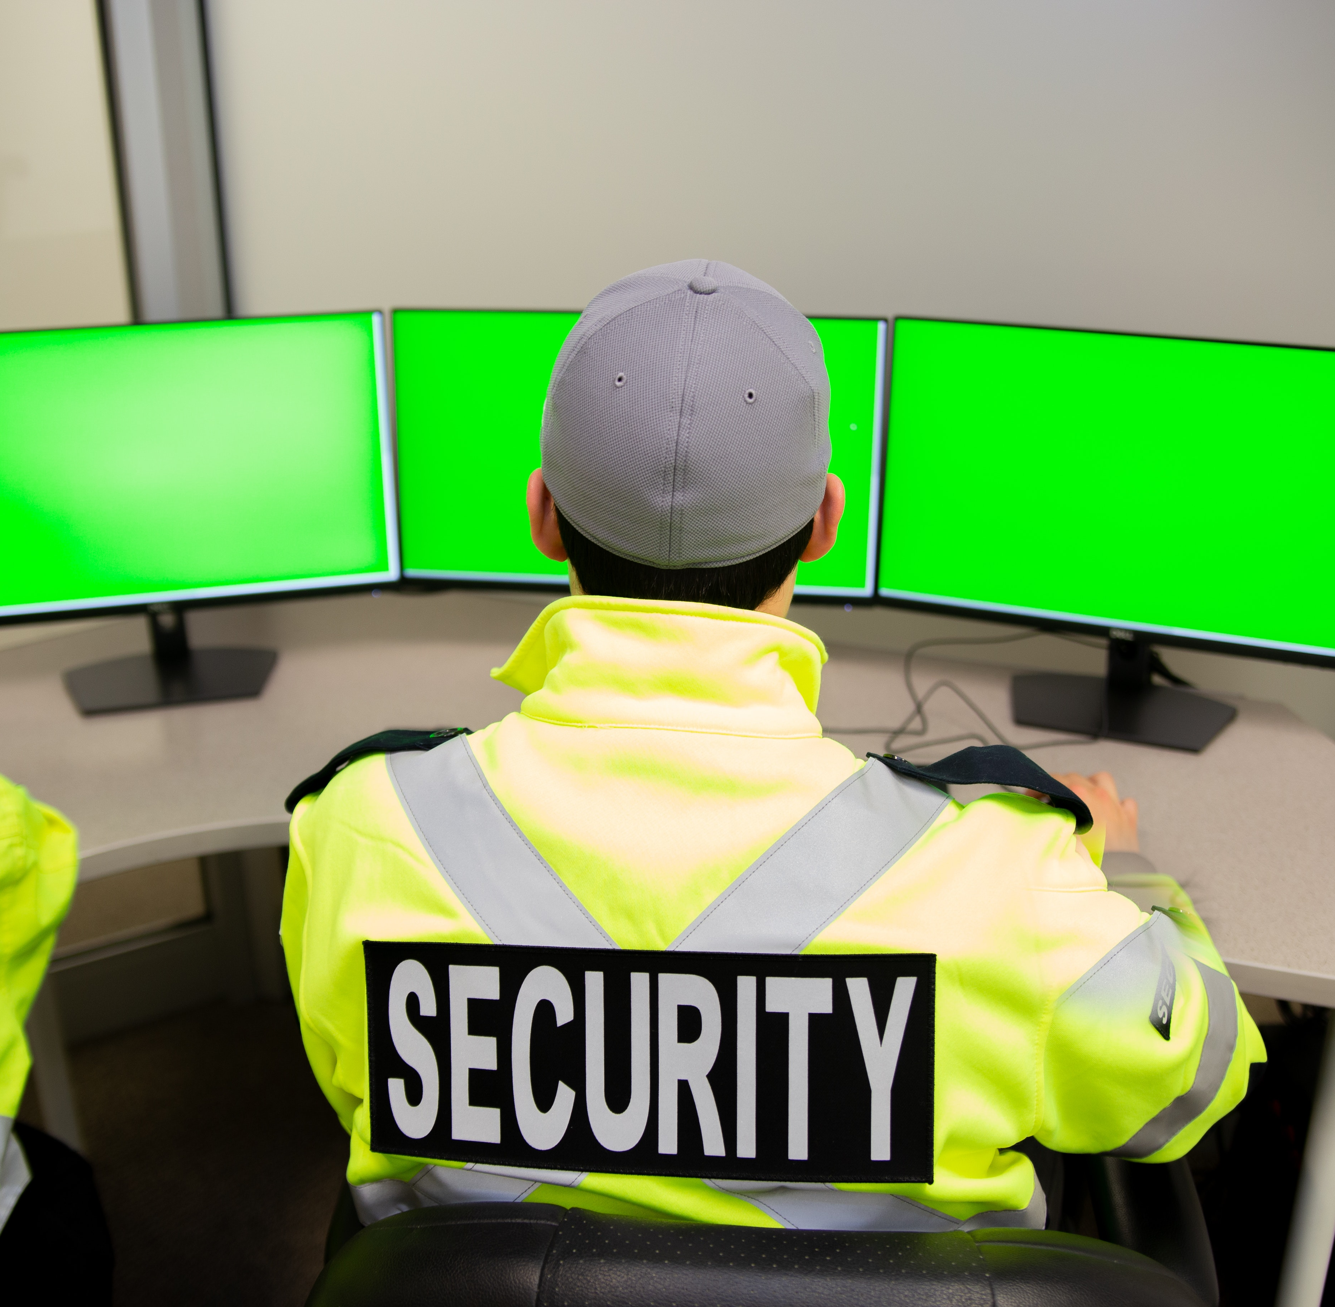
Effective Regional Crisis Tourism Marketing (Public Private Sector Alliances)
Case Study
Airline Carriers Can Help to Market the Destination out of a Crisis
In times of crisis, the effectiveness of regional working relationships is often put to the test. The typical reaction is that everyone engages in their own intensive marketing programs featuring temporary discounts or incentives as tactics in the recovery strategy. This article demonstrates public–private sector alliances between national tourism authorities and the airline industry band together to market the destination out of a crisis.
EgyptAir played a major role in Egypt’s market recovery following the Luxor massacre in 1997. In the United States, Delta Airlines was one of a number of US carriers that encouraged travellers to visit New York City after the September 11 attack, through its offer to supply thousands of free tickets to Americans traveling to New York.
Restoring Tourism Destinations in Crisis

Slide 19
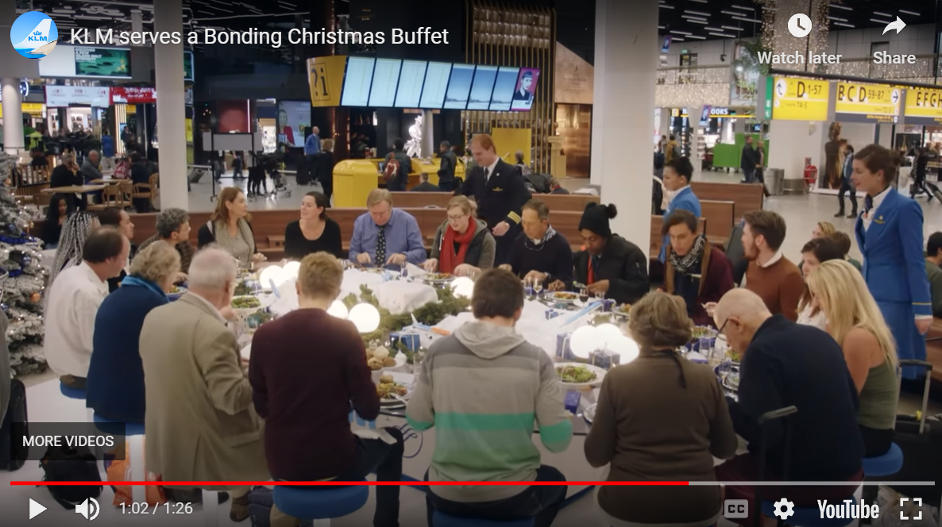
Case Study
The KLM Bonding Buffet
Cool Tourism Marketing Campaign Concept Get 20 strangers to share a Christmas dinner buffet together in an airport. The catch? The buffet descends from the ceiling (in its futuristic Star Trek way) in stages, each time a new person fills a seat. And once all 20 seats are filled, the table laden with food locks in place. KLM Airlines really knocked it out of the park on this one.
https://youtu.be/g5IAy-QnsZM
Source

Slide 20
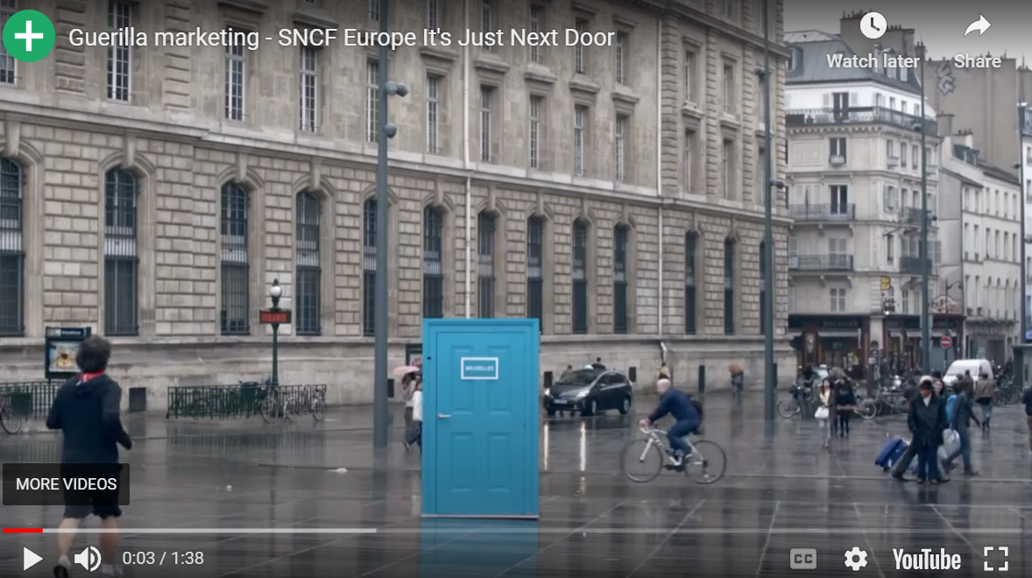
Case Study
Europe Its Just Next Door
France
Cool Tourism Marketing Campaign Concept: French national railway company SNCF wanted to encourage people to take a train journey to other European countries. So, they placed THE coolest freestanding, interactive doors in unexpected places all around Paris. People who opened the door experienced real-time interaction with engaging locals in other cities.
https://youtu.be/hYs4g09vm_8
Source

Slide 21
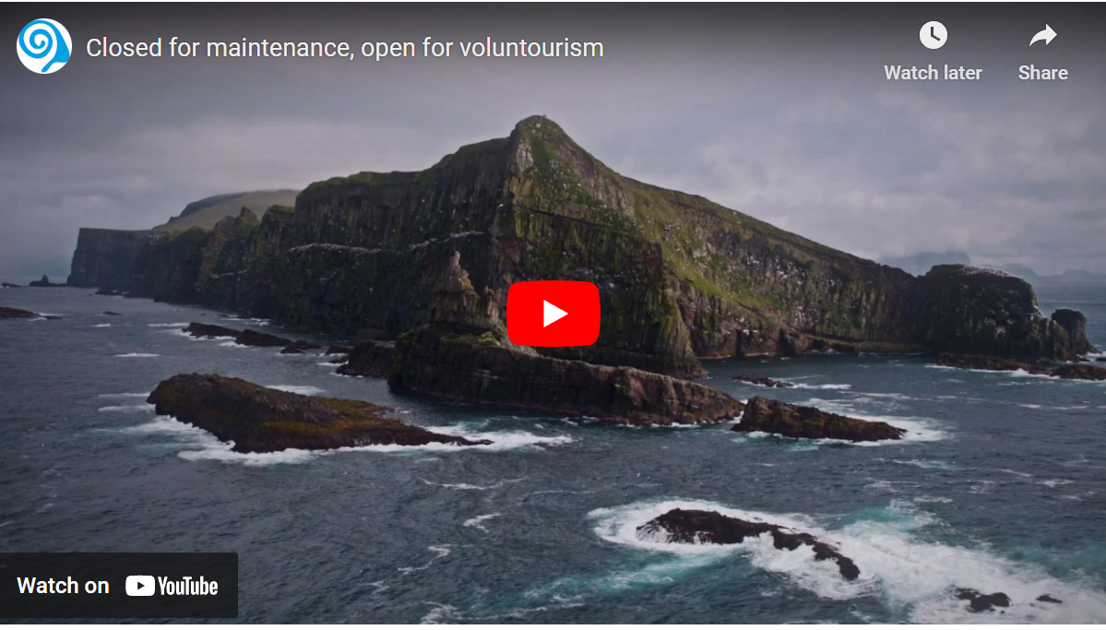
Case Study
Closed For Maintenance
The Faroe Islands
Cool Tourism Marketing Campaign Concept: This is an incredibly genius idea to both combat and draw attention to the over-tourism problem. While at the same time promoting tourism for an off-season weekend. Visit Faroe Islands “closed” to visitors the last weekend in April. Instead, that weekend it welcomed volunteers from abroad to help with the maintenance and clean-up of the islands’ many natural sites and attractions. In return, visitors get a free room and meals during their stay.
https://youtu.be/W4jBMrDpFXI
Source

Slide 22
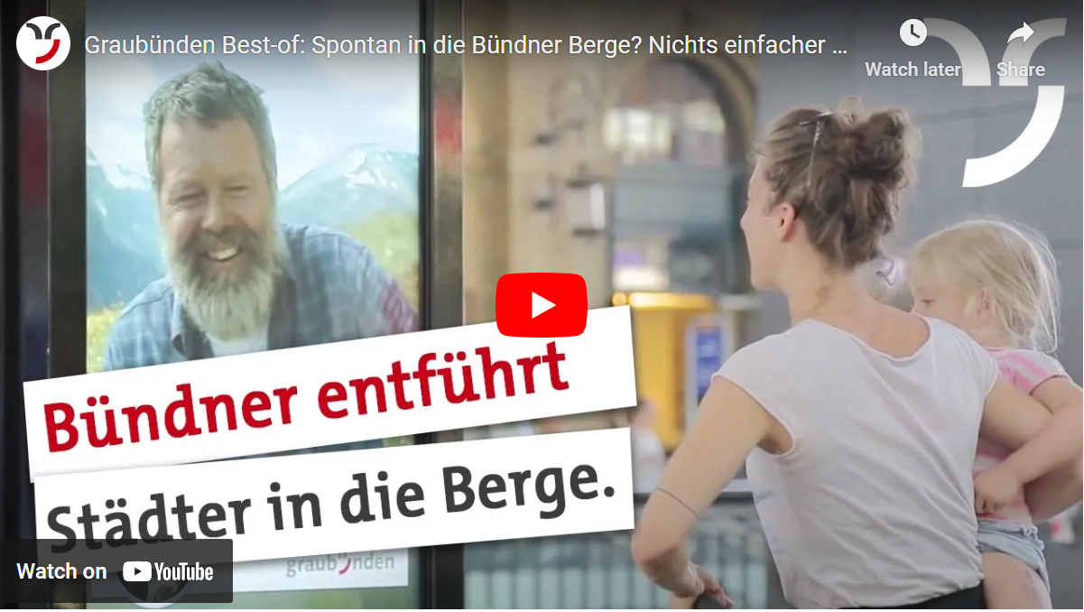
The Great Escape To Graubünden
Switzerland
Case Study
Cool Tourism Marketing Campaign Concept: Wow, the folks at Graubünden Tourism must really eat their marketing Wheaties, because here’s another winner from them. In this promotion, people at the Zurich train station could interact in real-time with a friendly, welcoming, grandfatherly-type gent in the village of Vrin. He even prints free tickets for spontaneous-minded folks to hop on a train and go visit him that day.
https://youtu.be/l8Y5MDVhZDQ
Source

Slide 23

Article: Digital, Digital, Digital. It’s Quick and Effective Especially During a Crisis.
The pandemic accelerated many of the digital transformations that were currently underway. In addition to virtual meetings, conferences, and more, we have evolved many of our communications tools, such as taking Club traveller previously printed is now completely digital. Digital is highly effective and kinder to the environment, can be monitored, and page views and clicks can be monitored and measured for content performance. Digital can be updated and distributed quickly especially when information is urgent. It can fit into the traveller’s pockets on their phones and allows tourism companies to distribute their information in real-time, they can connect and share news, schedule updates, and more. This effectiveness and efficiency are so important during crisis events.
Read Research Article

Slide 24
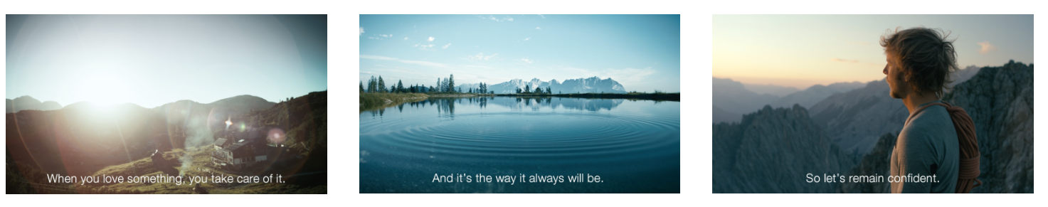
Case Study
The Winter Campaign
Austria
Austria’s goal was to urge people to be responsible, stay at home and follow government guidelines through the message that “when you love something, you keep it safe” and a reminder that all the beautiful scenery and thrilling activities will be waiting by using a variety of videos. It also ran a giveaway allowing people to ‘Gift a Friend a Holiday in Austria’ by telling the tourism board why they deserved a break. The winner was a midwife from the UK who received a flexible offer of a week-long stay in Tirol’s SkiWelt resort, with an extra ‘twist’ being that the friend who nominated her also won a holiday “for being so kind to her friend”. The campaign was all built around the kindness and empathy themes
Source
https://youtu.be/l8Y5MDVhZDQ

Slide 25
Article: Destinations that Create Websites that Enable Tourists to View Real-Time Safety Information Can Bolster Confidence
Tourists seem particularly interested in seeking advice through online travel experience-sharing platforms (Marine-Roig & Huertas, 2020). As such, DMOs should consider partnering with these platforms and designing campaigns to encourage tourists to share their positive destination experiences. In addition, DMOs should consider helping destinations create websites that enable tourists to view real-time safety information and related guidance. This information could bolster potential tourists’ confidence (even before their departure) that they will encounter a safe environment (Brown, 2015).
Read Research Article

Slide 26
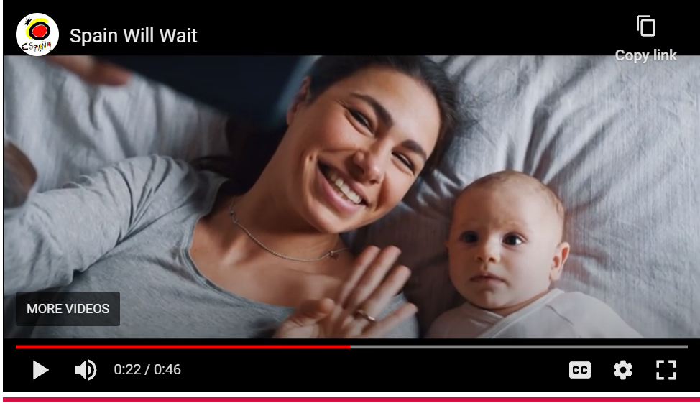
Case Study
Spain Will Wait
The work is entitled ‘#SpainWillWait’ (España te espera). The objective of the initiative is to consolidate tourists’ loyalty to the destination by reminding them of all that Spain has to offer and all that can be enjoyed once the Covid-19 crisis has passed.
The video looked to convey an evocative idea of Spain, transporting holidaymakers from their homes and strengthening lasting emotional ties with the destination.
https://youtu.be/GHHrJh7swUY

Slide 27
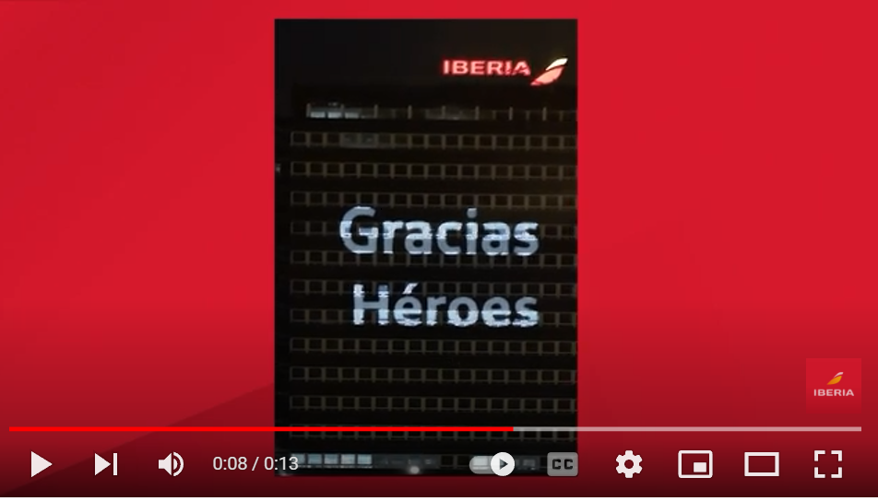
Emphasis Ethics and Community Spirit
Case Study
Iberia Thanks the Medical Teams for their hard work during COVID
Businesses and regions that demonstrate their humanity are remembered. Corporate Social Responsibility has never been more important for your brand image, especially with the global focus on climate change and how people were impacted during the crisis. From helping at food banks to offering beds to healthcare workers and providing assistance to staff, these are values-driven actions that show a “people-first” attitude. Iberia Airlines, for instance, has dedicated a massive thanks through a video mapping at its HQ to all the effort of the health workers and people who are helping to overcome the situation with their work and by staying at home. Besides being positive, they’re also opportunities to show empathy via social media updates. A Deloitte study found that Millennials and Gen Z in particular want to do business with organizations that reflect their values.
https://youtu.be/znkHS8q4L5c
Source

Slide 28
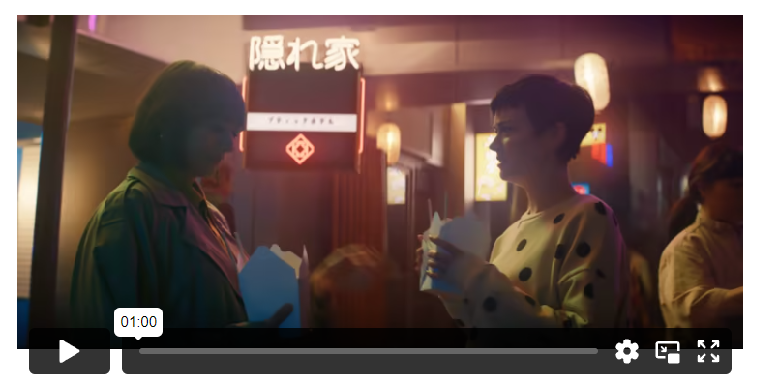
Case Study
Expedia All By Myself
Expedia’s “All By Myself” ad shows a traveller having a series of bad flight and hotel experiences on their trip. Then a representative from Expedia (Rashida Jones) swoops in and saves the day by helping them find a better hotel and have a great time. The takeaway is (as Expedia puts it), “It matters whom you travel with.” Expedia’s campaign is effective because it addresses a change in consumer values.
As Shiv Singh, Expedia’s General Manager, explained, “People think about value differently.” So rather than focusing solely on “getting away for a great price,” travel companies should also ensure their advertising includes messaging about the support they provide their customers.
https://www.shootonline.com/video/expedia-remedies-all-myself%C2%A0traveler-woes-spot-directed-anthony-mandler

Slide 29
Article: Trust is an Effective Approach to Minimising The Perception of Uncertainty and Risk
Trust is an effective approach to minimizing the perception of uncertainty and risk (Han & Hyun, 2013; Pavlou et al., 2007). Therefore, tourists believe a trustworthy destination can provide transparency, reliability, less risk, and less-hassle free services and experiences (Roodurmun & Juwaheer, 2010).
Customer trust or brand trust has been intensively discussed in the customer behaviour and marketing area and is essential in building strong customer relationships and sustainable market share (Urban et al., 2000).
Sirdeshmukh et al. (2002) developed a framework and proposed that customer trust significantly influences perceived value and then impacts customer loyalty. Trust develops customers’ emotional attachment toward a brand (Esch et al., 2006) and thus it has a positive effect on perceived corporate social responsibility and purchase intention (Nguyen & Pham, 2018).
Read Research Article

Slide 30
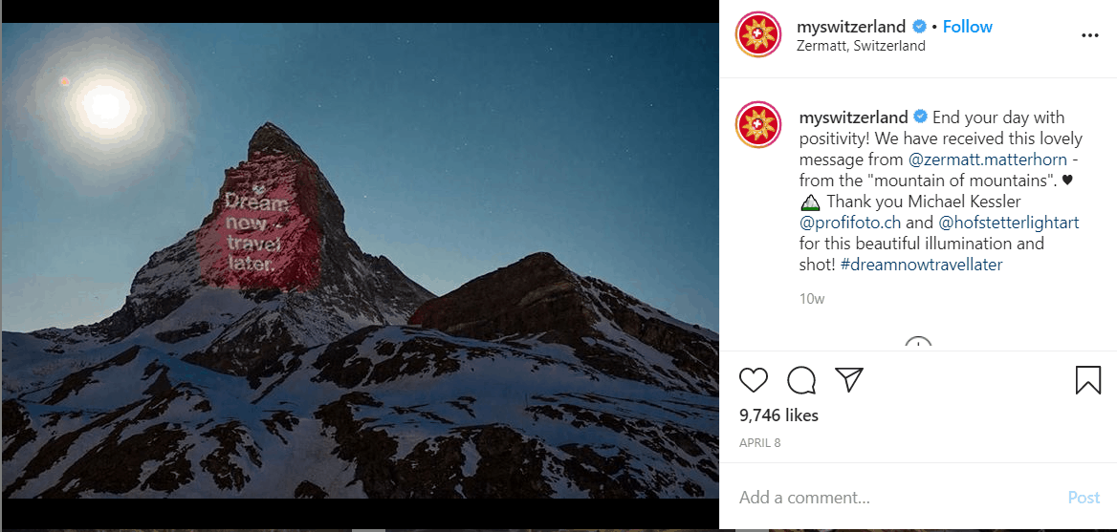
Case Study
Dream Now Travel Later
Switzerland
#inLOVEwithSWITZERLAND
Instagram: https://www.instagram.com/myswitzerland/
Tag: #neverstopdreaming
This outstanding campaign by My Switzerland quickly became viral with its heart warming message: Dream now, travel later. To further strengthen this message, My Switzerland released a short video inspiring people to dream and plan. The same was later projected on Matterhorn mountain, symbolizing that light is hope. They undertook the approach to celebrate local culture as one of their greatest assets. Their social media feeds aimed to bring Switzerland to people’s homes through beautiful pictures, emotional videos, and entertaining stories.
https://youtu.be/rn38MSf-eKM

Slide 31
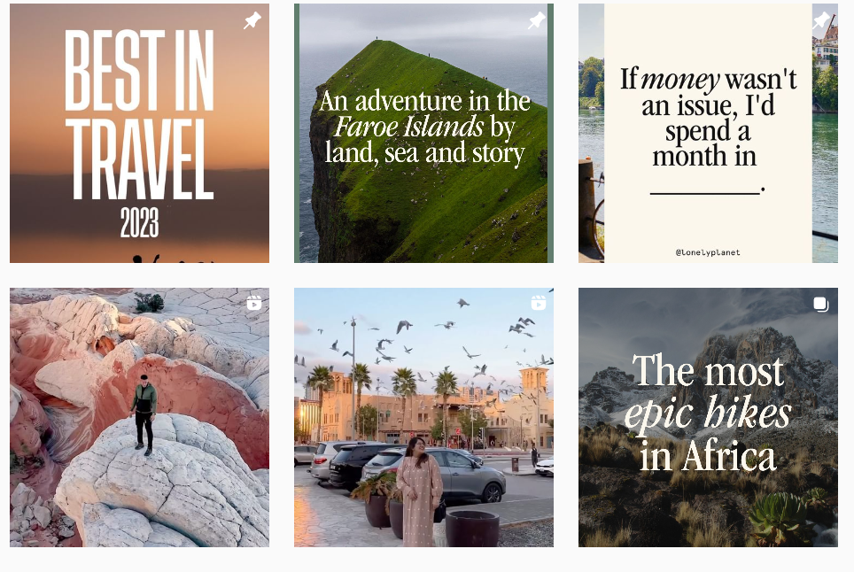
Case Study
Keep Dreaming
Lonely Planet
Lonely Planet: For 45 years we’ve been helping travelers to explore every day. Tag: #lonelyplanet
Instagram: https://www.instagram.com/lonelyplanet/
Remaining true to their vision of the piece, Lonely Planet is committed to helping people feel better during isolation. They continuously engaged their extensive audience with beautiful landscapes from around the world.
While suggesting nature is the best remedy for the soul, they invited people to embrace its beauty and richness. The Lonely Planet even supported the practice of hugging a tree for 5 minutes, popular in Iceland. Their Instagram account promoted it as a great way to feel better and less lonely during the months of lockdown.
https://www.instagram.com/lonelyplanet/

Slide 32
Articles: Social Media Spreads Safety Information Faster and to a Larger Audience
When tourists search for news articles about destination safety before a trip, reports’ eye-catching titles may magnify danger, sparking concerns about security (Mawby, 2000). The advent of social media has caused safety-related information to spread faster and to a larger audience than ever before.
When tourists' destination experiences are positive and surpass their expectations, individuals become passionate promoters of the destination and may even offer others safety tips.
Read Research Article

Slide 33
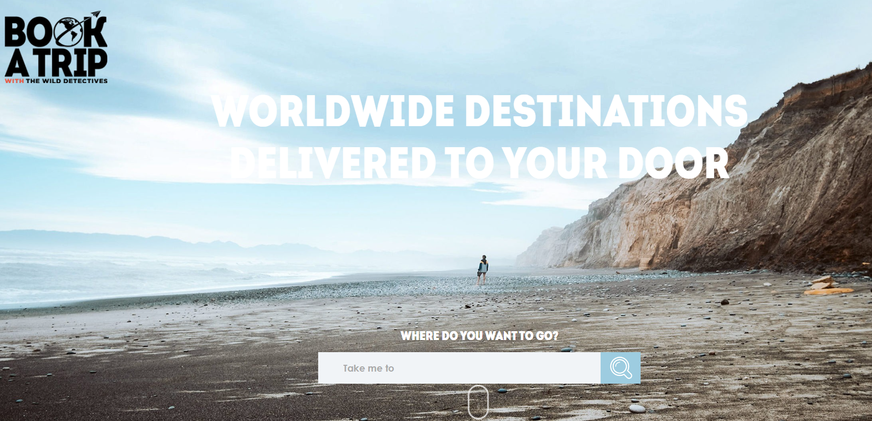
Case Study
Book a Trip to Your Door
Books Inspiring People to Travel
This truly outstanding idea by a Dallas book shop called The Wild Detectives became a travel agent by launching Book a trip – an online platform offering “holidays” to a range of destinations worldwide. Book a trip is a remarkable campaign aiming to help the shop keep going during the pandemic. The holidays they offer are actually books that could transport people to different countries and worlds. And the mission – to inspire people to keep reading and exploring the world through the magic of books.
https://www.gobookatrip.com/

Slide 34
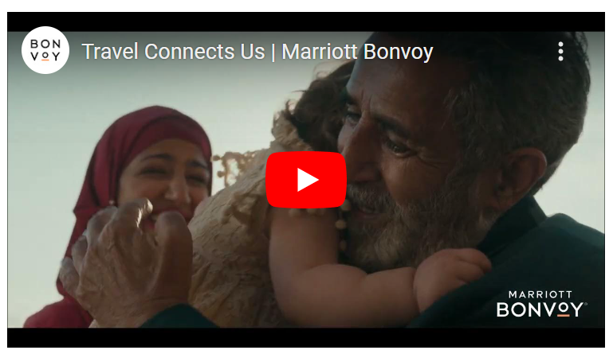
Case Study
The Power of Travel
Marriot Hotels
In the first quarter of 2021, Marriott released a series of ads to highlight what travel means to people. For example, this ad shows families and friends reuniting in their hotels after long periods of time away from each other (presumably due to COVID-19). The idea was “Travel Makes Us Whole.” Other ads in the campaign highlight similar themes, such as how Travel Makes Us Daring and how Travel Makes Us Open. Mark Beal, an assistant professor at Rutgers University—New Brunswick, explains, “they want to see actions and messages from companies that communicate a higher purpose at this time and deliver a service or product that will benefit individuals, communities and the greater society.” Marriott’s campaign does this by addressing motivations for travel many consumers are likely feeling right now to inspire them and connect with them.
https://youtu.be/GwqZqoRuRTI

Slide 35
Article: Communication Has Evolved Since Covid
‘Studies continue to show that many tourists want to travel, but it's important to help them feel safe while they're traveling. It's our job as communicators to be transparent while building trust with our owners and customers. We continually educate our owners and customers on our Enhanced Care Guidelines that have been implemented to help keep them safe. I recommend sharing your company's guidelines widely across all channels, including press releases, targeted owner communications, team member communications, dedicated web pages and social media platforms. Communicating this new standard of cleanliness will give your owners and guests the confidence they need to travel safely, thus reducing cancellations and rescheduled vacations’.
Read Research Article

Slide 36

Leverage Influencers
Research from Discover shows that consumers are currently more concerned about their health and safety while traveling than the price they pay. Reassuring travelers that precautions and safety measures are in place to protect them should be a top priority for any travel or tourism related brand.
The next slide shows a video that is powerful because the reassurance comes from a third party rather than Disney itself. Some studies show that up to 93% of consumers ignore ads but 82% of consumers are highly likely to follow the recommendation of a micro influencer.
When tourists' destination experiences are positive and surpass their expectations, individuals become passionate promoters of the destination and may even offer others safety tips.
Research Article

Slide 37
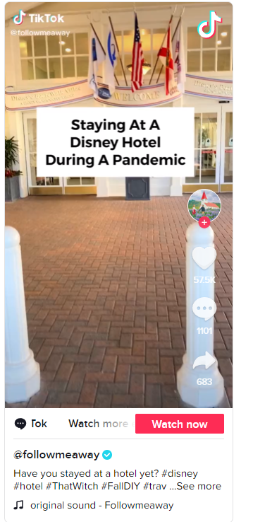
Case Study
Staying at a Disney Hotel During COVID 19
Tik Tok Influencer
In this video, a TikTok influencer showed their 1.2M followers what it was like to stay at a Disney hotel during COVID-19. While walking through the hotel, the influencer explained and showed all of the rules and precautions Disney took to keep visitors safe when the risk of infection was high. For travel brands, there are two lessons to take away from @followmeaway’s video. First, craft messaging that shows travellers the steps a business crafted to keep them safe. Second, leverage peer-to-peer marketing tactics like micro-influencer and referral marketing to help connect with consumers and earn their trust.
https://youtu.be/GwqZqoRuRTI

Slide 38
Article: Crisis Management Means Dealing with Human Perceptions Through Communication
Marketing and advertising are also noted as an important part of crisis communication, especially during the long-term recovery stage of a crisis or disaster. As Heath (1998:26) notes “crisis management is as much about dealing with human perceptions about the crisis as it is about physically resolving the crisis situation.” This suggests that crisis
communication is an essential part of managing crises and disasters and will be an important consideration for the tourism industry.
For the Foot and Mouth, The BTA representative interviewed noted that there was no united approach and that different messages and statements were provided by different tourism and hospitality organisations. This inconsistency of messages sent out by tourism organisations and other government agencies involved in handling the disease impacted the dissemination of facts and figures concerning the disease, but more importantly confused potential tourists and the tourism industry. Coombs (1999) suggests that consistency is important to avoid speculation and confusion. (BTA British Tourism Association)
Read Research Article

Slide 39
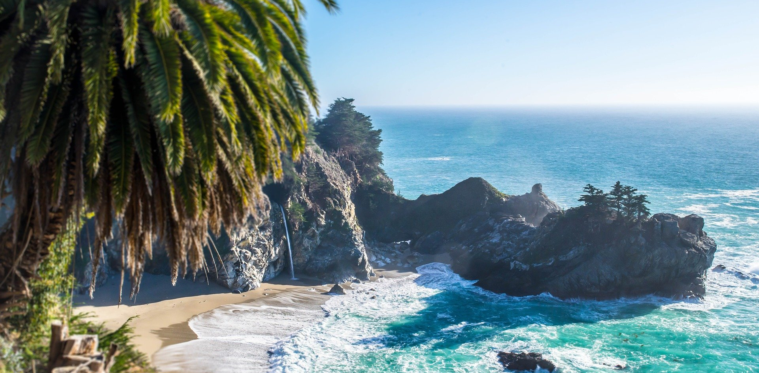
3. Regional Recovery and Restoration Marketing
Discovering and Adapting to the Needs of ‘New’ and ‘Existing’ Tourism Markets

Slide 40
A Crisis Doesn’t Deter People From Travelling
Now that the worst of COVID is over we can see that COVID-19 didn’t kill the desire to travel. In fact, online search trends indicate people are starting to think about it again after a few weeks of low search volume. A recent Travel Age West article mentioned an uptick in Google Trends that shows search volume for terms like “luxury travel” and “family vacation” are up 25% and 11% respectively.
Travel marketing and advertising company Sojern says their analysis indicates increased travel within Europe by Q4, especially to Italy and Spain. Sojern says travel signals for International travel in Q1 of 2021 also look promising though that could be because the airlines have opened up early bookings.

Slide 41
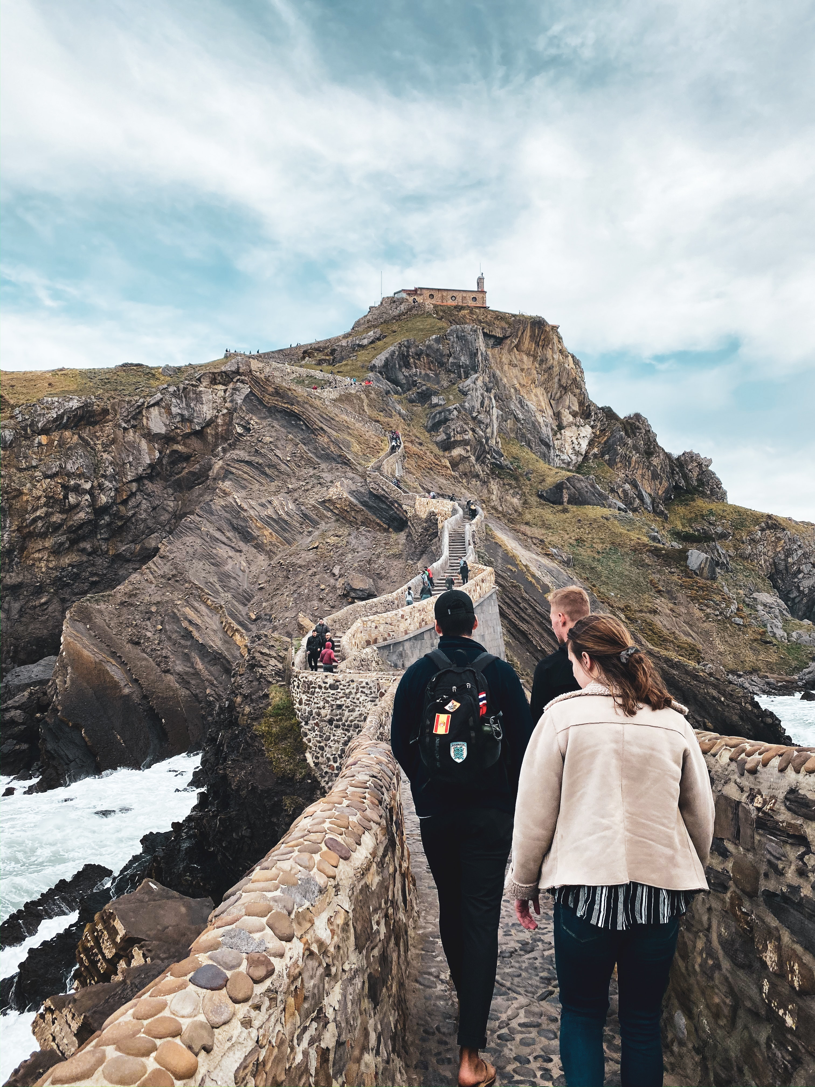
Recovery Marketing
It is essential that the region delivers marketing messages as quickly and effectively as possible when a region or area re-opens for business (the recovery phase) in order to regain consumer confidence and counter any negative or inaccurate perceptions of the region. To aid the efficient rollout of this process, including some potential marketing strategies in the Marketing Plan which relate to your key crisis risks.
Source

Slide 42
Research: Marketing is Important During Each Crisis Phase. Context of the Restoration Phase
An integral part of effective marketing management of crises and their restoration phases is for tourist authorities to establish and maintain effective alliances with those private and government organisations sharing common vested interests. Airlines, hoteliers, resorts, museums, attractions and wholesale tour operators all depend on the successful selling and marketing of destinations which form all or part of their programs.
Read Research Article

Slide 43
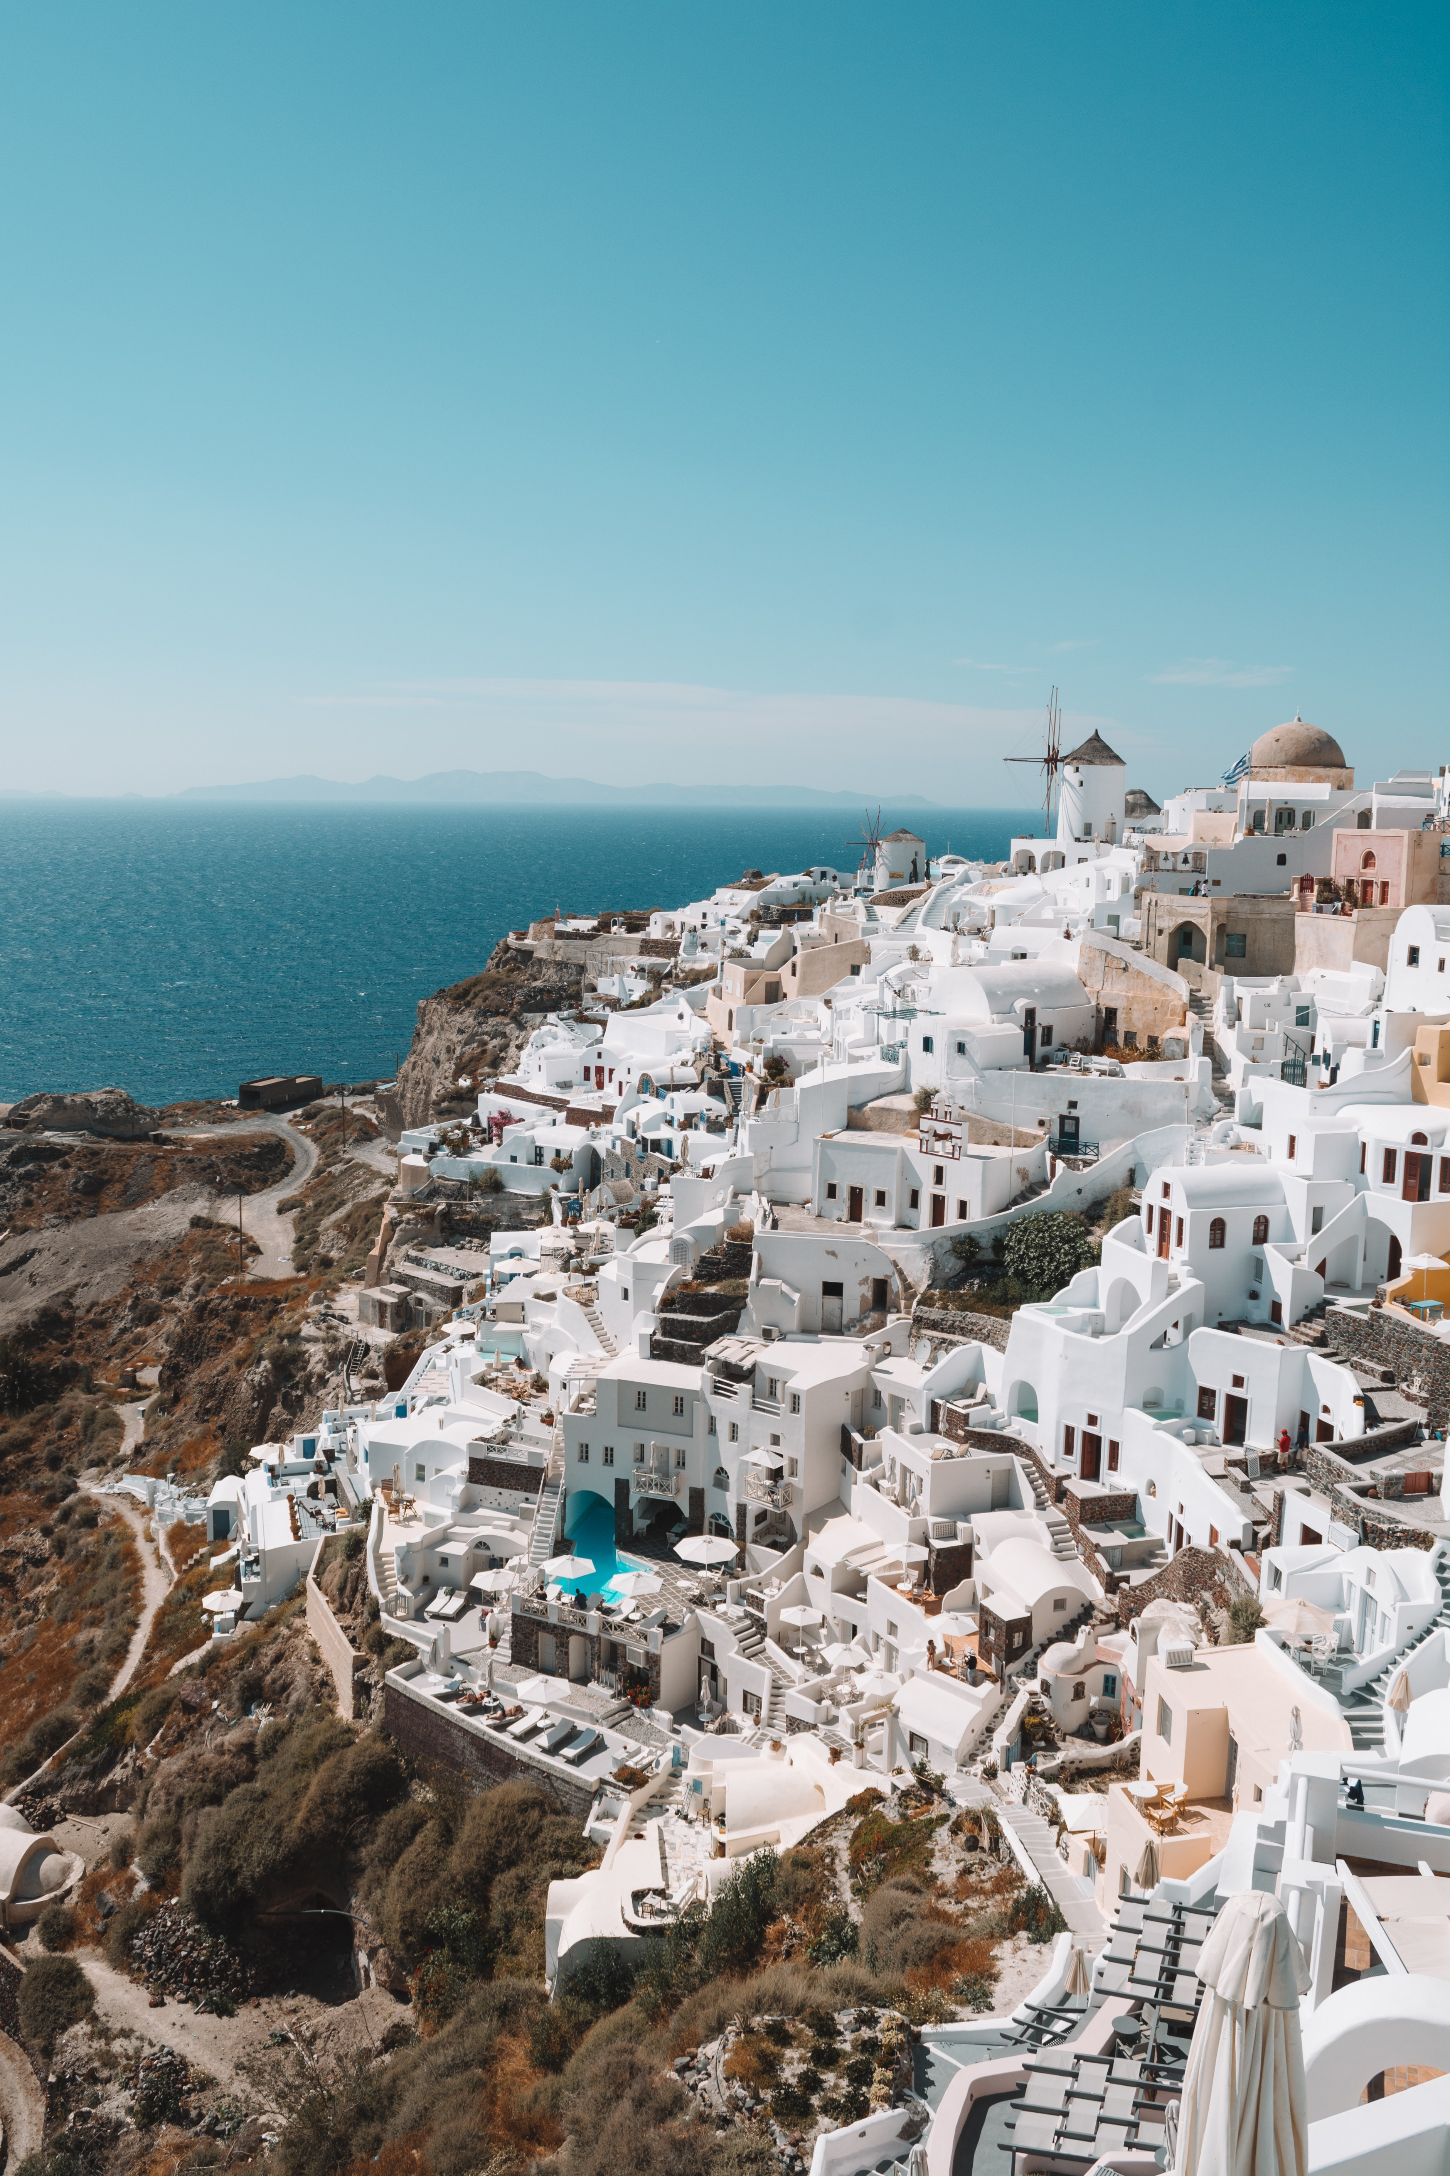
Re-Opening Marketing
The recovery phase should be accompanied by a marketing campaign to bring visitors back to the region. It’s important to note that the TCMT will often be under pressure to promote a region and encourage visitation before it’s really ready. However, be sure the visitor experience is satisfactory before re-opening. A region is considered to be open for business and in the ‘recovery’ phase when:
A range of visitor services and products are operating again
Vital infrastructure is restored, including access routes and transport services if they are critical for visitation
It is safe and enjoyable to visit.
Not all businesses must be operating for a region to be considered open for trade but it’s important that there’s a choice of facilities and services such as accommodation, dining, attractions, etc.
Source

Slide 44
Research: Understanding Tourist Decision Making Post Pandemic
The uncertainty about the future of the tourism industry forces us to rethink the different tourism management scenarios and analyze the impact of the pandemic on the emotional behavior of tourism demand. Hence, COVID-19 becomes a transformative opportunity [5] for researchers to explore, measure and predict the impacts of COVID-19 on tourism for monitoring and improving response strategies [6], especially in destinations where they have had a history of high COVID-19 incidences.
On the other hand, academic literature on consumer behavior suggests that pre-purchase expectations determine product/service selection. In a post-pandemic context, it is necessary to deepen the analysis of the attitudes, behaviors, and expectations of tourists before deciding to travel to predict future tourist demand and to be able to develop adequate recovery strategies. Therefore, understanding the new characteristics of tourists allows us to guide decision-making and choices of destination behavior.
The research questions posed by this study for the post-pandemic era are:
RQ1: What are the preferences of tourists?
RQ2: What are the attitudes of tourists on their trips?
RQ3: What are the expectations of tourists?
Read Research Article

Slide 45
Research: Destinations Need to Consider How Tourist Perceptions Have Changed Post Crisis
For a tourist destination to fulfill its mission of attracting tourists, it is vital to recognize the needs of its potential visitors and discover the key elements that lead tourists to choose between one destination and another. Therefore, understanding tourists’ preferences and travel behavior is essential to develop infrastructure, products and services that satisfy their preferences [39]. In the context of risk, tourists make destination choices based on their individual perceptions of destination attributes, including risk-associated elements [40]. Likewise, income level is also a determining factor when selecting a destination, for example, in relation to the motives underlying the selection of destinations, low-income people were highly influenced by factors of “accessibility and discounts” despite the global health emergency [41]. For academics González-Reverté et al. [42], tourists with a previous environmental attitude are less interested in visiting mass tourism beach destinations in the future. For this reason, it is necessary to establish what preferences about tourist destinations exist in demand after the health crisis.
Read Research Article

Slide 46




Tourist’s expectations for a destination in the post-COVID-19 recovery stage.
Smart care
Pricing strategy
Tourists’ expectations
Safety
Read Research Article
Comfort
Social distancing
Read Research Article

Slide 47
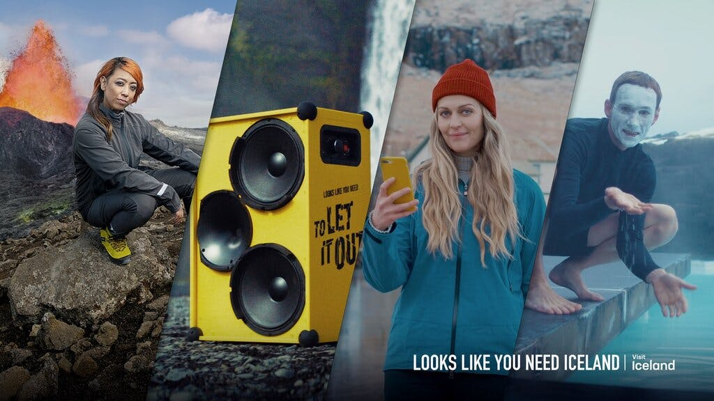
Iceland - Looks Like You Need Iceland Campaign
Case Study
Iceland Strengthening the Perception Of Iceland, Its Culture, And Its People
Inspired by Iceland is a series of marketing initiatives to promote Icelandic tourism. The Icelandic government created the initiative in 2020 as part of the economic measures to alleviate the impacts of COVID-19 through 2022.
The Inspired by Iceland initiative follows the vision and guiding principles of Icelandic tourism until 2030, entitled "A leader in sustainable development," and is part of a long-term strategy for collaboration between government and industry for Icelandic exports.
The initiative seeks to strengthen Iceland's image and promote Iceland as an exceptional destination while assisting companies in increasing sales. Business Iceland will collaborate with its partners on marketing strategies and analyses and facilitate information sharing.
1160 Media mentions 2021
83 million Video views
18 International awards
Article

Slide 48
Report: Mass Destinations Are "Killed" By Fear, Which Opens A Chance For Small Destinations
"One of our activities is to create opportunities for entrepreneurs to adapt the existing and create a new tourist offer that will be in line with the new wishes of travelers. And that is why we need to look at Europe 'with different eyes'. No longer as a mega-destination, but as a space of many micro-destinations, focused on local communities that need cultural, social, environmental and economic sustainability",
Vlasta Klarić, thematic expert for tourism EUSAIR Facility Point project Adriatic-Ionian strategies pointed out.
Read Research Article

Slide 49
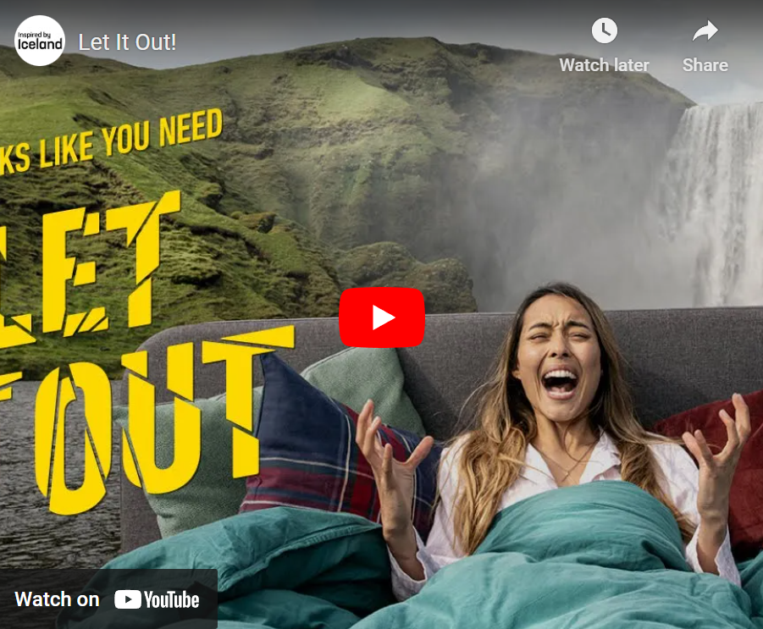
Iceland - Scream campaign - The Best Of The Best
Case Study
Iceland Attracting Prospective Tourists Back Post Covid Lock Down
The marketing campaign Looks Like You Need to Let It Out, created for the destination Iceland and known to many as the Scream campaign, was awarded the best in the tourism category at the Global Effie Best of the Best awards.
The campaign started on 15 July 2020 and invited prospective tourists to Iceland to connect with the country and release COVID-related stress by screaming at home and streaming the scream through the Internet to speakers in Icelandic nature. The campaign attracted a lot of attention from foreign media, with over 800 articles about the campaign published in foreign media, reaching around 2.6 billion consumers in the main markets of Icelandic tourism. Approximately 2.5 million people visited the project’s website, and almost 200,000 screams were streamed.
https://youtu.be/7iWeMPEEuk0
Article

Slide 50
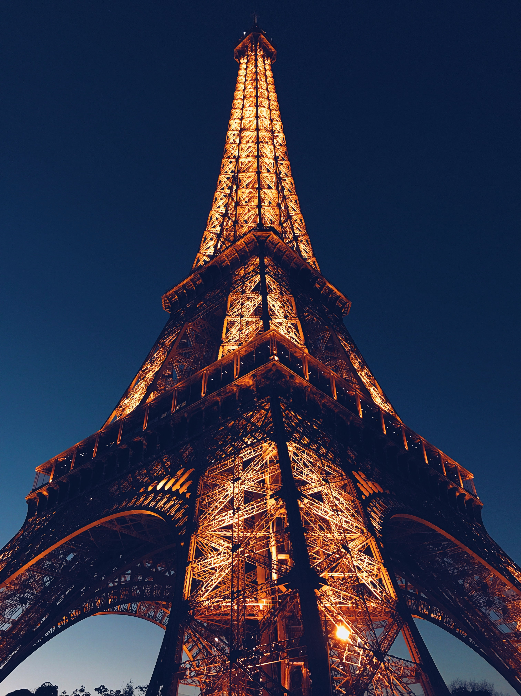
Low Cost Recovery Marketing Activities
Media
Provide regular media updates
Promote newsworthy stories
Distribute fact sheets
Highlight recovery milestones
Shine a light on newsworthy recovery strategies e.g., expanding green spaces and practices
Invite high-profile visitors or influencers to come
Highlight the impact of crisis on local businesses and how they have adapted for the new tourist
Advertising/Marketing
Targeted advertising in tourism publications blogs and online
Social media including videos, campaigns
Direct communication to inbound travel operators
Free call Information Line
Existing outlets promoting (e.g., VICs (Visitor Information Centers) and radio, podcasts)

Slide 51

Low Cost Recovery Marketing Activities
Identify which products and experiences are likely to be most affected, and identify potential replacements (product types) for promotion
Identify target markets most likely to return after a crisis, and who suit the products that would be available
Identify marketing activities that will stimulate visitation by target markets
Identify how the tourism region will be involved in the redevelopment of affected visitor experiences. (Source)

Slide 52
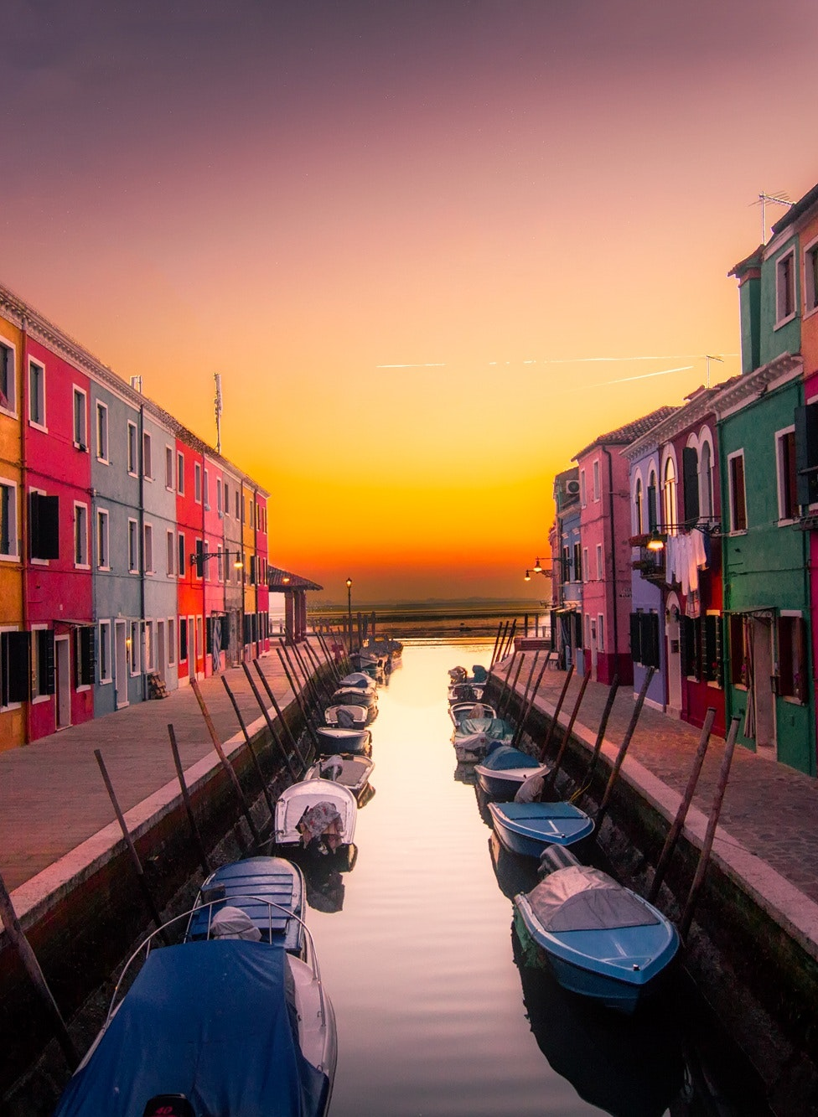
Low Cost Recovery Marketing Activities
Adjusting business models and innovating products have become critical for survival and recovery.
Craft new, unique, customized products to cater to the changing demands of ‘new tourists’ e.g., tour operators could develop 25 new itineraries/products that suit new tourism preferences (e.g., green experiences, private tours, slow adventure, adventure and activities in remote landscapes). Create a star attraction or hero experience e.g., a helicopter ride or cruise.
Invest in staff and human capital e.g., tour guides have become more popular. Update your staff and sales staff in storytelling tactics, and help them become experts in the history and culture of their home.

Slide 53
Research: Destinations Need to Consider Complex Tourist Preferences to Position and Build Brand
Tourist preferences are related to multiple travel attributes in terms of transport-accommodation consumption [32], price sensitivity [33], hotel and shopping choices [34], length of stay [35], and seasonality [36]. Vacation activity choices and preferences are an important aspect of tourist behavior. They influence tourists’ experiences, their levels of satisfaction, and their happiness with particular destinations [37]. People’s choices and preferences are shifting toward newer experiential and participatory activities that provide an escape from daily routines [38]. Therefore, activities at the destination are a crucial consideration in positioning and building destination brands [38].
Read Research Article

Slide 54
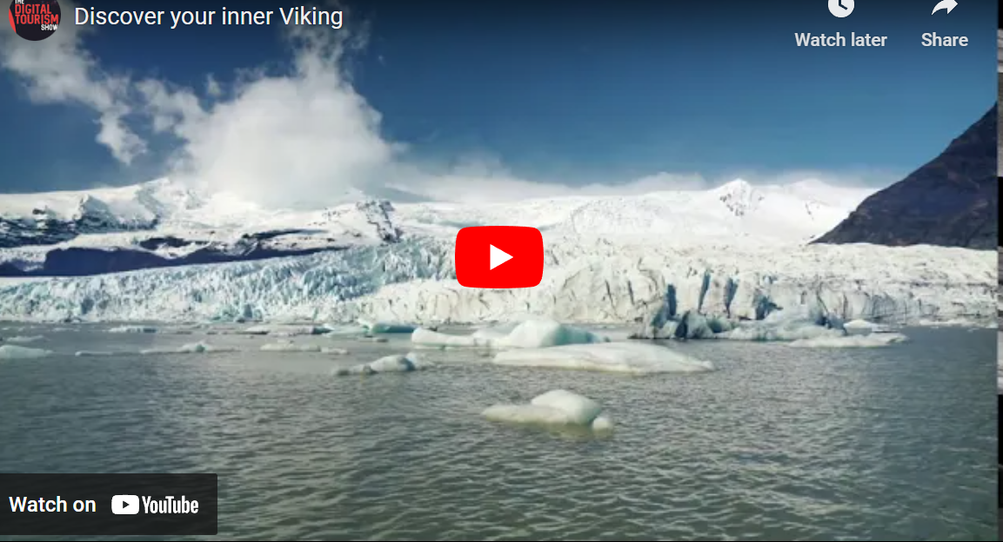
Iceland – Discovery Your Inner Viking
Case Study
Low Budget 4 Month Campaign Crafted Around Unique Culture Heritage Experiences
Cool Travel Iceland is a tour company based in Reykjavik that specialises in day tours and private tours all around Iceland. They have a diverse and dynamic range of tours and activities to choose from and they needed our help with their SEO as they were struggling to rank for any important keywords on Google.
We developed a four-month campaign based around private and self-drive tours around Iceland, creating a series of ads and videos to attract their target audience within the United States and the United Kingdom — the first destinations likely to be able to travel to Iceland once covid travel restrictions are lifted.
Leads Generated 321
Ad Spend USD$1.1k
Date Updated 28th June 2021
https://youtu.be/aGQUa7oW_xE
Article

Slide 55
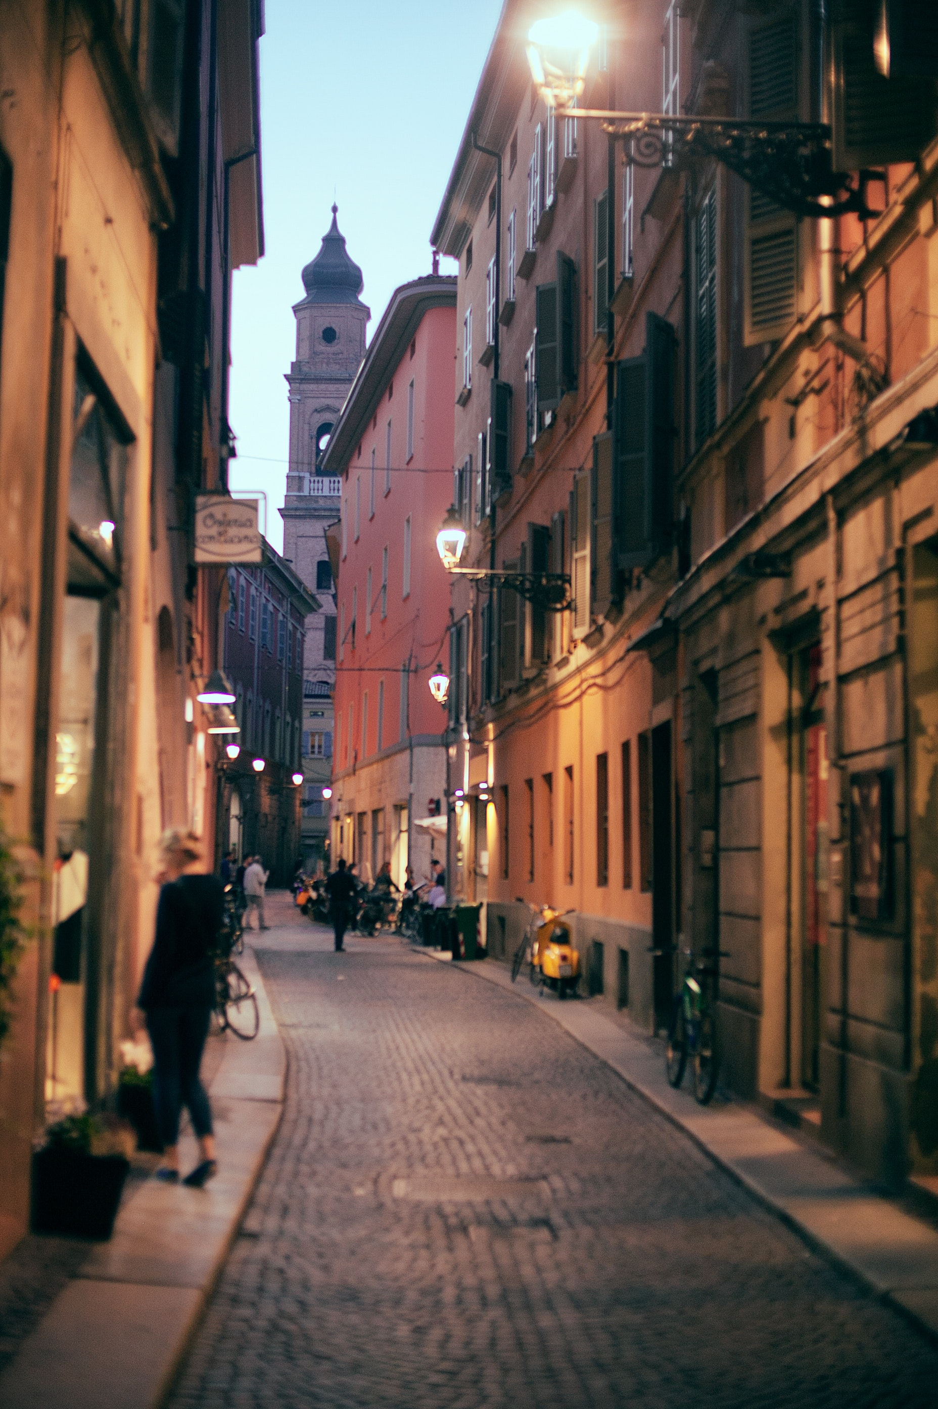
Low Cost Recovery Marketing Activities
Upgrading to include digital platforms and tools e.g., having digital self-exploration tours on iPads or using personal devices to get visitors to explore the destination, village, attraction or city. Make sure it tells the story in multiple languages. Make sure they get to know tips about the area and secrets and see the less well-known areas which are full of stories.
Online Commercial Communications. Social media and new media are major sources of information for travel decisions. Chinese tourists take advantage of digital media from trip planning (virtual tours and videos) to booking (digital payment platforms) and to enjoying the journey itself (sharing on social media platforms). Therefore, online commercial communications are vital for survival.

Slide 56
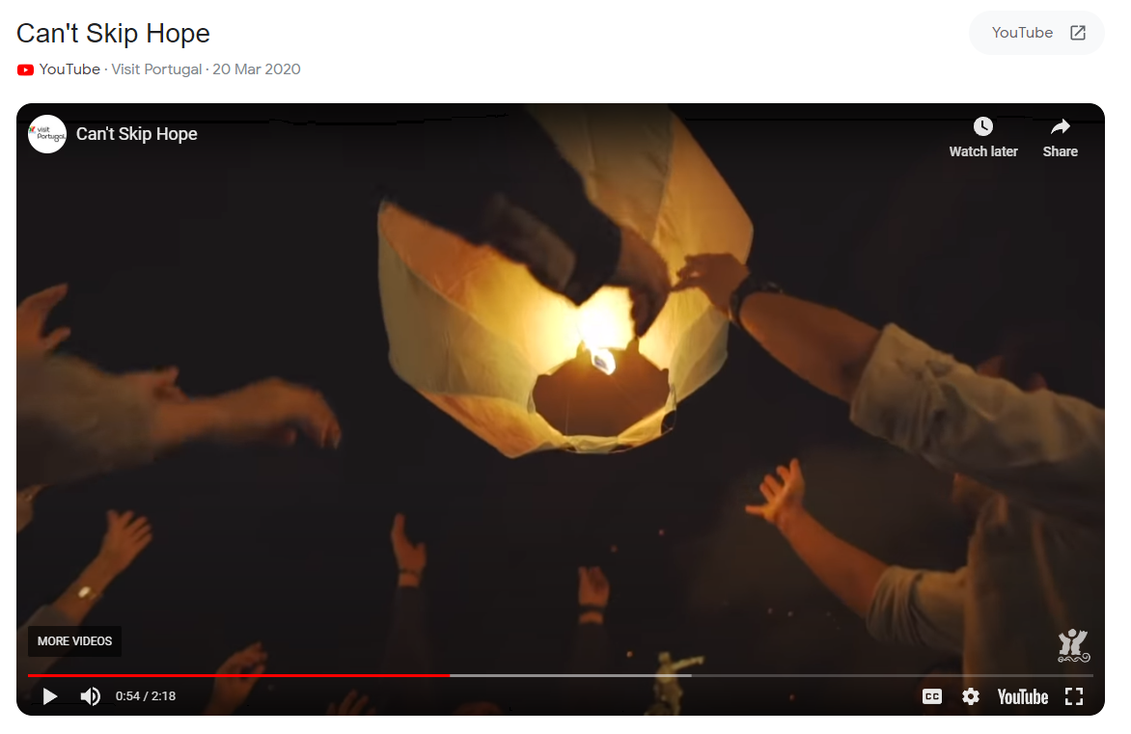
It’s Time to Stop – Engaging with Local Culture and Values
Visit Portugal
Instagram: https://www.instagram.com/visitportugal/
Tag: #CantSkipHope
Visit Portugal demonstrated support while still engaging with the local culture and values. To do that, the DMO changed its usual marketing message from #CantSkipPortugal to #CantSkipHope. This was further strengthened by a video they released along with the campaign saying: It’s time to stop. It’s time to take a break, for the good of the world. In the meantime, we can dream for the great days to come. We’re in this together.
While calling all people to continue dreaming for the amazing days to come, they implied that now is a time to stop and take a break. The video attracted over 590K viewers in less than 3 months and continues to gain traction. Through a mixture of rural landscapes and cheering crowds, it clearly narrates the idea of appreciating privacy while dreaming for togetherness.
https://www.google.com/search?q=portugal+its+time+to+stop+video&rlz=1C1CHBF_enIE952IE952&oq=portugal+its+time+to+stop+video&aqs=chrome..69i57j33i10i160l2.4936j0j7&sourceid=chrome&ie=UTF-8#fpstate=ive&vld=cid:ee806062,vid:70tcUNgd8IM

Slide 57
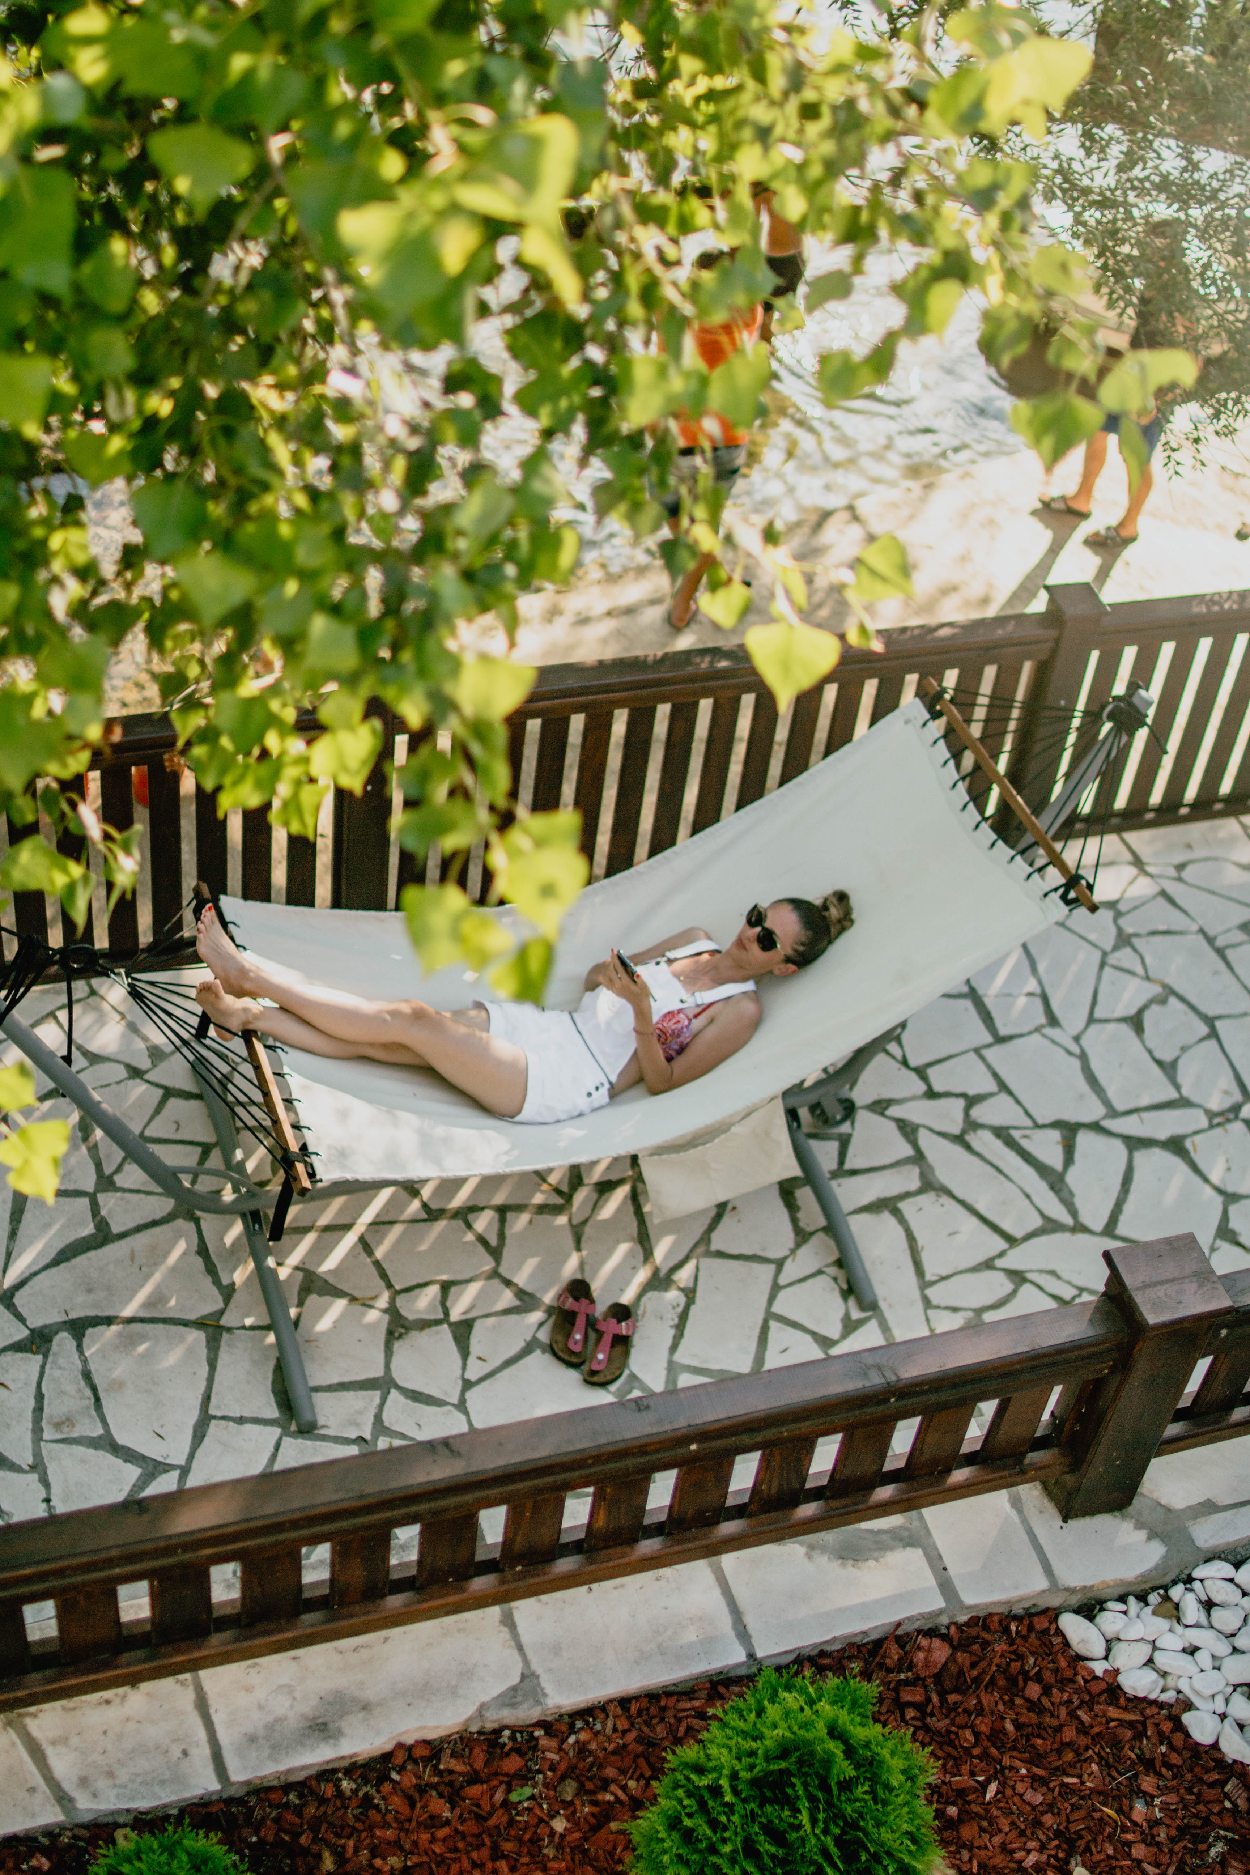
Low Cost Recovery Marketing Activities
Also the pandemic accelerated the acceptance and adoption of online transactions. Anyone who resisted incorporating online transactions felt the pinch.
Co-operative promotion and online selling e.g., [Destination Name] Book of Vouchers, Offers and Packages in the hope of attracting tourists to try your food, see your attractions or stay at your hotel

Slide 58
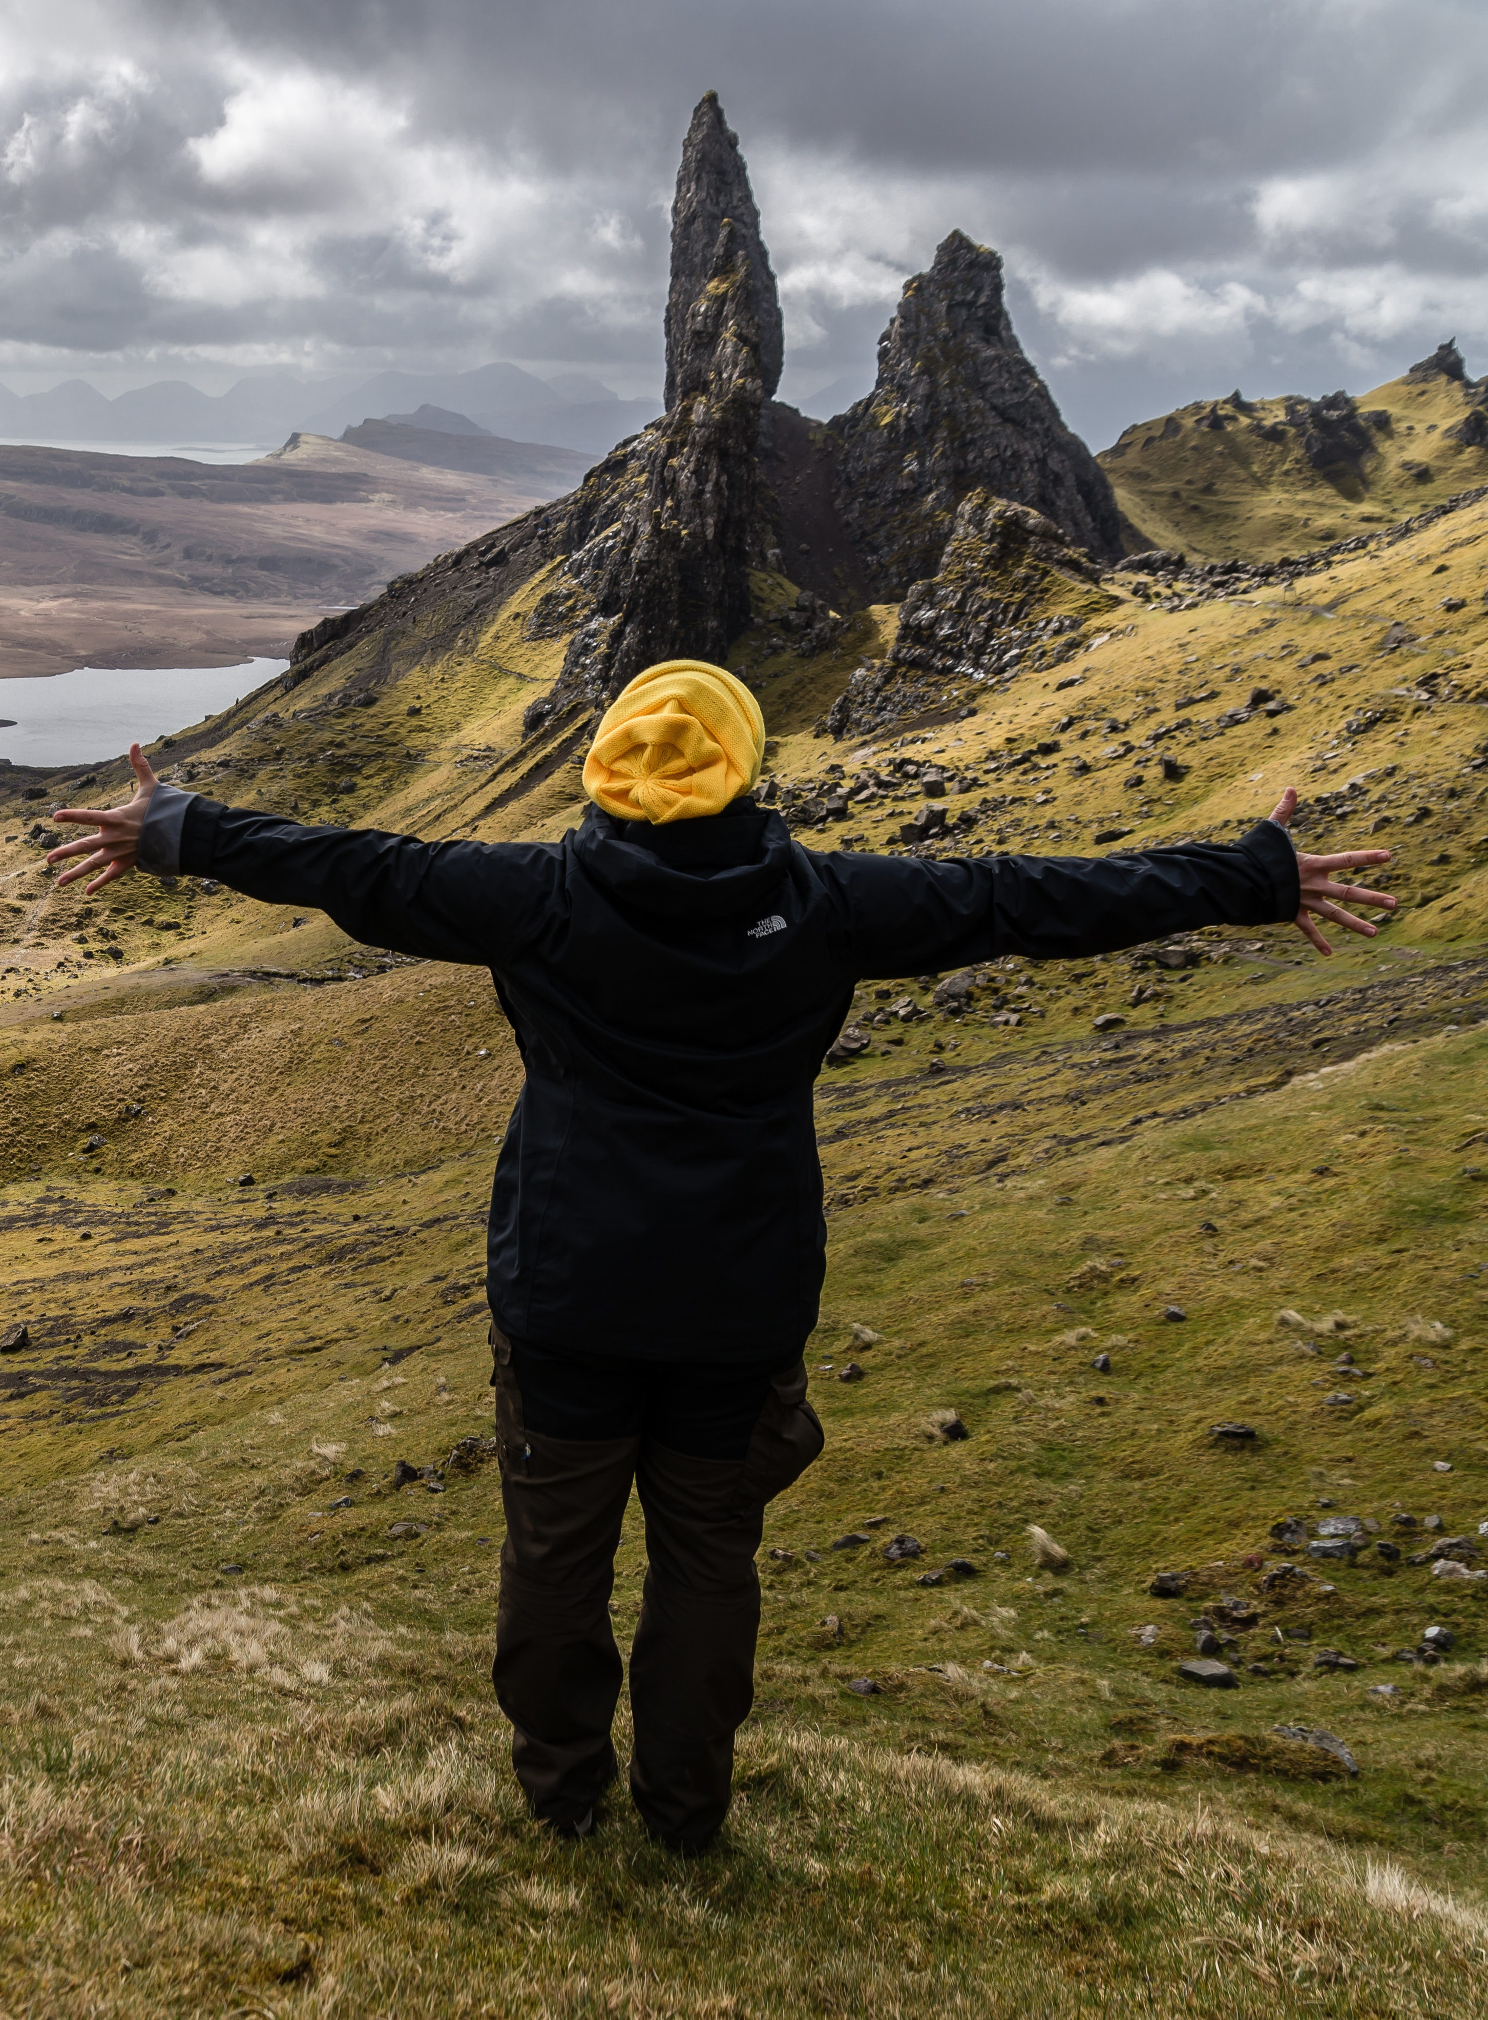
Low Cost Recovery Marketing Activities
Tourism businesses and regions need to deliver solely online to promote and sell the destination and their respective properties and attractions online e.g., via YouTube, Instagram, Tik Tok, etc.
They also need to augment their online touchpoints and experiences. For example, virtual reality 360 and high-definition videos are used to provide viewers with audio and video experiences at home.
Livestreamed marketing allows regions to share real-time content directly to viewers, increasing viewers’ engagement. Social media influencers, also known as key opinion leaders (KOLs), should be involved. More and more people are going to social media influencers for recommendations and referrals.

Slide 59
Report: Personal Distance is a New Normal
Authenticity and individuality will be especially expressed in the creation of an offer in which the heritage and tradition of a particular region will be presented in open spaces and landscapes that have yet to be revealed to tourists. Personal distance is also a new normality in tourism and a consequence of the fear of infection, and the only cure for fear is a sense of security.
Read Research Article

Slide 60
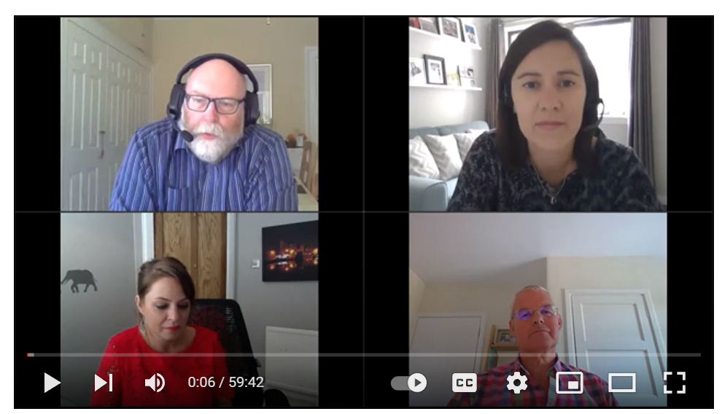
Marketing Response to Coronavirus
Visit Scotland
VisitScotland is launched a global campaign to ensure Scotland is top of mind for those first returning visitors, recognising the emotional connections people are looking for in a holiday post pandemic. It was to
Help Scottish tourism recover as quickly as possible, in a responsible way
Position Scotland as a responsible year-round destination that stands out and responds to consumer desires
Maintain and grow share of the domestic market
Increase awareness and consideration of Scotland internationally
Watch the regional stakeholder webinar from Wednesday 24th June on how Scottish tourism businesses can get back to work and follow the official guidance.

Slide 61
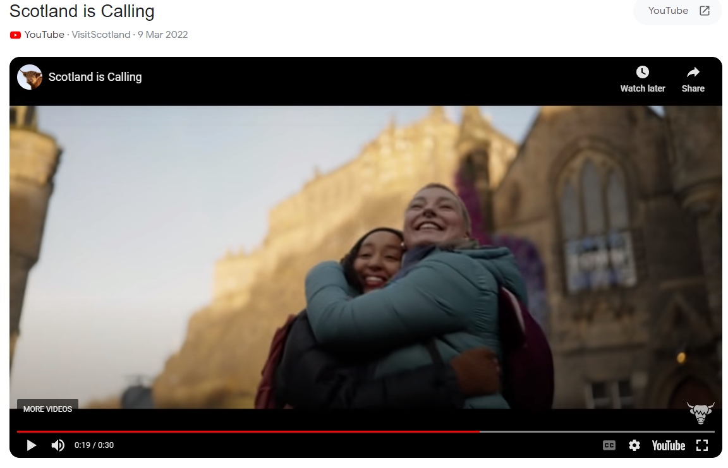
Marketing Response to Coronavirus
Visit Scotland
Insights have directed them to target new audiences – Generation Z will lead the international travel markets post-COVID as well as inspire traditional visitors through our social, email, and intermediary partner channels. Will include new inspirational content to encourage visits this year, with an ongoing program of consumer PR activity that will tap into new trends, pitching why people should visit Scotland. Responsible tourism lies at the heart of their activities
Its insights say ‘consumers are looking to fill the void from lockdown with experiences that promise to stir the emotions and elevate in-the-moment moods. They increasingly want to understand the impact of their actions - on the people around them and the wider world. Consumers are focusing on what matters to them in life’.
https://www.visitscotland.org/about-us/what-we-do/marketing/covid19
Video Link

Slide 62
Article: Crisis Communication and Recovery for The Tourism Industry
Although understanding the nature of crises is important, understanding how to manage crises is more critical. In particular, managing communication and perceptions through a crisis communication strategy can limit the negative media coverage and manage perceptions both during a crisis or disaster and at the recovery/resolution stage. Crisis communication and marketing are important to provide information to key publics and to help tourism destinations limit the impact of a crisis as well as help them recover from incidents by safeguarding the destination image and reputation which is of immense value to tourism destinations. The development of crisis communication and marketing strategies by organizations is therefore a critical competency for tourism managers.
Read Research Article

Slide 63
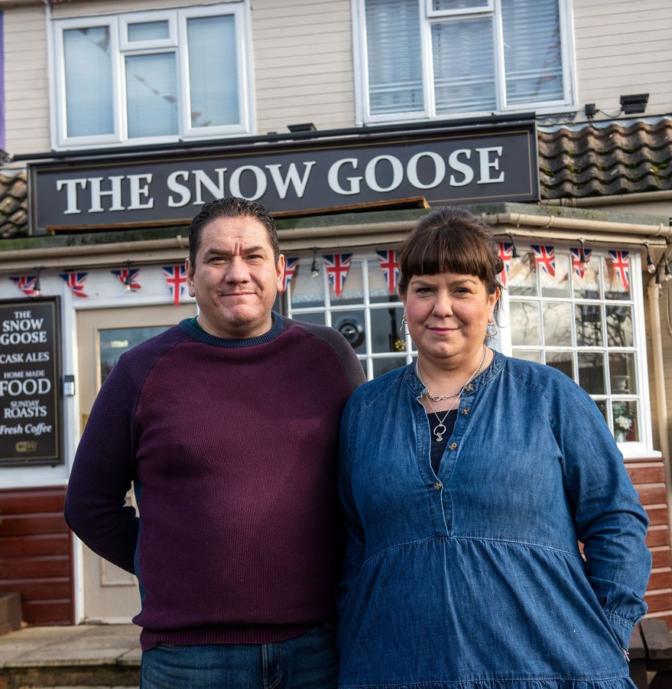
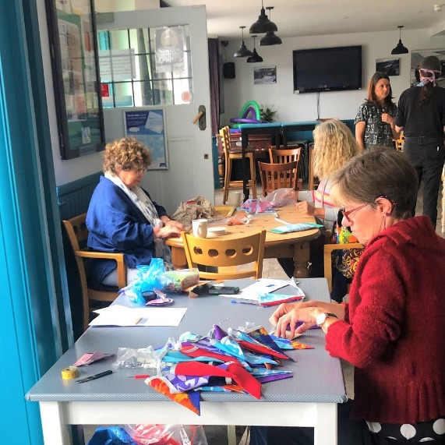
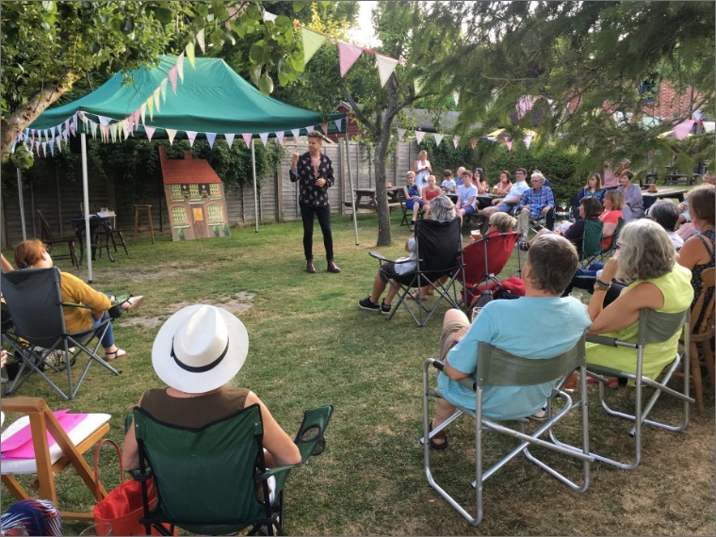
Last Orders for Loneliness Campaign
How some pubs are improving people’s well-being. The Snow Goose in Farnborough, Hampshire, is the center of its local community, and plays a key role in tackling loneliness.
The aim of its publicans is to ensure that the pub is open and accessible to all – even the layout of the pub provides a sense of openness that invites people to socialize and mix, and staff members make sure customers know their names. The team hosts regular conversations about the impact of loneliness, which has created a culture of staff automatically checking the well-being of their customers. Before COVID-19, the pub brought its local community together by hosting a range of activities and events, such as a monthly knitting club and a complimentary ‘Seniors Christmas Lunch’, all helping to boost community spirit and fight loneliness. Then the restrictions caused by the pandemic had been especially difficult for people. In response, The Snow Goose team stepped up and launched a helpline for anyone feeling lonely or needing practical support. (Source)

Slide 64
Module 1
Module 2
Module 3
Phase 1 Preparation & Mitigation
Introduction to Regional Crisis Tourism Management & Its Complexities
Set Up a Regional Public Private Partnership & Crisis Management Team
Conduct a Regional Crisis Vulnerability SWOT Analysis and Destination Audit
Phase 2 Planning,
& Response
Module 4
Module 5
Module 6
Develop a Regional Crisis Management Strategy (Long Term Mitigation Planning)
Develop a Regional Crisis Management Response Plan (Short Term Response Plan)
Response Activation and Communication with Industry for Regional Collaboration
Phase 3
Recovery, Rebuild, Resilience
Module 7
Module 8
Module 9
Communication Strategy and Dealing with PR & Media
Strategic Regional Crisis Response and Recovery Marketing
Regional Recovery, Rebuilding & Resilience Towards a ‘New Norm’ Post Crisis

Slide 65

Well Done!
You Have Finished Module 8 Strategic Regional Crisis Response and Recovery Marketing
Now Get Ready for
Module 9 Regional Recovery, Rebuilding & Resilience Towards a ‘New Norm’ Post Crisis
https://www.tourismrecovery.eu/
Facebook
Momentum, Ireland Developer of Modules
The European Commission supports the production of this publication and does not constitute an endorsement of the contents which reflects the views only of the authors, and the Commission cannot be held responsible for any use which may be of the information contained therein 2020-1-UK01-KA203-079083

