Slide 1
Regional Tourism Crisis Management (RTCM)
HEI Course, 2023
Developed by Laura Magan (Momentum)
Module 5
Regional Tourism Crisis Management Plan
(Short-Term Response and Recovery Plan Driven by the Crisis Management Centre)

Slide 2










Module 1
Module 2
Module 3
Phase 1 Preparation & Mitigation
Introduction to Regional Crisis Tourism Management & Its Complexities
Set Up a Regional Public Private Partnership & Crisis Management Team
Conduct a Regional Crisis Vulnerability SWOT Analysis and Destination Audit
Phase 2 Planning,
& Response
Module 4
Module 5
Module 6
Develop a Regional Crisis Management Strategy (Long Term Mitigation Planning)
Develop a Regional Crisis Management Response Plan (Short Term Response Plan)
Response Activation and Communication with Industry for Regional Collaboration
Phase 3
Recovery, Rebuild, Resilience
Module 7
Module 8
Module 9
Communication Strategy and Dealing with PR & Media
Strategic Regional Crisis Response and Recovery Marketing
Regional Recovery, Rebuilding & Resilience Towards a ‘New Norm’ Post Crisis

Slide 3
Regional Tourism Roadmap to Managing a Crisis
(Prepare, Prevent, Mitigate, Plan, Respond, Recover, and Rebuild)
1
Regional Tourism Crisis Management Team (TCMT) Create for a collaborated, coordinated response to a crisis
2
Regional Risk Analysis
Assess the most likely crisis a region will face and the priority actions to mitigate the risk.
3
SWOT Analysis
Analyse strengths, opportunities, and threats to review and strengthen a tourism region.
4
Regional Crisis Audit
Audit regional gaps and needs to implement Risk and SWOT Priorities and Actions
5
Crisis Management Strategy
Develop a CMS so a tourism region can follow a long-term plan to mitigate and prevent the impact of a crisis
6
Crisis Management Plan
Develop a CMP so a tourism region can follow a short term plan to respond and recover from a crisis
7
Activating a Response to a Regional Crisis
Crisis response activation measures, protocols, systems of communication, and information sharing with internal industry stakeholders to ensure an aligned response.
8
External Communication with PR, Media, and Tourist Marketing Regional response and communication approaches with different external stakeholders. How each is dealt with differently in terms of messaging, approach and timing.
9
Rebuild, Recovery, and Resilience Rebuilding tourism regions to a ‘new normal’ using business continuity and resilience approaches, discovering a need to prioritize change, and adapting to the ‘new norm’.

Slide 4
Table of Contents
1
Introduction to the Purpose of a Regional Tourism Crisis Management Plan
Regional Tourism Crisis Management Plan
This Module is designed to guide regional crisis management teams and centres to formulate and implement the Crisis Management Plan which is designed to support the Crisis Management Strategy. It provides guidance and examples to regional tourism crisis management, including pre-event planning, managing the crisis, and post-event activities. It shows how to create a crisis management plan for a tourism region and all the elements, activities, procedures, and resources needed to assist a region to respond to an eminent crisis. In addition to many other modules in this course there are also free downloadable crisis management plan templates and checklists to help aid implement the design of a CMP.
.
2
What Happens if a Region Doesn’t Have A Crisis Management Plan
3
How to Develop an Effective Regional Crisis Management Plan
4
Crisis Management Plan Template
6

Slide 5

Learning Outcomes
Learn how the CMP is a competitive advantage to steering regions that will face an eminent or potential crisis
Understand how a tourism region needs to come together so that it is a well-thought-out and thorough live document that includes all important regional crisis elements. The devil is in the detail.
Learn how everyone has a role to play in the response and activation, response, training, monitoring, and evaluation of the plan.
Learn how to develop a regional crisis management plan that has all the necessary supporting documents, checklists, procedures plans, and actions
Become aware of crisis scenarios and the crisis playbook so that the plan can be put to the test during and after development to see if it actually works.

Slide 6
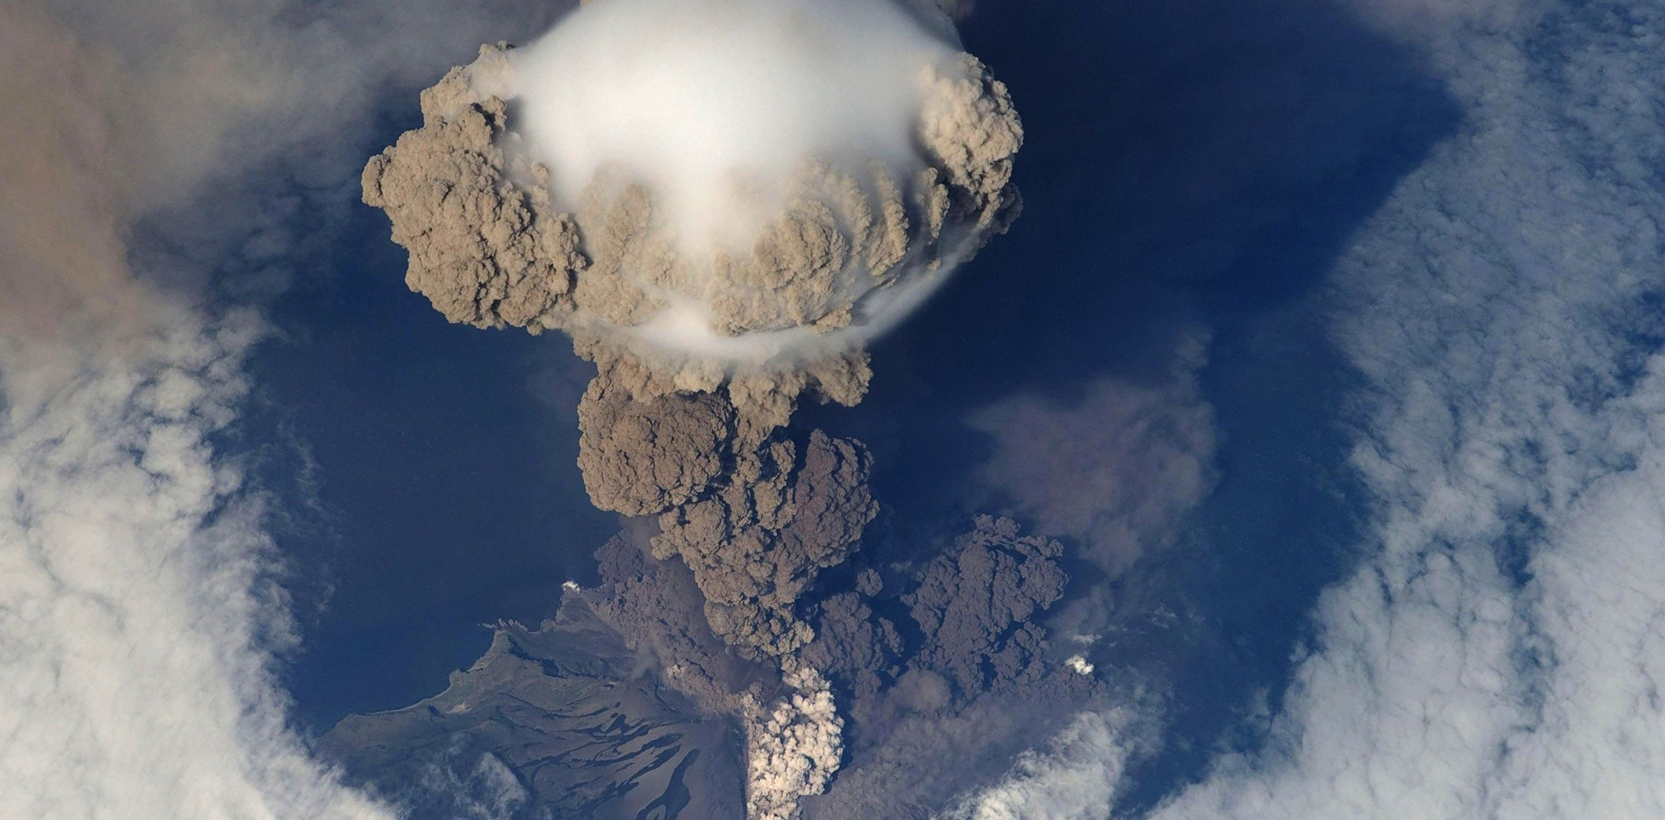
1. Introduction to the Purpose of a Regional Crisis Management Plan

Slide 7
Regional Tourism Crisis Management Plan
Regional Tourism Crisis Management Plans outlines the series of response operations and actions that a region needs to take to respond and recover from a crisis.
Depending on the type of crisis it is the short-term regional crisis framework inclusive of a number of actionable items e.g., emergency lists, maps, resources, hierarchy list, action or task lists, procedures, plans, and training schedules.

Slide 8
The Regional Crisis Management Plan Overview
The purpose of this CMP is to provide European tourism regions with an effective short-term crisis management plan that may be enacted in the event of a tourism-related crisis. It focuses on crisis response management. It attends to all the actions, plans, procedures, and operations that are needed to support the Crisis Management Unit and Response Team. It is supported by and is aligned with the Crisis Management Long Term Strategy. It aims to:
Come up with a crisis framework and list of initiatives that are needed to prepare the crisis response team so they know what to do and when to do it in the event of a crisis event. This Module will use a flooding crisis as an example.
Implement the correct crisis status, monitoring, and assessment procedures and tools
Develop and deliver crisis training starting with priority to first responders’ Delegate responsibilities and roles, develop and maintain the appropriate contact business, staff, and emergency lists
Develop the required communications procedures and Communications Plans to deal with Industry and PR and Media
Deliver strategic response and recovery marketing campaigns
Put in place all the required procedures, plans, operational plans, health and safety checks, action lists, etc that are needed for a crisis

Slide 9

A Crisis Management Plan is Critical for Regional Tourism Sustainability
Developing a Regional Tourism Crisis Management Plan for smart crisis planning and management is no longer an option. In an age of the coronavirus pandemic and increased cybersecurity attacks, tourism regions more than ever should have a "when, not if" mentality regarding crisis management planning and should form a plan as if an incident will happen. It's important to be proactive, rather than reactive. A crisis management plan (CMP) helps regions outline how they can respond to a critical situation that would negatively affect their profitability, reputation, or ability to operate. (Source).

Slide 10

Tourism Crisis Management Plans
Strong regional tourism crisis management requires a strong crisis strategy, plan, manuals, and other support materials so everyone is singing from the same hymn sheet and;
can promptly respond to a disaster or crisis event in an adequate way; and
minimize the negative impacts on visitors and the tourism industry.
Well-prepared destination and tourism businesses are quick to get involved to become part of the crisis plan so they too can take necessary actions for crisis preparation, mitigation, response and post-disaster recovery.
CANCELLED

Slide 11


What is a Crisis Management Plan?
Crises are a fact of life, whether novel viruses, natural disasters, cyberattacks, or any other form of critical event. CMPs are what tourism businesses, agencies, operators and regions can do to prepare, respond and recover.
The CMP presents all the crisis preparatory activities needed – a catalogue of roles, responsibilities, and tasks personnel will perform before, during, and after a crisis.
The CMP lays out how the region and its stakeholders can and will respond to a critical event that could negatively affect its visitors, profitability, reputation, and/or ability to operate. Everyone involved knows how to react to a crisis, including who is involved and what they will do.

Slide 12
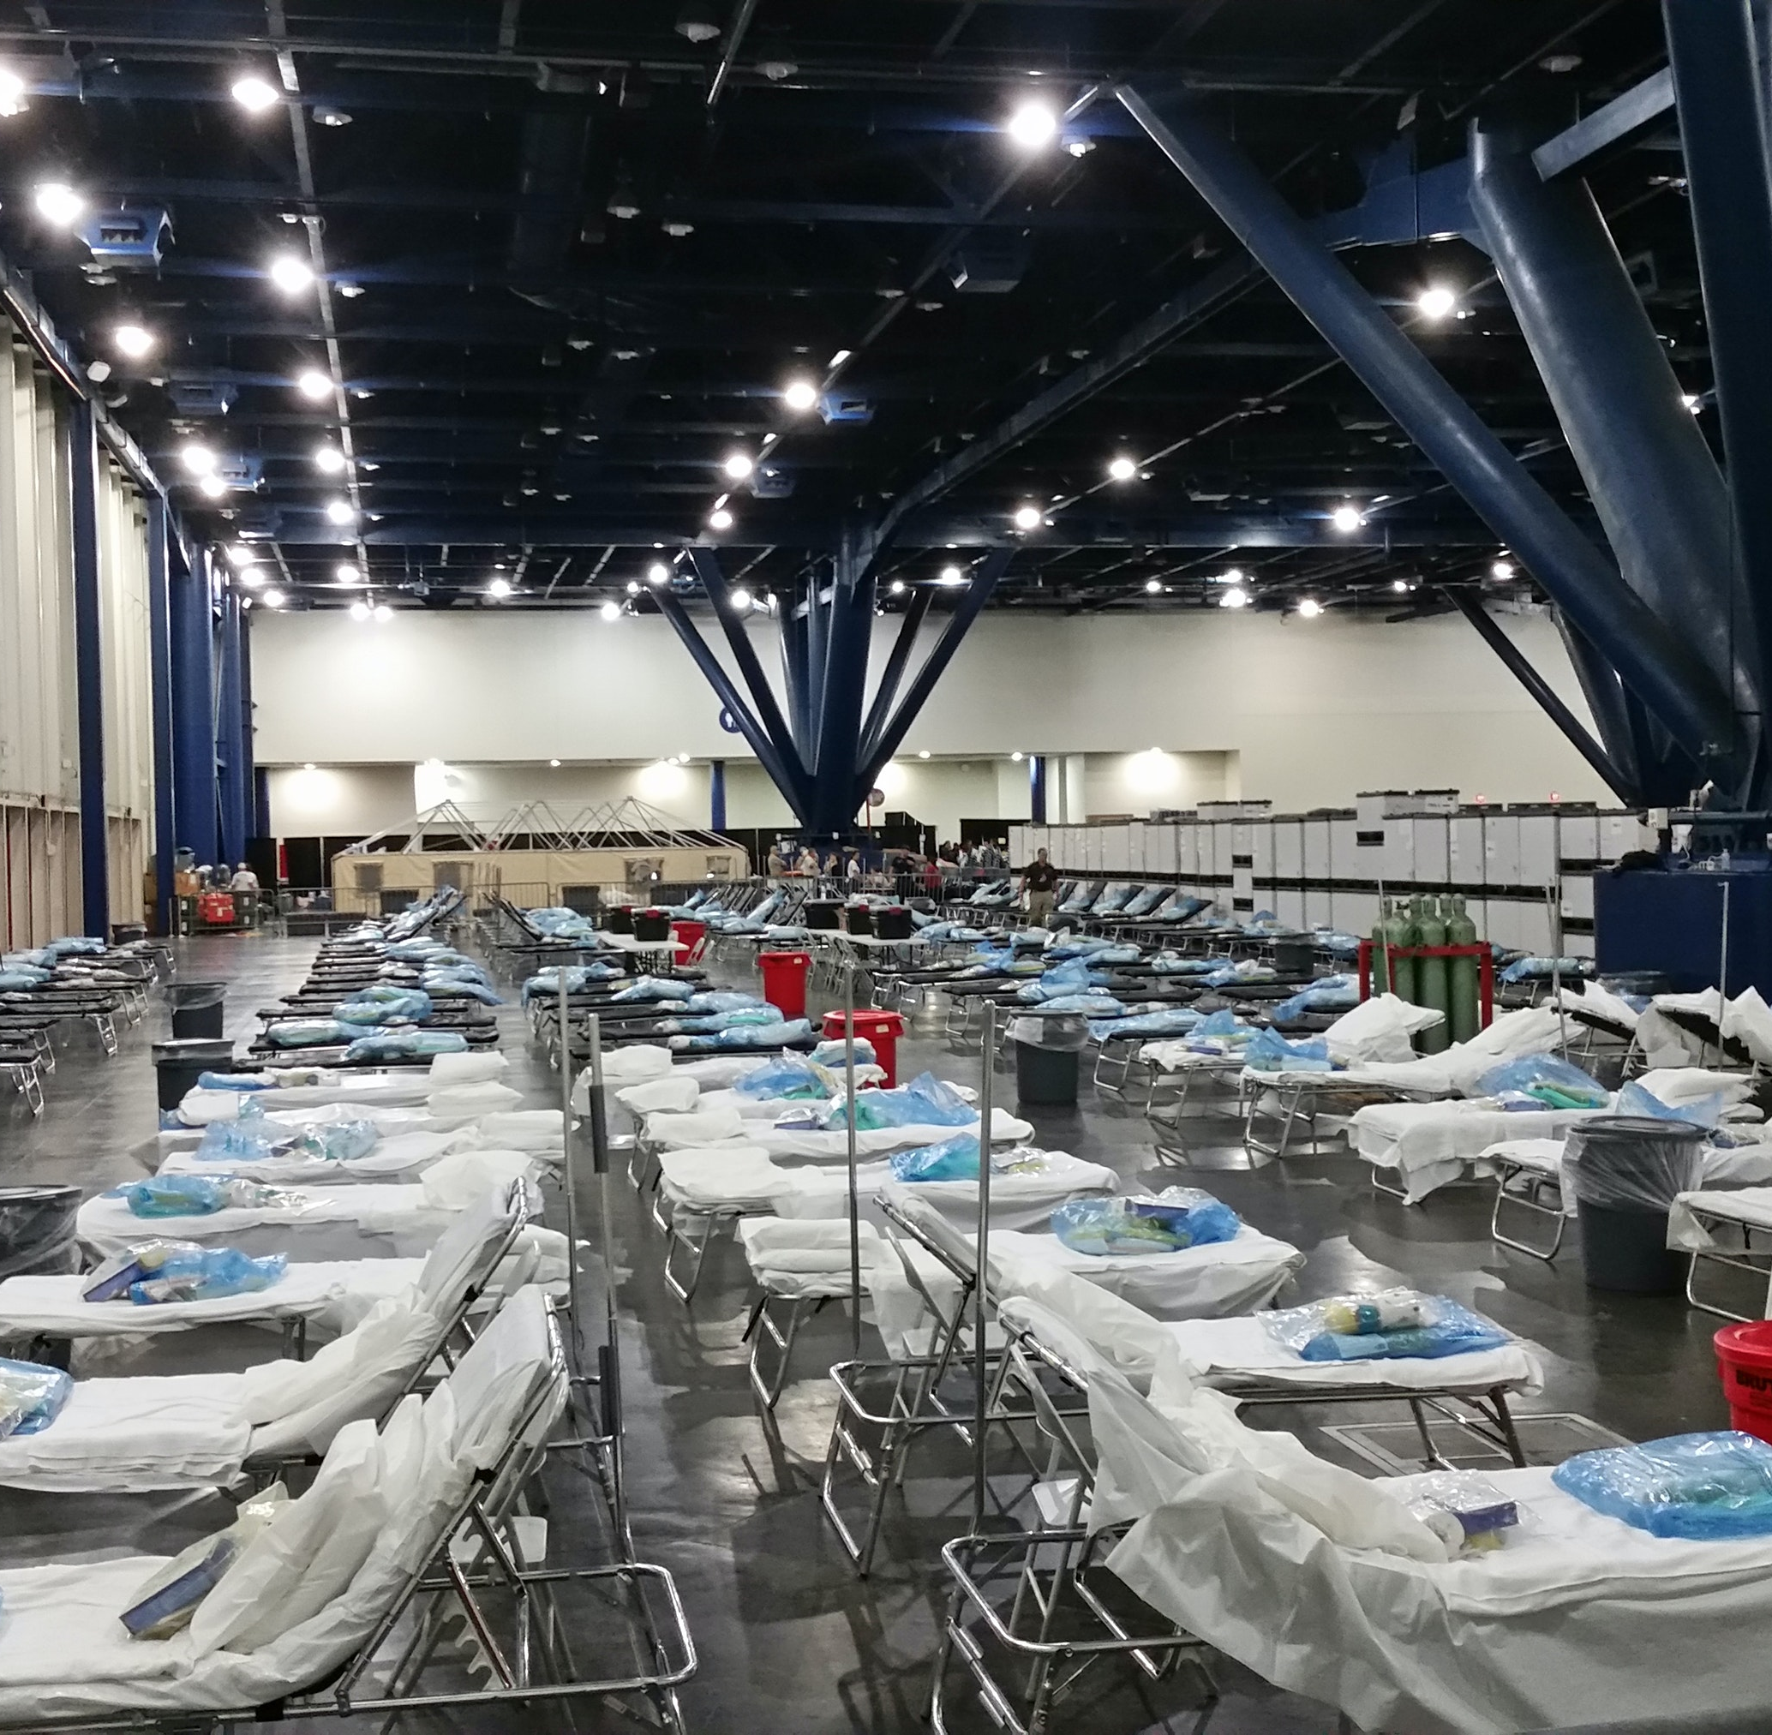
Tourism Regions Need a Crisis Management Plan
Its purpose is to avoid or minimize damage, as well as provide direction on critical matters, such as personnel, safety, resources, and communications – so they can be actioned effectively during the crisis.
It Helps Mitigate Loss & Damage. The answer is simple. Planning saves. In the emergency or crisis management context. The better prepared a region is for a disaster the less needed to spend resources, time, money, and energy on recovery. CMPs mitigate the loss of unnecessary resources, and people, damage to reputation, injuries, money lost, infrastructural damage, health problems…the list goes on.

Slide 13
Tourism Regions Need a Crisis Management Plan
Peace of Mind. It gives stakeholders and regions peace of mind, uncovers risk, provides a sense of security and safety, maintains reputation, accelerates response and recovery, and might ensure compliance and efficiencies. These positive outcomes are transferred to visitors and tourists.
Not all regions have a sufficient crisis plan. Given its importance, it’s imperative to get the CMP and crisis management planning right. Since every region is different this is not an easy task. Its definitely true to say even similar regions will have an often very different CMP.
This section will demonstrate how to create a Crisis Management Plan

Slide 14
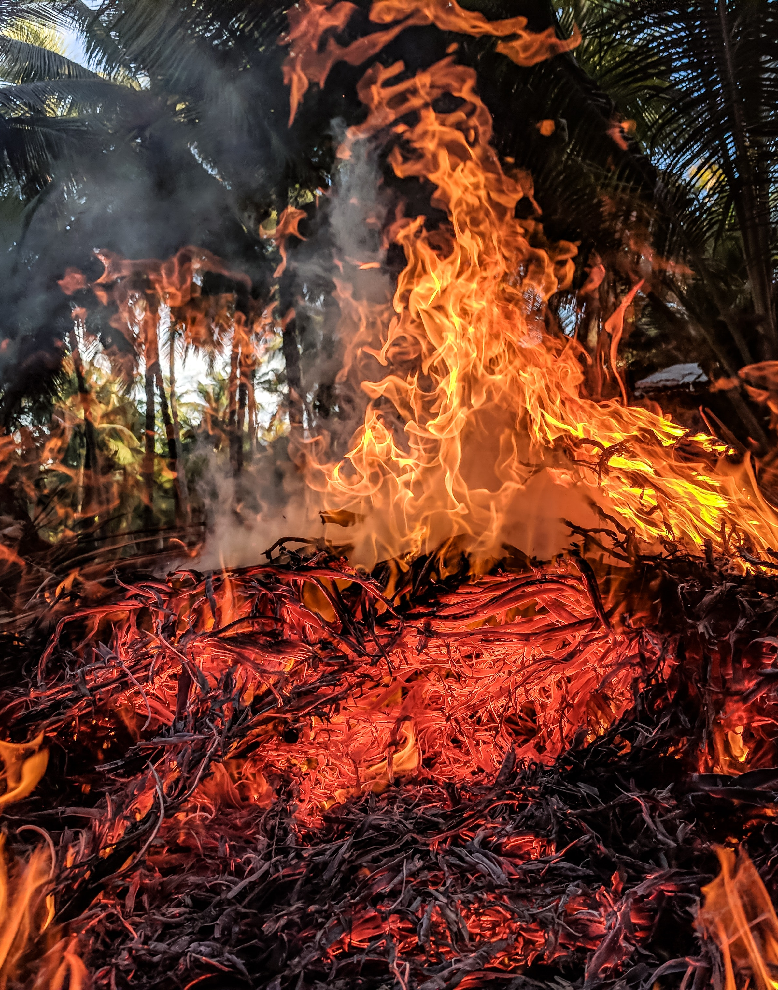
The CMP is a
Competitive Advantage
Good crisis management is a competitive advantage.
For example, the Incident Command System, which originated as a structure to streamline the coordination of different agencies fighting California wildfires, is becoming more widely adopted because it enables faster, more efficient responses.
The private sector has enhanced the efficiency of the Incident Command System with technology by embedding features such as real-time incident status reports, dynamic organization charts, audit trails of responses, and form generation.

Slide 15

A Study states how to Improve Tourist Experiences with Destination Safety
Tourists tend to remember a destination's prominent safety features or activities (Yu et al., 2021). When destination safety is better than expected, tourists are more likely to revisit, share the experience with prospective tourists, and recommend the destination to others (Zhang, Wu, & Buhalis, 2018).
It also states that to improve tourists' experiences with destination safety, brochures or mobile apps that cover local laws and regulations, medical services, police contacts, important transportation information (e.g. bus/train timetables), driving instructions, and local cultural taboos can be provided to tourists once they arrive at the destination.
Read Research Article

Slide 16
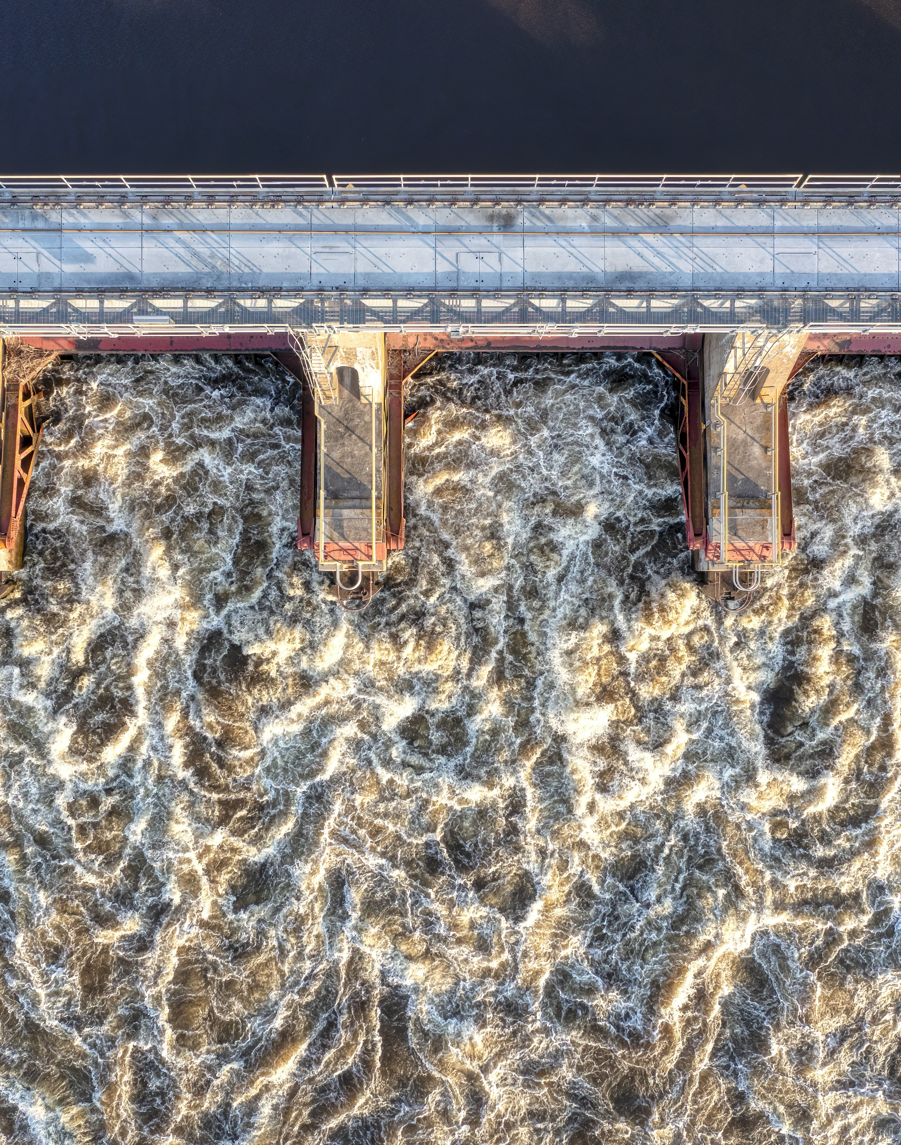
A Crisis Management Plan Implementation Needs Leadership
The Crisis Steering Group (CSG) and other senior executives in a region are largely responsible for making sure a Crisis Management Strategy and Crisis Management Plan exists.
Planning and implementation is ultimately the responsibility of the Crisis Management Unit Manager or Leader and their team but theyneeds support, expertise and advice when needed from regional planners, crisis trainers, emergency operators and responders, risk managers, legal aid, data strategists and assessors, and other specialized areas.
Learn About the Crisis Management Unit Team and Supports in Module 2

Slide 17
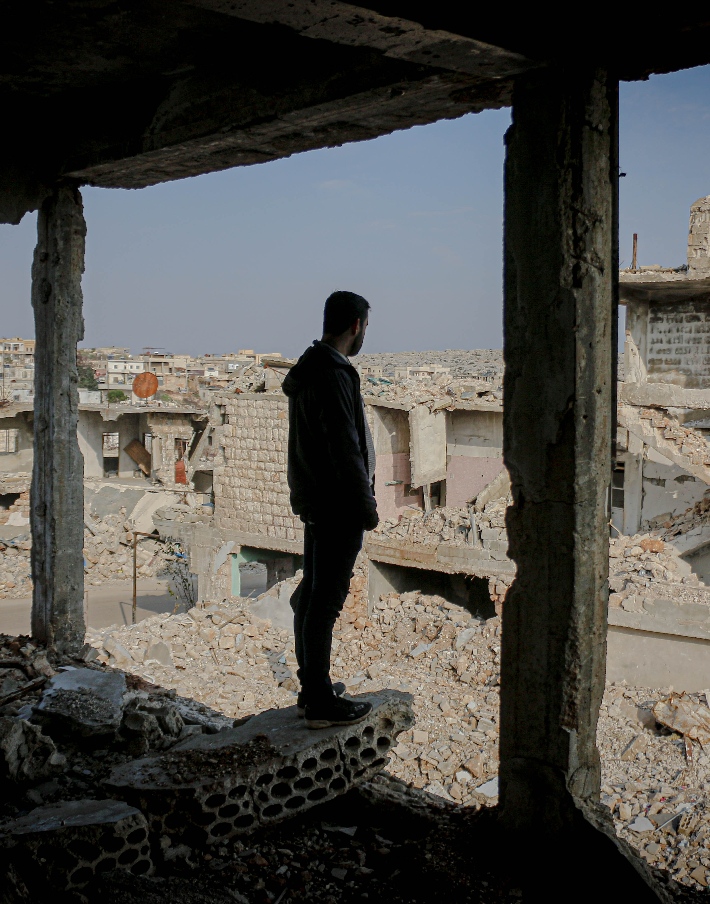
Developing and Implementing a CMP is a Region Being Proactive
It is great to have a Crisis Management Plan but it also needs to be used, updated, and implemented. It is crucial regional tourism stakeholders and companies are aware of and understand it so they too can help prevent or avert catastrophes, and get operations back to normal as quickly as possible.
Events such as the 2020 global pandemic it couldn’t be clearer that major crises are more than possible and likely and that being proactive is a basic survival skill required by tourism regions.
“Despite this reality, surveys show that only 54% of businesses have a proactive crisis management plan in place. These numbers mean that when disaster inevitably strikes, 46% of organizations won't be ready—and may suffer devastating consequences as a result’’. (Source)

Slide 18
A Crisis Management Plan Requires Regional Ownership
Competent Leadership
Crises never unfold exactly as anticipated, but the planning process should develop crisis management skills and a preparedness mindset. Every Crisis Management Strategy and Plan needs to be driven and managed strategically by a responsible competent leader and crisis management team. That way, tourism regions can deal with whatever happens more effectively.
Ownership by all Regional Stakeholders
The Aim is to Regional Recovery and Business Continuity as Soon as Possible
A crisis should be collectively managed by all the regional stakeholders. They need to understand all the calamities that could befall their region, and that requires tourism operational staff, not just top managers. Once the team drafts a crisis management plan, make sure to allocate adequate resources to train responders, acquire staff or material that may be needed, and update the plan regularly.
A major goal of preparation is to keep operations running or resume them as quickly as possible in the event of a crisis. A business continuity plan focuses on this aspect of crisis management. See “Business Continuity Planning: How to Do It Well” to learn more. “Free Disaster Recovery Plan Templates” offers templates for disaster recovery plans at different kinds of organizations and for business needs such as payroll and data.

Slide 19

A Good Crisis Management Plan…
“The best plans use an all-hazard approach, meaning you don’t write plans with a specific crisis in mind, but rather with all potential hazards in mind. Using this method ensures that you’ll have a consistent response and a team that’s always ready, regardless of the nature of the incident,” recommends Regina Phelps
Regina Phelps, Founder of crisis management consulting firm Emergency Management & Safety Solutions.
Regina Phelps is an internationally recognized thought leader in the field of crisis management, exercise design & pandemic, and continuity planning. Since 1982, she has provided consultation & speaking services to multinational companies on five continents.

Slide 20
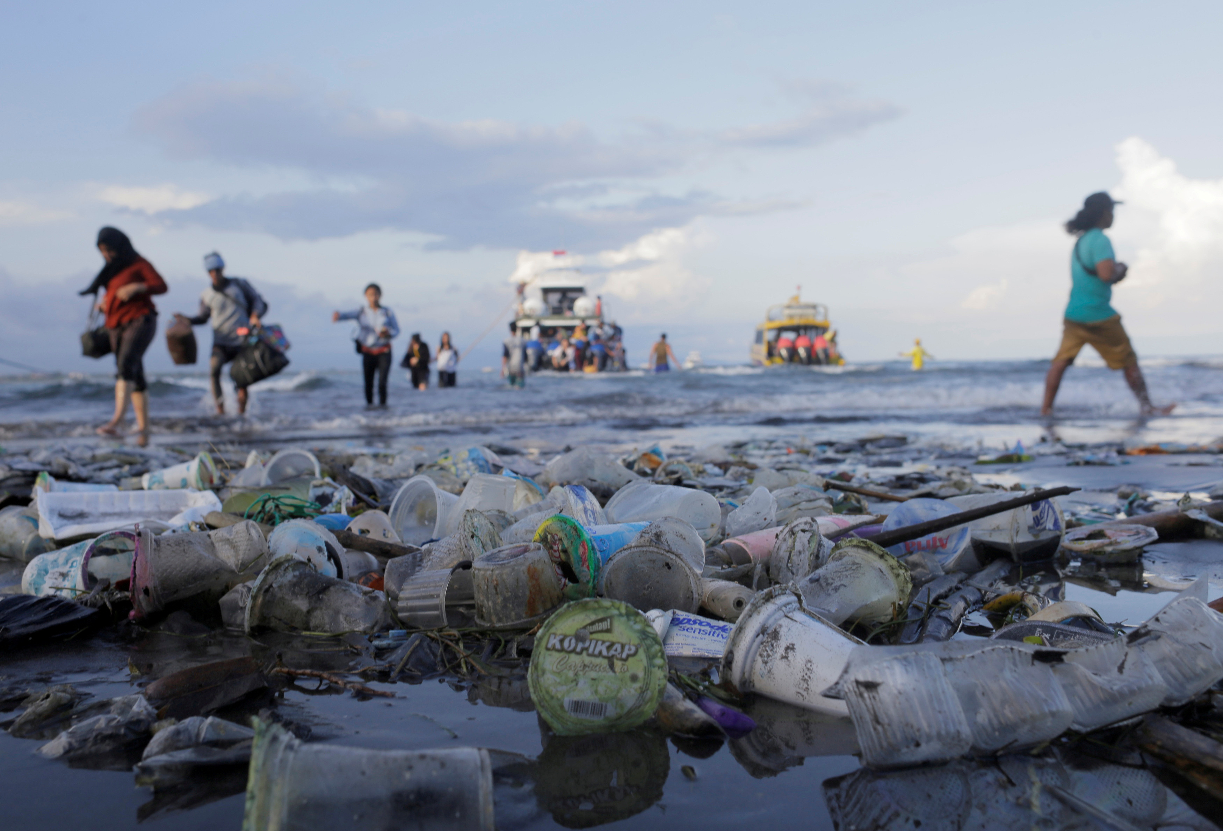
2. What Happens If a Region Doesn’t have a Crisis Management Plan

Slide 21


What Happens Without a CMP
Poor Decisions Are Made. Having a crisis management plan is critical because, without one, people under stress may make poor decisions and may unintentionally extend or worsen a crisis. Taking swift, constructive action may be the key to a region’s survival.
Stakeholders Can’t Assist in Crisis Management. In the wake of a crisis, a CMP keeps regional stakeholders aware, informed, prepared and focused. It enables them to understand and implement a region’s response measures, identify potential vulnerabilities, and understand and assist with top priorities. Moreover, training exercises and scenarios help stakeholders identify threats, minimize their likelihood, and improve the regional response. This autonomy helps combat their fears and uncertainty which can compound the damage.

Slide 22

What Happens Without a CMP
Vulnerability and Instability Increase as Crisis is Inevitable. A strong crisis management plan is essential because emergencies and disasters are more common than many people realize.
In 2019, consulting company PwC interviewed more than 2,000 senior executives around the world and found that 69 percent had experienced at least one crisis in the last five years; in fact, these executives experienced an average of three crises during that same time period.
These crises fell into almost 20 different categories, the most common being a financial or liquidity-related crisis, a technology failure, and the failure of an operation. Cybercrime, natural disasters, viral social media, and leadership misconduct also featured prominently on the list.

Slide 23

What Happens Without a CMP
Mitigation and Prevention are Almost Impossible. Planning helps a region contain and mitigate the negative effects of a crisis, which can include damage to reputation, loss of operations, and legal or regulatory trouble. A crisis can even close down a company or region.
The Paris Terrorist Attacks (November 2015) where 130 people were killed and many wounded. The attacks were claimed by the jihadist Islamic State group the following day. The city was closed off for a number of days with multiple disruptions (raids, searches, blocked access, and arrests) continued until April 8, 2016. It continued up until May 25, 2022, with high-level media court proceedings reminding the victims, tourists, Paris, and the world that it wasn’t over yet. (Read the Timeline)

Slide 24

Difficult to Preserve Operations
A crisis management plan prepares a region how to cope with an unexpected crisis or calamity by;
Shortening and lessening the impact of a crisis;
It protects stakeholders, tourists employees, and anyone else affected;
It preserves operations and productivity as much as possible; and
It safeguards a region’s reputation.
Crisis planning seeks to make a tourism region more resilient and more capable of weathering the long-term effects of a crisis.
A PwC study cited that organizations that had a crisis response plan in place fared better (after a crisis) by a margin of nearly two to one. In fact, 41 percent of those companies with plans emerged stronger than before, and 39 percent saw their revenue grow as a result. (source)

Slide 25
Response Approaches to Crisis Management
7 different approaches along a crisis management maturity model, from most to least advanced, are as follows (Source)
Pre-emptive
Responsive
Reactive
Pro-active
Prevent & Resolve
Ready to React to a Crisis
Not Ready
Anticipate and Manage
This is often a panic-driven or knee-jerk reaction. Emotions like fear play a leading role, and objective thinking is largely absent from the crisis response. The company or region faces crises reluctantly and, after the crisis, it may experiences problems e.g., low visitor numbers, or even business failure.
In this approach, regions seek to take initiative early in the crisis and seek to shape how events unfold. They are prepared and in the response phase, anticipate knock-on effects and voluntarily disclose the most negative information before the media discovers it.
This approach regions/business seeks to prevent or resolve a crisis at its earliest sign.
This occurs when there is little warning of a crisis. However, thoughtful and quick analysis can lead to effective action that accounts for long and short-term results.
Denial
Accommodative
Defensive
Hides from Reality and Responsibility
Accepts Reality & Responsibility
Only Participates if Made by Law
The company or region accepts that a crisis is possible and involves a broad set of stakeholders in preparation. In a crisis, the company accepts responsibility, voluntarily meets the needs of the victims, and tells the truth.
The business or region prepares or participates only if required by law e.g. if it risks high expected costs or fines or risks involving external regulation e.g., government, and environmental authorities. During a crisis, the region resists admitting full responsibility but does admit some. The region or some of its companies only does what is mandated by law.
The company or region denies the possibility of a crisis and any negative consequences. In a crisis, the company denies all responsibility, closes off communications, and hides the truth. Its stance is uncooperative.

Slide 26
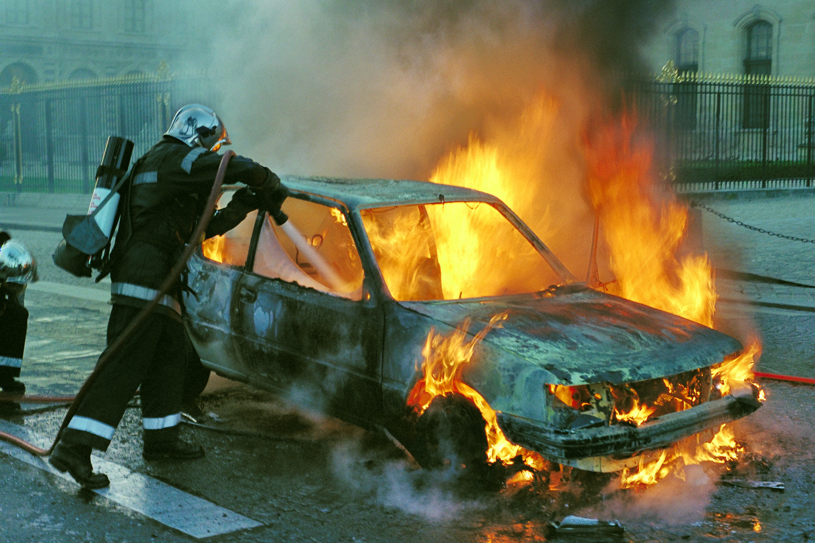
3. How to Develop an Effective Regional Crisis Management Plan

Slide 27

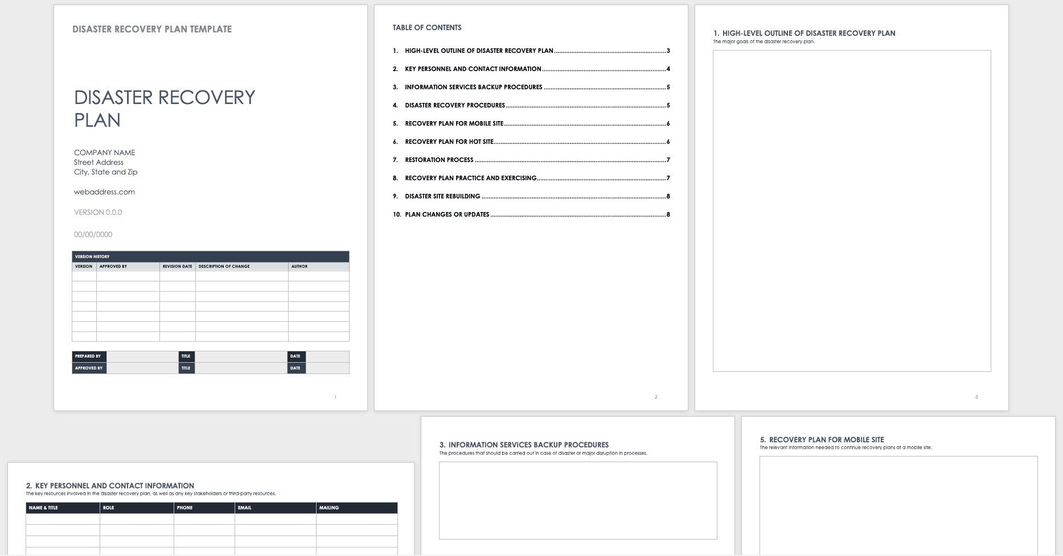
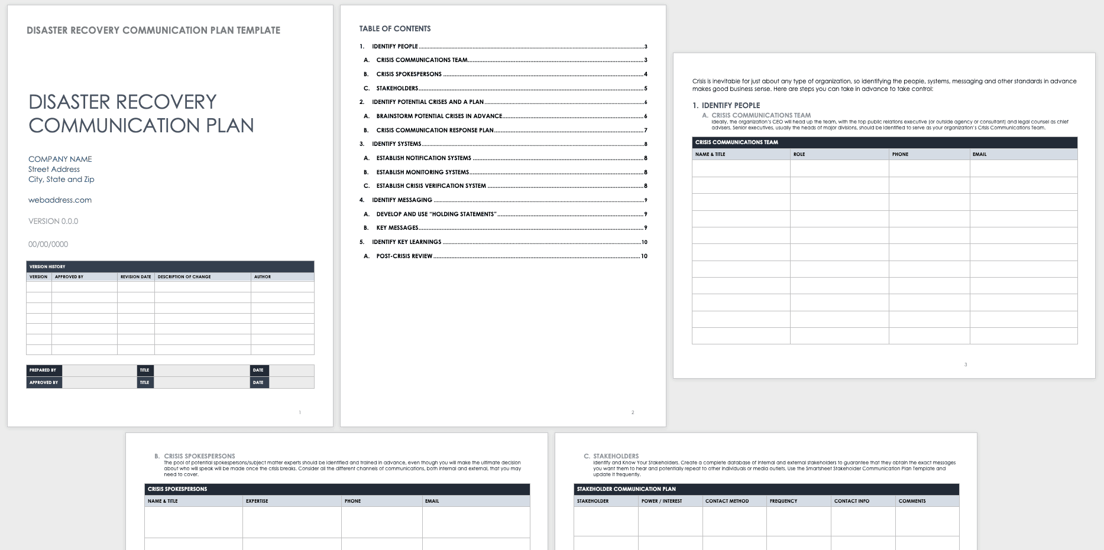
A Crisis Reactive Strategy is Not Ideal
Sample Disaster Recovery Plan Templates
Management by crisis means that your region is in a constant state of crisis response, leaping from one emergency to the next. Without a plan, regional tourism businesses and managers are putting out fires all the time, and they have no opportunity to plan or take initiative; they are stuck in a stressed-out, reactive mode. They are not able to operate strategically and perpetuate the conditions that give rise to problems.
Tourism managers and leaders who manage their business as a crisis comes may also manufacture a regional atmosphere of crisis with the well-intended goal of getting their teams to exert superhuman efforts. However, the result is ultimately employee and stakeholder burnout, low morale, and turnover. Common moves that contribute to a regional crisis atmosphere include unpredictable business patterns, staff shortages due to too much shuffling, dilapidated infrastructure, inability to plan events etc.
Disaster Recovery Templates from Smartsheet

Slide 28
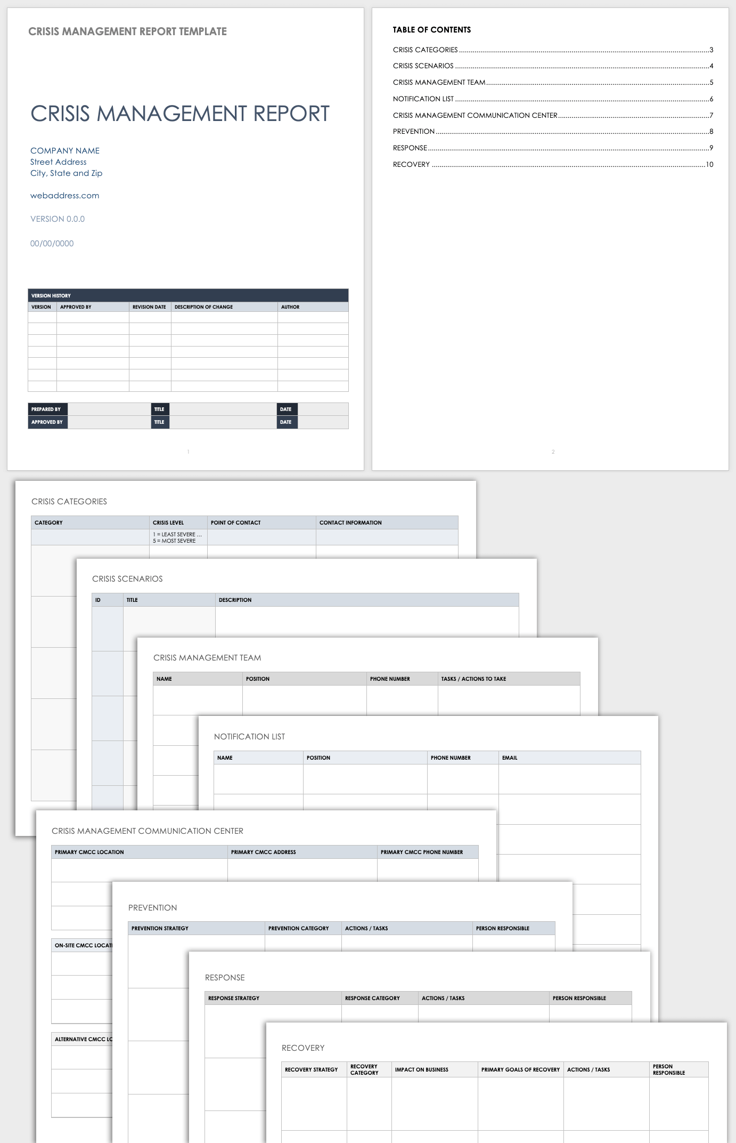
Step 1
Start with Likely Regional Crisis First
Focus on the Inevitable Crisis First!
Sample CM Report Templates
Tourism companies and regions shouldn’t get hung up on all of the possible bad things that can happen. Businesses and regions simply can’t plan for every contingency. It’s not practical. Instead, start a Crisis Management Plan with the likeliest crises to strike a company or region. These crises are detected during the Risk Assessment (Module 3)
Start with the inevitable first but forget to address other potential crises and possible crises that may occur during an initial crisis. Prepare for a crisis that can potentially disrupt or shut down a tourism business or region’s day-to-day operations. Depending on its nature and severity, that crisis has the potential to create significant financial, safety, security, and/or reputational harm.
Crisis Management Templates from Smartsheet

Slide 29
‘A crisis is an event or set of circumstances that can severely compromise or damage the marketability and reputation of a tourism business, its brand, or an entire tourism destination region’. (Source)
There are two broad categories of tourism-related crises that impact tourism businesses and regions.
Category 1 Crisis events that are beyond the control of management. These include natural disasters, acts of war or terrorism, political upheavals, crime waves, epidemics, and sudden global economic downturns.
Category 2 Crisis events that result from a failure of management action, process, or lack of contingency measures taken to deal with predictable risks. These include a business collapse due to management failure, inappropriate strategic management, financial fraud, loss of data, destruction of a place of business due to fire or flood without adequate backup procedures or insurance cover, and massive turnover or loss of management and staff. It can also include service or equipment failures that compromise the reputation of the business.

Slide 30


CMP Risk Analysis
10 Elements of a Crisis Management Plan
1
The Crisis Management Team outlines the scenarios it thinks the region could face. Having a more specific sense of these potential occurrences will guide regional planning. Those involved in developing the CMP do not need to include every conceivable risk but cover a crisis or number of crises that can potentially and are most likely to happen, refer to Module 3 for Regional Risk Assessment.
It is important to start with the most likely e.g., a natural disaster (e.g., a flood which will be used as an example in this module), a cyberattack, a loss of utilities, a technology failure, a shooter at a tourist attraction, a financial crisis, an operational accident, and a product or experience failure.
Risk analysis
A study of the most likely crises you will face.
2
3
4
Activation
protocol
Chain
of command
Command
center plan
Triggers for your crisis response.
Lines of authority for crisis management.
A bases of operations for the crisis response.
5
6
7
Response
Action plans
Internal communicaitons
External communicatoins
Detailed plans for the actions you will take.
Systems for crisis team communicaitons and information sharing with employees.
A plan for communicating with media and the public
8
9
10
Resources
Training
Review
Information, equipment, supplies, outside advisors to have available.
Plans for practicing the crisis response.
Producers for updating the plan and analyzing crisis response.
Source
Source

Slide 31
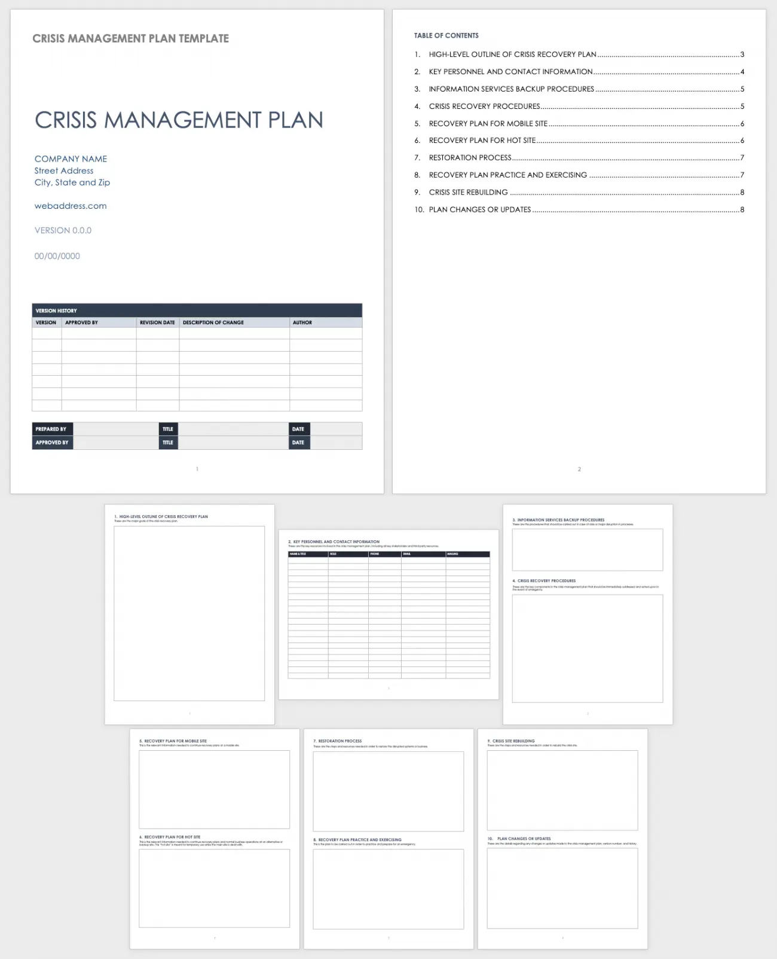
Step 2
Start Collaborating
Sample CMP Templates
A Strong CMP Needs a Collaborative Effort
Creating a crisis management plan is the most challenging part of your preparation. CMPs are used by regional business continuity teams, emergency management teams, crisis management teams, and damage assessment teams to avoid or minimize damage, and to provide direction on responding, staffing, resources, training, and communications.
A crisis management regional effort begins with designating a Crisis Management Team with a Steering Group and a Crisis Management Unit Manager (see Module 2). In the preparation stage, they should work together through the phases of identifying risks, developing and documenting response plans, practicing those plans, implementing them when needed, and reviewing the results. Within these stages fall key tasks such as detecting warning signs, damage control, learning from experience, and updating crisis plans are required. The CMP should be underpinned by a strong Training Schedule and Communication Strategy and Plan (See Modules 7 and 8)
See “Free Crisis Management Templates” to download templates for management plans, helpful checklists, and tabletop exercises.
Crisis Management Templates from Smartsheet

Slide 32
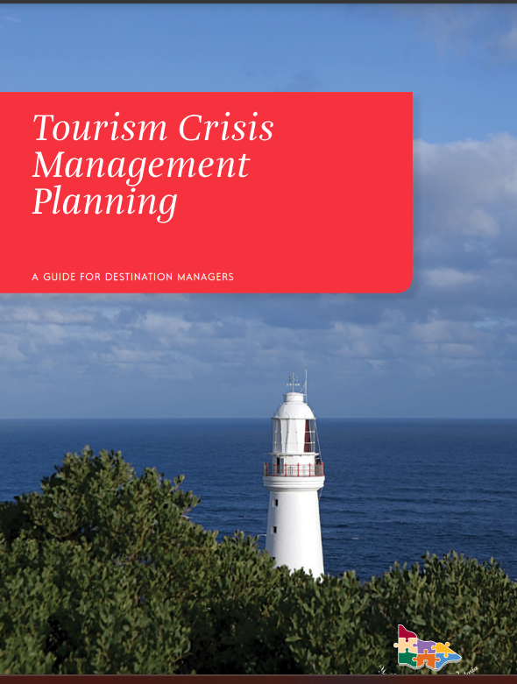
Case Study
Victoria, Australia
A CMP Should be A Collaborative Effort, Victoria States
Preparing your Tourism Crisis Management Plan should involve bringing relevant organizations together to brainstorm the most appropriate way to handle crisis situations, and recording the results. It is valuable to engage agencies and groups in the development of the Plan whom you may need to work with the management of a crisis. This will help to:
Inform your Plan with a range of expertise and new ideas;
Increase understanding of the tourism industry’s needs amongst participating organizations;
Assist with the coordination of crisis/emergency management plans in the region;
Gain the support of participating organizations and tourism businesses in the region; and
Foster more effective implementation of the Plan.

Slide 33
Case Study
Victoria, Australia
Planning is Both Educative and Developmental to Stakeholders
The Emergency Management Manual Victoria states:
The process of planning is both educative and developmental.
Production of a plan through a consultative process promotes a sense of involvement without which the document will be of less practical value to its users.
A well-managed planning process develops trust between agencies and individual officers, commits agencies to particular roles, and helps develop shared goals.

Slide 34
Steps How to Include Regional Stakeholders in Preparing a Tourism CMP
Identify and contact any existing regional or local emergency services and source their relevant plans.
Identify the main organizations that will have a role, or be impacted upon, in the event of a crisis in the region.
Conduct a workshop with representatives of these organizations and the Tourism Team to discuss the contents of your Plan, undertake a risk assessment and conduct crisis scenario planning.
Prepare a draft CMP based on the steps outlined in this document. Have a second workshop to refine the draft CMP.
Circulate the draft Plan and corresponding procedures and plans to participating organizations and other relevant stakeholders for comment.
Consult with tourism operators for feedback about proposed crisis management arrangements.
Finalise the Plan and procedures and attain sign-off from the Board or Crisis Steering Group.
Communicate the contents of the Plan to tourism businesses and other key stakeholders.
Publish any relevant crisis communication on the crisis management website to ensure visitors, tourists, and other inhabitants know what to do to respond to a crisis or support the CMP and procedures
Regularly review and practice the Plan and procedures.

Slide 35

Step 3
Key Elements
The CMP Has Essential Elements
An effective crisis management plan has a number of different essential elements. These include a risk analysis, an activation protocol, a chain of command, a command center and plan, response action plans, internal and external communication programs, resources, training, and an evaluation and review.
The Crisis Management Team is largely responsible for creating the crisis plan. All team members have input, and the team also consults other stakeholders, such as the tour operators, tourism organizations, the community, local government, staff, and senior management.
The Crisis Management Plan also spells out important roles in the crisis response and each person’s responsibilities. For in-depth instructions on how to form a crisis team, see Module 2

Slide 36
Key Elements of a Crisis Management Plan
Step 3
Create a List of all The Key Elements a Regional Crisis Management Plan Needs to Support the CMS
Once the Crisis Management Centre Manager understands the CMS they should get to work to develop the complementary CMP. All key elements of the CMP should be aligned with the CMS elements. (See Module 5)
There are several key elements to a CMP. According to business continuity and disaster recovery (BC/DR) expert Paul Kirvan, a crisis management plan should include:
An outline of the purpose, scope, and goals of the plan (these should be aligned and support the purpose, scope, and goals of the Crisis Management Strategy)
An Evacuation Plan
A Crisis Response Plan for each crisis that develops a framework to respond to and manage each crisis. This includes different Procedures and Tasks and Operations responses required for different crises and incidents; and
Contact information, including lists of staff, emergency, health and safety, tourism businesses, fire safety, and law enforcement
Media management supported by a Communications Plan
Integration with other Emergency Plans.
Source

Slide 37

A good Crisis Management Plan possesses a variety of elements that prepare crisis team members to effectively perform their duties when a crisis occurs,” explains Deborah Hileman, President and CEO of the Institute for Crisis Management.
“You should include team roles and responsibilities, the chain of command, the operations center details, the command system structure, and communication, mitigation, and recovery activities. You should also include protocols that are specific to certain common scenarios.”
‘Because emergencies are unpredictable — and crises rarely unfold exactly as you’ve rehearsed — your crisis management plan must be flexible and practical. Therefore, make sure that your plan can adapt to changing circumstances and that you can realistically execute it under pressure’.
Deborah Hileman, President, and CEO of the Institute for Crisis Management.
Responsible for consulting, training, and crisis communication planning to help clients plan and prepare for potential crises, and mitigate damage when a crisis erupts.

Slide 38
Identify crisis management team members.
Identify the possibility of different types of crisis
Document what criteria will be used to determine if a crisis has occurred.
Establish monitoring systems and practices to detect early warning signals of any potential crisis situation.
Specify who will be the spokesperson(s) in the event of a crisis.
Provide a list of key emergency contacts.
Document who will need to be notified in the event of a crisis and how that notification will be made.
Identify a process to assess the incident or crisis its potential severity and how it will impact the region and stakeholders.
Identify and document tailored processes and procedures needed to respond to a crisis and select emergency assembly points where people can go.
Develop a strategy for social media posting and response.
Provide a process for testing the effectiveness of the crisis management plan and update it on a regular basis.
Step 4
Aim to Tackle the Following CMP Initiatives First to Ensure Effectiveness. Extend the List with the Regional Crisis Audit Findings and Results.
Crisis Management Plans involve a lot of ‘planning’, preparation, analysis, discussion, development of processes and procedures and testing and training.
1

Slide 39
This study states the type of initiatives that should be included in a CMP
Tourism destination safety management can involve a number of initiatives (e.g. safety warnings, public rules, crisis management, emergency rescue services, and disaster recovery plans) (Becken & Hughey, 2013; Rittichainuwat, 2008, 2013).
The same study states the term ‘safety climate’, which is often applied in organizational studies, refers to the collective perception of policies, operations, procedures, and practices implemented to ensure tourism safety (Stackhouse & Turner, 2019; Yen et al., 2021).
A destination's safety climate is coloured by tourists' overall perceptions of safety-related issues based on personal evaluations of public safety regulations, supervision, and maintenance (Yen et al., 2021). The data unearthed four major subjects in this regard: human factors, environment and social order, facilities and equipment, and management factors.
Read Research Article

Slide 40
10 Key Elements of a Regional Crisis Management Plan
Risk Analysis
Activation Protocol
Chain of Command
Command Centre Plan
Outlines the scenarios and crises it thinks the region could face. Having a more specific sense of these potential occurrences guides the development of the plan. Not every risk needs to be included but covers a broad range, such as a natural disaster, a cyberattack, a loss of utilities, a technology failure, the death of a tourist, a shooter at an attraction, a financial crisis, an accident, and a service failure. This is covered in the previous Crisis Management Strategy phase.
The CMP should have a system with a series of triggers with a set of steps, rules, triggers, and communication as the natural first response to a certain emergency. Using levels of urgency as criteria for the level of response, define the circumstances that activate a particular crisis response. Explain how to escalate that response, in the event that a crisis turns out to be more serious than it first appeared. The protocol should establish some type of communication that signals the end of a crisis.
A region must include a crisis management regional organizational chart, so it’s clear who does what, who has final authority and who reports to whom. A well-defined org chart supports coordination and consistency, which fragmented regions sometimes struggle to achieve. Depending on the seriousness of the event, the CMP may call for additional layers of command. For example, an emergency at one site may activate the emergency response services team but also a tourism expert from the CSG.
This is usually called a Crisis Management Unit or Center and is what will serve as the base of operations for the team during a crisis. In addition, it has the resources, supplies and utilities the team or volunteers will require. In the event that the first command center is unavailable, it may be necessary for the region to designate a backup command center e.g., temporary set up in a community center. Please see Module 2 how to set up a Crisis Management Unit.

Slide 41
10 Key Elements of a Regional Crisis Management Plan
Response Action Plan
Internal Communication Plan
Resources
Regions need to create systems and backup methods for members of the crisis management team to communicate with each other. Collect contact information for all team members as well as anyone they might need to call upon, including outside consultants and subject matter experts.
Establish ways to disseminate urgent information to all employees, such as using a notification provider to send texts and automated calls or implementing a method for your employees to check in and report their safety and whereabouts.
Determine how it will share sensitive news internally, such as a threat to the region’s reputation, viability, or a loss of life. In addition, establish a schedule and mechanism for updates.
The region must perform detailed planning around how it will respond to various scenarios, risks, and hazards. This planning includes assigning responsibility for each task. These response actions should be approached as modular elements that should be rolled out as if the actual crisis situation is occurring and requires them. Conceptualizing crises in this way makes regional crisis management plans through and adaptable.
This is where the Crisis Management Team must think about everything they might need, from hard hats, to cell phones, to a dedicated residence, to credit cards, vehicles, and a standby public relations advisor, and line these things up. Information resources will be especially important in a time of crisis. These resources include e.g., maps of crisis areas, timelines, a crisis management website, helpline informatoin, flowcharts of key processes and procedures, emergency contacts, and more.

Slide 42
10 Key Elements of a Regional Crisis Management Plan
Response Procedures
External Communication Plan
Training
A Regional CMP needs to define an External Communication Plan to deal with external Media and PR. It is also used for communicating with the public and key external stakeholders. A spokesperson should be appointed.
A priority pre-crisis should be about building a strong relationship with external PR, media and stakeholders.
It should include detailed instructions, including who needs to be notified (e.g., media outlets in a particular geographic area).
A set of holding statements should be drafted for certain events and scenarios, the details of which can be edited or filled in later, once the relevant information is acquired.
Strategic communication objectives should be prioritized and outline talking points. The Communication Plan should align with other communication efforts.
A crisis management website or telephone line is critical to answering consumer or community questions.
Being able to execute the CMP quickly is paramount. Holding drills and exercises with the Crisis Management Team is crucial to that goal. Rehearsals or even tabletop drills can reveal flaws in the plan, and practice will help the crisis team become comfortable with their individual roles and work together. It must stay current by doing regular training. Training should be provided to other staff and stakeholders based on their strengths e.g., a hotel receptionist could train and teach others how to respond to crisis calls.
A crisis procedure is a document that instructs responders on how to execute one or more activities of a crisis response. It describes the sequence of steps and specifies for each step what needs to be done, often including when the procedure should be executed and by whom. This does not include emergency response e.g., fire, health, and police but other Crisis Management Unit activities that manage a crisis response e.g., industry communication, PR & Media, assessing the overall regional crisis response.

Slide 43
Step 5
Work with and Collaborate with the CMS Executives (Crisis Steering Group) for Support and Guidance
Regional tourism crisis management planning and the crisis preparedness plan are only as good as the personnel tapped to create and execute them.
The Crisis Manager needs to have a cohort of people. The Crisis Steering Group must be centrally involved in the creation and execution of the Crisis Management Plan this step is crucial to any positive outcomes. It should regularly review its performance and effectiveness at each crisis stage.
The Crisis Management Unit & Manager should feel fully supported by the Crisis Steering Group. For example; if the CMU Manager suggests it needs additional smaller teams focused on particular issues or crisis expertise. The CSG should review the request promptly with due consideration to help address the issue and provide relevant support, information, resources, and advice.
Crisis Managers should be trained in the CMP and making critical crisis decisions. When a crisis strikes, it tends to move quickly. This means the Crisis Manager needs to be confident in making quick decisions often in a high-stakes environment (possibly the highest). To relieve any stress and assist in making better decisions expert crisis training, support, mentorship, expertise, and resources should be provided. Practice ahead of time where information, expertise, and resources are limited.

Slide 44
A study states that emergency response measures, training, and disaster plans are lacking in the tourism industry
Many studies have found that the tourism industry did not have enough emergency response measures and disaster plans for natural hazards
In the tourism industry, staff training for evacuation responses and awareness of tourist business executives and managers were also low
However, tourism workers in coastal areas desired to learn response measures for tsunami warning [30]. Tourists have since demanded the preparation of tsunami evacuation and safety measures for the emergency management of accommodations in coastal tourist areas.
Read Research Article

Slide 45
Tourism Crisis Management Team Structure
The Public Private Partnership essentially brings together the expertise of the Government and the private sector to meet the priorities and needs of the public effectively and efficiently when in a crisis.
Public-Private Partnership Collaboration (Regional Level)
This is when all regional public and private representatives who want to be part of the crisis management of the tourism region come together to form a coordinated cohesive alliance or partnership.
All Regional Tourism Stakeholders
Crisis Management Steering Group (Executive Level)
Public-private sector partnership representatives or high level group. These are the key tourism crisis executive decision-makers, experts, strategic thinkers, leaders, local government, etc. They do not get involved with crisis response activities but support the Crisis Management Unit with expertise, guidance, and advice.
Crisis Decision Makers
Crisis Management Unit (Response Level)
This group is made up of all the crisis managers and responders. They are the people on the ground e.g., Emergency Response Teams, Emergency and Health Services, Crisis Hotline, Crisis Marketing, Media, PR & Communication Officer, Volunteers, etc.
Crisis Managers & Responders
Public & PR (Public & PR) (External)
All external stakeholders including; PR & Media, Tourism Agencies, Wider Public & International Individuals and Organisations, Existing and Potential Tourists, Visitors.
External Stakeholders

Slide 46

Stick to Good Crisis Management
It is vital to commit to crisis readiness for the long term
“Emergency planning is not a light switch, and it’s not a magic wand. It’s a process,”
Michael Fagel, founder of emergency response consulting firm Aurora Safety,
Prepare and make crisis readiness an ongoing process
Work closely with your peers, the Crisis Steering Group, and the Crisis Management Unit Team and keep everyone else updated
Stay calm and convey confidence to others. Enable others to help
Gather clear and accurate facts about the crisis as soon as possible
Prioritize people over property and infrastructure and anything else
Make sure the crisis team has the support and resources it needs
Empower people and your team with the CMP Crisis Management Plan, Training, Support, and Information
Don’t make things worse. Try to not deviate from the CMP. Never, ever lie
Communicate clearly and quickly but avoid a knee-jerk reaction
Don’t lose touch with humanity. Recognize people are under stress and may be grieving.
Learn from the crisis and fix any underlying problems revealed as soon as possible
Appoint one credible spokesperson and have consistent messaging
Source Smartsheet

Slide 47
Step 6
Include Regular Monitoring & Reporting Measures, & KPIs to Check Crisis Status and Manage Regional Preparedness
The Crisis Manager must regularly monitor, assess, compare and report the status of regional risks or crises identified in the Risk Assessment. Crisis status and priorities change over time so do their probability and likely impact. Heighten monitoring when the crisis is most likely to occur.
Monitor the crisis occurring. e.g., use weather programs to detect weather-related flooding. Check it more during the months of September to May when it is most likely. Document and report findings to those that need to know.
The devil (crisis) is in the detail. A crisis response plan is only as good as the activation guidelines it includes. To this end, the crisis management team needs to document all the criteria and crisis indicators they will use to determine how a crisis impact. Note: These are different from the CMS indicators.
Crisis Impact Indicators e.g., multiple injuries, an unnatural death, widespread infection, high unmanageable flooding levels, significant environmental damage, multiple properties damaged by falling trees, a large sudden decline in tourism numbers, a large sudden increase in cancellations.

Slide 48
Keep a Finger on the Regional Crisis Pulse!
The CMP helps the Tourism Crisis Management Unit to understand all the calamities that could befall their region, however, they must keep their finger on the crisis pulse by;
monitoring (e.g., water levels),
watching (e.g., the weather forecast)
researching (e.g., looking back on previous and forecasting predicted yearly trends),
updating (e.g., maps, plans, statistical reports)
reading (e.g., what other similar regions are doing or experts are saying) and
consulting (e.g., with experts and advisors)
building knowledge (e.g., knowledge exchange networks)
communicating with the community, local government stakeholders, and staff, not just tourism managers.

Slide 49
Step 7
Assign Roles & Responsibilities and Organise Resources
The CMU Manager and crisis team’s time is precious during a crisis, there is no time to be reactive. The CMU Manager must plan responders, resources, and responses in advance.
Time is precious during a crisis. Preparing and allocating precious resources in advance means the CMU can optimally be ready when a crisis occurs. It should rank the list of potential crises in order of likelihood and occurrence. Then have the necessary resources and procedures in place to respond.
In addition to setting activation guidelines and procedures, crisis management teams should make sure they have the key crisis emergency, response, and recovery teams in place. Assign and train them on their responsibilities and have a second backup person, just in case.
All responders should fully understand at a minimum their plans and procedures, relevant crisis logistics, the chain of the command structure for different potential scenarios, and off-site gathering points in the case of evacuations.

Slide 50
Step 8
Develop the Response Plans, Procedures, Actions, Lists, etc
Developing and implementing an incident response plan for a type of crisis involves several steps. The order depends on how critical infrastructure systems and resources are used, the potential vulnerabilities of those resources, and the effects on the region if the resources are disrupted or destroyed. The next part demonstrates what should be considered when developing a response plan for critical infrastructure
Sample Response Crisis Management Plan for critical infrastructure:
description, definitions, and scope;
risk and critical infrastructure vulnerability analysis;
delivery of required training to required people
process for reporting a critical infrastructure incident;
first responders and their contact details;
incident team members and their contact details;
infrastructure organizations and their contact details;
assessing the critical infrastructure incident and initial response steps;
site evacuations and employee relocation if the event is serious;
actions to perform during the critical infrastructure incident;
disaster declaration if the situation escalates;
launching Business Continuity Disaster Recovery plans;
criteria for standing down from the critical infrastructure incident;
post-event review and after-action report;
updating critical infrastructure response policies, procedures, training, hardware, software, and network services; and
scheduling and conducting testing of IR plans and updating them as needed.
Source

Slide 51
Support the CMP with Relevant Plans and Procedures
A crisis, which can last from a few hours to several days or longer, requires decisions to be made quickly to limit damage to a destination, or region by its key stakeholders and the public. A strong CMP should have a strong team in place pre-crisis each with a role to play. The CMP should be supported with a well-documented set of responses, procedures and actions to potentially critical situations so that regions can act quickly, should a serious incident or crisis occur.

Slide 52
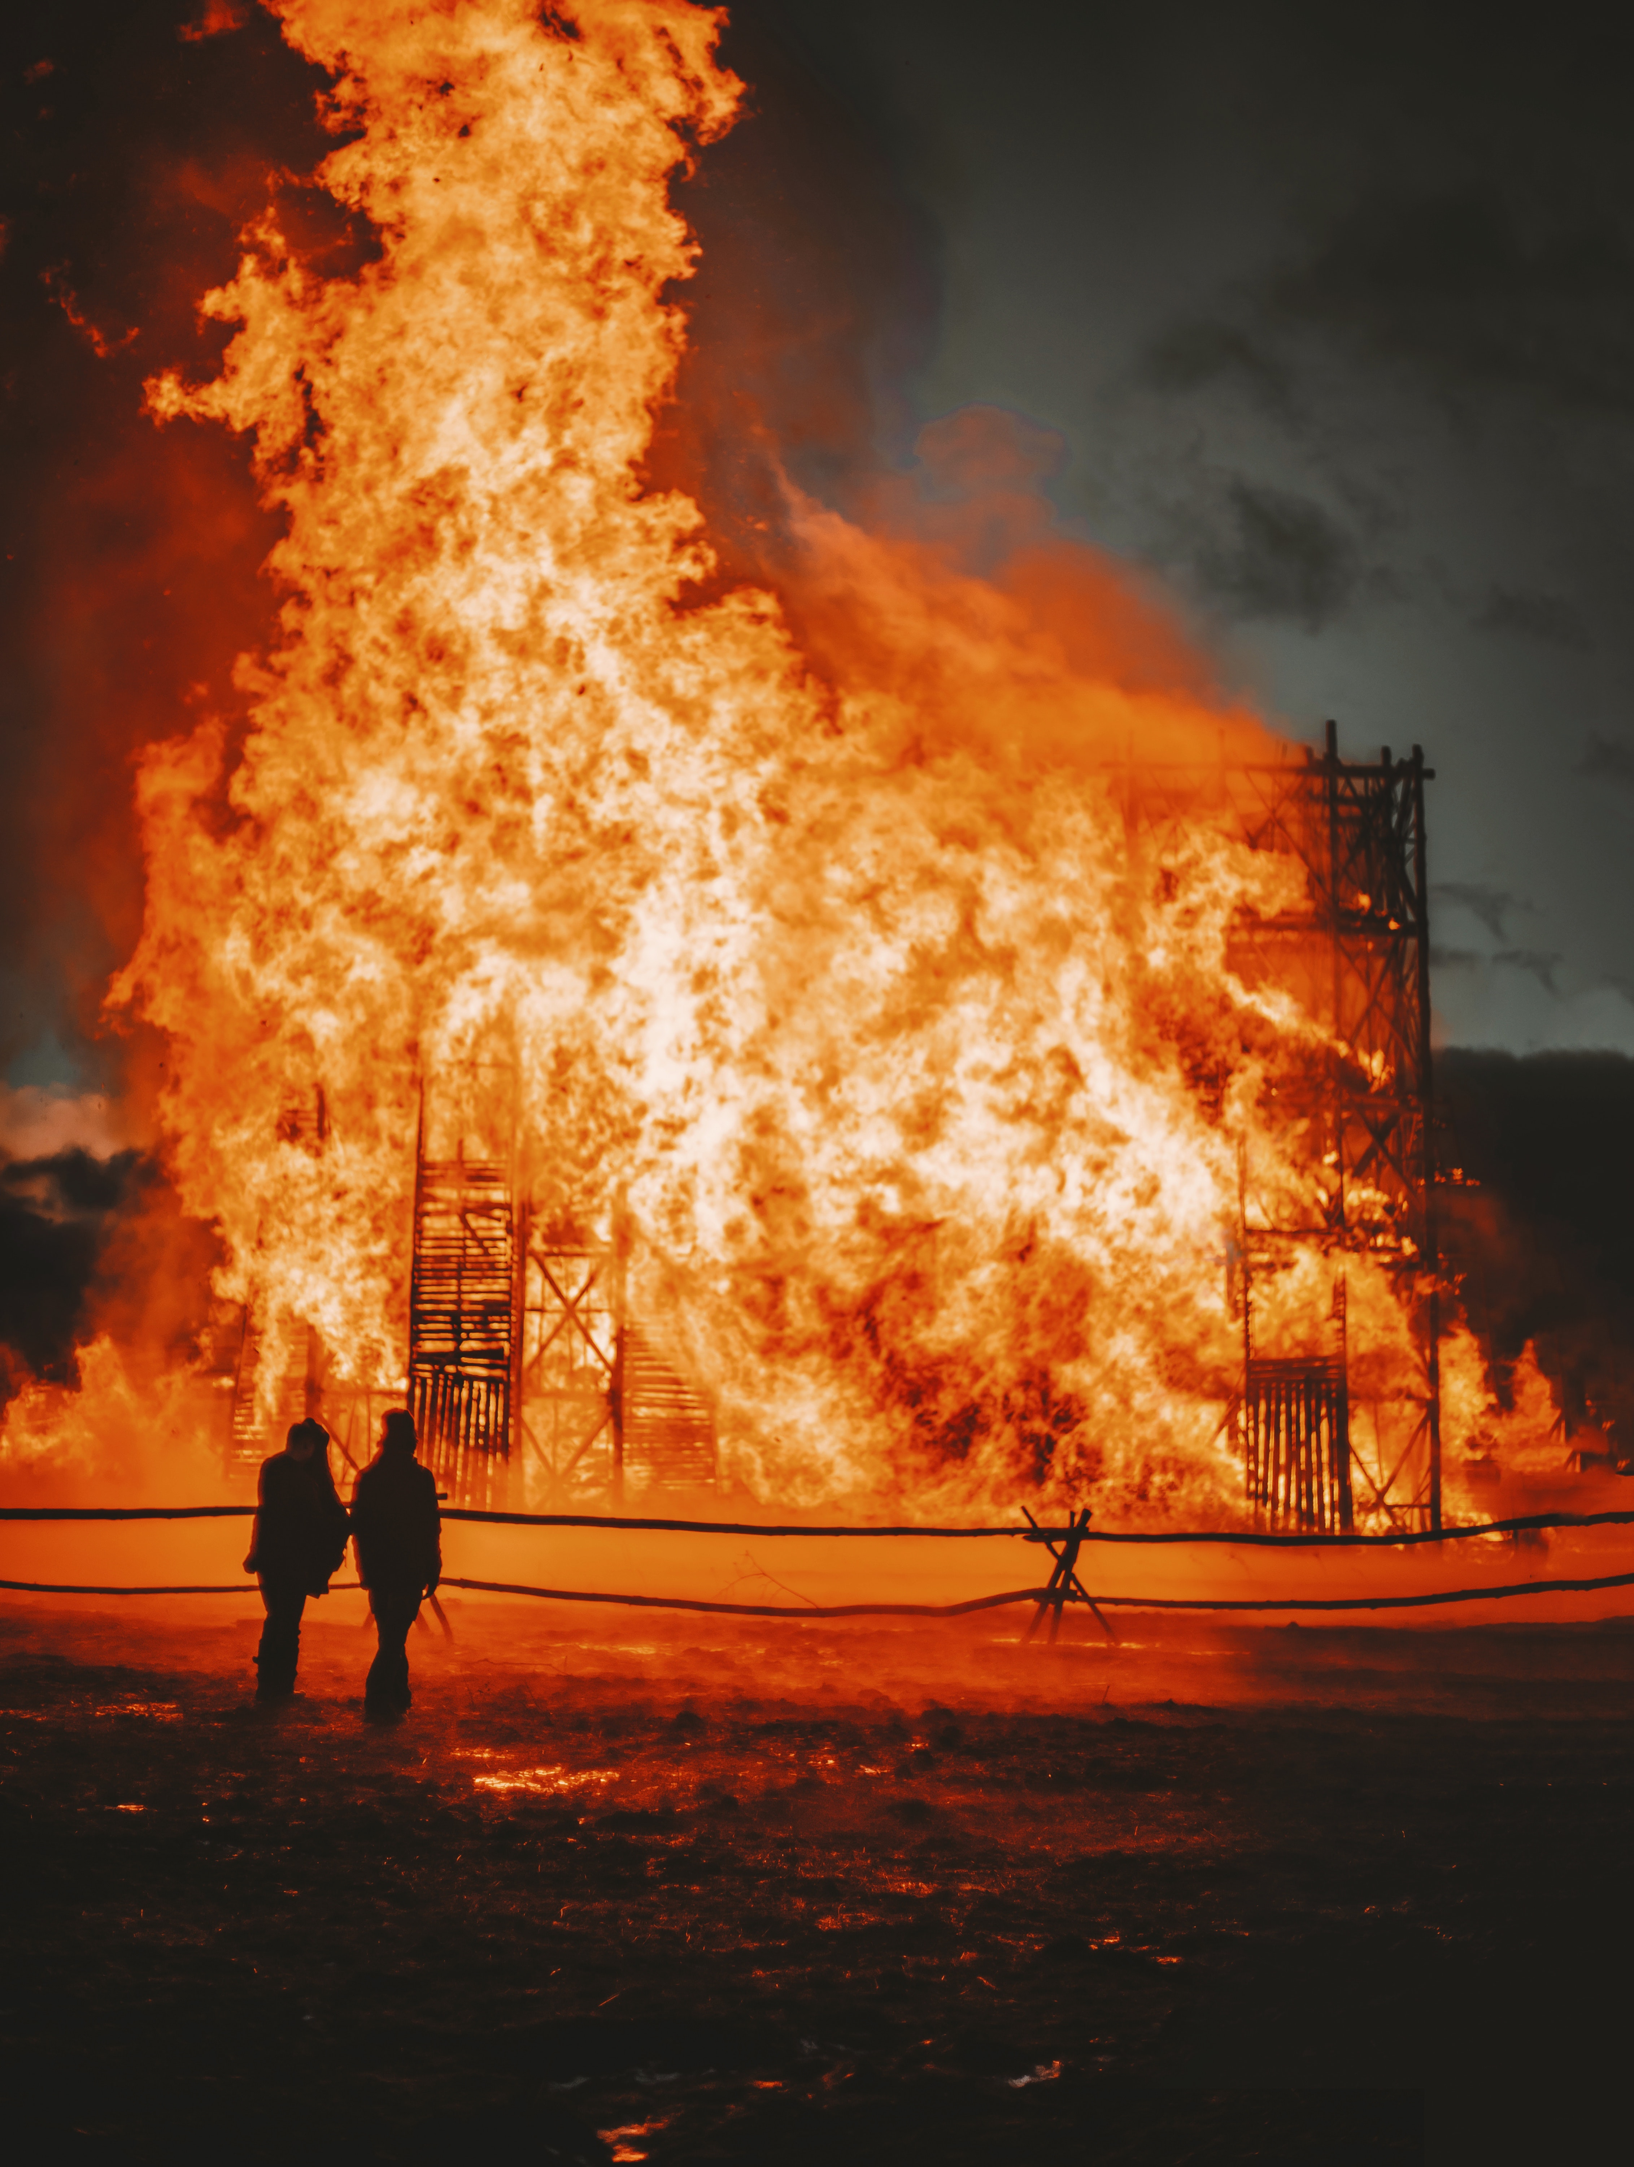
Getting the Tourism Region Crisis Ready
Once the Crisis Management Unit and Manager get the Crisis Management Plan, they must start working on what they need to do to make it happen e.g., allocate adequate resources to develop training, train responders, acquire staff or materials that may be needed, update key contacts, set up or update the crisis website and update the plan to record all activities and changes conducted.
A major goal of preparation is to keep regional operations running and resume them as quickly as possible in the event of a crisis. A business continuity plan focuses on this aspect of crisis management. See “Business Continuity Planning: How to Do It Well” to learn more. “Free Disaster Recovery Plan Templates”

Slide 53

Plans, Procedures, and Activities for a Flood Crisis
Preparation Phase; should include the following activities with relevant reports, logs, and procedures
Perform a risk analysis to understand the types of flooding events in the region and where
Analyze data on the weather for the likelihood of happening again
Analyze geography that could support floods detection and level of impact
Identify historical occurrences of flooding to measure potential reoccurrence
Identify potential internal building and external infrastructure vulnerabilities
Prepare incident response, business continuity, and disaster recovery plans that address flooding
Train stakeholders on responding to flooding
Identify alternate business operations if an evacuation is needed
Define how the region will operate post-flood
Create a Flood Business Continuity Plan and Recovery Plan

Slide 54
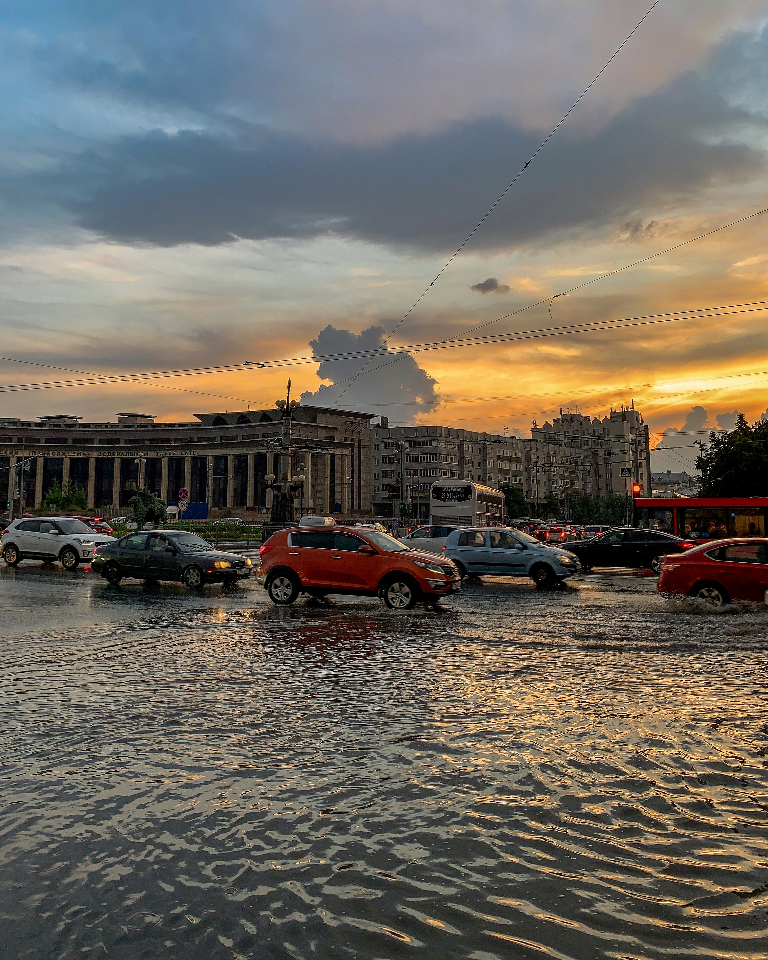
Plans, Procedures, and Activities for a Flood Crisis
Response Recovery Phases; should include the following activities with relevant reports, logs, and procedures
Update contact data for all employees, first responders, and other relevant emergency and crisis entities (e.g., fire, police, clean up, sandbag suppliers)
Install and test emergency notification and communication systems
Regularly test evacuation procedures (especially for people with high-impact or mobility challenges)
Establish logistics to relocate people to alternate locations.
Document internal procedures for dealing with health-related incidents from the flood
Establish procedures to recover businesses
Establish procedures to temporarily resume business activities until the effects of the flood can be determined
Complete on-site repair and clean-up activities
Replace, repairs assets damaged in the flood
Resume business operations to an acceptable level
Create a Flood Business Continuity Plan and Recovery Plan

Slide 55
This study emphasizes the need for tourists and tourism industry managers to receive crisis training
In terms of preparedness for crisis management and evacuation responses, a gap was found between the awareness of tourists and tourism industry managers. Many studies have suggested that simulation exercises and practical drills could be useful for tourism workers and that staff training is necessary. For crisis planning intention, subjective norm, attitude, perceived behavioural control, and past crisis experience were included as factors in the accommodation sector
Read Research Article

Slide 56
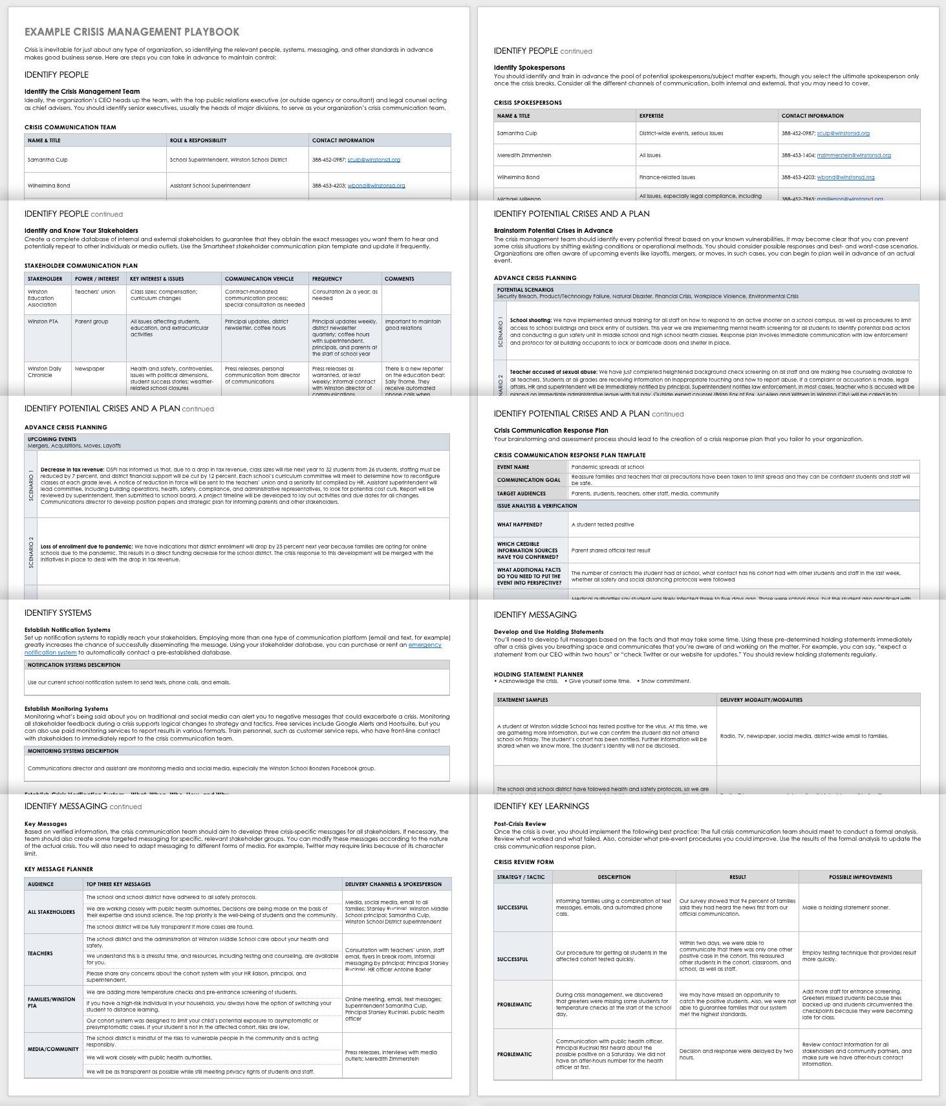
The Devil is in the Detail!
Crisis Management Playbook
Sample CM Playbook Templates
A crisis management playbook is a useful document to gather details of possible response actions, processes, and roles. In some ways, it is similar to a Crisis Management Plan, but the playbook is usually more detailed, succinct, and oriented to the immediate response actions.
Click to see an example of such a playbook. This example provided of a crisis management playbook summarizes how a fictional school district intends to respond to its most likely crises. The example goes into more detail on the response to a positive case of infectious disease including how to verify there is a crisis, key messaging points, and post-crisis analysis.
Imagine something similar happening in a tourism region setting e.g., a hotel or cruise ship contracts a virus how would you handle it?
Crisis Management Playbook Templates from Smartsheet

Slide 57
Step 9
Know when and how to initiate the Crisis Management Plan, Communication & Training
Its Best to Practice As Quickly as Possible! Communication and training are king and should start immediately addressing all stakeholders, tourists, and the public.
When dealing with a crisis good crisis management means responding quickly. A region must give the crisis its full attention so it can be resolved quickly as each stage requires a different response. (Stages explained in next slide)
Regular Consistent Communication. A region should issue a statement within the first hour of a crisis and publish frequent updates. Keep stakeholders, and other stakeholders informed about progress. If you’re unsure about frequency, err on the side of too much communication, rather than too little but be careful what you say! If you don’t know the solution or have any updates then that is your message.
Immediate Honesty and Integrity. If a region has little information it should act quickly and acknowledge the problem publicly. Regions need to assure they are working on resolving what happened, how it is being addressed, and when it should be solved.
Act Promptly Speak the Truth to Protect Reputation. It is always better to give a positive message from the horse’s mouth than gossip, and untrue rumours damaging the reputation of a region. If a region is at fault they need to own up and take responsibility. This, believe it or not, is a positive step it will prevent mistrust and resentment.

Slide 58
A sense of safety varies through each stage of the travel process
This study emphasizes intangibility in arguing that one's sense of safety varies throughout the travel process. Considering safety perceptions before, during, and after a trip unveils noteworthy topics that differ from stage to stage.
Read Research Article

Slide 59
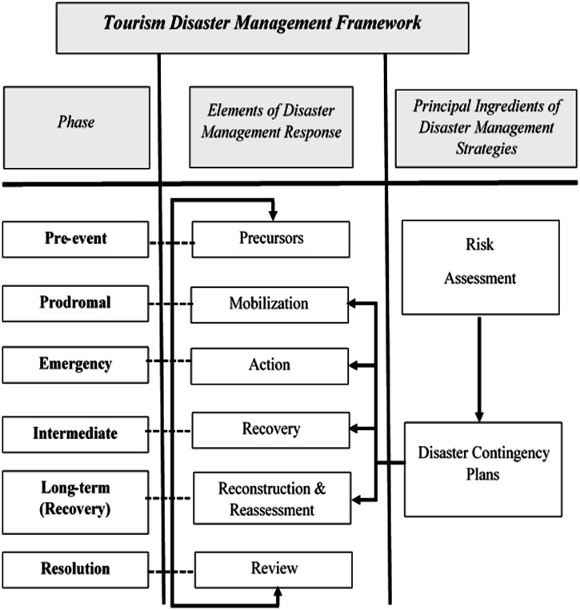

A Crisis Progresses Differently at Different Crisis Stages
CM theories assume that a crisis situation progresses through a series of stages wherein appropriate and timely action can prevent a crisis. This section summarizes the tourism disaster management framework adopted from Faulkner’s (2001) study. This framework consists of six phases of the disaster process, elements of responses, and the principal ingredients, which are the outlining prerequisites of effective disaster management strategies. Such strategies should be based on potential disaster assessments’
Pre-event
Prodromal
Emergency
Intermediate
Long-term (recovery)
Resolution
Source

Slide 60
Stage 1 Pre Event | In the pre-event stage, all efforts must be directed at preventing the crisis from occurring. Risk and crisis management and planning are needed in this stage to mitigate the impact of the potential crisis. At this time, some protocols, coordination, and disaster team appointment should be established, and communication is essential for keeping everyone well informed.
Stage 2 Prodromal | In this stage, it is apparent that a crisis is imminent. Prevention is no longer possible, and mobilization and contingency plans are instead needed. Moreover, at this point, leaders should begin reviewing and revising their marketing and communication plans.
Stage 3 Emergency | In the emergency stage, several impacts occur due to the crisis. Swift action is essential in this stage to protect the people, property, and establishments.
Stage 4 Intermediate | Immediate actions are needed in this stage to return to normality. The main focus is to plan a recovery step. Address the short-term and intermediate needs of employees. Clear media communication is also crucial in this stage.
Stage 5 Long-term (recovery) | This stage is a continuation of step 4; nevertheless, it requires swift action to implement the plan formulated in the intermediate stage. Leaders begin to conduct self-assessment, analysis, and healing. The main point is to engage in reconstruction and reassessment, correct any environmental problems, and reinvestigate (and debrief) strategies. The practice example is the rebuilding and reconstruction of damaged infrastructure and environmental areas.
Stage 6 Resolution | In this stage, all efforts are directed to return to the former routine, as well as to review the decisions made and enforced by the team. Procedural improvement is also required.

Slide 61
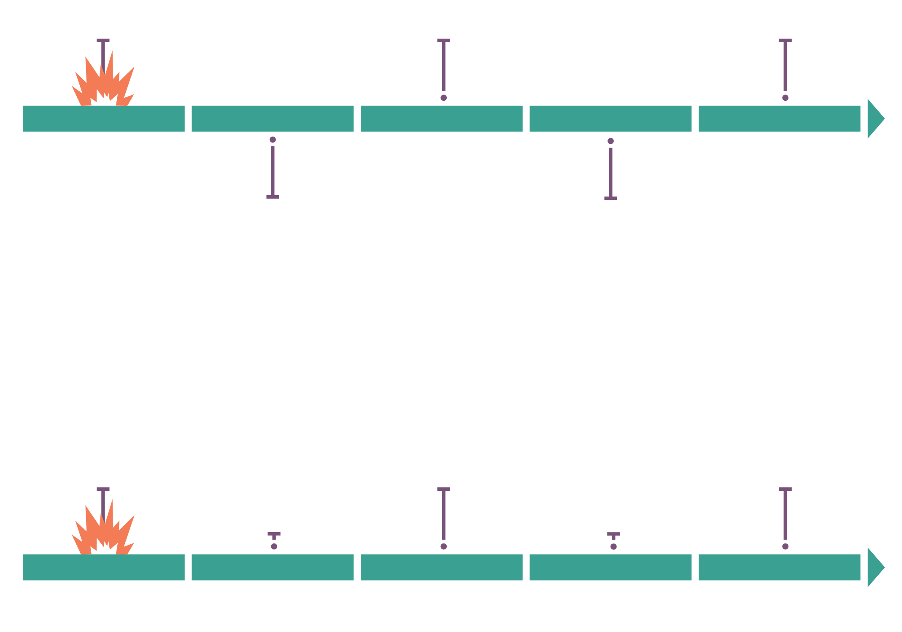
Incident response planning
Decide next steps: BD/DR plan, evacuation plan, stand down, other
Launch incident response plan
Event occurs
What do we do?
Perform actions from incident response plan
Timeline from securing incident to business continuity
Emergency management
Business continuity
Event occurs
Incident management
Disaster recovery
Source
Source

Slide 62
This study emphasizes early warning can build a culture of safety and resilience
Enhancing early warning and building a culture of safety and resilience have also been driven by factors of the Hyogo Framework for Action (2005) and Sendai Framework for Disaster Risk Reduction (2015).
Surveys on tourists’ perceptions of tsunami risk indicated a lack of knowledge of local and regional natural hazard risks and issues of information communication. Many tourists in high tsunami-risk areas also did not know whether the places they were currently in were in tsunami-risk areas.
https://www.sciencedirect.com/science/article/abs/pii/S2212420922003107
Read Research Article

Slide 63
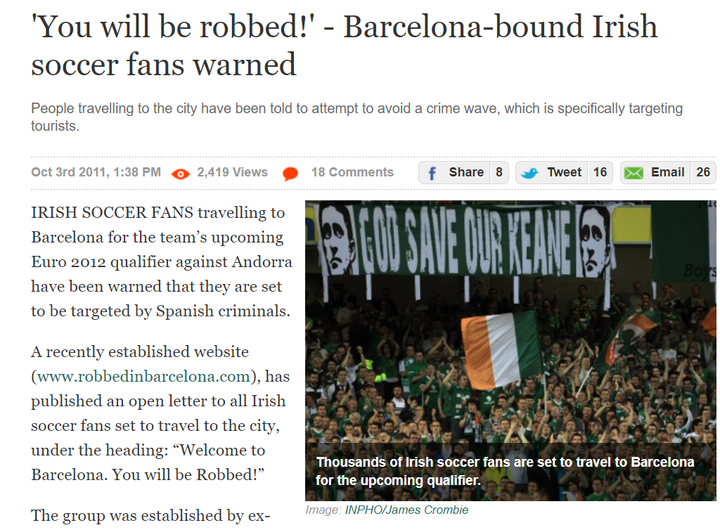

Case Study
Barcelona Initiates Crisis Management Plan at Different Stages of its Pickpocket Crisis
Crime Crisis, Barcelona, Spain
The Catalonian capital is notoriously rife with pickpockets. In 2018 there were an average of 12 robberies an hour, according to Spain's interior ministry. The large drop-off in street robberies in 2021 - plummeting by 56 per cent compared to 2019 - suggests the ebb in tourists was a big contributor.
More than 80 people were arrested over a single weekend from 20-21 May 2022, largely for theft, according to local media reports.
‘In 2018 there were an average of 12 robberies an hour’.
Article

Slide 64
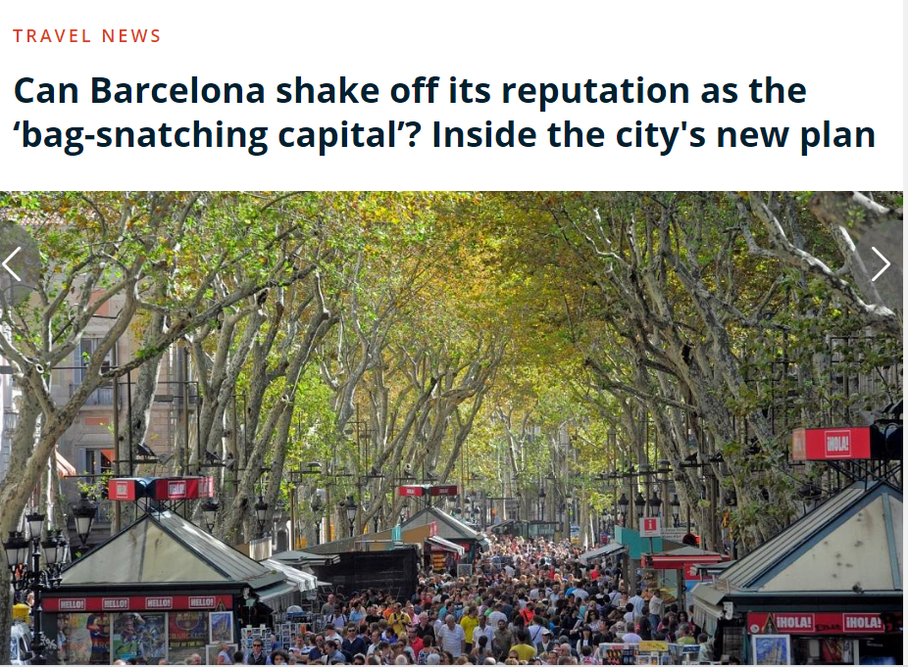
‘Operation Summer’ Campaign
The cities new 7 pronged Operation Summer Plan to tackle crime where there will be
12% or 349 more police officers in the busiest areas with both plain and uniformed clothing
Increased the city security budget by 16%
Tougher sentences against repeat robbers
Developed a dedicated Tourist Guide for tourist if they are robbed in Barcelona. Gives advice and steps on what you can do to reduce risk, app, map of police stations etc.
90 officers to patrol the seafront with an extra 32 vehicles
Implementation of ‘safe routes’ especially those near public transport
Strategy ‘Operation Summer’
Article 1 , Article 2, Article 3

Slide 65
How Barcelona Initiated a CMP at Different Crisis Stages
Stage 1 Preparation/Mitigation
Identify and Clarify the Problem/Challenge before it happens
e.g., too many tourists getting robbed
Stage 2
Response
Analyse the Risk Levels & Impacts
e.g., where is it happening, how often, time frames, how severe are the robberies , are they violent etc
Step 3 Recovery/Review
Analyse Why It Happens and Why Tourists
e.g., is it because the tourists are walking around with maps, is it happening in busy areas where there are touristic sites, how are they being robbed
Step 3 Recovery/Solutions
Evaluate the Risk & Come up with Solutions (or refer to CMS and CMP)
e.g., tourists aren’t protecting themselves properly. Solution to provide a Guide for tourists on how to prevent getting mugged and a Tourist App so they don’t look so obvious.
Step 6 Recovery/Resilience
Monitor Effectiveness of Plans, Analyse and Report
e.g., check police reports of pick pocket, check if there is an increase or decrease, if tourists are still the targets, check where they are happening, etc.
Step 5 Recovery/Rebuild
Treat the Risk & Implement the Solution(s)
e.g., increase street security by increasing number of police and getting them to wear normal and uniform clothing.

Slide 66
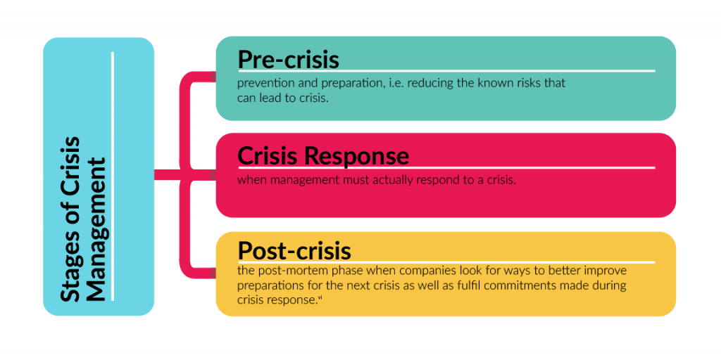
Training Development and Delivery is Essential
A region should develop a CMP and its corresponding support documents, procedures, and activities according to the different stages of a crisis. The manager needs to include all the things that need to happen at each stage of a crisis (preparation/pre-crisis, response, and recovery/post-crisis) see the diagram to the right.
Training is an essential part it gets everyone knowledgeable and on the same page before and when a crisis occurs. Training should be delivered pre-crisis so everyone should know what they need to do at each stage. Particularly the Crisis Management Team (i.e., Crisis Steering Group, Crisis Management Unit, emergency services, etc.) should be trained so they know how to activate and implement the plan. As a rule, acting and responding as soon as possible can help a region greatly reduce the damage caused by a crisis, training enables this to happen.
Set up a training needs analysis session. Start by delegating tasks, and allocating and explaining roles clearly so that attendees can identify the skills and resources gaps. It is also a good way to cover questions and concerns.
Sample activities that occur at each stage of a crisis.
Pre-crisis the CMP and risk assessment are done before the crisis unfolds, staff get training, and skills and understand how to prepare, manage, react, and recover from the crisis
Response stage decisions are made and everyone knows their role, and what to do, and puts the CMP into action. A Communication Plan should be set up at this stage.
Resolution stage is where everyone is actively doing their duty and all is hopefully under control.
Post-crisis is when the recovery plans are put in place and everything starts to return to normal again.

Slide 67
Optimising Management of a CMP
CMP’s are important to develop operational responses and specific contingencies. It is important regions keep considering and reviewing a wide range of potential crisis and prevent them from occurring (Read Source)
Reverse Engineer
Conduct Regular Vulnerability Audits
Regular Crisis Training
Collect Intelligence
Empower with Knowledge & Skills
Learn from others’ mistakes
Examine & Assess the Risk
Be Fully Aware & Informed
Educate and empower stakeholders on how to act and respond to a crisis adequately. Deliver Crisis Prevention and Response Training using different formats from table top exercises, and drills to full-scale simulations.
Know what you need to know to prevent a risk of crisis. Set up and monitor your warning signals e.g., internet cantered communication, digital tools, ear to the ground and empower employees.
Research how other regions failed to prepare or respond to a crisis, disaster, lawsuit, death or major complaint.
Assess and examine current and potential areas of operational emergency and crisis weaknesses, and strengths, and come up with potential solutions
Optimise Physical Systems
Prepare Response Team
Backup, Backup Data
Review and Update
Capability before Position
Protect and Store Data
It’s an investment, not an expense
Test and Plan Response
Test how technology and physical systems function under a crisis. What happens when the website or emergency lines crash under stress with too many hits or calls?
The Crisis Response Team should be assessed if they have the right skills, ability, and capacity to carry out a certain crisis response e.g., just because John is an expert firefighter doesn’t mean he can talk to the media
Organise and back up all important computerized data. Not just business contracts but crisis response information e.g., response teams’ information, employee knowledge that is critical to operations, and expert knowledge critical to a crisis response
Crisis management planning and training should be regularly reviewed and tested. Changes in tourism is inevitable. Personal turnover is routine. Update and retrain training. Update procedures. Regroup regularly with experts to optimize your CMP.

Slide 68
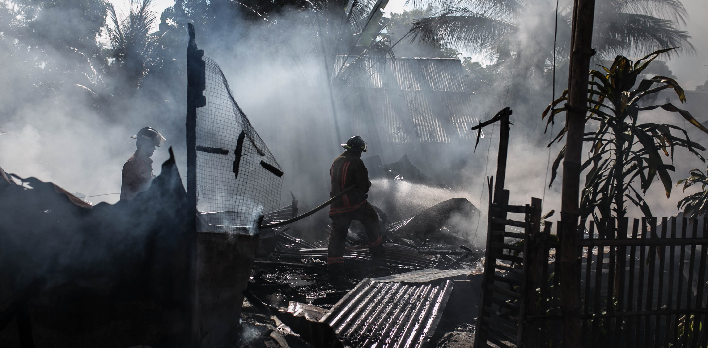
4. Template to Support the Development of a Robust Crisis Management Plan

Slide 69
Regional Tourism Crisis Management Plan (Flooding) |  |  |  |  |  |  | Approved by Dermot Johnston Leitrim Tourism Regional Crisis Manager
Priority | Purpose/Crisis Description Carrick on Shannon is known as the ‘marine capital of Ireland’. Huge flooding is occurring on a yearly basis often taking tourism businesses more than 6 months to recover. It has been moved into a severe risk category. Read |  |  |  |  |  | Date Assessed 3 July 2020
 |  |  |  |  |  |  | Date Updated 3 July 2022
 |  |  |  |  |  |  | Person Responsible Tony Hughes, Manager of Tourism Crisis Unit
 | High Priority Status Flooding of Carrick on Shannon Town and Surround Region
High-Level Outline of the Crisis Recovery Plan These are the major goals of the crisis recovery plan | Role |  |  |  |  |  | Contact Details
Text here
Key Personnel, Partnerships and Contact Information These are the key personnel involved in the crisis management plan, including all key stakeholders and third-party resources. Identify the TCMG’s roles and list members and key positions. Identify other internal crisis management roles and contacts that will support the TCMG.
Name and Title |  | Role | Phone |  | Email | Address |  |  | Expertise
General Emergency |  | xxxx | xxxx |  | xxxx | xxxx |  |  | xxxx
Text here
Action to be Taken to Prepare or Reduce the Risk These actions come from the Risk Assessment, Crisis SWOT Analysis, Regional Crisis Audit, and CMS |  |  |  | When |  |  |  | Report/Plan/Procedure
Participate in regional emergency flood planning and response meetings Communicate regional emergency plans with industry stakeholders Train the tourism industry in preparing for a flood disaster |  |  |  | Ongoing Ongoing By March 2024 |  |  |  | See Risk Management Plan

Slide 70
Information Crisis Response – Emergency Services Procedures and Plans These are the procedures that should be carried out in case of crisis or major disruption in processes. Identify and implement other emergency/crisis management plans and procedures that have been developed for the region or local area that this procedure will need to link with.
Resources Needed (Checklists, Equipment, Tools, Technology, Vehicles, Contacts etc)
Risk Assessment and Responses (potential risks that could occur and recommended responses)
Crisis Communication & Plans (Industry & PR and Media) (Identify tourism industry stakeholders and audiences you may need to work with. Identify communication tools available. Identify sources of funding for a communications program. Develop Communication Plan for Industry and a separate plan for PR & Media. Identify what is needed and how to communicate with visitors during a crisis, and in the recovery phase)
Communication Plan for Industry. Identify how a region will support the work of emergency service agencies and contact the tourism industry. Identify and plan the communications with emergency services that are needed to undertake during a crisis, and in the recovery phase.
Communication Plan for PR & Media. Identify what communications with the media a region needs to undertake during a crisis, and in the recovery phase. Identify protocols for working with the media. Work up proformas for communications pieces such as a media release, and holding statement. Have a relationship-building plan in place.

Slide 71
Crisis Recovery Stakeholders Procedures and Plans These are the key components in the crisis management plan that should be immediately addressed and acted upon in the event of an emergency.
Recovery Plan for Mobile Site This is the relevant information needed to continue recovery plans at a mobile site should it be needed, or the Crisis Management Unit become inaccessible. This is the relevant information needed to continue recovery plans and normal business operations at an alternative or backup site. This “hot site” is meant for temporary use while the main site is dealt with.
Recovery Marketing Plans and Strategies Have the generic recovery marketing strategies and actions ready to edit, update and roll-out
Restoration Process These are the steps and resources needed in order to restore the disrupted systems or business. Identify how you will assist the tourism industry to be better informed about crisis management for their businesses and business continuity at different crisis stages.
Recovery Plan Practice and Exercising This is the plan to be carried out in order to practice and prepare for an emergency. Identify how and when a region should review, test and update its Plan Refer to all checklists for Pre-response, Response, and Recovery phases.

Slide 72
Crisis Site Rebuilding These are the steps and resources needed in order to rebuild the crisis site.
Plan Changes or Updates These are the details regarding any changes or updates made to the crisis management plan, version number, and history.
Media Communication Plan
Method/How |  | Stage of Crisis/When |  |  | Message or Statement/What
Incident Diagnostics
Incident | Scenarios | Scenarios | Solutions/Actions to Implement | Possible Results | Actions | Department Responsible
Recovery Plan
Recovery Strategy Implemented | Recovery Category |  | Impact on Business | Actions/Tasks |  | Person Responsible

Slide 73
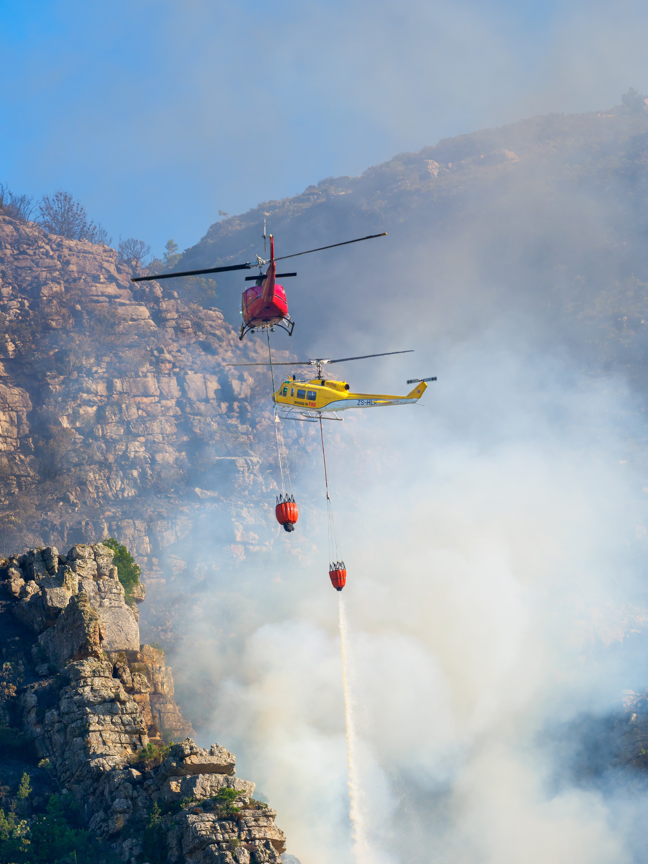
Conclusion
Worldwide and local experience has shows that when a crisis occurs, the absence of effective crisis preparation, response and recovery activities can be devastating to local businesses, towns and regions.
While regions may be well serviced by emergency management plans at a local government level and by plans prepared and maintained by other agencies, some of these plans do not specifically address the communication needs of the tourism industry.
The TC NAV Crisis Management Plan will assist European regions to take a proactive stance and quickly and effectively respond to ensure that impacts on the tourism industry are minimized. Regions will also be able to make their best endeavour to minimize any long-term reputational damage to their tourism industry.

Slide 74
Module 1
Module 2
Module 3
Phase 1 Preparation & Mitigation
Introduction to Regional Crisis Tourism Management & Its Complexities
Set Up a Regional Public Private Partnership & Crisis Management Team
Conduct a Regional Crisis Vulnerability SWOT Analysis and Destination Audit
Phase 2 Planning,
& Response
Module 4
Module 5
Module 6
Develop a Regional Crisis Management Strategy (Long Term Mitigation Planning)
Develop a Regional Crisis Management Response Plan (Short Term Response Plan)
Response Activation and Communication with Industry for Regional Collaboration
Phase 3
Recovery, Rebuild, Resilience
Module 7
Module 8
Module 9
Communication Strategy and Dealing with PR & Media
Strategic Regional Crisis Response and Recovery Marketing
Regional Recovery, Rebuilding & Resilience Towards a ‘New Norm’ Post Crisis

Slide 75

Well Done!
You Have Finished
Module 5 Regional Crisis Management Plan (Response and Recovery)
Now Get Ready for
Module 6 Response Activation and Communication with Industry for Regional Collaboration
https://www.tourismrecovery.eu/
Facebook
Momentum, Ireland Developer of Modules
The European Commission supports the production of this publication and does not constitute an endorsement of the contents which reflects the views only of the authors, and the Commission cannot be held responsible for any use which may be of the information contained therein 2020-1-UK01-KA203-079083

