Slide 1
Module 7:
Crisis Resilience

Slide 2
Resilience is a success factor in a crisis.
1
Organisational crisis resilience
After completing this module, you will have insight knowledge on…
2
Future-oriented tourism offers
3
Factors influencing resilience
4
Sustainable tourism development
This presentation is licensed under CC BY 4.0.
To view a copy of this licence, please visit https://creativecommons.org/licenses/by-sa/4.0/deed.en

Slide 3

After completing this module, you will…
…have deepened your understanding of resilience
…know what organisational resilience is and what companies can do to achieve it
…be able to understand and win the guest of the future
…be familiar with factors that influence resilience in tourism SMEs
…know why resilience and sustainability go hand in hand
Photo: Adobe Stock

Slide 4
Organisational Resilience

Slide 5

In almost all cases, crises could have been prevented. Most situations can be predicted – and if you can predict them, you can prevent them - or at least minimize their effects.
Hard truth about corporate crises
Most crisis situations can be PREDICTED and PREVENTED; those that can’t be avoided can be MINIMISED.
The longer a crisis goes on, the MORE DAMAGE to attendance, earnings, stock price, morale, competitive position and trust in management.
To achieve crisis resilience, organizations need to LEARN from what goes well - and not just from what went wrong.
MANAGEMENT DENIAL is the biggest obstacle to effective crisis management.
Serious problems don’t become a “crisis” until the PROBLEM “ESCAPES” MANAGEMENT.

Slide 6

The primary goal of tourism SMEs should be crisis prevention.
The Crisis Resilience Ladder
There are different levels of crisis resilience for companies. The goal should be not only to react to crises when they occur, but to anticipate them before they happen.
The key is prevention.
Generative
Proactive
We anticipate and prevent business crisis
Calculative
We constantly analyse and work on problems that we find
Reactive
We have systems in place to manage a crisis
Apathetic
Crisis Management is important, lot of firefighting once the crisis emerges
Who cares as long as we don’t have a problem
Increasingly crisis resilient & increasingly vigilant

Slide 7

Resilience is about change, recovery and adaptation.
What is organisational resilience?
Ability of a company to…
… recognize, perceive and prepare for market or environmental developments that threaten the company in a changing environment in good time.
1
… survive disruptive events and stabilize the company after a period of stress.²
… respond to unforeseen events and manage lasting change.³
1 - International Organization for Standardization (Hrsg.) (2017): Security and resilience – Organizational resilience - Principles and attributes. ISO 22316. Genf: International Organization for Standardization.
2 - Bishop, T. J. F.; Hydoski, F. E. (2009): Corporate Resiliency. Managing the Growing Risk of Fraud and Corruption. Hoboken, NJ: Wiley & Sons.
3 - Becker, B.; Braumandl, S. & Schoemakers, J. (2019): Digitale Transformation: Resilienz als neue Schlüsselressource. Überleben im permanenten Veränderungsdruck. In: ZCG, 14(2), S. 19–22.

Slide 8
The ISO standard is a good guideline for the different approaches to make tourism SME more resilient.
The nine factors of organisational resilience I/III
Based on research and practical cases, a panel of experts developed concrete recommendations for the International Organisation for Standardisation (ISO) standard 22316 on organisational resilience.
Organisations can take action in nine key areas to increase their resilience:
1. Shared vision and clarity of purpose
Vision, purpose and core values should be unambiguous and communicated to all interested parties regularly reflected upon and adapted as needed.
2. Understanding and influencing context
Customer relationships are cultivated, the actions of the competition are analysed, market developments are recorded and strategic measures are aligned accordingly. This increases the scope for action and opportunities to exert influence are used.
3. Effective and empowered leadership
Leadership is based on trust, integrity and effectiveness. Leaders offer orientation even in uncertain times and remain capable of acting, while employees take responsibility and actively participate in the decision-making process.

Slide 9
The ISO standard is a good guideline for the different approaches to make tourism SME more resilient.
The nine factors of organisational resilience II/III
These fields of action result in various possible approaches to support the company in navigating between flexibility and security.
The security systems must be strong enough to withstand disturbances.
At the same time, companies need a high degree of flexibility to be able to react quickly and efficiently to stresses and disturbances.
4. A culture supportive of organisational resilience
Fundamental values are known, shared and embedded in everyone in the organisation. Mutual support, open error culture and commitment to shared values foster open communication, innovation and creativity.
5. Shared information and knowledge
Knowledge is recognised as a significant resource that is created, preserved and used. Knowledge, experience, skills should not be lost or only used in individual areas – they are shared effectively and systematically so that everyone in the organisation benefits from it.
6. Availability of resources
Resources are routinely reviewed, continuously expanded and profitably utilised. Employees are supported in their development. Technologies are used to improve work processes, eliminate weaknesses and ensure the ability to act in case of unforeseen events.

Slide 10

The ISO standard is a good guideline for the different approaches to make tourism SME more resilient.
The nine factors of organisational resilience III/III
7. Development and coordination of management disciplines
Different management disciplines are capable of acting and are constantly being developed. They coordinate and cooperate with each other and are able to work well together in response to current events in the organisation (interdisciplinary cooperation).
8. Supporting continual improvement
Measures and results are regularly evaluated to learn from experience, identify opportunities and overcome difficulties. Processes, strategies and goals are analysed and optimised. This also includes transparent feedback.
9. Ability to anticipate and managing change
The company is able to react quickly, flexibly and agilely to changes and even anticipate them. Resilience is increased when the company prepares for change or unexpected events.

Slide 11


SMEs need to plan effectively but also adapt to change to be resilient.
Resilience and its challenges
To be resilient in times of crisis, organisations need to manage a number of apparent contradictions, juxtaposing effective planning with adaptability to changing circumstances:
Leaders who are able to give people a sense of hope and direction while understanding the situation they are in
An organisational culture that values disciplined planning while encouraging innovation
Plan and make decisions carefully and in a structured way, while being responsive and bold
Teams that are able to recognise patterns and integrate information to understand a chaotic situation, while being alert to subtle changes as the situation evolves

Slide 12


Please watch: Building Resilience and Community in the Service Industry
Example of a resilient restaurant
Melissa Miranda shares her experiences with a broken, abusive restaurant industry, and her dreams of a better way of leading - through kindness, community and compassion. When Melissa started her own restaurant in 2020, she envisioned a new business model centring around collaboration and empowerment for her employees. The pandemic proved to be a test of her new community philosophy - a philosophy that resulted in a thriving restaurant, proving that what is good for people is also good for business.
Source: TED
https://youtu.be/t8XEF_X6GK8

Slide 13
Basically, most of the results in SMEs come in as expected.
Learning from what goes right I/III
Most activities in companies have more or less exactly the results that are expected.
Event Frequency
Unwanted
Outcomes
Expected
Outcomes
Positive
Surprises

Slide 14
There is as much value learning from ‘what goes right’ as ‘what goes wrong.
Learning from what goes right II/III
We try to learn especially when something has gone particularly wrong.
Event Frequency
Scope of learning activities
Unwanted
Outcomes
Expected
Outcomes
Positive
Surprises

Slide 15
If you don't look at the processes that are going well, you miss learning opportunities to achieve crisis resilience.
Learning from what goes right III/III
Daily work is a rich and often untapped source of learning.
It is an incredible wealth of knowledge to learn from it why something works exactly the way it does.
Event Frequency
Missed learning opportunities providing insights for crisis resilience
Scope of learning activities
Unwanted
Outcomes
Expected
Outcomes
Positive
Surprises

Slide 16
Understanding and winning the guest of the future:
future-oriented tourism offers

Slide 17
To develop a sustainable offer and thus increase crisis resilience, a tourism SME can orientate itself in five steps.
Big five for future-oriented tourism offers
Understand the guest of the future
Create unique travel occasions based on the guest's desires and needs
Create desires
Communicate precisely with the guests
Immerse guests in worlds of life

Slide 18
It is important to understand the guest of tomorrow in general and the needs of one's own target group in particular.
1. Understand the guest of the future
Trends should be taken into account:
Getting to know the current and future target group:
Travel behaviour has changed, increasing tendency towards local markets
Guest wants to relax from everyday worries
Guest wants to be a temporary local
Guest is comfortable and wants to be pampered, processes have to run smoothly
Guest is looking for more exchange
Guest is looking for new impressions and experiences
Host is a door opener to the living space of the locals
Creation of guest profiles to gain an in-depth understanding of the guest
Profile based on a realistic description of their personality
Insights from conversations with guests, data / information about future guests
For 3-6 most important target groups
Key data and description of values, attitudes, cultural environment

Slide 19



Travelers want to leave everyday life behind to experience something new. Tourism SMEs should try to provide unique experiences for guests.
2. Create unique travel occasions
Top three themes for travel occasions of the future according to a German study:
Wellbeing & health
Special experiences through tranquillity, e.g. green power places with plants, water pools, high-quality relaxation rooms
Special spa offers, e.g. spa in the nature, privately bookable rooms
Learning about health topics for use at home, e.g. yoga, breathing exercises, meditation
Indulgence & food
Culinary experiences to remember / exceptional setting
Regional and local dishes / visits to suppliers in the area
Learning about nutrition, e.g. cooking classes / experimental ways of preparing food / trying out food trends
Culture & entertainment
Try out artistic activities
Thematic festivals
Source: Fraunhofer IAO (2020): Futurehotel - innovative Erlebnisse als Erfolgsfaktor für die Hotellerie

Slide 20
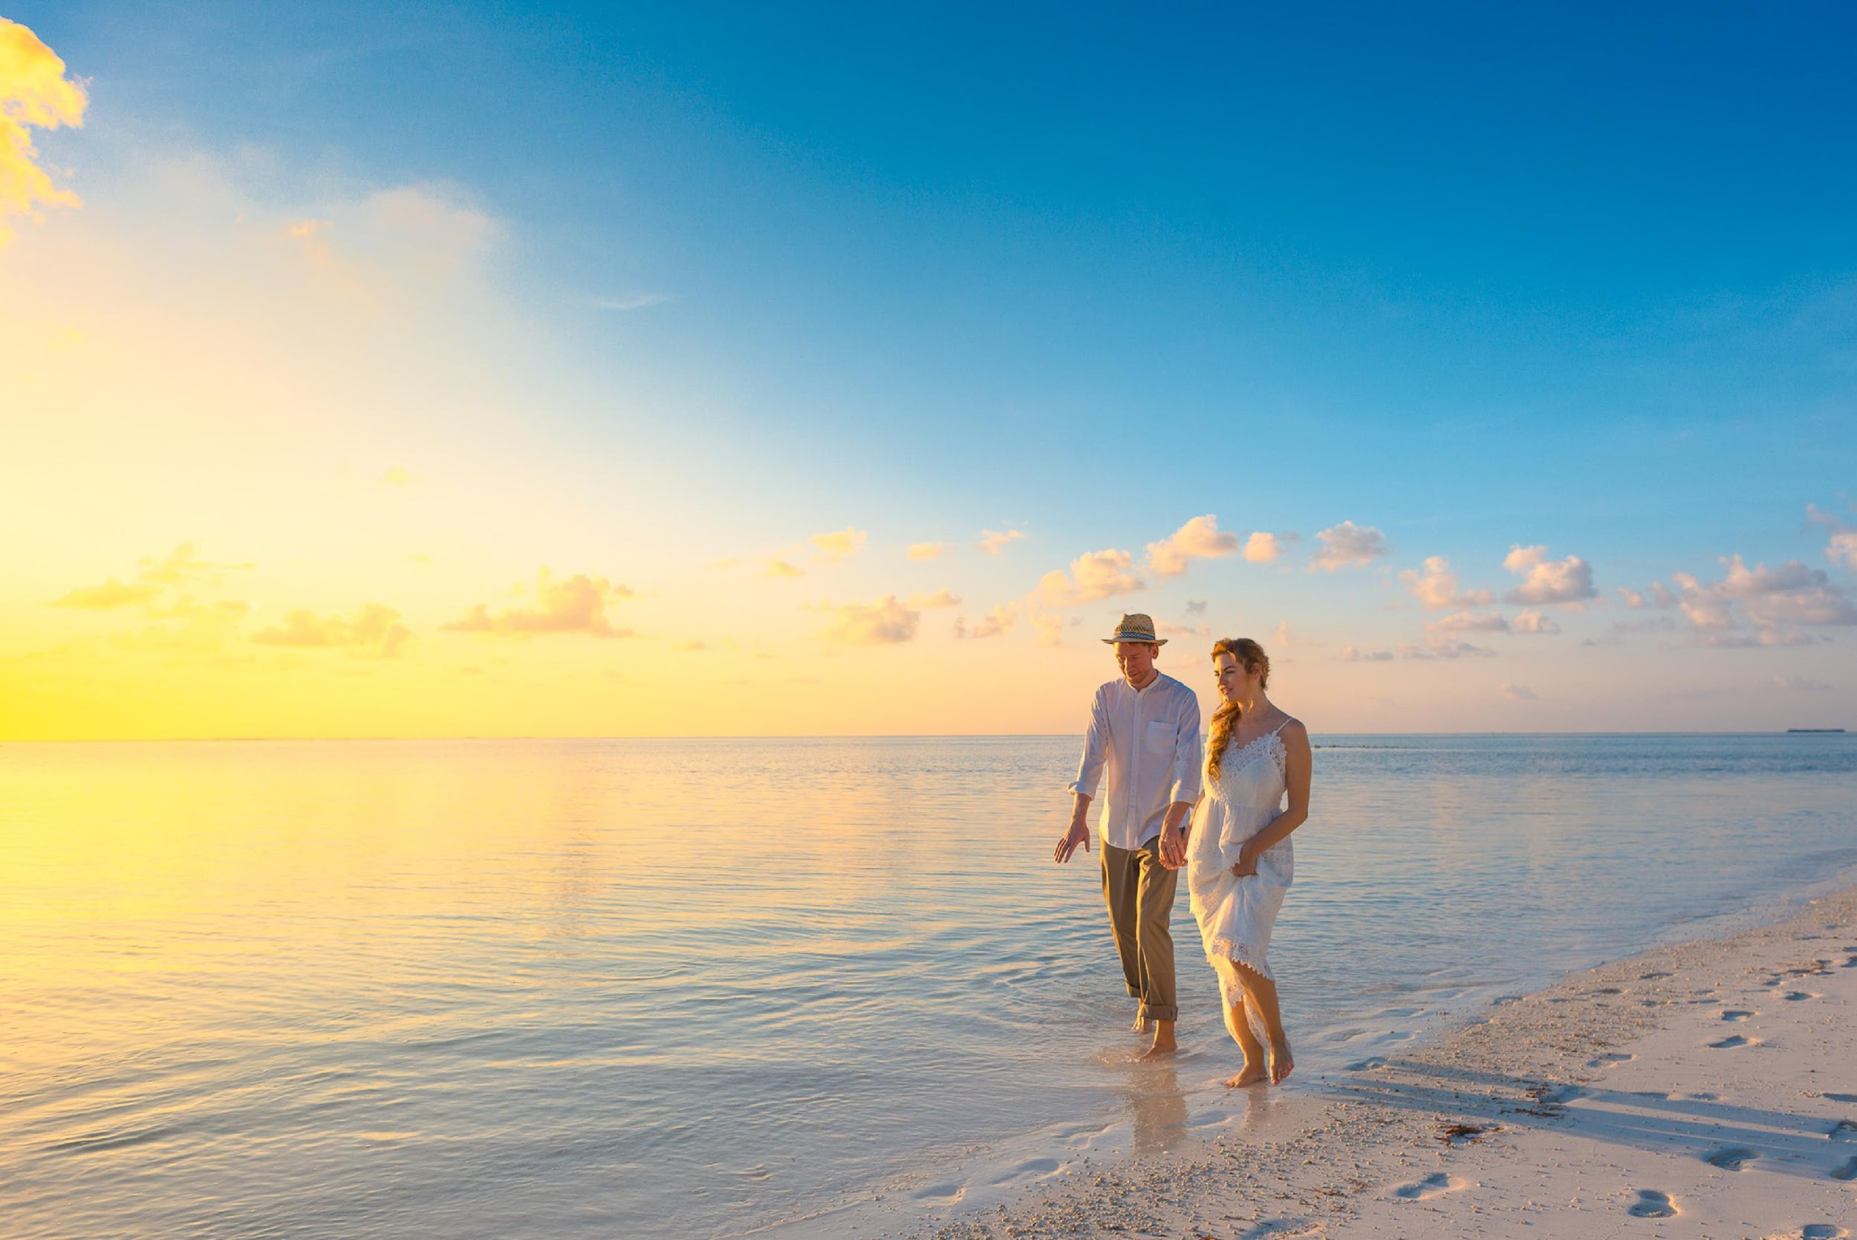
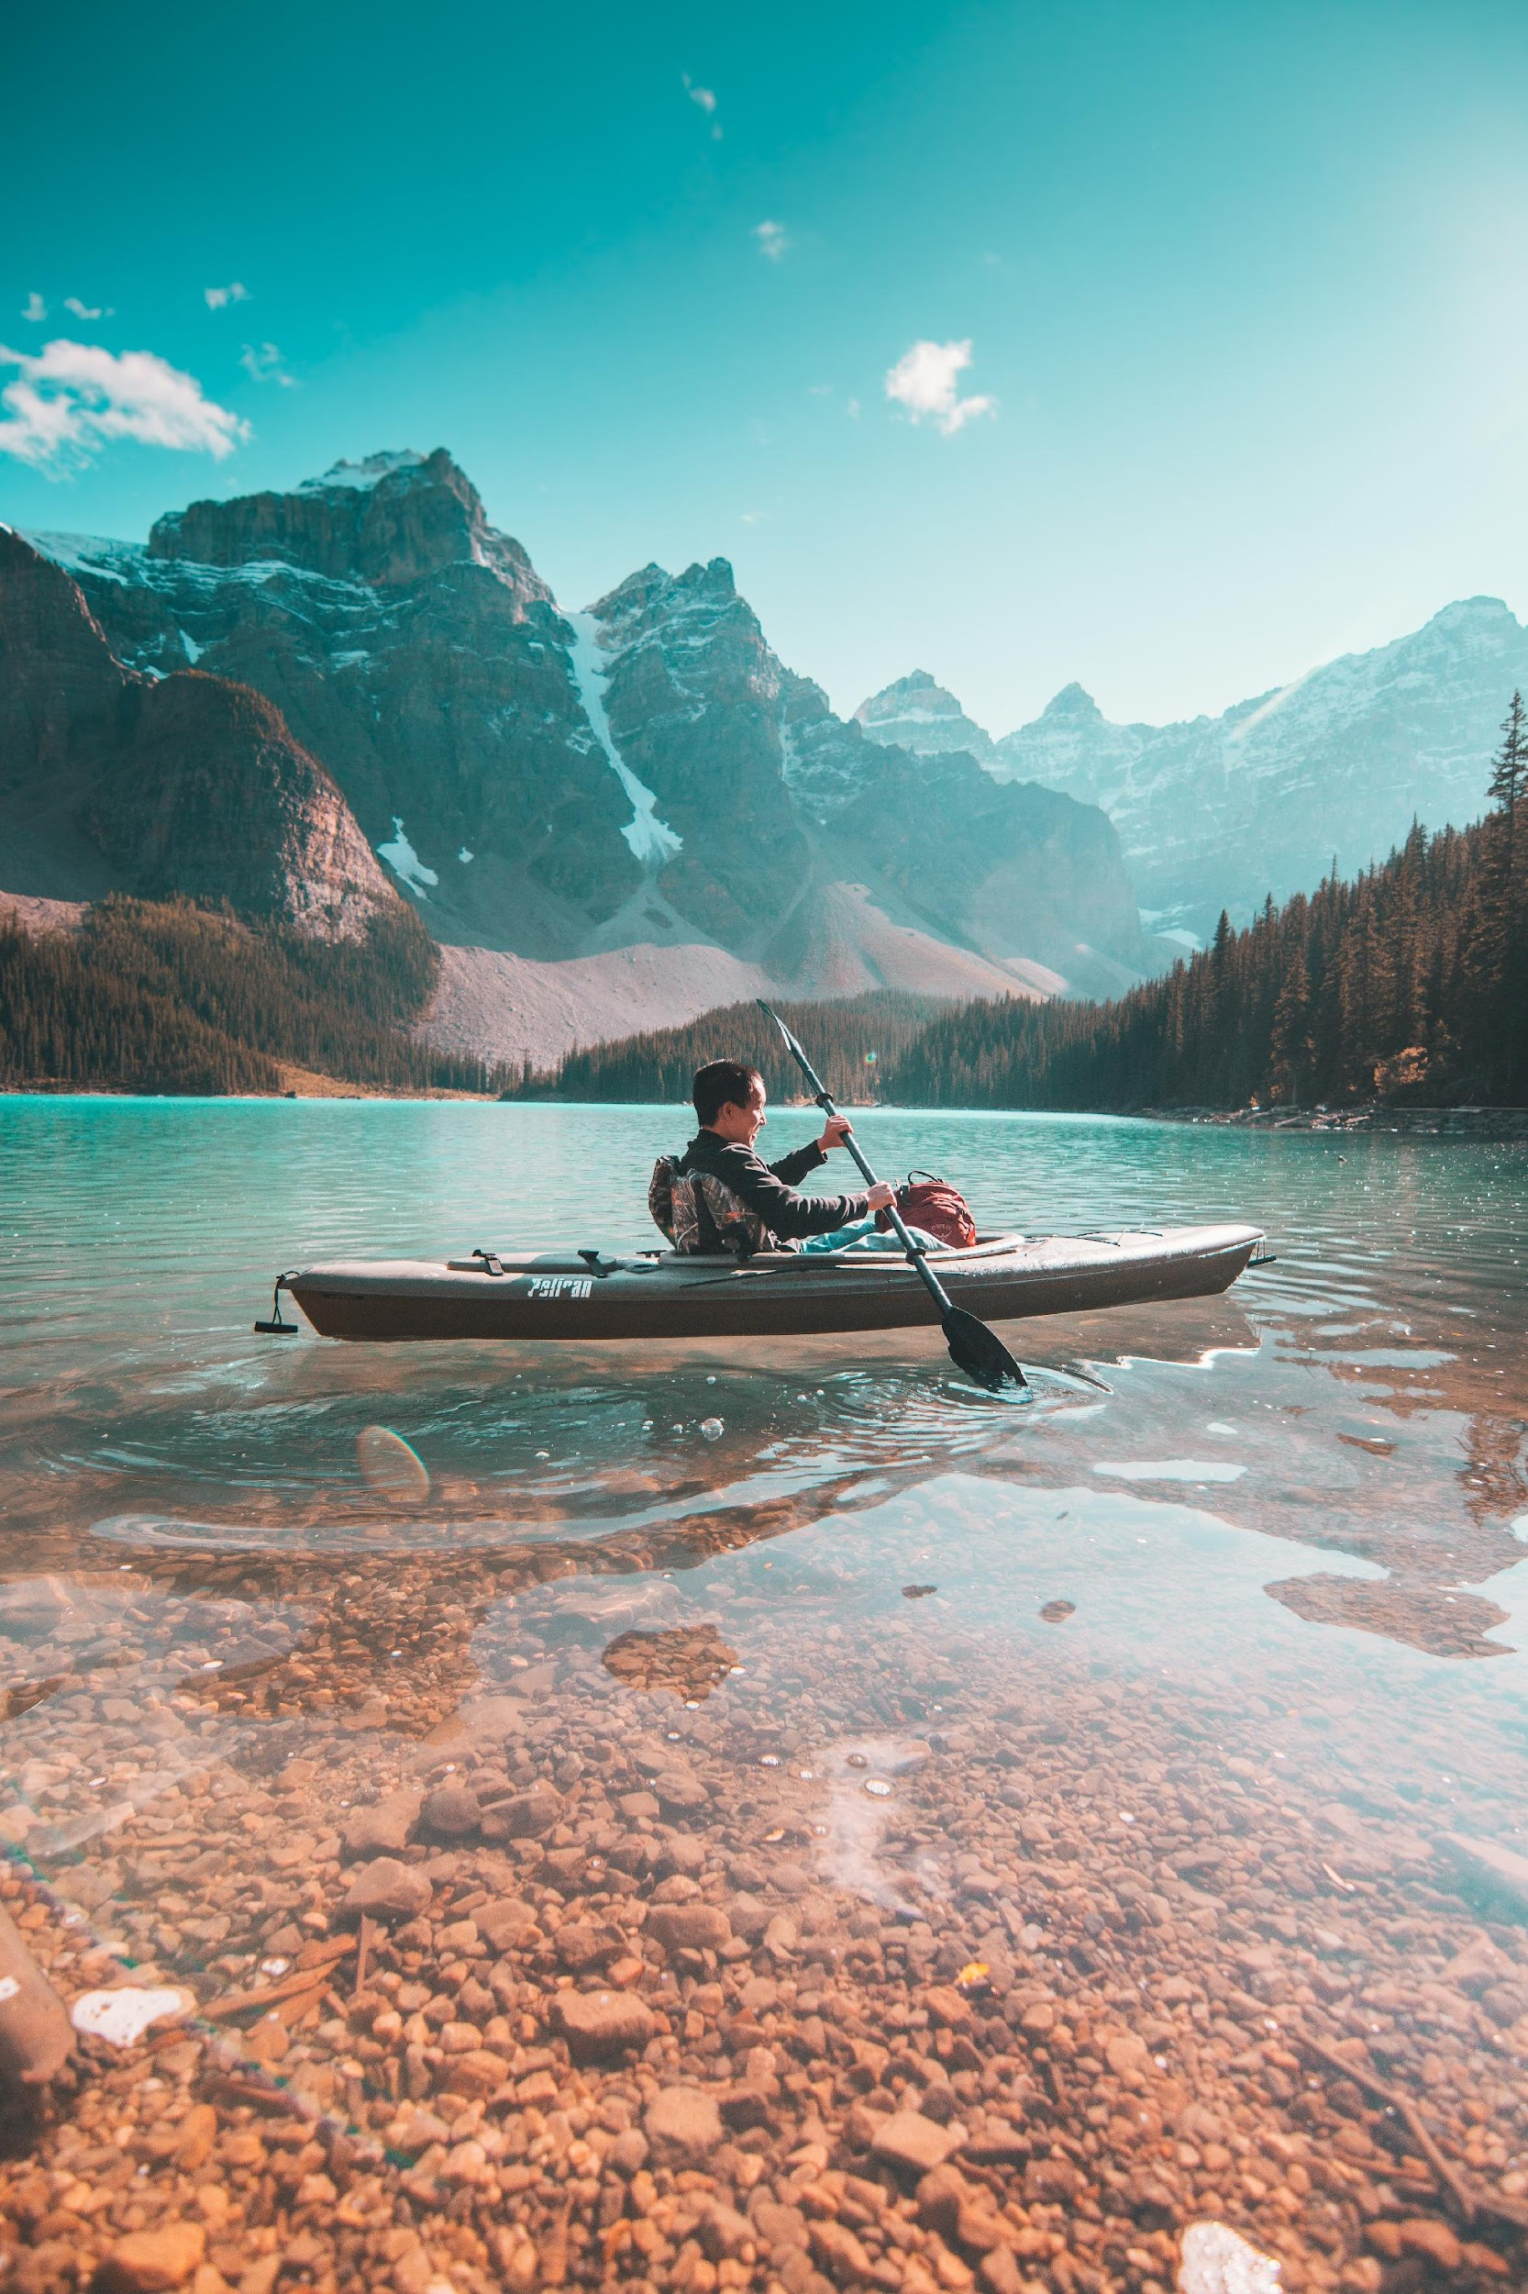
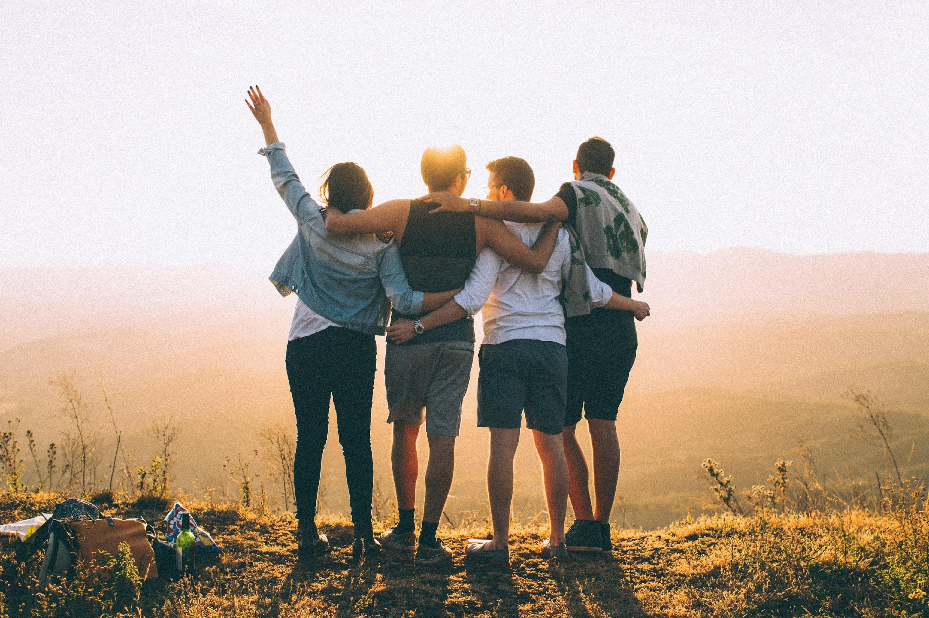

The tourism product/service must be emotionally packaged in the next step to create desires.
3. Create desires
To get noticed, tourism SMEs need to convince with the right messages and arouse emotions.
The emotional aspect is particularly important in tourism because travel decisions are predominantly a matter of feeling.
Pick up on deep longings that determine the actions and booking behaviour of the target group(s)
Include fundamental social developments
(e.g. the more global the world, the more home, tranquillity and mindfulness are needed)
Use touching images
Use faces and personal stories to convey values

Slide 21
The guest should be addressed with the appropriate communication in his different information phases.
4. Communicate precisely with the guests
The better tourism SMEs know their target groups and their needs, wishes and behaviour, the more targeted the communication measures can be.
The guest should be accompanied in the following phases:
Experience
Booking
Getting a quote
Information
Inspiration

Slide 22
To reach the guests emotionally, they must be addressed with all their senses. If this succeeds, it is reflected in customer loyalty, repeat purchases or bookings and recommendations.
5. Immerse guests in worlds of life
The product/service must be experienced with all the senses. This creates enthusiasm among the guests, which ensures that they come back and become credible ambassadors.
Light
Sound
Taste
Addressing with all senses
Odour
Materials

Slide 23
Influencing factors of the resilience of tourism SMEs

Slide 24
Human resources, processes, networks and innovation are influencing factors for the resilience of tourism enterprises.
Influencing factors for resilience
Recently, research on corporate resilience has come to the fore. It focuses mainly on three elements:
the ability to adjust
recover and
adapt
The resilience of tourism businesses is essentially influenced by four factors:
Innovation & Entrepreneurship
Processes
(Preparation & Planning)
Resilience
Networks & Cooperation
Human Resources

Slide 25
Business continuity planning aims at creating systems of prevention and recovery to deal with potential threats to a company. It also enables ongoing operations before and during execution of disaster recovery.
Processes (Preparation & Planning)
Planning & preparation are essential to be efficient in response and to ensure continuity of operations in the event of disaster.
A business continuity planning should be carried out to deal with potential threats.
Understand
your
business
REMEMBER
Exercising,
maintenance
and audit
Business
continuity
strategies
We have dealt with the business continuity management cycle in Module 2.
Feel free to look there again to refresh your knowledge if needed.
BCM
Innovation & Entrepreneurship
Processes
(Preparation & Planning)
Resilience
Building and
embedding
BCM
culture
Develop
and implement
a BCM
response
Networks & Cooperation
Human Resources

Slide 26
There is a positive relationship between employee resilience and organisational resilience.
Human Resources: Employee Resilience
Employees can influence the resilience of the company.
Studies show that there is a positive relationship between employee resilience and organisational resilience
Resilient employees are considered to be better equipped to navigate through turbulent and stressful workplace
Companies that care about the well-being of their employees are better equipped to deal with crises
How can you as a manager promote resilience in your employees?
Innovation & Entrepreneurship
Processes
(Preparation & Planning)
Respect individuality
Staff appraisals
Strengthen self-confidence
Clearly define goals and priorities
Help and support where needed
Healthy corporate culture
Resilience
Networks & Cooperation
Human Resources

Slide 27
In times of crisis, resilient teams work together successfully and manage critical situations together more quickly.
Human Resources: Team Resilience
Resilient teams are defined by well-functioning interaction processes, the way the team is led and the different personal competencies and skills of the team members.
There are four resilience keys that make a team resilient:
all team members dare to raise questions, concerns and worries without fear of negative reactions
increases the innovative power of a team
work together flexibly to be able to adapt working methods and distribution of tasks appropriately to the situation
request support in good time
Psychological safety
Dealing with the unexpected
Holistic approach
Processing critical situations
team has overview of tasks/goals, works together and cooperates with other areas in the company
reliable sharing of information among each other and passing on
critical situations are worked through together so that they can learn from them for the future
approaching not only facts but also emotions
Source: https://www.linkedin.com/pulse/resilienz-der-krise-wieder-stabil-werden-teil-1-heller/?trackingId=ARp27V2XKiT7FPNqOJw%2B1g%3D%3D

Slide 28
Every tourism SME-owner/manager should internalise the seven pillars of resilience and ensure that they are firmly embedded in the company culture.
Seven Pillars of Resilience
Companies are only as resilient as their leaders.
As a leader, you should not only promote your own resilience, but also that of your employees.
This succeeds with the internalisation of the 7 pillars of resilience.
Resilience
Acceptance
Self-Regulation
Network Orientation
Future Planning
Realistic Optimism
Solution Orientation
Assuming Responsibility

Slide 29

PLEASE LISTEN: Resilient Leadership Podcast
The podcast Resilient Leadership is designed to help you lead with more calm, clarity and conviction even in turbulent times.
The show will offer you practical tools and help you grow your resilience and strengthen your leadership.

Slide 30
Networks, relationships and cooperation are essential for the resilience of a company.
Networks & Cooperation: Relevant research results from various international studies
Relationships are important to be able to respond effectively to crisis and to get through adversity.
Networks can be an asset for accessing important resources that could otherwise be inaccessible.
The embeddedness of tourism SME owners and managers to the local community bring more opportunities to deal with crises and therefore affects the resilience of the businesses.
There is a positive relationship between inter-firm social capital and business performance.
Innovation & Entrepreneurship
Processes
(Preparation & Planning)
The structure of network is a strong factor that determines hotel performance in the hotel industry. There is a need to establish relationships with other companies in the same geographical area.
Resilience
Networks & Cooperation
Human Resources
A detailed overview of the research results including literature references can be found in Part 4 of our European Needs Analysis on Crisis Management for Tourism SMEs.

Slide 31
Cooperation in competition can be important for improving business performance.
Networks & Cooperation: Cluster Theory by Porter
Cluster theory, by Porter (2000), takes the idea of relationships by implying that enterprises who compete, can by collaborations better their performance
In a crisis situation the cluster can provide certain advantages like bettering access to necessary resources for coping with crisis
“Clusters are geographic concentrations of interconnected companies, specialized suppliers and service providers, firms in related industries, and associated institutions in particular fields that compete but also cooperate” (Porter, 2000, p. 15)

Slide 32
The typical personality trait of entrepreneurs is considered to be ideal for times of crisis.
Entrepreneurship
Many entrepreneurs exhibit personality traits that can be commonly associated with resilience.
According to this, entrepreneurial characteristics of the SME owner/manager can have a positive impact on resilience.
Creativity
Solution-oriented thinking
Flexibility
Willingness to experiment
Responsiveness
Innovation & Entrepreneurship
Processes
(Preparation & Planning)
Resilience
Networks & Cooperation
Human Resources

Slide 33
Innovation and crisis resilience are closely linked.
Innovation
In times of crisis, innovation can have a positive impact on the performance of tourism SMEs and help them to adapt and recover quickly.
Innovation does not necessarily have to result in a complete reorientation of the company. It can also be intelligent adaptations to changed conditions.
Examples from practice show that it can also be a matter of the following:
Further development of what already exists
Variation of what already exists
Variation or imitation of an existing business model from other sector
Innovation & Entrepreneurship
Processes
(Preparation & Planning)
Please have a look at case study no. 11 to see how an Icelandic company has responded to the changing environment due to the Corona pandemic.
Resilience
Networks & Cooperation
Human Resources

Slide 34
Awareness of the business model is an important prerequisite for change.
Innovation: Approach
To find out whether the existing business model should be retained and slightly adapted or whether a realignment is necessary, a review and evaluation of the existing business model is an essential step.
Evaluate
  Customer view
  Internal view
  Keep the business model with minor changes or complete reorientation?
  Use opportunities
  Manage risks
Review
Decide

Slide 35
Within the framework of a BMI, basic things are changed, but also decisive things are achieved.
Business Model Innovation (BMI)
A BMI is about rethinking the mindset and changing fundamentals - at least two of the shown WHO-WHAT-HOW-VALUE-components.
Studies show that SMEs in particular achieve important competitive advantages through BMI because it makes them more flexible in the market and opens up new potential for success.
WHO are the target customers?
WHAT is the benefit for customers and partners who are involved in value creation?
HOW is the company created and how did it deliver the benefit?
HOW does the company earn money?

Slide 36



Business Model Patterns may help tourism SMEs to find the right business model.
Business Model Patterns I/III
90 per cent of all new business models are based on a limited number of patterns. We present you some of those Business Model Patterns that are / can be applicable for tourism SMEs:
 | Name | Underlying Principle | Known examples
 | add-on | The basic offer is competitively priced, but can be extended with various extras that drive up the final price. In the end, the customer may pay more than he intended. The result is a variable offer that can be adapted to individual needs. | Ryanair
 | crowd-funding | A product, service or start-up is financed by a group of small investors who support the underlying idea. If enough money is raised, the project is implemented and the investors receive certain benefits. | Pebble Technology
 | customer loyalty | Customers are tied to the company with bonus programmes. It aims at increasing loyalty by creating an emotional connection and/or rewarding it with special offers. Customers voluntarily commit to the company, which can protect future revenues. | American Airlines

Slide 37




Business Model Patterns may help tourism SMEs to find the right business model.
Business Model Patterns II/III
 | Name | Underlying Principle | Known examples
 | digitalization | Existing products/services are converted into digital variants that offer advantages over conventional products/services (e.g., easier & faster distribution). Ideally, this does not reduce the perceived customer value. | Facebook, Airbnb
 | make more of it | Know-how and other assets of the company are not only used for the production of own products, but are also offered to other companies for use. Thus, additional revenue can be generated. | Amazon Web Services
 | e-commerce | Products or services are (additionally) offered via online channels. This can result in higher availability and convenience for customers. | Amazon Kindle
 | peer to peer | The company serves as an intermediary or transaction platform for private individuals who want to lend things, sell products/services or exchange experiences. | Airbnb, Ebay

Slide 38




Business Model Patterns may help tourism SMEs to find the right business model.
Business Model Patterns III/III
 | Name | Underlying Principle | Known examples
 | rent instead of buy | The product is not sold but rented out. The company benefits from higher profits per product, as the rent is paid continuously over the entire period of use. The time of non-usage (which binds capital), is reduced on each product. | Rent a bike, Car2Go
 | revenue sharing | Revenues are shared with stakeholders of the company. In this way, partnerships are used to reach more customers. One party is able to receive a portion of the revenue from another that benefits from increased value to its customer base. | Apple iPod/iTunes
 | self service | A costly part of the value chain is borne by the customer so that the company can sell the product/service at a lower price. Particularly suitable for process parts that generate high costs but contribute little to customer value. Customers benefit from efficiency and time savings, but have to contribute a part themselves. | McDonalds, IKEA
 | shop within a shop | Instead of opening own shops, a partner is chosen who operates an existing branch and could benefit from the integration of a small shop within another shop (win-win). While the host benefits from more attracted customers and gains constant revenue from the hosted shop (rent), the hosted shop gains access to cheaper resources (location, workforce,…) | Tim Hortons

Slide 39

Group Discussion
Which business model pattern could suit your company?
How could you make use of it?

Slide 40
Sustainable Tourism Development

Slide 41
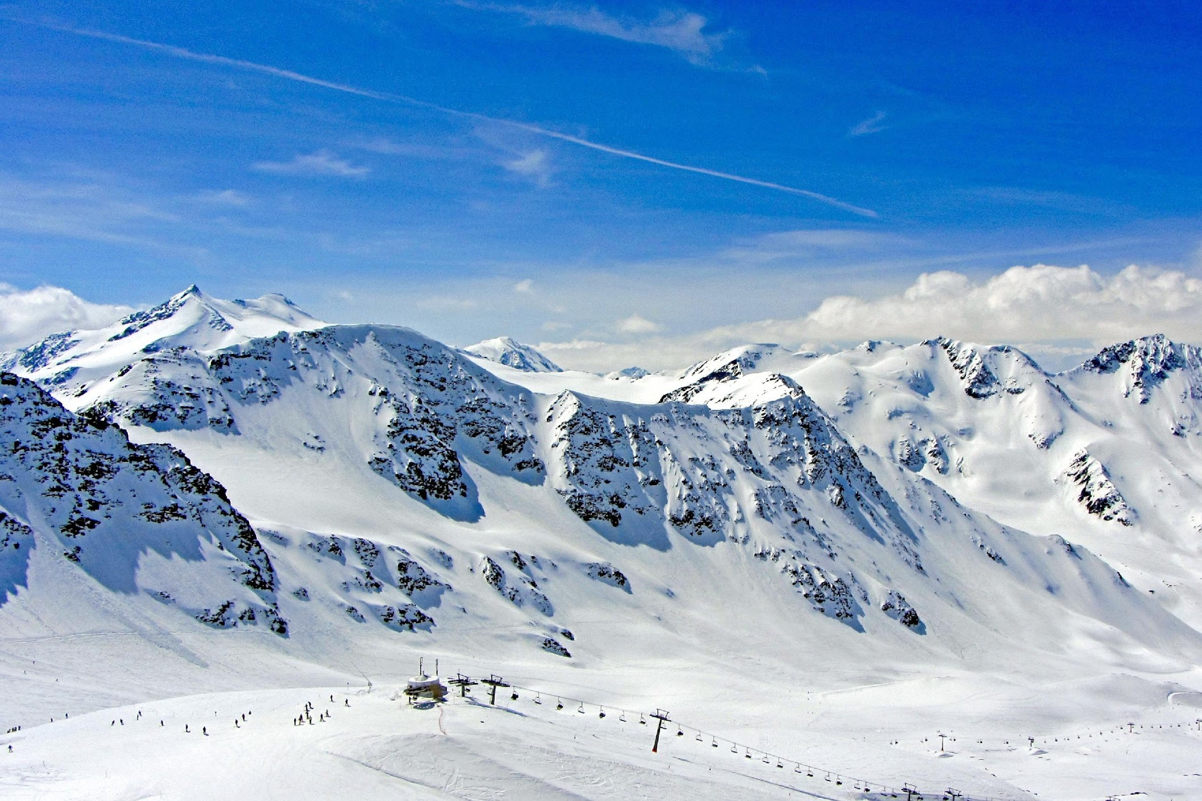

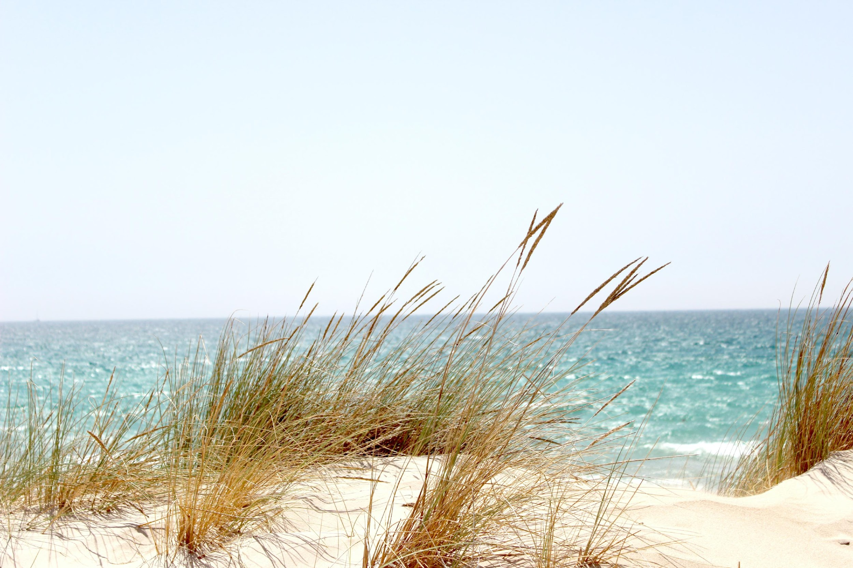
Sustainable tourism development is in harmony with nature, landscape and population.
Sustainability in Tourism
More than almost any other industry, tourism depends on an intact nature and environment as well as on aesthetic landscapes:
Climate protection and the preservation of habitat diversity are therefore essential prerequisites for the protection and preservation of tourist destinations!
Sustainable tourism development makes an important contribution to preserving liveable natural and cultural habitats and protecting the environment and climate. This enables sustainable value creation without consuming resources and future opportunities of future generations. Sustainable tourism should help to ensure that the economic, ecological and social impacts on the population, the environment and the economy are compatible.
Real snow for winter sports
Healthy forest for hiking
Clean waters for bathing

Slide 42
Achieving sustainable tourism is a continuous process.
Sustainable tourism development guidelines
Sustainable tourism development guidelines can be applied in all forms of tourism offers in all types of destinations (incl. mass tourism, niche tourism segments, etc.).
The principles of sustainability relate to the environmental, economic and socio-cultural aspects of tourism development. An appropriate balance must be struck between these three dimensions to ensure long-term sustainability.
Make optimal use of environmental resources that constitute a key element in tourism development, maintaining essential ecological processes and helping to conserve natural heritage and biodiversity.
Respect the socio-cultural authenticity of host communities, conserve their built and living cultural heritage and traditional values, and contribute to inter-cultural understanding and tolerance.
Ensure viable, long-term economic operations, providing socio-economic benefits to all stakeholders that are fairly distributed, incl. stable employment and income-earning opportunities, and contributing to poverty alleviation.
Source: World Tourism Organization: https://www.unwto.org/sustainable-development

Slide 43

Sustainability and Resilience
Resilience and sustainability go hand in hand:
If sustainability is understood as the transition from aftercare to prevention, it holds the key to building resilient companies!

Slide 44
There is a growing consensus among tourism stakeholders as to how the future resilience of tourism will depend on the sector’s ability to embrace a low carbon pathway and cut emissions by 50% by 2030
Please have a look at case study no. 12 to deal with the reduction of the carbon footprint of a hotel and its corporate social responsibility.
Source: World Tourism Organization: Transforming Tourism for Climate Action (https://www.unwto.org/sustainable-development/climate-action)

Slide 45
Recommended Reading

Slide 46
Recommended Reading
ISO 22316:2017: Security and resilience — Organizational resilience — Principles and attributes: https://www.iso.org/obp/ui#iso:std:iso:22316:ed-1:v1:en
PwC (2018): Operational resilience: https://www.pwc.co.uk/audit-assurance/assets/pdf/operational-resilience-guide.pdf
Breier et al. (2021): The role of business model innovation in the hospitality industry during the COVID-19 crisis .
Hall et al. (2017): Tourism and resilience: Individual, organisational and destination perspectives.
Frey (2020): Der KMU Innovator - So machen Sie Ihr Geschäftsmodell fit für das digitale Zeitalter, Midas Verlag AG.
Bauer (2020): Den Gast der Zukunft verstehen und gewinnen – Gästetrends für touristische Angebote nutzbar machen. In: Bauer et al. (2020): Tourismus nach COVID-19, Linde Verlag.
7 Pillars of Resilience to Master Any Challenge

Slide 47
WELL DONE!
https://www.tourismrecovery.eu/
https://www.facebook.com/tourismcrisisrecovery
You have completed our SME Training Package

