Slide 1
Module 2
PRECAUTION & AVOIDANCE OF CRISES

Slide 2
Module 2:
Precaution & Avoidance
1
Business Risk Management
After completing this module, you will have insight knowledge on…
Strategy Development
2
3
Risk Factors & Early Warning Signs
4
Continuity Management
5
This presentation is licensed under CC BY 4.0.
To view a copy of this licence, please visit https://creativecommons.org/licenses/by-sa/4.0/deed.en

Slide 3

After completing this module, you will…
... understand what factors lead to a crisis and how to prevent it
... understand the importance of risk management for companies
... know the tools for developing a sound strategy and how to apply them
... recognise and evaluate crisis risk factors for your company at an early stage
...know the principles of business continuity management
Photo: Tobias Bjørkli

Slide 4
01
Business Risk Management

Slide 5
REMEMBER
The Timeline of a Crisis
Crises rarely (never) come overnight. For detecting a crisis at an early stage an effective risk management is mandatory.
Core problems:
Business key figures react with a large time delay
If the figures indicate a crisis, the causes of the crisis have often already taken full effect (and cannot be remedied in the short term)
Permanent risk analysis required
Objective identifiability
of the crisis (in %)
Crisis in operating
results
Liquidity Crisis
Source: Roland Berger – based on an Analysis of 800 Restructuring Cases
Time

Slide 6
Overview of the Skills Needed during a Crisis
Very few managers combine all the necessary prerequisites for effective management in different crisis phases in one person.
The roles they have to assume are extremely diverse.
The art is to know your own strengths - and even more importantly your own weaknesses - in the individual phases and to build a crisis management team - if necessary, with external support.
01
02
03
04
PRE-CRISIS
DURING CRISIS
POST-CRISIS
LEARNING
Scanning
Assessing situation
Designing tools & systems
Monitoring
Detecting
Containing
Recovering
Following Up
Shaping memories
Assessing effectiveness
Learning from failures
Implementing the right measures

Slide 7
A matter of Perspective?
A crisis can be attributed to external and internal factors. But depending on whom you ask, the external or the internal factor is given more weight.
If one asks the management about the causes of the crisis, the acting persons usually arrive at completely different attributions of causes than external consultants. While management naturally tends to attribute the crisis to external factors and sees few mistakes internally, an external view from consultants is often contradictory. An objective view from outside is particularly helpful in a crisis.
External Factors | Perceptual asymmetry | Internal Factors
Shrinking / saturated markets |  | Strategy deficits
Digitization |  | Outdated technology / products
Changes in regulations |  | Lack of operational efficiency
Technology leaps |  | Insufficient management / leadership quality
Globalization |  | Unbalanced financing structure
New products / new competitors |  | Overpriced acquisitions
Raw material prices / exchange rates |  | Insufficient controlling
Insolvencies of customers / suppliers |  | Organizational deficiencies
Perception of Management
90%
10%
EXTERNAL
INTERNAL
Perception of Advisors
10%
90%
EXTERNAL
INTERNAL

Slide 8

Internal Factors Count
Internal factors are avoidable but are responsible the majority of corporate crises.
The internal business environment comprises the factors within the company that affect its success and approach to doing business. Unlike the external environment, the company has control over these factors and can actively take action. While we know that it is important to identify potential opportunities and threats outside the company's operations, the key to corporate success lies in knowing corporate strengths and weaknesses and taking advantage of them.
The best thing about internal factors is that you have control over most of them. By addressing internal factors today and recognising warning signs, you strengthen your starting position for the future. Learn how to do this with the help of this module.
Photo: Shane Aldendorff

Slide 9
5 Common Internal Factors that can cause a SME Crisis
Strategic misalignment (Module 2)
Internal crises are not caused by external factors, but by internal wrong decisions and deficits. These are often located at the leadership and higher management levels and manifest themselves, among other things, through poor leadership, lack of crisis management as well as financial knowledge, lack of operational management skills, insufficient communication as well as strategic misalignments. In practice, it is mainly internal causes of crises that are considered, as they are the main cause of insolvencies.
No reactive crisis management (Module 3)
Lack of financial knowledge and KPIs (Module 4)
Lack of operational efficiency & poor communication (Module 5)
Poor leadership (Module 6)

Slide 10
Importance of Business Risk Management
Risk management is the art and science of identifying, analysing, and responding to risk throughout a company or throughout the life of a project and in the best interests of meeting project objectives.
Risk management is often overlooked in both companies and projects. It can help improve success by helping select target-aimed strategies and projects, determining scope, and developing realistic estimates.
Business risk management prioritises and addresses the risks associated with changes to your business operations, systems and processes. It serves as a guide for informed decision-making, strategy alignment and planning in the event of an emergency or crisis situation.
Entrepreneurial action is not possible without risks, since the future and the effects of actions cannot be predicted with certainty. The task of risk management is to create transparency about the risk situation in the company by using suitable methods (risk controlling) and to optimise the risk/return profile of the company (risk management).

Slide 11
Proper Business Risk Management
Risk management enables the company to identify risks and mitigate them through a variety of preventive measures.
The aim of risk management is to ensure that uncertainty and risk do not distract the company from its defined goals.
Dynamic
Dynamic challenge assumptions, think unthinkable, constant learning
Governance
Clear governance structure & behaviour, aligned with business aims
Transparent
Transparency, honest debate, role-modelled at ‘top’
HR-Integrated
HR helps to set the agenda and ‘educate’
Robust people processes – supporting risk balance. Management buy-in; adherence; constantly refreshed
People Processes
Triangulation
Triangulation – use multiple perspectives, data sources
Consistent
Consistent approach from individual to team to Organisation – yet variegated according to needs

Slide 12
Risk Management Processes
Risk management is a continuous process
Risk management processes are grouped in different ways but generally include the same. Ideally, each of these processes should be ongoing rather than, for example, annual.
Report
Identify
Assess/
Monitor
Measure
Manage /
Respond

Slide 13

The extent to which an externally caused crisis affects a company depends on its internal preparation.

Slide 14
02
Strategy Development

Slide 15

Your Strategy matters
A strategy may seem superfluous for a going concern - it costs time and money to create one. But a strategy is essential to prevent business crises and is fundamental to surviving a crisis.
But what exactly is an overall strategy?
"We want to be the best hotel in town in five years" is not a strategy, but a vision. "We want to expand our offer", on the other hand, is a goal. A strategy has many facets. Why do you want to expand your offer? How do you expand it? What do you have to consider, what pitfalls await you?
A strategy could be described as a long-term plan that defines exactly how you intend to reach higher-level goals in order to achieve a vision. Sounds complicated? Usually, you already have everything ready to develop your strategy. We'll show you how!
Photo: Andrea Piacquadio

Slide 16
What constitutes a Strategy
1
PLAN
There is no one term for strategy - we show you 5 approaches that can constitute a strategy
2
PLOY
Management expert Henry Mintzberg argued that finding the right strategy can be difficult. To provide a deeper analysis, he developed five Ps of strategy - five different definitions (or approaches) for developing strategies.
According to this theory, a strategy is a…
3
PATTERN
4
POSITION
5
PERSPECTIVE
https://uk.indeed.com/career-advice/career-development/mintzberg-5-ps-of-strategy

Slide 17

01 Strategy as a PLAN
Invest in planning to save costs later on.
The advantages of effective planning are manifold. Planning involves little cost, while later strategy steps can be more expensive. The more planning a company does, the more likely it is to achieve its goals and minimise risks. Tools such as SWOT analysis, the PEST analysis (Module 1) and the Portfolio analysis help you develop a successful plan. Effective plans help managers provide clarity to their teams and define actionable steps for each goal.
Photo: Andrea Piacquadio
https://uk.indeed.com/career-advice/career-development/mintzberg-5-ps-of-strategy

Slide 18
REMEMBER
SWOT Analysis
With the help of the SWOT analysis, you can analyse the strengths, weaknesses, opportunities and threats of your company.
SWOT analysis (or SWOT matrix) is a strategic planning technique used to help a person or organization identify strengths, weaknesses, opportunities, and threats related to business competition or project planning. This perspective helps you to make better use of your strengths and opportunities and to keep an eye on your weaknesses and potential threats.
ANALYSIS
INTERNAL
EXTERNAL
STRENGTHS
WEAKNESSES
OPPORTUNITIES
THREATS
Strengths describe what an organization excels at and what separates it from the competition: a strong brand, loyal customer base, a strong balance sheet, unique technology, and so on.
Weaknesses stop an organization from performing at its optimum level. They are areas where the business needs to improve to remain competitive: a weak brand, high levels of debt, an inadequate supply chain, or lack of capital.
Opportunities refer to favorable external factors that could give an organization a competitive advantage. For example, if a country cuts tariffs, a car manufacturer can export its cars into a new market, increasing sales and market share.
Threats refer to factors that have the potential to harm an organization. For example, a drought is a threat to a wheat-producing company, as it may destroy or reduce the crop yield. Other common threats include rising material costs, increasing competition, tight labor supply etc.

Slide 19
Portfolio Analysis
Portfolio analysis is a way of analysing one's own offering and developing sound strategies.
Portfolio analysis is the process of reviewing or evaluating the elements of a company's overall service or product portfolio. This analysis helps you to derive the current state of the company and to design well-founded decisions and strategies.
QUESTION MARKS
STARS
Demand
POOR DOGS
CASH COWS
Growth / Profit potential

Slide 20
Portfolio Analysis
Analyse your offer using portfolio analysis to make economic decisions.
If you categorise your offer according to the areas, this will result in different strategies:
QUESTION MARKS
STARS
Demand
POOR DOGS
CASH COWS
Growth / Profit potential

Slide 21
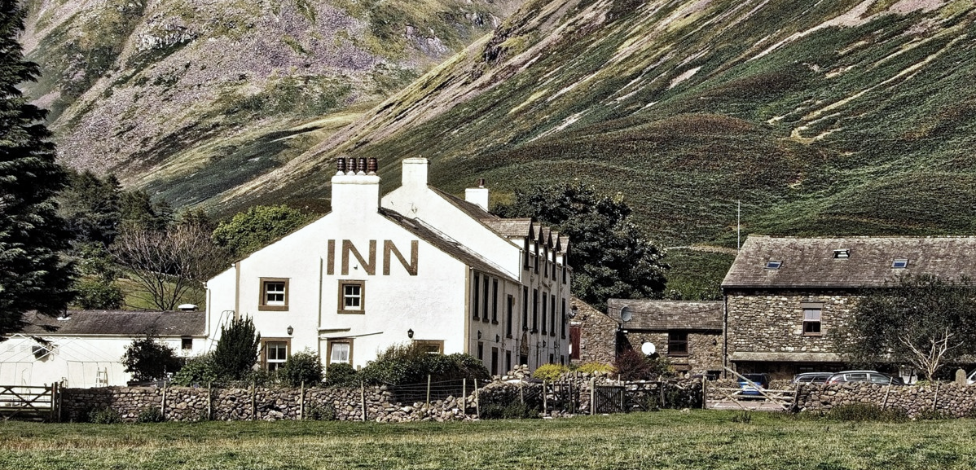
EXAMPLE: Portfolio Analysis
Let's take a hotel in the mountains as an example. The place is moderately popular with tourists and many come to this area for the great scenery and its sports opportunities in nature. The hotel is small, has a wellness area, which is very popular, and a hotel café for coffee and cake - however, this is not so well used. The hotel has been offering tours and sports for a long time, very popular with all visitors. It is now considering offering e-bikes in addition to general bicycle rental, following several requests.
QUESTION MARKS
STARS
Demand
POOR DOGS
CASH COWS
Growth / Profit potential
Photo: John Smith

Slide 22
EXAMPLE: Portfolio Analysis
If the hotel applies a portfolio analysis, the offer and strategies could look like follows:
QUESTION MARKS
STARS
Demand
POOR DOGS
CASH COWS
Growth / Profit potential

Slide 23

02 Strategy as a PLOY
Outsmarting the competitors can be a strategy to stay ahead of the competition.
Staying one step ahead of competitors by trying to disrupt, deter, or otherwise influence them is part of a larger strategy, according to Mintzberg. He refers to this as "trickery". An example of this would be a local hotel that may threaten to expand its business to prevent a competitor from doing so. Tools like the Future Wheel help you examine future situations where competition might arise.
Photo: Mary Taylor
https://uk.indeed.com/career-advice/career-development/mintzberg-5-ps-of-strategy

Slide 24


Ploy with consequences?
The Future Wheel is a powerful tool to develop scenarios and their consequences
A decision not only has direct consequences, but also indirect ones - ever heard of the butterfly effect? In this theory, the flap of a butterfly's wings can trigger a tsunami. When making decisions on how to deal with your competition, it helps to look at the direct and indirect consequences beforehand. The future wheel is a creative method to tap into possible consequences in 3 simple steps.
The Futures Wheel - Identifying Consequences of a Change (mindtools.com)
Photo: Tranmautritam

Slide 25
The Future Wheel
The Future Wheel is a powerful tool to develop scenarios and their consequences
3
3
3
1
THE SCENARIO
In the middle, write the scenario / decision to be analysed
3
2
2
2
DIRECT CONSEQUENCES
Now consider the immediate impact of the scenario. Each consequence is written in a circle, placed around the scenario and connected to the scenario with a cause-effect line. These are direct consequences.
3
1
STRENGTHS
2
2
3
3
INDIRECT CONSEQUENCES
Now look at the direct consequences. What consequences could arise if these were to happen? These are indirect consequences. Analogous to before, arrange them around the respective direct consequences and connect them with a cause-effect line.
2
2
3
3
3
3

Slide 26

03 Strategy as a PATTERN
A multitude of past individual decisions together result in a consistent pattern and are subsequently placed in an overall context - the strategy.
A strategy is sometimes derived from historical behaviour and the sum of past decisions. A consistent and successful business style can become a strategy rather than a conscious decision. Pay attention to the patterns you find in the team and organisation to apply this part of the five P's. Then consider whether these patterns have become an unspoken part of the organisation's strategy and what influence they have on how future strategic planning is handled. This is also called emergent strategy.
Photo: fauxels
https://uk.indeed.com/career-advice/career-development/mintzberg-5-ps-of-strategy

Slide 27

04 Strategy as a POSITION
Strategy is understood as a position in the market and competition that a company wants to take.
The importance of position in defining corporate strategy must be carefully considered, designed, planned and implemented as it determines the overall position of the company in the market. It focuses on how the company wants to present itself in the market and in the minds of customers in order to gain a competitive advantage.
To establish a company's position in terms of strategy, you should consider internal factors such as the type and quality of products/services offered, as well as external factors such as demand. Learn more about this in Module 3.
Photo: Pixabay
Photo: fauxels
Photo: fauxels
https://uk.indeed.com/career-advice/career-development/mintzberg-5-ps-of-strategy

Slide 28

05 Strategy as a PERSPECTIVE
Strategy as a perspective defines the way an organisation acts.
The perspective aspect does not refer to any of the above approaches. Instead, a larger framework is used in which the company is the focus. The organisation creates the strategy taking into account the most important and significant factors of the company, e.g. how the individual stakeholders (employees, suppliers, the public) perceive the company or how decisions are made within the framework of the company's values. The sum of these different perspectives can be helpful in strategic decision-making.
Photo: Pixabay
https://uk.indeed.com/career-advice/career-development/mintzberg-5-ps-of-strategy

Slide 29

BOOST YOUR STRATEGY
A strategy can be seen as a bridge between the present and the future. The Mintzberg Strategy Bridge approach helps you to look at your strategy from all perspectives.
Analyse your strategy by considering the following questions:
Where do we come from and where are we? (Present)
Where do we want to go and be in the future? (Future)
How do we get from the present to the future? (Plan)
Photo: eberhard grossgasteiger

Slide 30
Be creative when creating your Strategic Plan
By following the 4 steps, you and your team will be able to develop your joint strategic plan, targets and actions.
THE VISION. Visions set the direction of development; the ideal target state. They are big and wide. The questions "Who do I want to be?" or "What do I want to be?" are the point of orientation.
THE GOALS. Divide the big picture into its components. These are the corporate goals. These can be quantitative, i.e. measurable, or qualitative, i.e. indirectly measurable. In addition, a distinction is made between short-term, medium-term and long-term goals.
THE STRATEGIES. These are the steps that need to be taken to achieve the company's goals. They are usually broader and include several measures.
THE MEASURES. The strategy is the operational plan from which measures (task packages) can be derived. These measures may include further analysis and surveys and are designed to serve the strategy.

Slide 31
Be creative when creating your Strategic Plan
By following the four steps, you and your team will be able to develop your joint strategic plan, targets and actions.
YOUR VISION
YOUR GOALS
YOUR STRATEGIES
YOUR MEASURES

Slide 32
03
Risk Factors & Early Warning signs

Slide 33
Early Warning Signs
FOUR KEY AREAS
1
Industry Issues
Systematic search for risks in the industry your company is working in
Through regular, systematic and comprehensive risk assessment based on four key early warning/risk signs, crises can be identified at an early stage and countermeasures can be taken.
2
Organisational Issues
Analysis of risks arising from your organisation
3
Stakeholder Relationships
Some risks arise from the specific relationships with stakeholders
4
Risk Assessments
Systematic scanning for implicit issues

Slide 34
1
Industry Issues – Sources to Identify Industry Trends
Industry information on influencing trends can be found in specific industry publications and web sources. It is essential that you constantly scan for and process important industry information, share it with the relevant people in the company (and advisors) and discuss it systematically.
Learn more about this in Module 3!
Newspapers
Business Magazines
Store important facts, share them with your team and discuss implications for your business
TV News
Trade Journals
Public Opinion Polls
Science Journals
Online

Slide 35
2
Organisational Issues – Key Peformance Indicators (KPIs)
There is a wealth of information available to identify early warning indicators.
The challenge is to look in the right places and operationalise this information, and KPIs are a particularly important source of data.
Learn more about this in Module 4!
Assessing KPIs often leads to the identification of potential improvements AND understanding of an upcoming crisis
Choosing the right KPIs is reliant upon having a good understanding of what is important to the SME and its success
KPIs are commonly used by SMEs to evaluate its success or the success of a particular activity it is engaged
KPI stands for Key Performance Indicator - and that's what it's all about - identifying, measuring and controlling the key indicators of the company's performance

Slide 36
3
Stakeholder Relationships
Stakeholder management is used to identify the needs and interests of your key stakeholders in order to avert threats and minimise risks. Stakeholder management aims to strengthen positive influences and minimise negative ones.
Stakeholder management is not a one-off analysis but must be carried out systematically and continuously. You will learn ways to identify, assess and communicate with stakeholders in Module 5. This scan is useful to roughly identify who needs to be involved.
Society
Media
Residents
Cultural institutions
Associations
Lobby groups
Media Organisations
Social media
Company
Science
Industry
Universities
Research institutes
Expert opinions
Competitors
Suppliers
Service providers
Financiers
Politics
Company
Banks
Other financiers
Government & municipalities
Other Authorities
Employees
Direct / indirect
Works council
Labour units

Slide 37
4
Using existing Assessments to Identify Risks
Many SMEs already carry out regular audits and assessments for various purposes (e.g. supplier audits), but far too often these are viewed in a siloed way and exclusively for the particular area of the business. When audits and assessments from different areas of the company are brought together and considered in their entirety, it is often possible to draw a very clear picture of the state of the company and possible causes of crises. Here are six areas that are looked at in regular - but are there more that are specific to your SME? Include them in your assessment!
Supplier
Audits
Safety
Accident
Records
Financial
Audits
Liability
Exposure
Risk
Audits
HR-
Audits

Slide 38


CAUSES OF CRISIS ALONG THE VALUE CHAIN
Learn about potential causes of crises based on your company's value chain
Now you know what early warning signs to look out for. But a rough look at the sectors is not enough to identify crises at an early stage. Analysing the value chain is a powerful way to know and keep an eye on risk factors.
This video might help you to familiarise yourself with the value chain analysis: https://www.youtube.com/watch?v=SI5lYaZaUlg
Photo: cottonbro studio

Slide 39
Early Detection of Crises – The Value Chain
Early crisis detection factors can be mapped using Porter's value chain
The value chain represents the stages of production as an ordered sequence of activities. These activities create value, consume resources and are linked together in processes. The concept was first published in 1985 by Michael E. Porter in his book Competitive Advantage:
"Every company is a collection of activities through which its product is designed, manufactured, distributed, delivered and supported. All these activities can be represented in a value chain.“
PRIMARY ACTIVITIES
INBOUND
LOGISTICS
OPERATIONS
OUTBOUND
LOGISTICS
MARKETING
AND SALES
SERVICE
VALUES
FIRM INFRASTRUCTURE
HUMAN RESOURCE MANAGEMENT
TECHNOLOGY DEVELOPMENT
PROCUREMENT
SUPPORT ACTIVITIES

Slide 40
From Value Chain to Crisis Chain
Early crisis detection factors can be mapped using Porter's value chain
But: Causes for corporate crises can also be found in all corporate divisions
PRIMARY ACTIVITIES
INBOUND
LOGISTICS
OPERATIONS
OUTBOUND
LOGISTICS
MARKETING
AND SALES
SERVICE
In this course, we use the value chain as structural model; not all sections are represented in every company (example: services).
Learn now how to identify potential crisis factors along the value chain!
CRISIS
FIRM INFRASTRUCTURE
HUMAN RESOURCE MANAGEMENT
TECHNOLOGY DEVELOPMENT
PROCUREMENT
SUPPORT ACTIVITIES

Slide 41
From Value Chain to Crisis Chain
Detect problems in the company infrastructure in time
The causes of a crisis can lie in all areas of the company. As a rule, a crisis cannot be traced back to singular issues but to a multi-causal connection.
PRIMARY ACTIVITIES
INBOUND
LOGISTICS
OPERATIONS
OUTBOUND
LOGISTICS
MARKETING
AND SALES
SERVICE
CRISIS
The recent outbreak of Covid-19 has shown that a forward-looking, strategic direction can make or break a company. If the company is already on shaky ground, short-term revenue losses can be the final blow.
FIRM INFRASTRUCTURE
HUMAN RESOURCE MANAGEMENT
TECHNOLOGY DEVELOPMENT
PROCUREMENT
SUPPORT ACTIVITIES

Slide 42

Prevent a Crisis in the Company Infrastructure at an Early Stage
Make sure that the company structure is clearly defined
Set out responsibilities or accountabilities
Ensure a balanced age of key managers/ employees
Define targets and use KPIs to control them
Gain an awareness of the strengths, weaknesses and risks of your company
Implement a risk detection system
Insure your business against potential business risks
Prepare a contingency plan for internal events
Photo: Max Bender

Slide 43
From Value Chain to Crisis Chain
Detect problems in Human Resource Management in time
The causes of a crisis can lie in all areas of the company. As a rule, a crisis cannot be traced back to singular issues but to a multi-causal connection.
PRIMARY ACTIVITIES
INBOUND
LOGISTICS
OPERATIONS
OUTBOUND
LOGISTICS
MARKETING
AND SALES
SERVICE
CRISIS
Chaos at airports, cancelled flights and restaurants unable to operate at full capacity due to lack of staff: This shows the importance of smart human resource management in crises like Covid-19, otherwise you go from the frying pan into the fire.
FIRM INFRASTRUCTURE
HUMAN RESOURCE MANAGEMENT
TECHNOLOGY DEVELOPMENT
PROCUREMENT
SUPPORT ACTIVITIES

Slide 44
METRICS FROM HR
A variety of indicators of crises in early phases can be identified from the HR department. Employees usually have a very sensitive feeling about the company - even if they do not articulate it directly. Use this information for your analyses!
Sick Leave
Did the percentage of
sick leaves change over time?
Time until positions
can be re-staffed
Is it more difficult to re-staff positions or do you need to pay more to convince candidates?
Initiative
Applications
Do less people send you initiative applications?
Online Ratings
as Employer
Do you track online platforms for ratings of employers?
Feedback
Culture
Do you have a constructive, open company culture? Did mood and motivation change?

Slide 45

Prevent a Crisis in Human Resource Management at an Early Stage
Establish an open communication culture in which the perspective of employees is valued
Plan regular meetings between managers and employees to exchange ideas and the latest developments
Manager training can foster a motivated and strong leadership team
Create a safe working environment and train others to take care
Plan and discuss responsibilities with your employees
Reduce dependencies on individual employees
Photo: Belle Co
For more on dealing with human resources in crises,
please see Module 5.

Slide 46
From Value Chain to Crisis Chain
Detect problems in Technology Development in time
The causes of a crisis can lie in all areas of the company. As a rule, a crisis cannot be traced back to singular issues but to a multi-causal connection.
PRIMARY ACTIVITIES
INBOUND
LOGISTICS
OPERATIONS
OUTBOUND
LOGISTICS
MARKETING
AND SALES
SERVICE
Innovation pays off: Hotels that had data management systems were able to control many activities (such as planning and billing) from their home offices during the Covid-19 crisis. Cancellation processes can be recorded digitally more efficiently and ensure better planning. Smart measurement and control of electricity and water consumption can provide cost savings in times of energy crisis.
CRISIS
FIRM INFRASTRUCTURE
HUMAN RESOURCE MANAGEMENT
TECHNOLOGY DEVELOPMENT
PROCUREMENT
SUPPORT ACTIVITIES

Slide 47
METRICS FROM RESEARCH & DEVELOPMENT (INNOVATION)
The person or team responsible for developing innovations is essential for the sustainable success of the company. Therefore, it is particularly important to keep an eye on their performance. Possible ways to monitor R&D activities are…
Time needed to prepare Innovations
Invested in R&D per € of Sales
Number of new Products/Services
Number of Product/Services Development Products in Pipeline
Cost savings achieved due to R&D/Innovations

Slide 48

Prevent a Crisis in Technology Development at an Early Stage
Check that you comply with national and international industry standards; these can be a good guide for action
Include a budget for innovation in your business plan
Keep up to date with trends and optimization potential, e.g., by internet research, visiting trade fairs and industry events
Keep an eye on your competitors
Regularly revise your service offer
Be open to innovation – e.g., you could adjust regularly tour offers, set up social media channels or communicate with customers via messenger services
Photo: Chokniti Khongchum

Slide 49
From Value Chain to Crisis Chain
Detect problems in Procurement in time
The causes of a crisis can lie in all areas of the company. As a rule, a crisis cannot be traced back to singular issues but to a multi-causal connection.
PRIMARY ACTIVITIES
INBOUND
LOGISTICS
OPERATIONS
OUTBOUND
LOGISTICS
MARKETING
AND SALES
SERVICE
CRISIS
Current developments due to the war in Ukraine have shown that dependence on a few suppliers can, in the worst case, lead to delivery failures, shortages of raw materials and strong price fluctuations, which can be fatal for small companies especially.
FIRM INFRASTRUCTURE
HUMAN RESOURCE MANAGEMENT
TECHNOLOGY DEVELOPMENT
PROCUREMENT
SUPPORT ACTIVITIES

Slide 50
METRICS FROM PROCUREMENT
In many business models, purchasing represents a central cost block and the supply chain is a key success factor. Here is an excerpt of the data you should monitor in the purchasing area.
Compliance Rate
Understand if suppliers fulfill your requirements
Number of
Suppliers
Track your level of dependency towards your suppliers
Supplier
Defect Rate
Evaluate your suppliers’ individual quality
Cost of
Purchase order
Control the internal costs incurred by each purchase
Procurement
Cost Reduction
Streamline the tangible costs savings

Slide 51
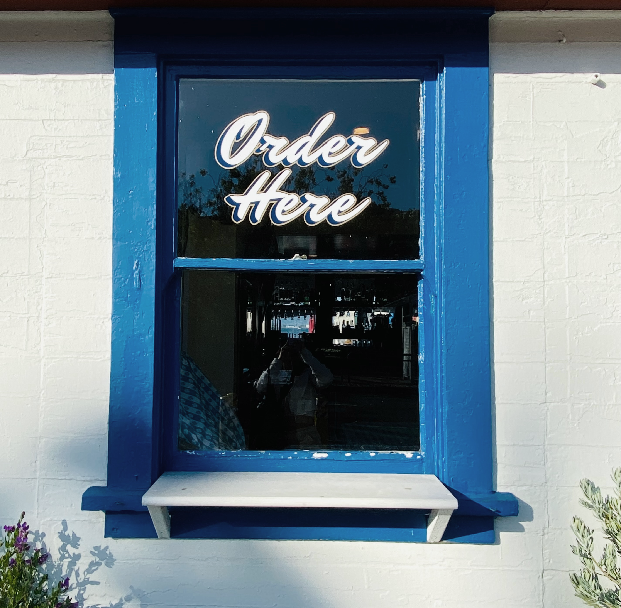
Prevent a Crisis in Procurement at an Early Stage
Finding the right supplier can take time - take this time to compare offers, prices, quality and potential risks
Written procurement procedures (e.g., checklists for supplier selection, etc.) can create certainty and commitment
Don't depend on one supplier/provider to work with - position yourself diversely; or at least always have some alternatives at hand
Supply is mutual - stick to the terms of the contract and pay your bills on time
Keep in regular contact with your suppliers or check the development of your suppliers at regular intervals - so you are always up to date
Photo: Wendy Wei

Slide 52
From Value Chain to Crisis Chain
Detect problems in Logistics in time
The causes of a crisis can lie in all areas of the company. As a rule, a crisis cannot be traced back to singular issues but to a multi-causal connection.
PRIMARY ACTIVITIES
INBOUND
LOGISTICS
OPERATIONS
OUTBOUND
LOGISTICS
MARKETING
AND SALES
SERVICE
CRISIS
The logistics do not only concern goods: After masses of tourists led to massive logistical problems in Venice, day tourists will have to book their visit to the historic centre in advance. The purchase of tickets is supposed to lead to a better control of tourist flows.
FIRM INFRASTRUCTURE
HUMAN RESOURCE MANAGEMENT
TECHNOLOGY DEVELOPMENT
PROCUREMENT
SUPPORT ACTIVITIES

Slide 53
METRICS FROM OPERATIONS
An operational KPI is a quantifiable value that expresses business performance in a shorter time frame. They are used to track organisational processes, improve efficiency and help companies reflect results. Choosing the right KPIs is of course dependant on your business model. Here are some examples of indicators from the manufacturing sector:
Production Costs
Monitor the costs implied in the production
Rate of Return
Measure the number of complaints (and the reasons)
Right first time
Understand the performance of your production process
Production Volume
Track the quantities that you can produce
Unit Costs
Track and optimise your unit costs over time

Slide 54

Prevent a Crisis in Logistics at an Early Stage
Keep an eye on your capacities - this applies equally to bed occupancy in hotels, booked reservations in restaurants and on tours, as well as to the storage of products
A medium-term capacity demand plan helps to estimate the storage capacity needed in the future and can prevent overloading
Conduct
regular stock takes
and quality controls
Safety comes first. Even if more occupancy is possible, health and safety have priority - a safety concept helps to visualize the measures to be taken
Photo: Alexander Isreb

Slide 55
From Value Chain to Crisis Chain
Detect problems in Operations in time
The causes of a crisis can lie in all areas of the company. As a rule, a crisis cannot be traced back to singular issues but to a multi-causal connection.
PRIMARY ACTIVITIES
INBOUND
LOGISTICS
OPERATIONS
OUTBOUND
LOGISTICS
MARKETING
AND SALES
SERVICE
CRISIS
The Covid-19 crisis showed that companies that reacted quickly to changing circumstances were able to avert the crisis; such as virtual tours, online cooking classes or restaurant tastings, quick implementation of hygiene measures
FIRM INFRASTRUCTURE
HUMAN RESOURCE MANAGEMENT
TECHNOLOGY DEVELOPMENT
PROCUREMENT
SUPPORT ACTIVITIES

Slide 56
METRICS FROM LOGISTICS
A logistics KPI or metric is a performance measurement used by logistics managers to efficiently track, visualise and optimise all relevant logistics processes.
These measurements relate to the aspects of transport, warehouse and supply chain, among others.
Order Accuracy
Monitor the degree of incidents
Transportation
Costs
Analysis of all costs connected with transport
Warehousing
Costs
Optimise the expenses of your warehouse
Number of
Shipments
Understand how many orders are shipped
Inventory
Accuracy
Avoid problems because of inaccurate inventory

Slide 57

Prevent a Crisis in Operations at an Early Stage
Always put agreements and contracts in writing and keep everything in one place
Consider the introduction of software to make processes, such as staffing and booking planning, more efficient and alert to errors at an early stage
The use of KPIs can help to get a picture of the current performance and quality of the business (such as performance indicators or customer satisfaction surveys)
Regular training of staff ensures that they are up to their tasks
The same applies to responsibilities for projects, tasks and jobs - communicate responsibilities to the outside world so that people know who to contact about issues
Photo: Alex Green

Slide 58
From Value Chain to Crisis Chain
Detect problems in Marketing and Sales in time
The causes of a crisis can lie in all areas of the company. As a rule, a crisis cannot be traced back to singular issues but to a multi-causal connection.
PRIMARY ACTIVITIES
INBOUND
LOGISTICS
OPERATIONS
OUTBOUND
LOGISTICS
MARKETING
AND SALES
SERVICE
CRISIS
The Covid 19 crisis has shown that rapid promotion of online sales or an adapted pricing policy can be levers to mitigate the impact of a crisis on the company.
FIRM INFRASTRUCTURE
HUMAN RESOURCE MANAGEMENT
TECHNOLOGY DEVELOPMENT
PROCUREMENT
SUPPORT ACTIVITIES

Slide 59
METRICS FROM MARKETING & SALES
Here you will find customer-related metrics that can be consulted when analysing your company.
Return on Marketing
Investments
How efficiently are you spending your marketing budget?
Cost per Lead
How much should you spend per lead?
Sales Targets
Is your sales growing and reaching its targets?
Costs per
Acquisition
Are your customer acquisition costs viable?

Slide 60

Prevent a Crisis in Marketing and Sales at an Early Stage
Know your target market, market size and customer needs.
Regularly track KPIs such as customer growth, your order book, turnover per employee and customer enquiries - seek professional help to analyse the figures if necessary.
Collect marketing and sales performance data at regular intervals and evaluate it with your team.
Conduct regular customer satisfaction surveys and ask for feedback.
Analyse your competitors and your environment regularly to be able to react quickly to changes.
Photo: Canva Studio

Slide 61
From Value Chain to Crisis Chain
Detect problems in Service in time
The causes of a crisis can lie in all areas of the company. As a rule, a crisis cannot be traced back to singular issues but to a multi-causal connection.
PRIMARY ACTIVITIES
INBOUND
LOGISTICS
OPERATIONS
OUTBOUND
LOGISTICS
MARKETING
AND SALES
SERVICE
CRISIS
In times of crisis, good service is essential to retain the trust of its customer base. Take your customers' concerns seriously and communicate openly and be solution-oriented.
FIRM INFRASTRUCTURE
HUMAN RESOURCE MANAGEMENT
TECHNOLOGY DEVELOPMENT
PROCUREMENT
SUPPORT ACTIVITIES

Slide 62
METRICS FROM SERVICE
These metrics can be useful to track and improve customer service.
Customer
Satisfaction
Customer satisfaction is everything. Measuring customer satisfaction is difficult.
Net Promoter
Score
The NPS measures the probability with which your customers recommend you to another person.
First Response
Time
Speed is a decisive factor for customer satisfaction.
Customer
Churn Rate
Customer churn helps you see trends in product satisfaction (or dissatisfaction).
ServeQual
Quality of service + customer satisfaction

Slide 63

Prevent a Crisis in Service at an Early Stage
Scan and analyse changes in your customers' behaviour at regular intervals.
Create a communication plan with your team. Find more information in Module 5.
Use different communication channels to reach customers in a better and targeted way.
Keep communication channels such as website, Google ads etc. up to date and communicate changes directly.
Photo: Andrea Piacquadio

Slide 64
Key Performance Indicators to Monitor
KPIs can be a powerful tool to measure the performance of a company.
Capital Market
Cyclical/Structural Developments
By defining relevant observation areas and selecting suitable early detection indicators, changes in the market and in the company can be systematically recognised and observed. If there is a significant change in an indicator, a signal is given to discuss and, if necessary, initiate measures.
Interest, exchange rates
Orders received / Business climate /
Consumer sentiment
Financials
08
Technology / R&D
Short-term liquidity planning /
3 Year Planning /
1 Year Forecast /
Accounts receivable /
Accounts payable
07
New process + technologies / Consumer behaviour / Number of current development projects / Number of own patents/ Licenses granted / Research and development costs
01
06
Employees
02
Sales
Fluctuation / Sick leave /
Age structure
05
Number of enquiries per period / Development of orders in your main industry (which will later affect your orders) / Revenues / Prices / Price and product strategy of your competitors / Lost orders
03
04
Production
Procurement
Age structure of machines / investment backlog / Capacity utilization / Energy consumption / scrap / Cost of poor quality / Maintenance costs
Raw material prices / Stocks / Quality and adherence to delivery dates of suppliers

Slide 65
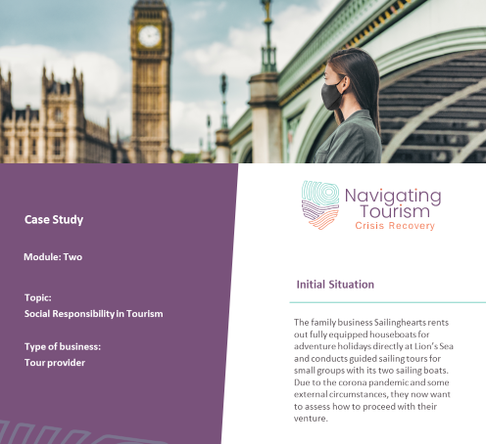
KPIs in Practice:
Case Study
Please have a look at the case study no. 1 which deals with the use of KPIs as early warning indicators for a small boat rental company.

Slide 66
04
Continuity Management

Slide 67
BUSINESS CONTINUITY MANAGEMENT CYCLE
Business continuity management (BCM) serves to restore business activity in the event of a crisis.
Understand
your
business
Business continuity planning is about putting systems in place for prevention and recovery to counter potential threats to a business. In addition to prevention, the goal is to enable ongoing operations before and during the implementation of disaster recovery.
Disasters can be external events (such as the Covid 19 pandemic), system failures, human error (e.g. in healthcare) or a significant business crisis.
Exercising,
maintenance
and audit
Business
continuity
strategies
BCM
Building and
embedding
BCM
culture
Develop
and implement
a BCM
response

Slide 68
5 Stages of the Business Management Cycle
Understand
your
business
Business
continuity
strategies
Develop
and implement
a BCM
response
Building and
embedding
BCM
culture
Exercising,
maintenance
and audit
Define the critical business drivers, analyse their impact on the business and implement a system for risk assessment and control measures
There are three levels of strategy: BCM strategy at company level, BCM strategy at process level, BCM strategy for the recovery of resources
BCM is a comprehensive approach to be prepared for the unexpected and includes planning, contact with external parties, crisis and accident management, emergency measures, communication (internal & external)
To reach a stage of effective crisis resistance, it is important to introduce and live a risk culture
To be prepared, staff must be trained, and plans and systems must be regularly updated

Slide 69
THE BCM PROGRAMME
Board commitment and proactive participation
BCM should be supported by senior management and key staff. Supporting pillars here are:
BCM strategy, policy and framework
Roles, accountability, responsibility and authority
Finance and resources
Assurance
Change management
Management information & metrics

Slide 70

DISCUSSION & EXCHANGE:
What do you think:
CAN A CRISIS BE AVOIDED?

Slide 71
Recommended
Readings
(will follow)

Slide 72
Short but interesting articles that we find enlightening…
Recommended Reading
5 SWOT Analysis Examples - Small Business Trends (smallbiztrends.com)
Portfolio Analysis and Investment Review Reduce Risk (thebalancemoney.com)
Accountancy-Europe-SME-risk-management-series-introduction-paper.pdf (accountancyeurope.eu)
5 Steps in a Business Process Management Life cycle – Customer Service Blog from HappyFox
Sgro et al (2021): Causes of Corporate Crisis : An Investigation on SMEs to support the learning process. Rivista Piccol Impresa, Issue 3 (https://journals.uniurb.it/index.php/piccola/article/view/2856/2993)
Vargo/Seville (2017): Crisis Strategic Planning for SMEs; Finding the Silver Lining, International Journal of Production Research – Creating resilient SMEs special issue , Vol. 49, Issue 18 (https://resorgs.org.nz/wp-content/uploads/2017/07/crisis_strategic_planning_for_smes.pdf)
KPI | Essential key performance indicators for small business
Ghaderi et al. (2014): Organizational Learning in Tourism Crisis Management: An Experience from Malaysia. Journal of Travel & Tourism Marketing, 31(5), p. 627-648. (https://www.tandfonline.com/doi/full/10.1080/10548408.2014.883951?casa_token=_SGxXQB5U7QAAAAA%3Ax6vigBqAtGsMyP-eGttGU9iLxjATe4XCzg3BnveOwkYrhSlwWOpknOd2Ca73-pooM61c9fTeGJ9EaA)
The Futures Wheel - Identifying Consequences of a Change (mindtools.com)

Slide 73
Next: Module 3
https://www.tourismrecovery.eu/
https://www.facebook.com/tourismcrisisrecovery
COPING WITH CRISES

